Slide 1
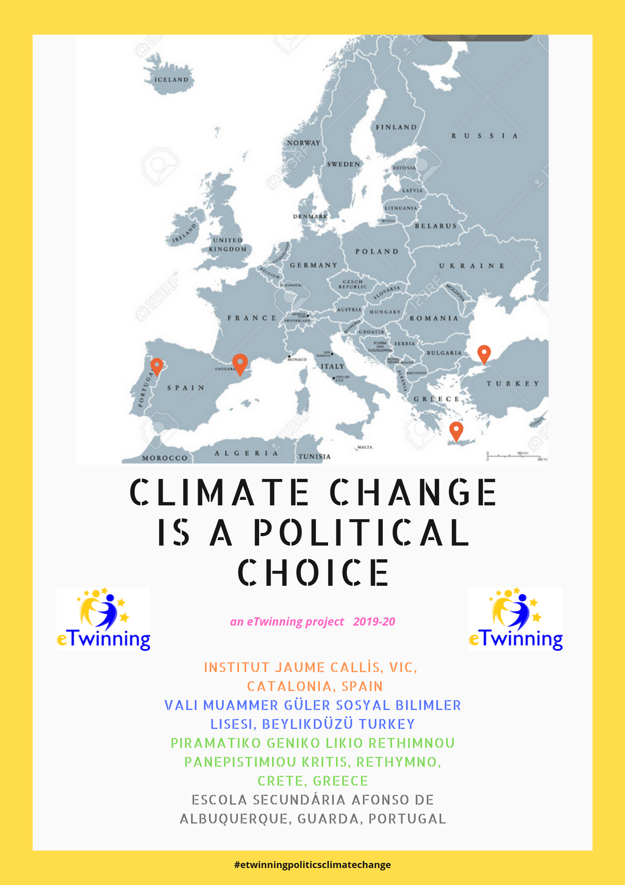
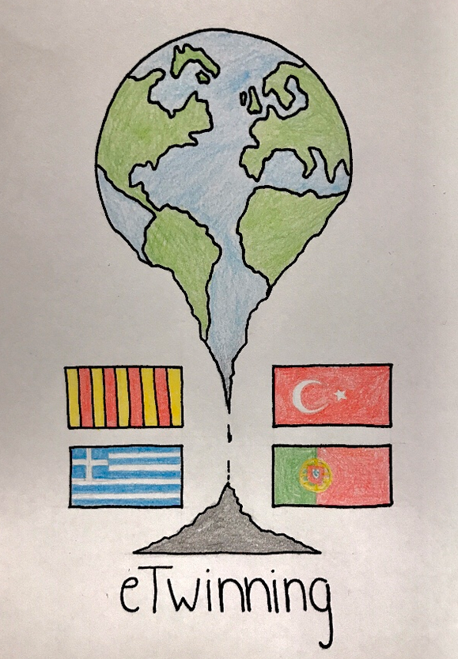
“CLIMATE CHANGE IS A POLITICAL CHOICE” An eTwinning project
About climate change
About the politics of climate change

Slide 2
PROJECT PLAN
OBJECTIVES:
research and learn about Global Warming, Climate Change and possible solutions;
use the ICT to create, communicate, exchange information and collaborate online;
develop writing, listening, reading and speaking skills in English as a foreign language;
develop key competences through a series of motivating activities;
create a European identity by learning about other countries and cultures, and infer their own.

Slide 3
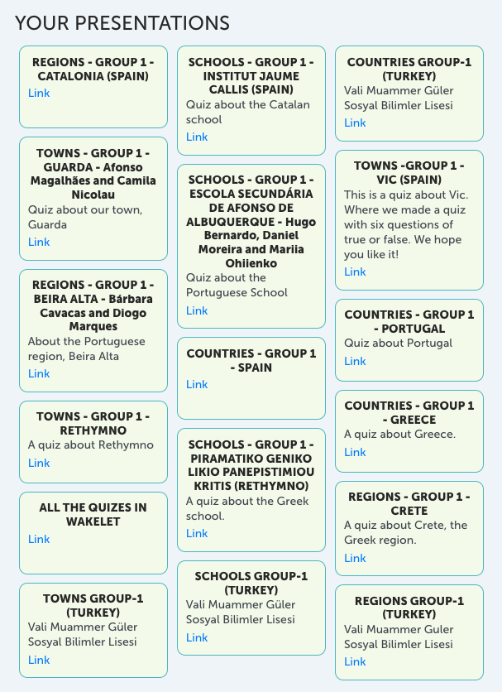
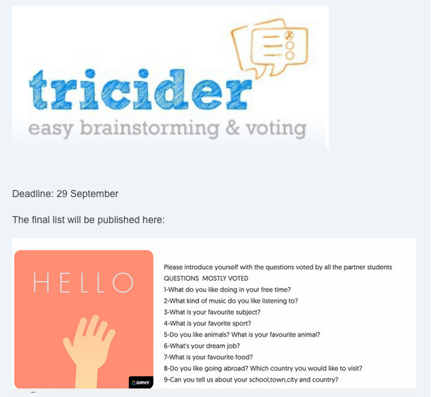
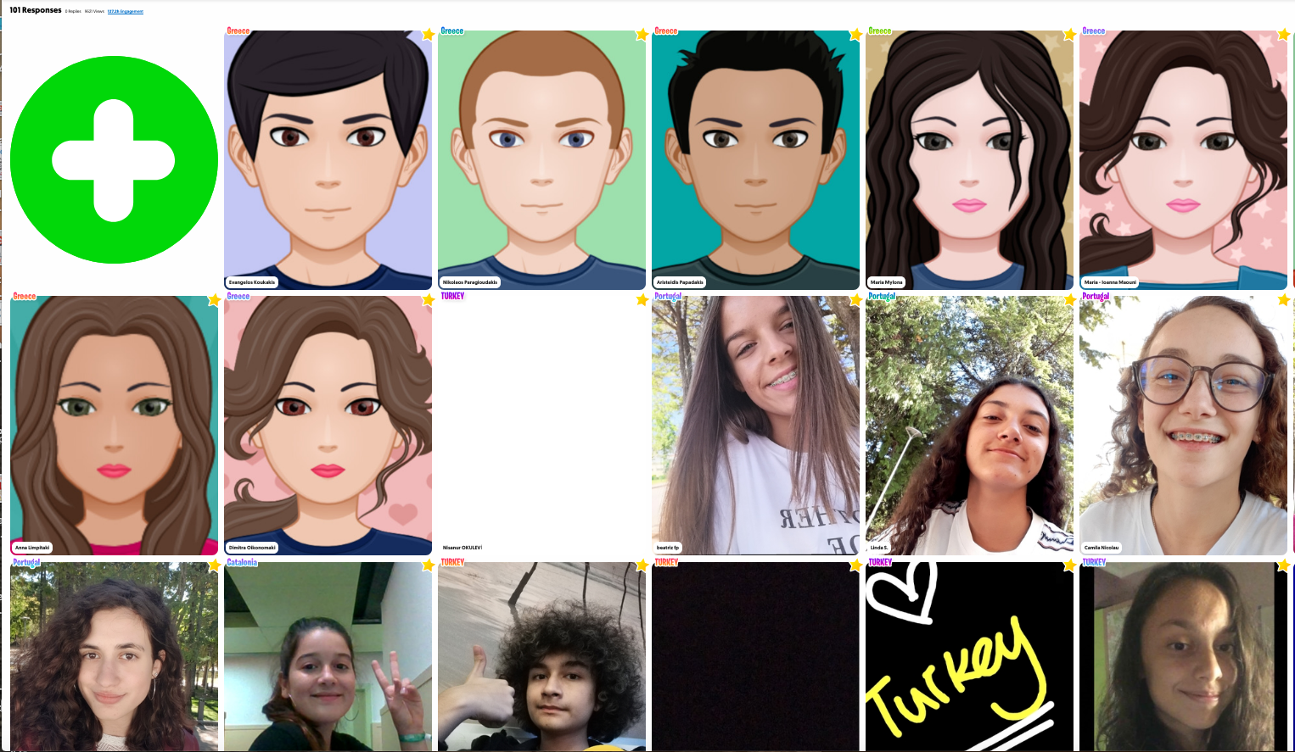
STEP 1: INTRODUCTIONS
What would you like to know about your partners?
Individual presentations with FLIPGRID
Presentations in ttransnational groups about our schools, towns, regions and countries with surveys using GOCONQR

Slide 4
LOGO CONTEST AND SEASON’S GREETINGS

Slide 5
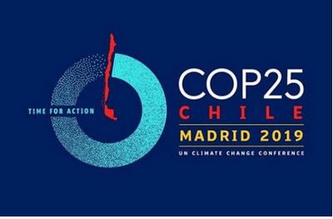
STEP 2: DELVING INTO CLIMATE CHANGE
Discussion forums on SUMMITS:
Which news, agreements, commitments have been made by world leader politicians and other influential people in the UN Climate Change Summit in New York (21-23 Sep 2019) and in Madrid (2-13 Dec 2019)?
What is your opinion? What should be done?

Slide 6
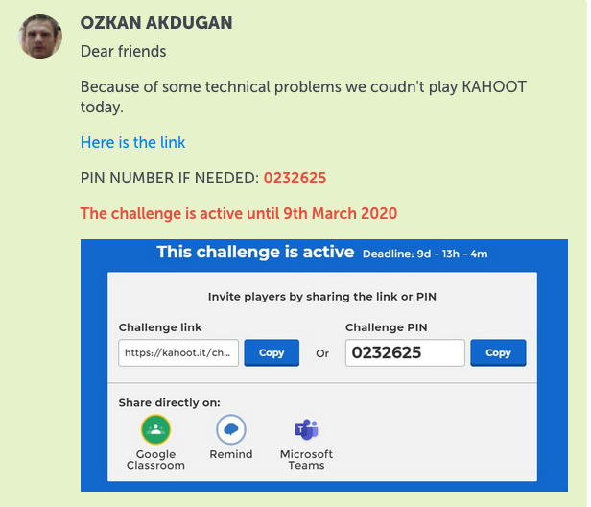
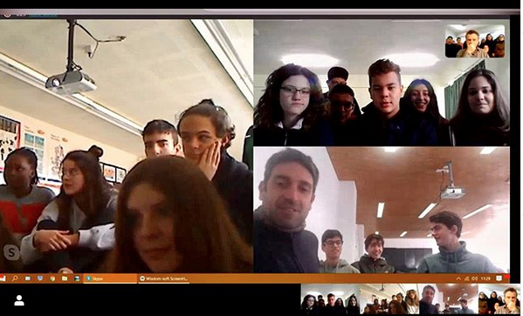
WARM UP ACTIVITY
Watch National Geographic documentary: “Before the Flood” by Leonardo di Caprio
Take part in a forum
Take part in a videoconference with student representatives of the 4 partner countries
Take part in a Kahoot challenge about the film

Slide 7
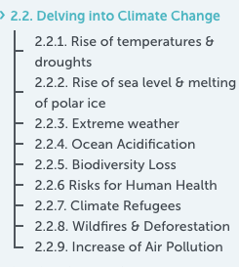
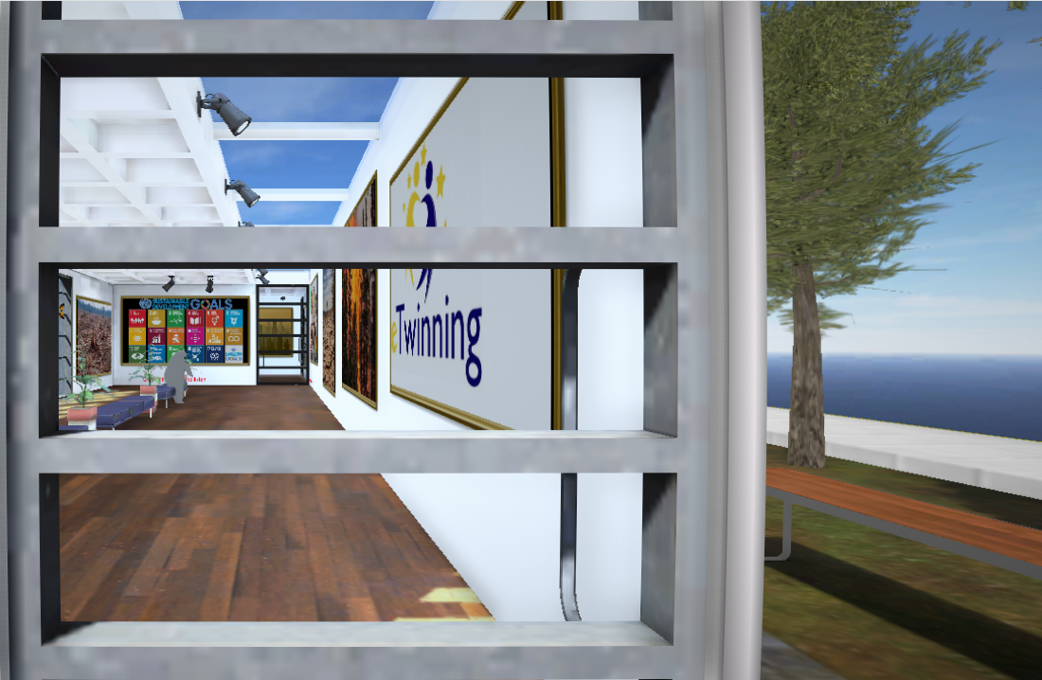
Create infographics and Virtual Reality Galleries in transnational groups in 9 different topics
https://www.artsteps.com/view/5e6690199520064e0d7030b8

Slide 8
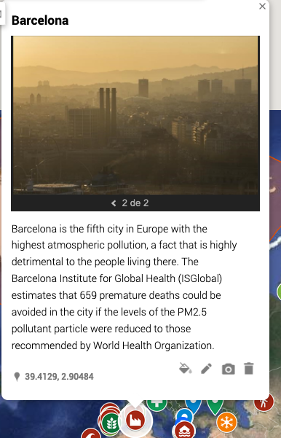
Our interactive climate change map

Slide 9
What are our politicians doing?

Slide 10
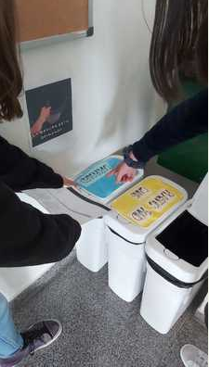
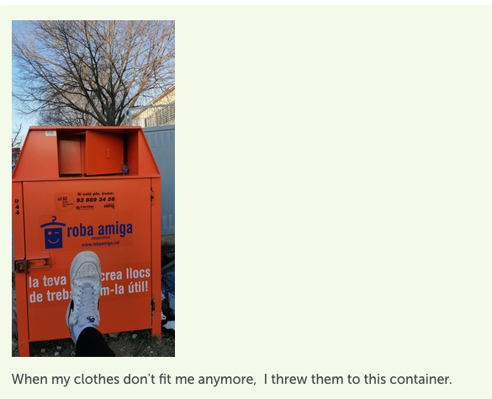
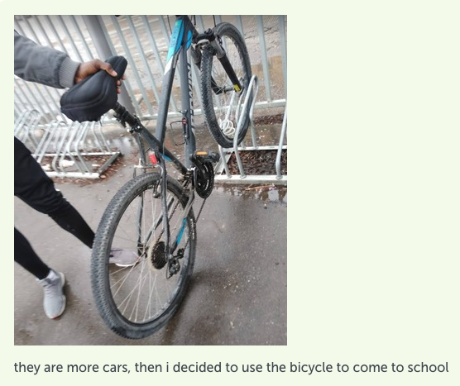
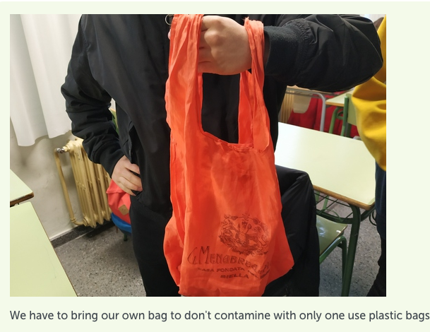
Take part in the UN Actnow Campaign

Slide 11
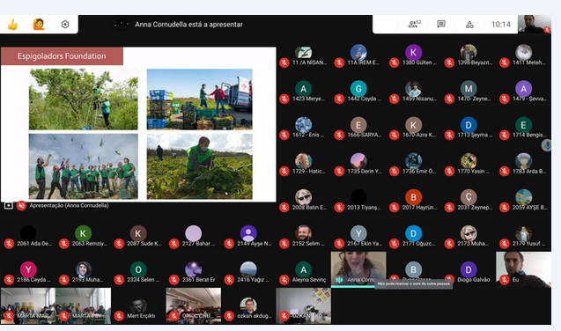
Participation in the EWWR campaign on invisible waste
Design of campaigns to raise awareness, in transnational groups
Virtual workshop for all schools carried out by the foundation ESPIGOLADORS from Barcelona

Slide 12
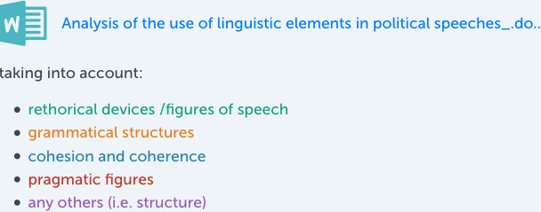
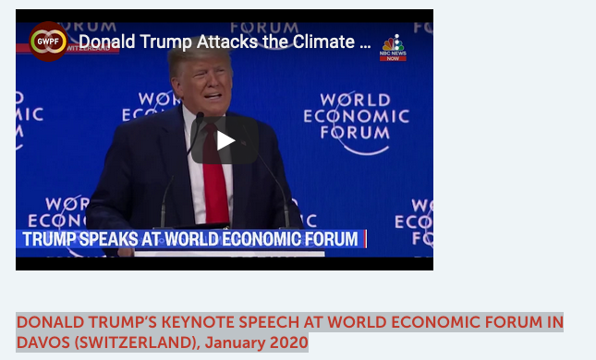
STEP 3: political speeches
Analysis of non-verbal and verbal strategies used in speeches delivered by world leaders and local politicians, as well as influenzers.

Slide 13
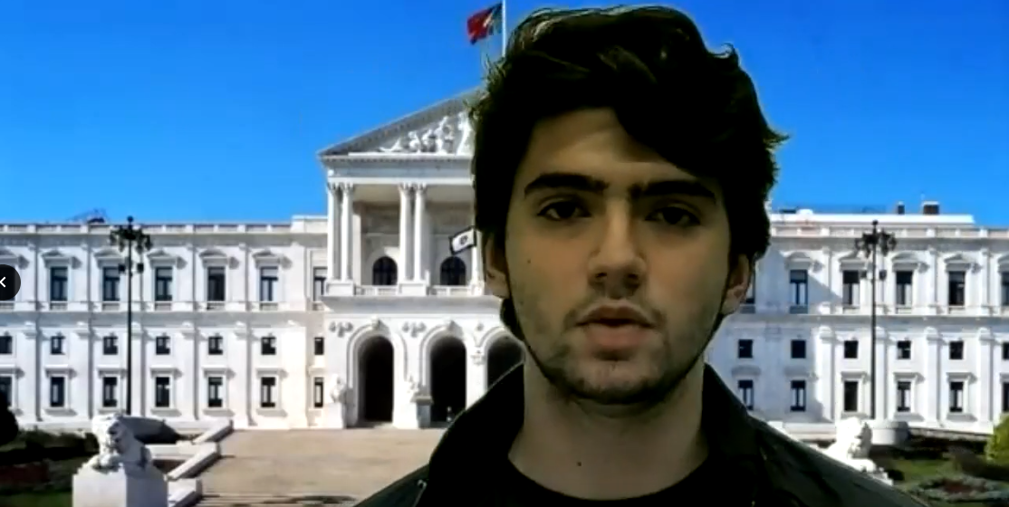
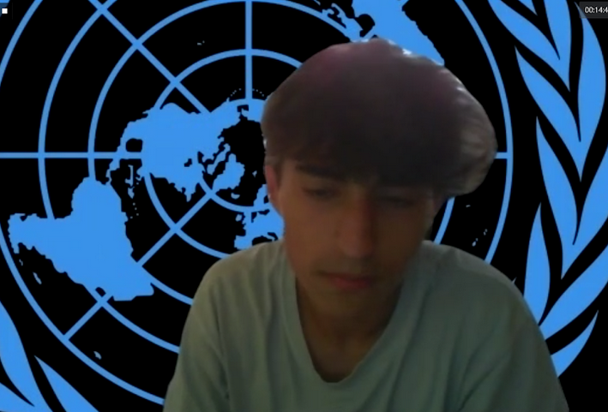
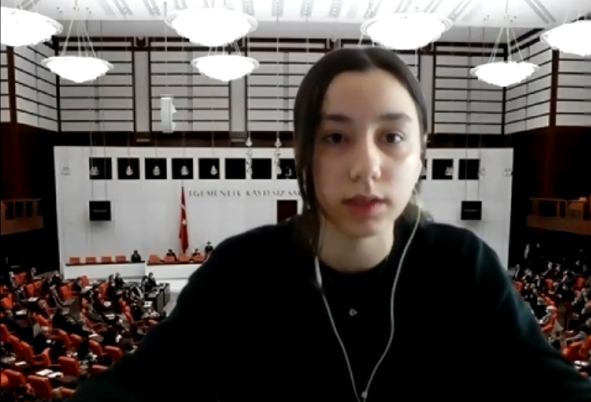
Step 3: Summit on climate change

Slide 14
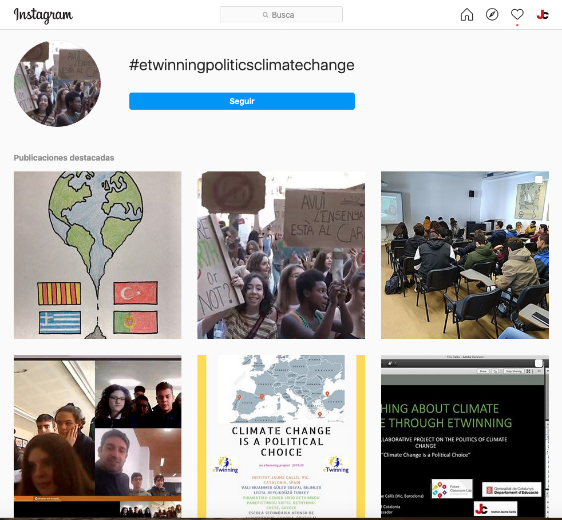
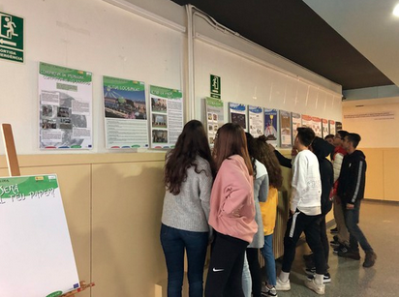
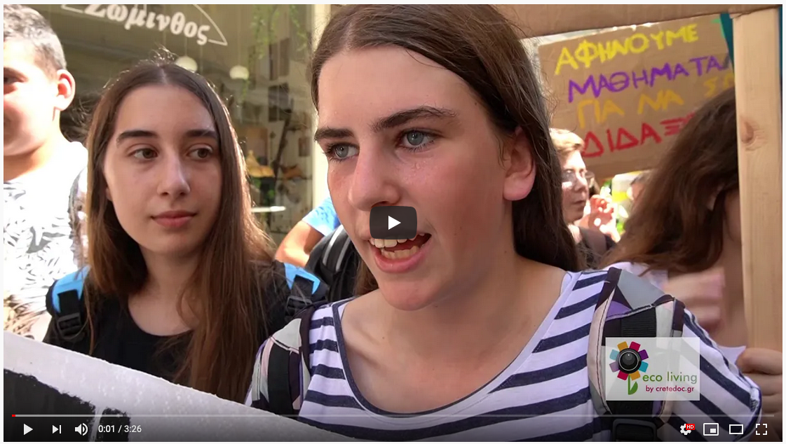
Impact and dissemination
Dissemination using different means:
Schools websites
Social media#etwinningpoliticsclimatechange
In national and international webinars, conferences, courses…
In our schools/towns:
Demonstrations
Exhibitions, conferences…
Celebration of International Days
Project website
Public Twinspace

