Slide 1
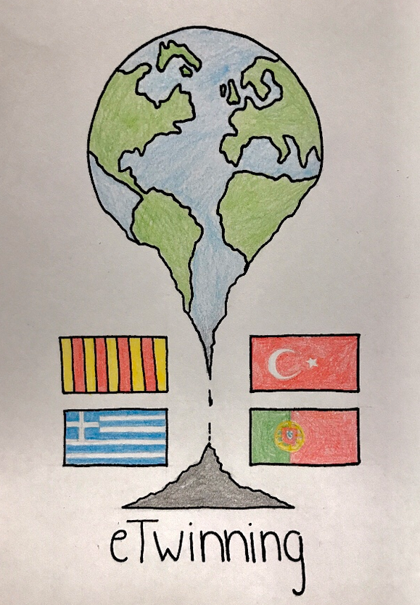
CLIMATE CHANGE IS A POLITICAL CHOICE
AN ONLINE COLLABORATIVE PROJECT ON THE POLITICS OF CLIMATE CHANGE
”

Slide 2
WE ARE LOOKING FOR ENTHUSIASTIC STUDENTS INTERESTED IN:
WOULD YOU LIKE TO JOIN US?
WE WILL HAVE FUN WHILE WE LEARN ALL TOGETHER
CLIMATE CHANGE
MEETING YOUNG PEOPLE FROM EUROPE.
ICT

Slide 3
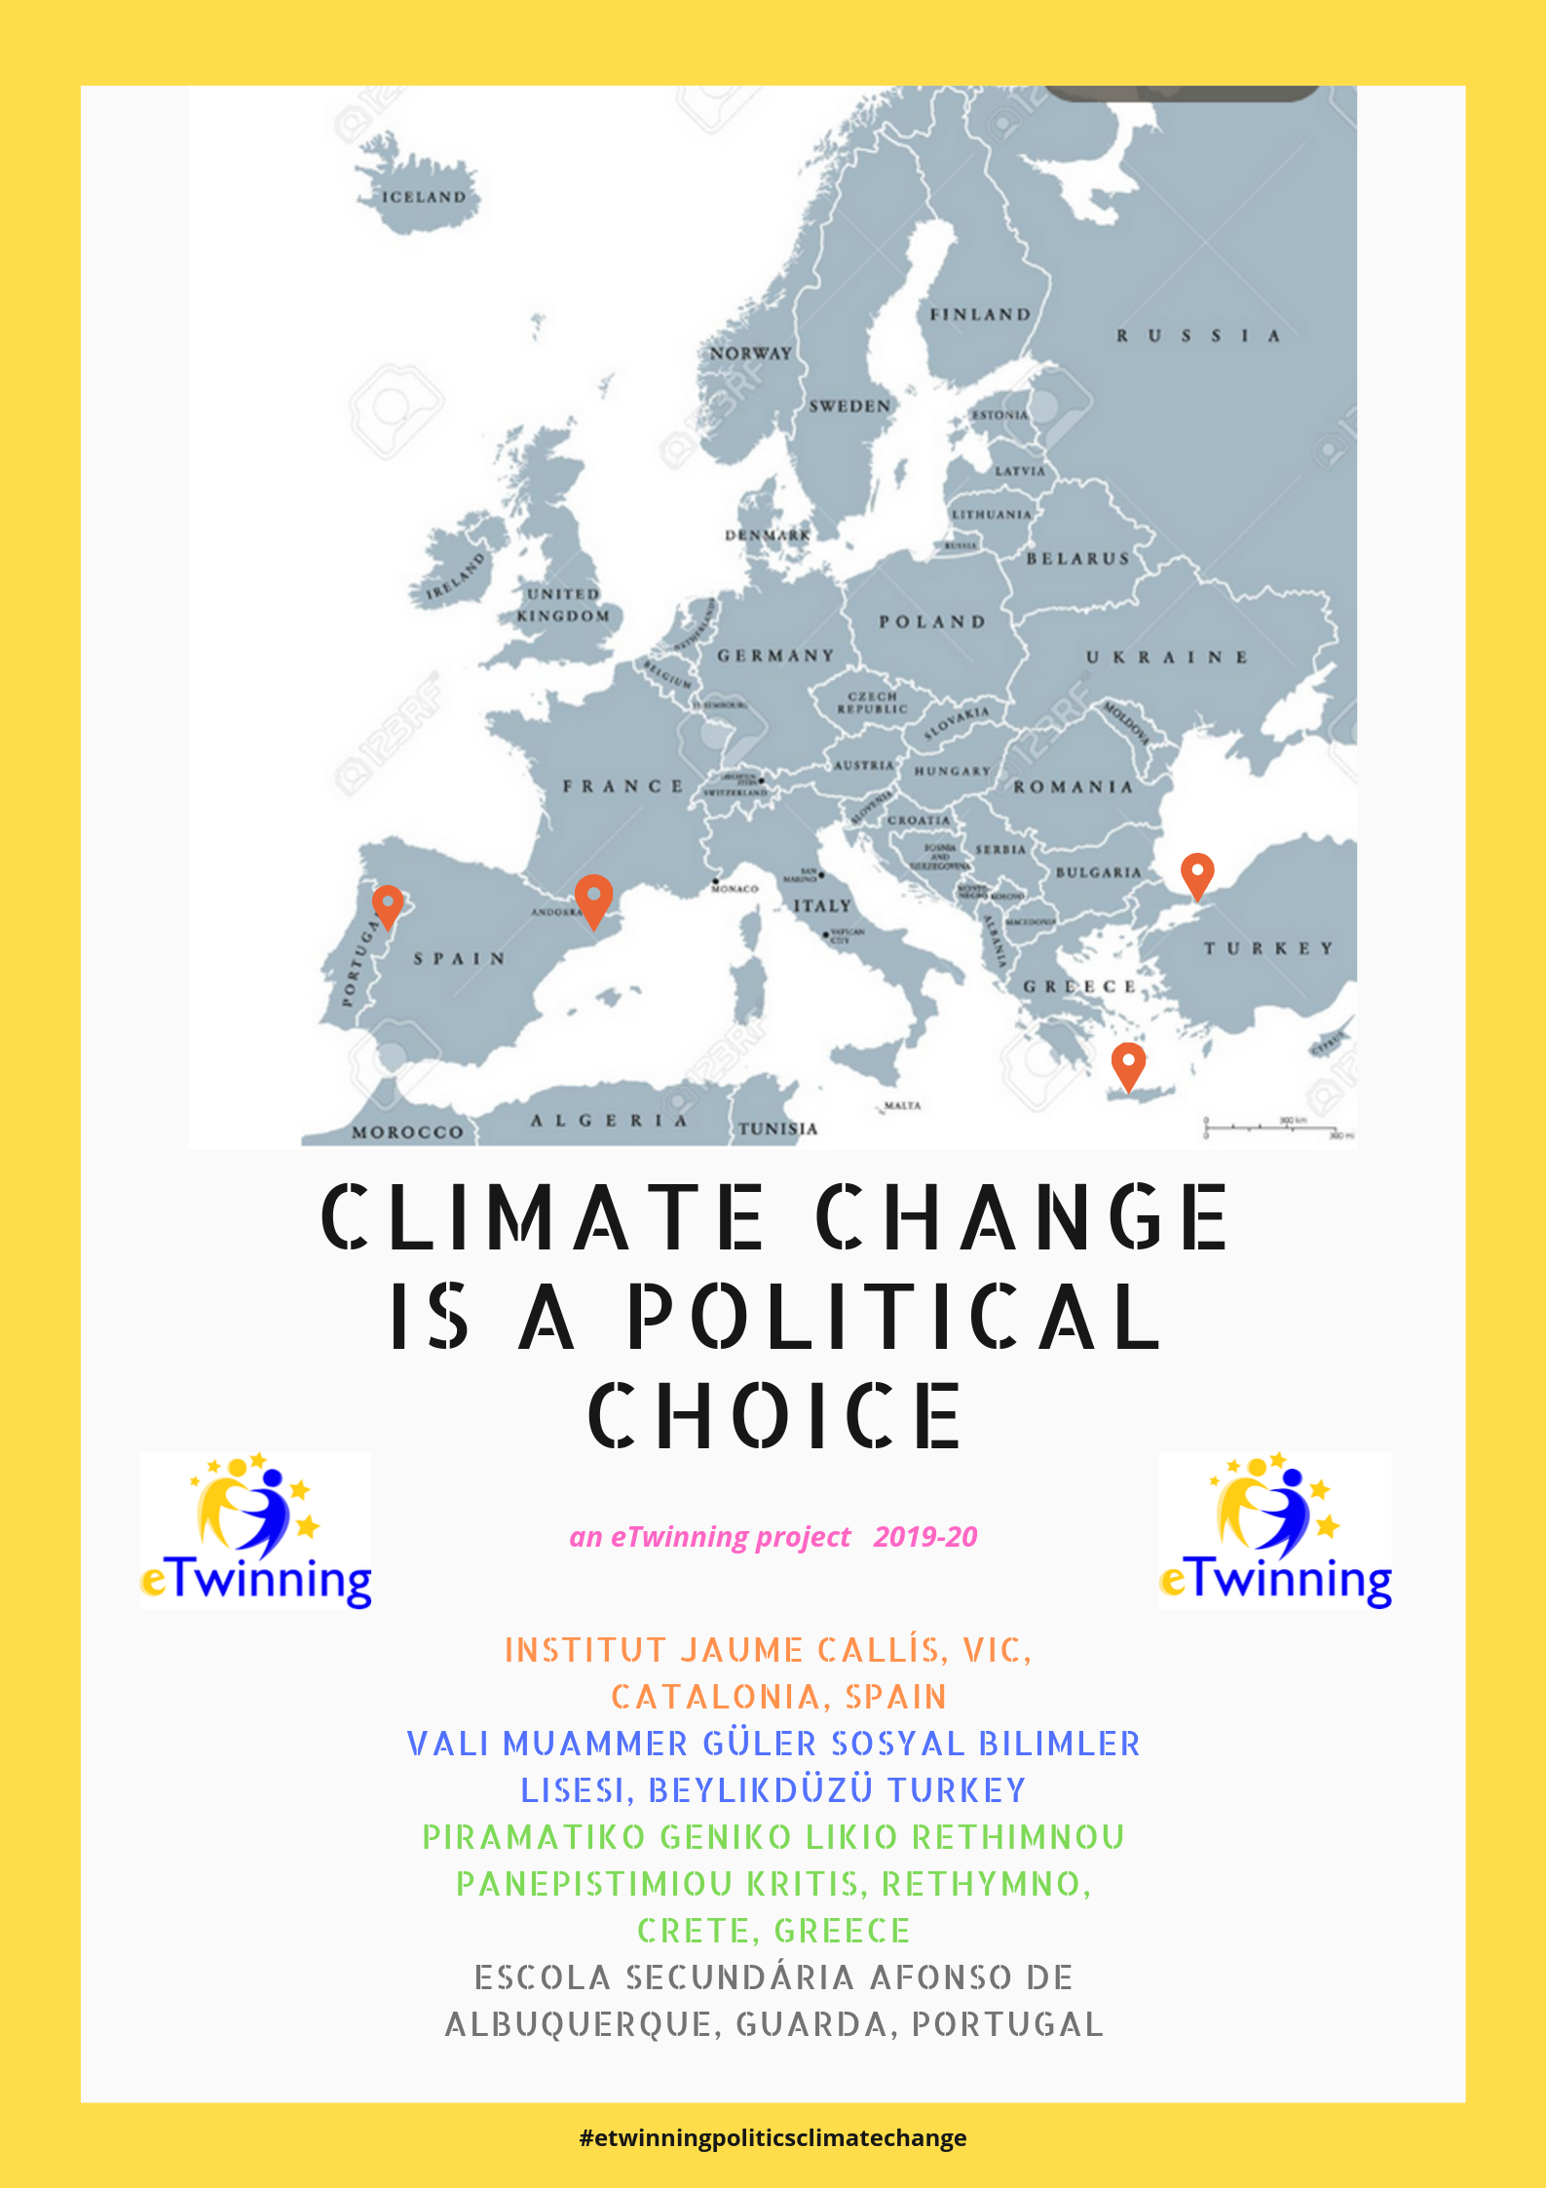
“CLIMATE CHANGE IS A POLITICAL CHOICE”
About climate change
About the politics of climate change

Slide 4
PROJECT PLAN
OBJECTIVES:
research and learn about Global Warming, Climate Change and possible solutions;
use the ICT to create, communicate, exchange information and collaborate online;
develop writing, listening, reading and speaking skills in English as a foreign language;
develop key competences through a series of motivating activities;
create a European identity by learning about other countries and cultures, and infer their own.

Slide 5
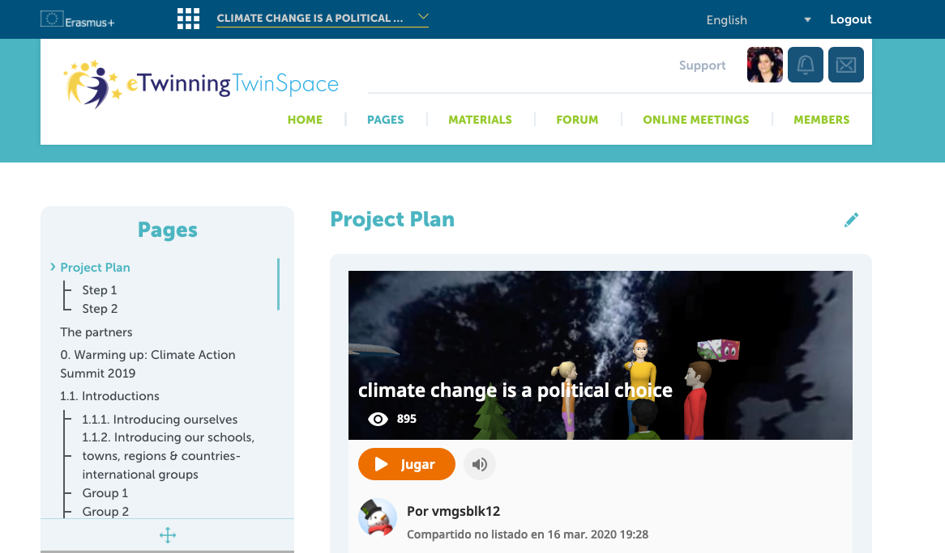
WHERE ARE WE GOING TO WORK?
TWINSPACE OF THE PROJECT:
https://twinspace.etwinning.net/93164/home

Slide 6
ACTIVITIES DONE IN YEAR 1
Discussion forums on SUMMITS:
Which news, agreements, commitments have been made by world leader politicians and other influential people in the UN Climate Change Summit in New York (21-23 Sep 2019) and in Madrid (2-13 Dec 2019)?
What is your opinion? What should be done?

Slide 7
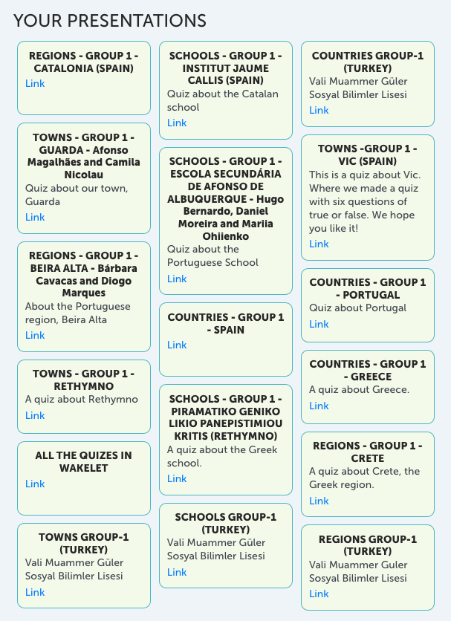
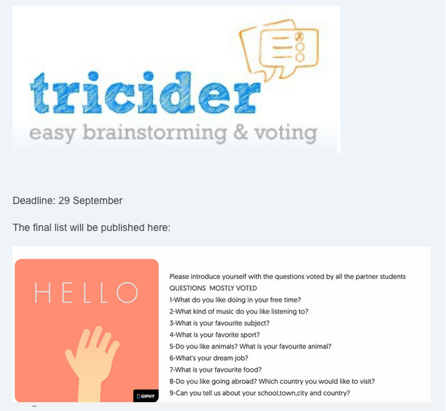
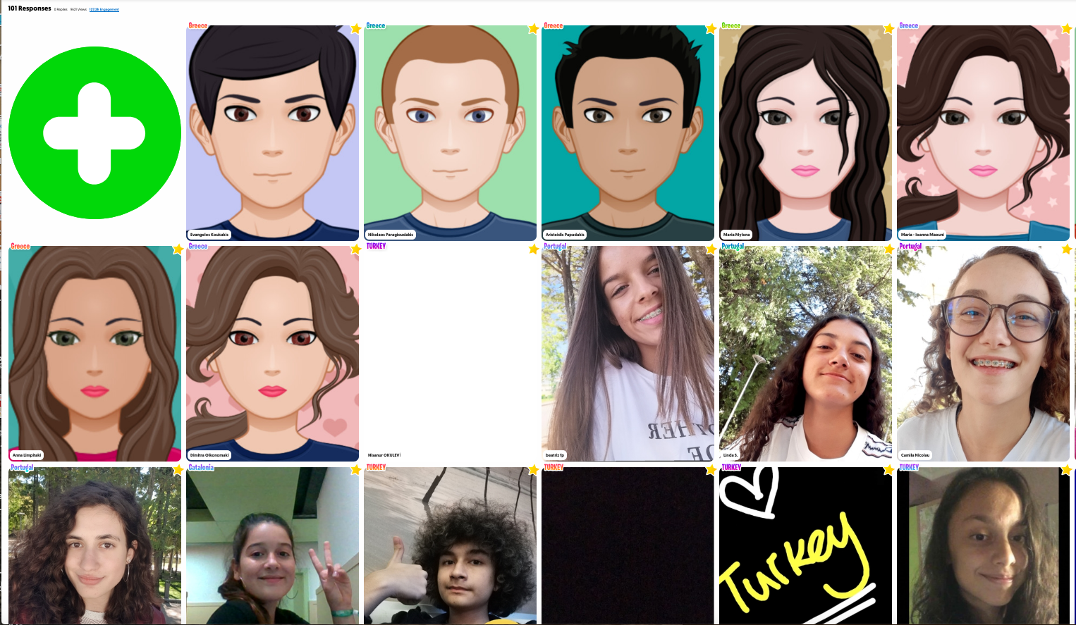
STEP 1: INTRODUCTIONS
¿Qué te gustaría saber de tus socios?
Presentaciones personales en FLIPGRID
Presentaciones en grupos transnacionales sobre nuestros institutos, ciudades, regiones y países con cuestionarios GOCONQR

Slide 8
LOGO CONTEST & SEASON’S GREETINGS

Slide 9
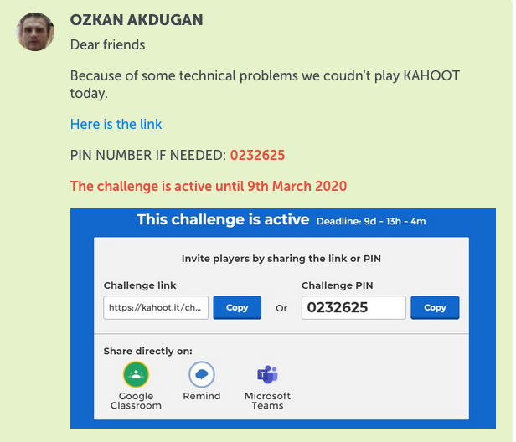
STEP 2: Learn about climate change & what politicians are or are not doing
Watch National Geographic documentary: “Before the Flood” by Leonardo di Caprio
Take part in a forum
Take part in a videoconference with student representatives of the 4 partner countries
Take part in a Kahoot challenge about the film

Slide 10
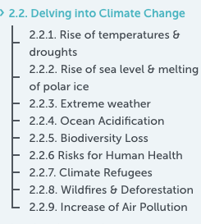
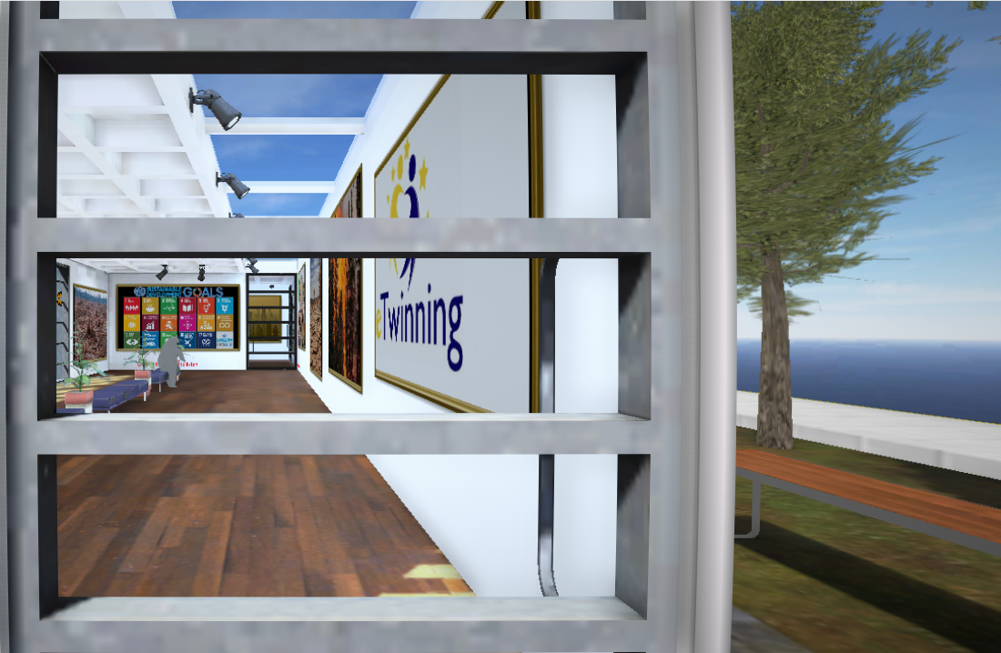
Create infographics and Virtual Reality Galleries in transnational groups in 9 different topics
https://www.artsteps.com/view/5e6690199520064e0d7030b8

Slide 11
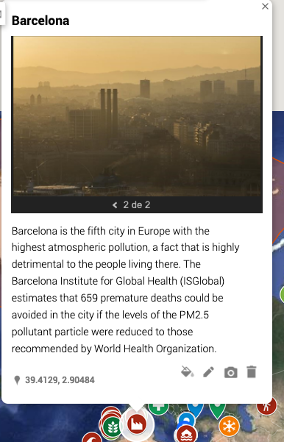
Our climate change map

Slide 13
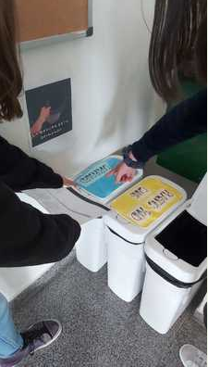
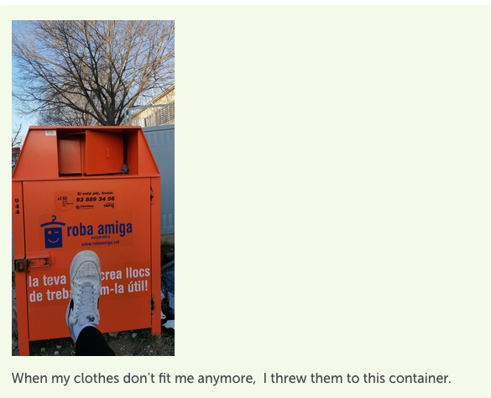
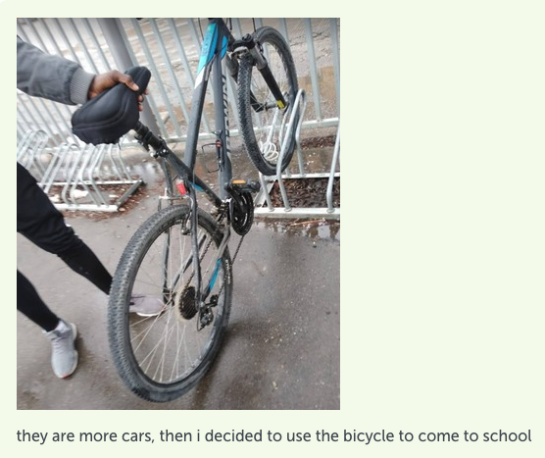
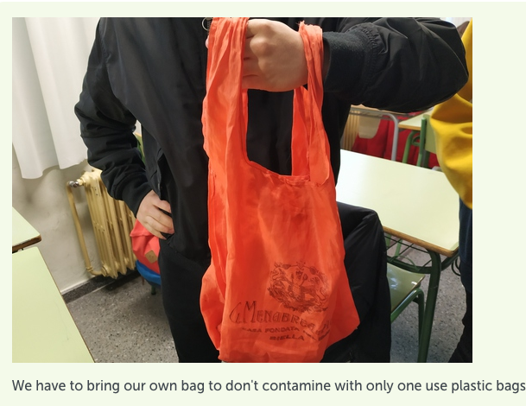
Take part in the UN Actnow Campaign

Slide 14
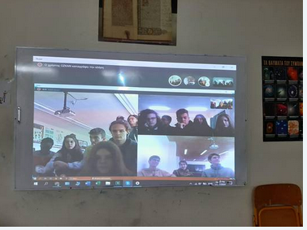
Videoconferences
1st videoconference: Catalonia-Portugal

Slide 15
And in Year 2 (2020-21)
Introductions of new students
Review & completion of activities done in Year 1
Take part in the INVISIBLE WASTE CAMPAIGN of www.ewwr.com
Start step 3
Evaluation of the project

Slide 16
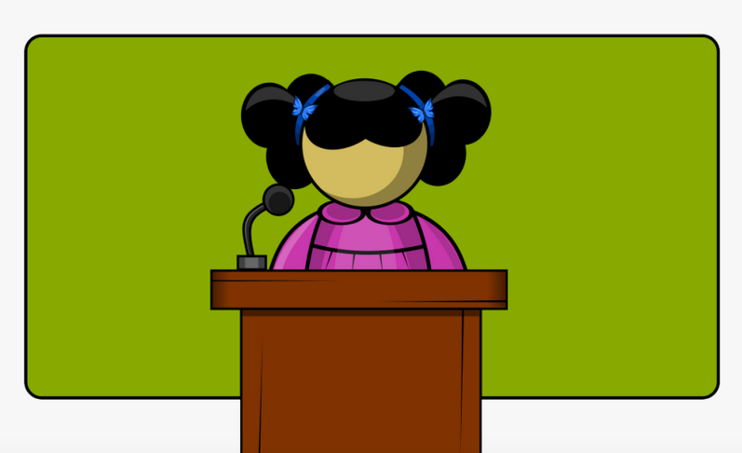
Step 3
INTERNATIONAL SUMMIT ON CLIMATE CHANGE
Political Speeches
Persuasive Techniques
Public Speaking

Slide 17
Hope this presentation has proved interesting
and you are willing to take part in this project
See you in
MIQUEL PLANES (4 ESO A)
MARTA PEY (4 ESO B)
martapey@callisvic.cat
ORIOL CHUMILLAS (4 ESO C)

