Slide 1
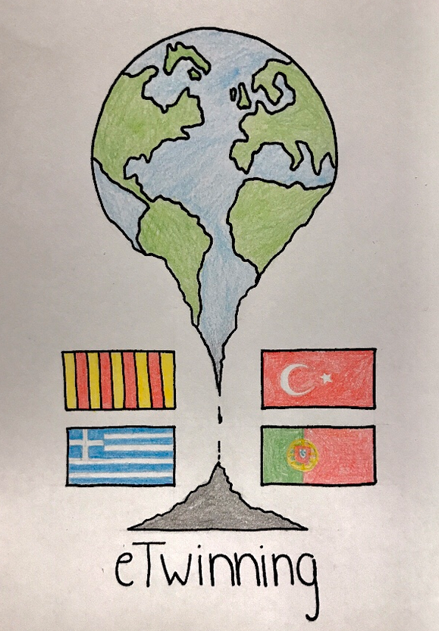
CODVID-19 & CLIMATE CHANGE
eTwinning project:
CLIMATE CHANGE IS A POLITICAL CHOICE
Thursday, 16 April, 4pm CET

Slide 2
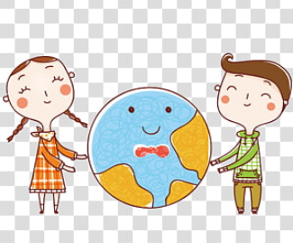
CODVID-19 IN OUR COUNTRIES
Please, introduce yourselves
What are the government measures in each country regarding the CODVID-19 crisis?
Are they similar in the 4 countries?
Notes:
curfew

Slide 3
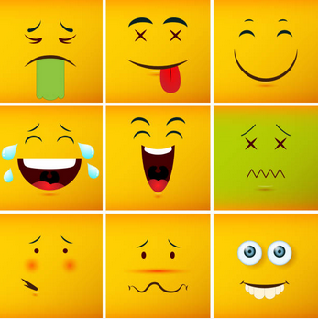
CODVID-19 AND US
How are you feeling?
(www.menti.com code 22 86 15)
https://www.menti.com/522ur79t8z
How are these measures affecting your daily life?
What do you do during the day?
How do you cope with your school work?
What do you miss the most?
What have you learnt/become aware of, that you took for granted before the quarantine?

Slide 4
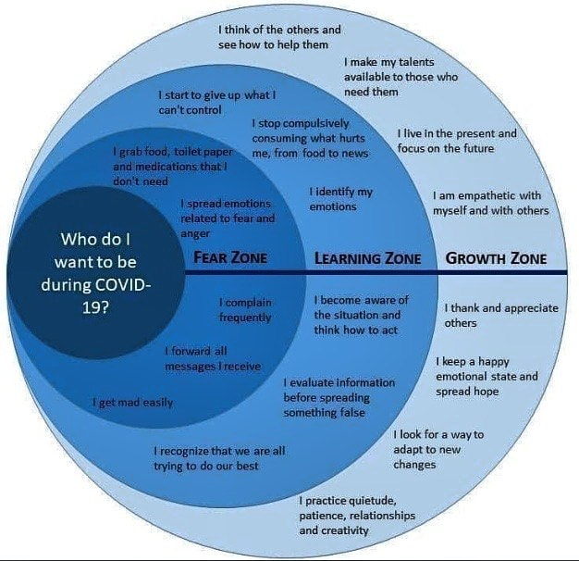
In which zone are you?
www.menti.com
code 22 86 15
https://www.menti.com/522ur79t8z

Slide 5
CODVID-19 AND CLIMATE CHANGE
How are our responses to climate change and the coronavirus linked?
Covid-19 and climate: how much impact is the current lockdown really having on our environment?
Is COVID-19 a silver lining for the climate?
Will Covid-19 have a lasting impact on the environment?
Notes:
https://www.weforum.org/agenda/2020/04/climate-change-coronavirus-linked/
https://www.socialeurope.eu/combating-covid-19-and-climate-change-one-fight
https://www.euronews.com/2020/04/13/covid-19-and-climate-how-much-impact-is-the-current-lockdown-really-having-on-our-environm
https://news.un.org/en/story/2020/04/1061082
https://www.newscientist.com/article/mg24532763-500-our-approach-to-covid-19-can-also-help-tackle-climate-change/
https://www.wired.com/story/the-analogy-between-covid-19-and-climate-change-is-eerily-precise/
https://www.bbc.com/future/article/20200326-covid-19-the-impact-of-coronavirus-on-the-environment

Slide 6
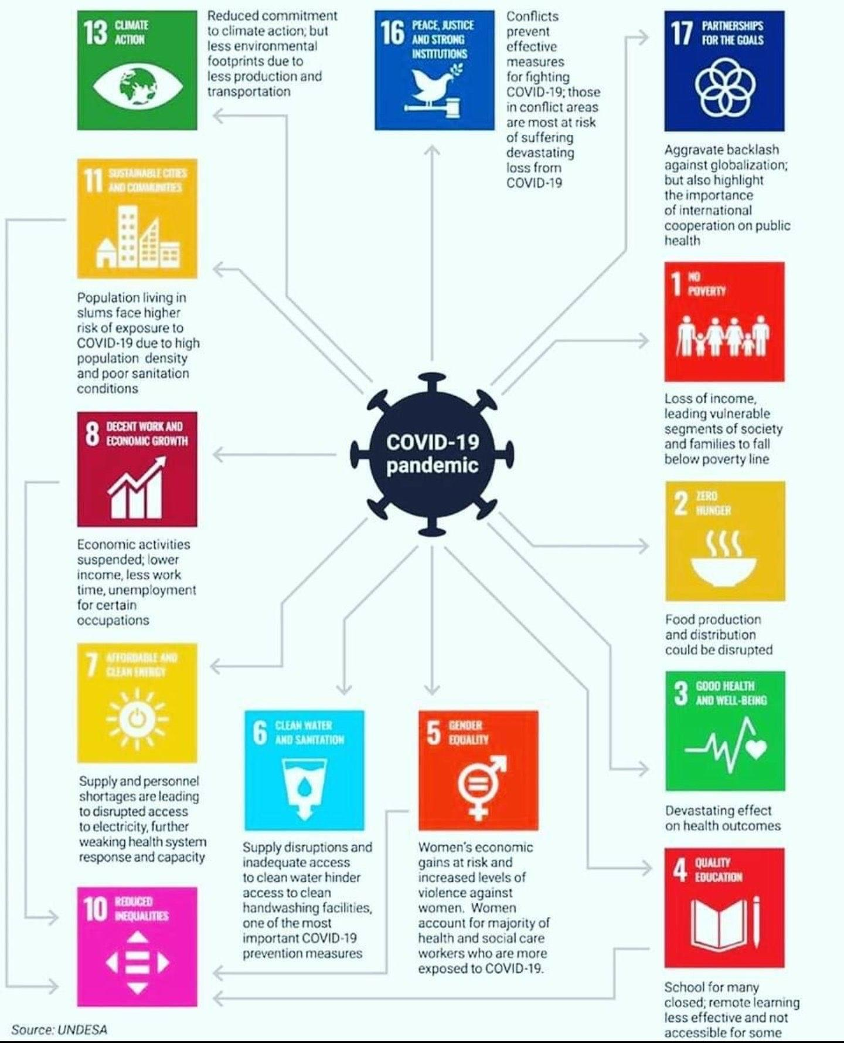
CODVID-19 & CLIMATE CHANGE
SDG 13: CLIMATE ACTION
“Reduced commitment to climate action, but less environmental footprints due to less production and transportation”

Slide 7
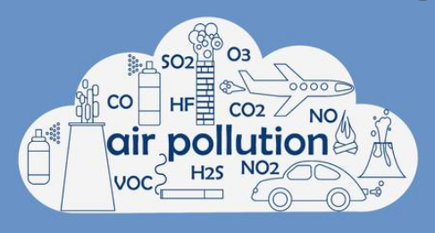
Air quality & climate change
“We need to make a clear distinction between air quality and climate change,” said Wim Thiery, climate scientist at Vrije Universiteit Brussel. “When we talk about air quality, yes, less traffic, fewer planes and factory shutdowns mean less NO2 and other pollutants over cities. But for the climate it’s much more complex.”
excerpt from https://sciencebusiness.net/news/covid-19-cutting-air-pollution-it-will-not-slow-climate-change

Slide 8
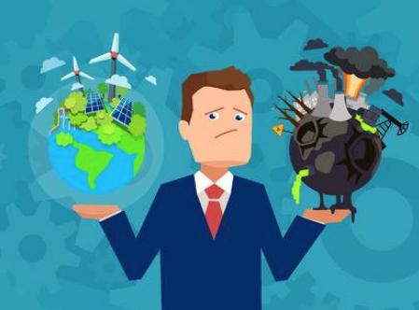
WORLD POLICIES
“The worry is that although reduced air pollution may bring health gains in the short term, emissions will rise when the crisis ends, and in the meantime climate policy will be sidelined as governments focus first on slowing the spread of the virus, and then on jump-starting stalled economies.”

Slide 9
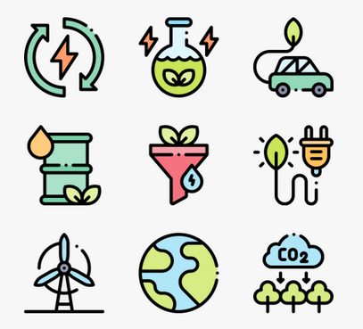
ENERGY SOURCES
“But as prices for oil continue to plummet – partly a result of the ongoing price war between Saudi Arabia and Russia, but also due to COVID-19 – renewable alternatives like solar power and wind energy become less competitive, and less interesting to investors.”

Slide 10
INDIVIDUAL ACTIONS
“On an individual level however, the coronavirus lockdown could inspire climate-friendly actions, according to Wouter. “This could be an opportunity to see how we can re-organise our activities to benefit the climate. Home office and teleworking, for example.”

Slide 11
DEAR PARTNERS…
THANKS A LOT FOR YOUR WORK!

