Slide 1
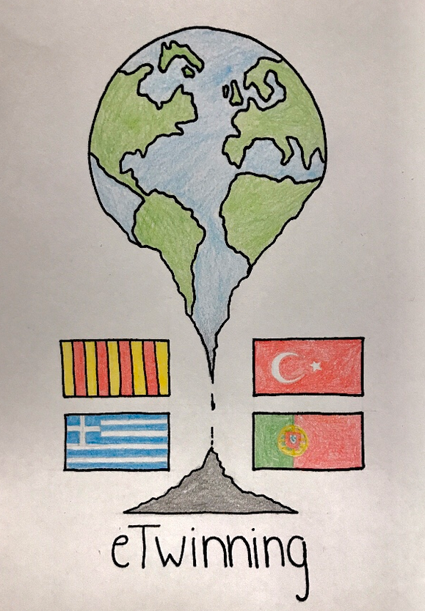
ANALYSING POLITICAL SPEECHES
ETWINNING PROJECT: ”THE POLITICS OF CLIMATE CHANGE”

Slide 2
POLITICAL SPEECHES – MAIN PARTS
1) INTRODUCTION: by which the speaker intends to attract the audience’s attention
Examples:
Making clear the purpose of the speech
Mentioning the topic by emphasizing its importance
Beginning with a rethorical question or a little story
Showing or referring to something related to the topic, ie. An object, a photo, statistics…

Slide 3
POLITICAL SPEECHES – MAIN PARTS
BODY: in the main part of the speech the speaker tries to maintain the audience`s attention.
Examples:
Using short and clear sentences
Developing his/her thoughts and main points step by step
Backing up his/her main ideas/points with facts and background information
Suggesting what should be done to improve the situation or presenting solutions to the problem
including personal experience, examples of a story to make his/her speech more lively, establish a “Personal” relationship to become well-liked
Using rhetorical devices ie. Repetition, alliteration, comparisons…

Slide 4
POLITICAL SPEECHES – MAIN PARTS
CONCLUSION: at the end of his/her speech, the speaker may appeal again to the audience’s intellect and/or emotions
Example by:
Summing up his/her main ideas/arguments in one or two sentences
Briefly mentioning what the outlook might be
Asking the audience to support his view, ideas, programme…

Slide 5
IMPORTANT ASPECTS FOR THE ANALYSIS OF POLITICAL SPEECHES
Key words or phrases
Clusters: a series of words that are related to each other in meaning
Oppositions (ie. Negative/positive, near/distant…)
Use of key symbols, slogans stereotypes
Abstracts and generalizations vs. the presentations of specific issues or events:
How are these two levels related to each other?
How does one level outweigh the other?
Use of rhetorical devices (see section)
Other characteristics of style (see section)
Use of personal pronouns (see section)
Patterns of identification and solidarity:
Who is “we” and who does the speaker refer to by “they”?
What role models or heroes are being praised, what sphere of life is touched upon?

Slide 6
RHETORICAL DEVICES/FIGURES OF SPEECH
ANALOGY: resemblance in some particular things otherwise unlike
i.e. Branches of a tree and branches of a family
SIMILE: two things are compared because they have something in common although they are different in all other aspects. Use of ”like” or “as”
i.e. “My love is like a red, red rose” (Robert Burns) / “I wandered lonely as a cloud” (W.Wordsworth)
METAPHOR: a simile condensed: a simile says that one thing is like another, whereas the metaphor says one thing is another
i.e. “All the world is a stage”, “Life is but a walking shadow” (W. Shakespeare)

Slide 7
RHETORICAL DEVICES/FIGURES OF SPEECH
ALLITERATION: repetition of a consonant sound of two or more neighbouring words
i.e. “whisper words of wisdom” (The Beatles)
REPETITION: of words and phrases for the purpose of emphasis
i.e. “it’s his only wish, his only ambition, the only plan he pursues”
PARALLESLISM: two or more parts of one sentences are given a similar form. This symmetry tends to produce an agreeable meaning. It can also help to bring out the point of a paragraph ( to emphasize the contrast, for example)
i.e. “We charge him with having broken his oath, we accuse him of having given up his people, and we censure him for having violated against the articles of the Bill of Rights”

Slide 8
RHETORICAL DEVICES/FIGURES OF SPEECH
ANTITHESIS: denotes opposing ideas by means fo grammatically parallel arrangements of words, clauses or sentences so as to produce an effective contrast
i.e. “He gave everything to those who deserved it, but he did not give anything to those who were idle”
ALLUSIONS: A brief and indirect reference to past events and from shared cultural knowledge
i.e. “This place is like a Garden of Eden.” – This is a biblical allusion to the “garden of God” in the Book of Genesis.

Slide 9
GRAMMATICAL STRUCTURES
Not + TO BE → Negation as a reaction to a real or virtual affirmative statement → counter-argument.
Verbs related to causality, consequence and argumentative operations: cause, makes, results in, conclude, infer, etc.
Tenses:
Past: finished facts
Present: universal, ordinary argumentations, states or facts.
Modality: assertion and interrogation.

Slide 10
COHESION AND COHERENCE
Sequence and cause and consequence connectors introducing paragraphs and revealing the structure of the argument : First, On the one hand, thus, etc.
Quotes and quotation marks → Reference to authorities “Scientists believe…”
Rhetorical questions
Hyphens or lines: indicate different levels of relevance.

Slide 11
PRAGMATIC FEATURES
Usually try to appear objective, and to persuade by the logic of the argument:
First person (I/We)
Modality verbs
Deictic items
Temporal references
Speech acts found in argumentative texts are:
Representatives (T/F): affirm, state, assert...
Directives: order, invite, challenge...
Commisives: promise, offer, swear...
Declaratives: define, amplify, explain...

