Slide 1
TEACHING ABOUT CLIMATE CHANGE THROUGH ETWINNING
AN ONLINE COLLABORATIVE PROJECT ON THE POLITICS OF CLIMATE CHANGE
“Climate Change is a Political Choice”
Marta Pey
English teacher at Ins. Jaume Callís (Vic, Barcelona)
European Projects Advisor
Department of Education of Catalonia
eTwinning & FCL Lab Ambassador

Slide 2
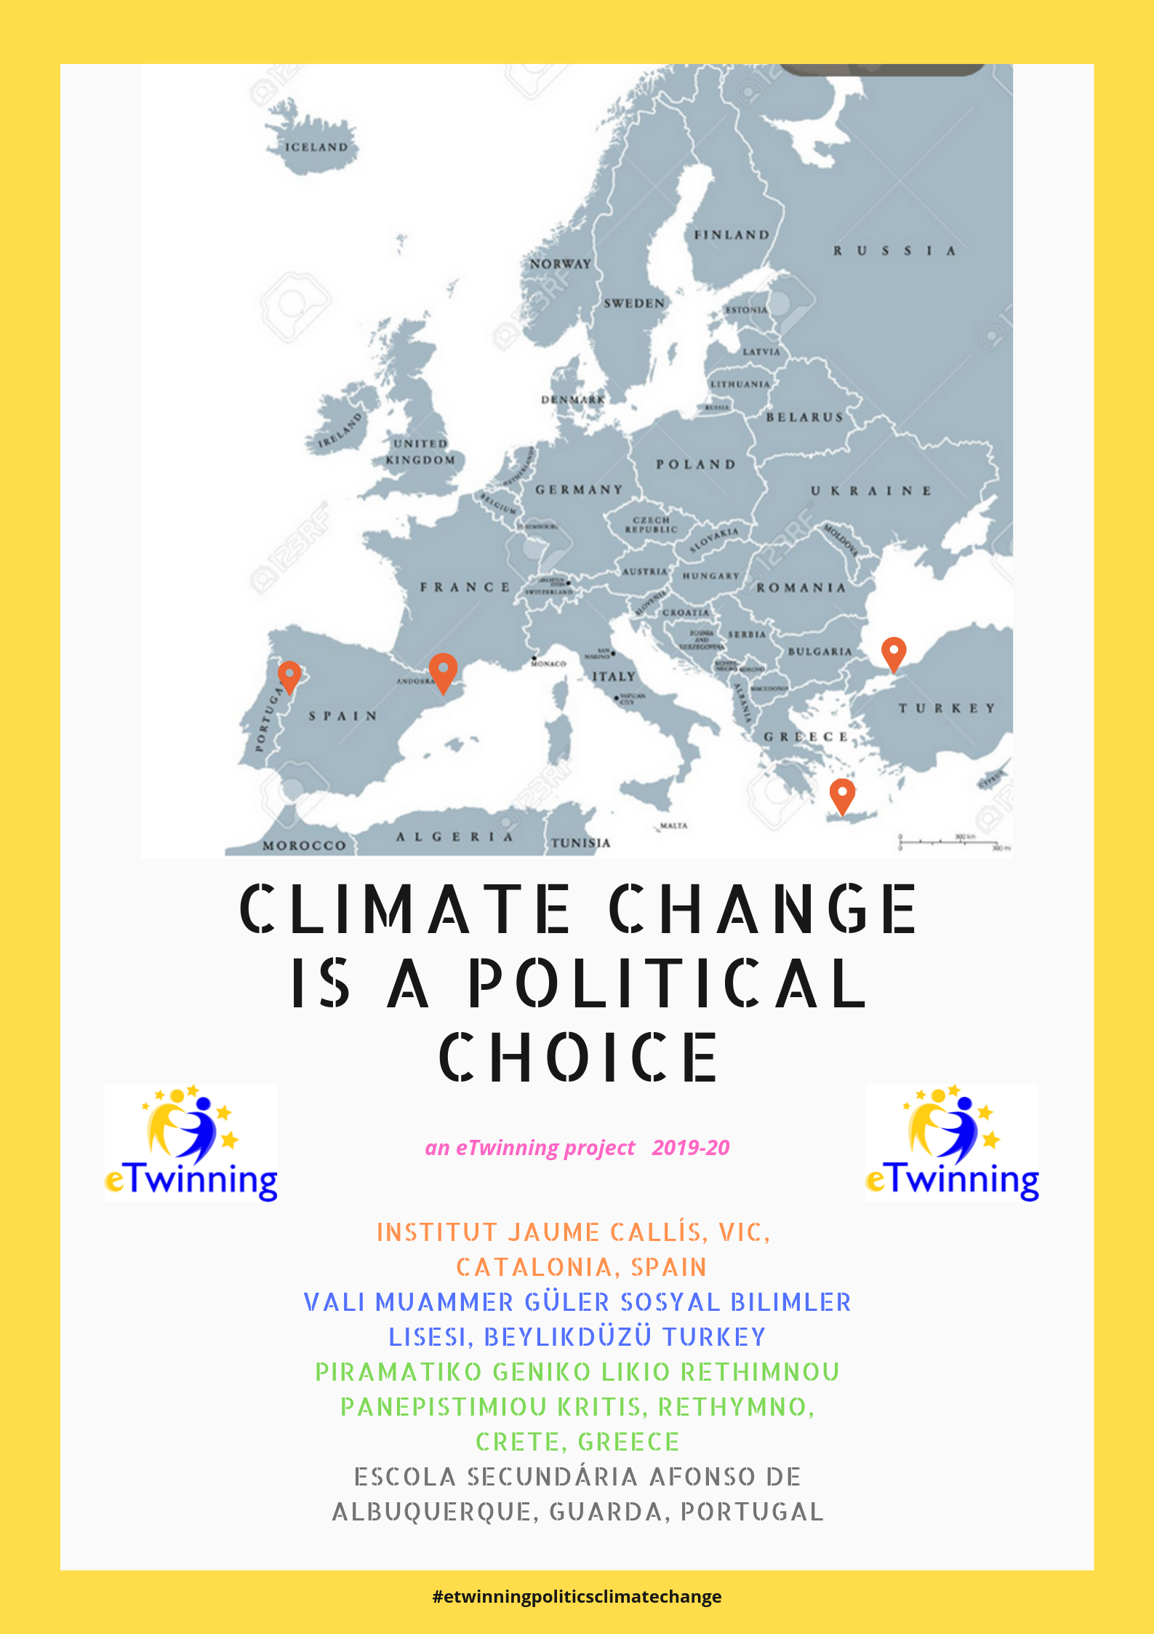
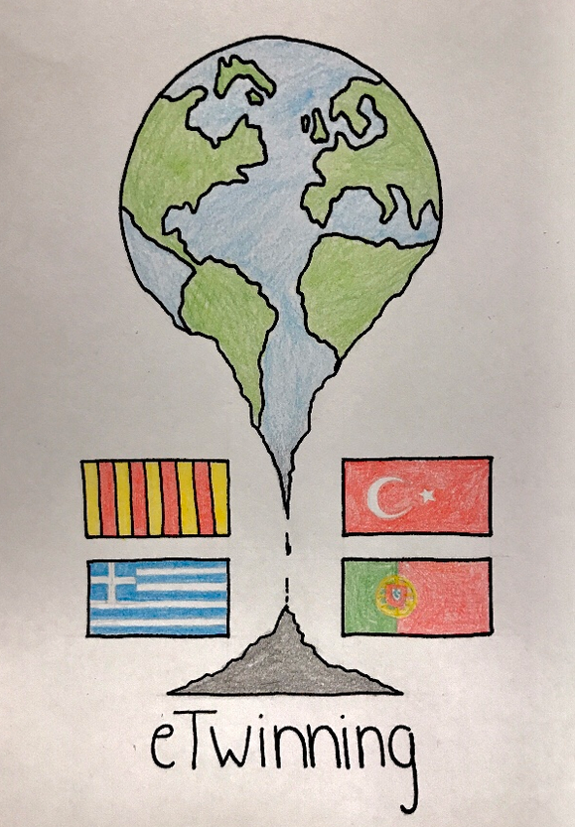
“CLIMATE CHANGE IS A POLITICAL CHOICE”
About climate change
About the politics of climate change

Slide 3
PROJECT PLAN
OBJECTIVES:
research and learn about Global Warming, Climate Change and possible solutions;
use the ICT to create, communicate, exchange information and collaborate online;
develop writing, listening, reading and speaking skills in English as a foreign language;
develop key competences through a series of motivating activities;
create a European identity by learning about other countries and cultures, and infer their own.

Slide 4
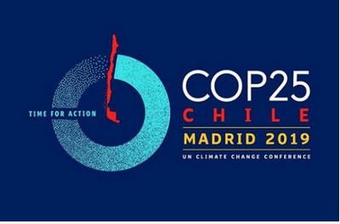
Some activities done so far
Discussion forums on SUMMITS:
Which news, agreements, commitments have been made by world leader politicians and other influential people in the UN Climate Change Summit in New York (21-23 Sep 2019) and in Madrid (2-13 Dec 2019)?
What is your opinion? What should be done?

Slide 5
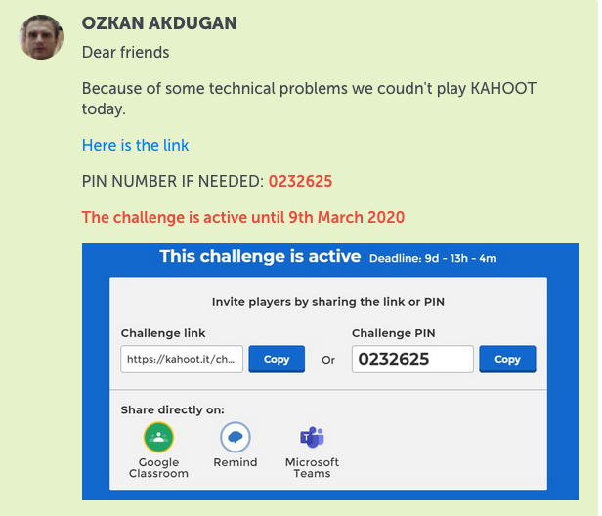
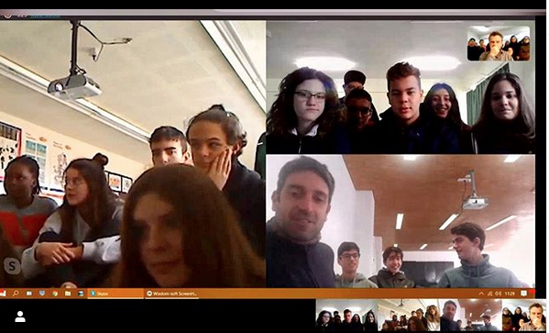
Learn about climate change & what politicians are or are not doing
Watch National Geographic documentary: “Before the Flood” by Leonardo di Caprio
Take part in a forum
Take part in a videoconference with student representatives of the 4 partner countries
Take part in a Kahoot challenge about the film

Slide 6
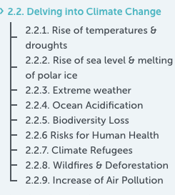
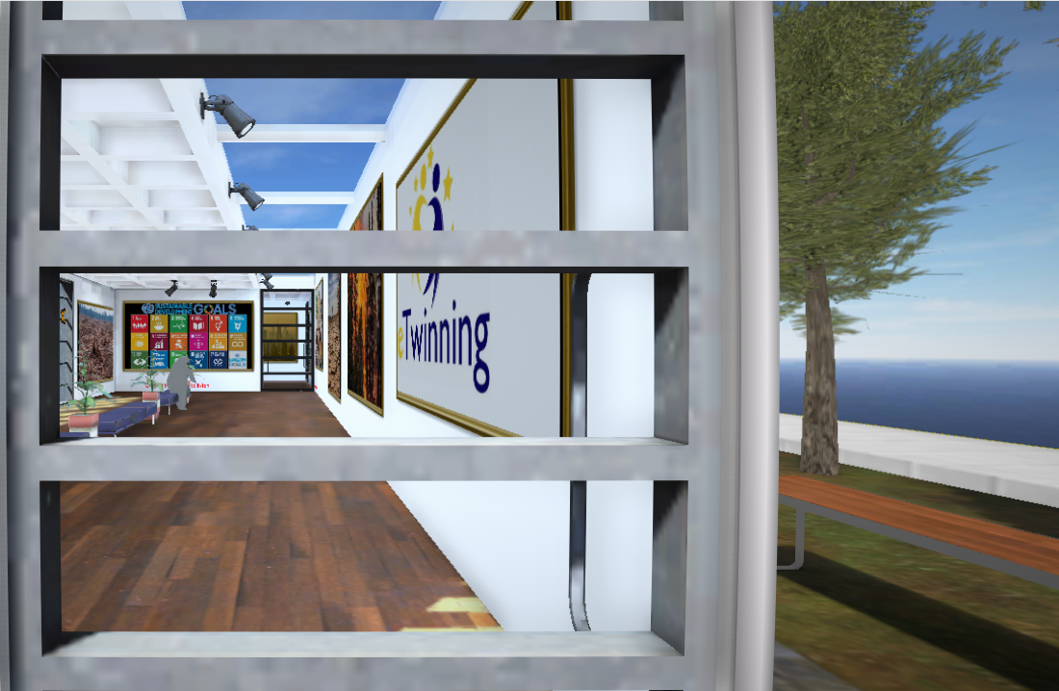
Create infographics and Virtual Reality Galleries in transnational groups in 9 different topics
https://www.artsteps.com/view/5e6690199520064e0d7030b8

Slide 7
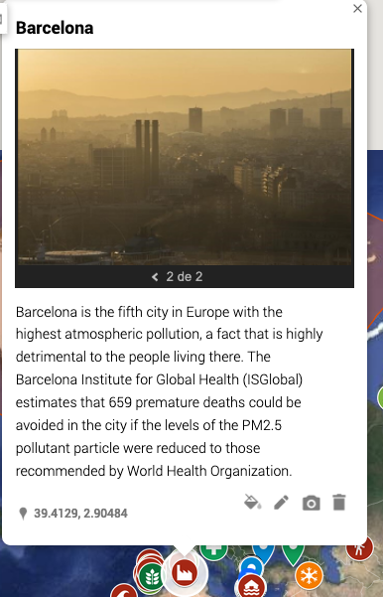
Our climate change map

Slide 9
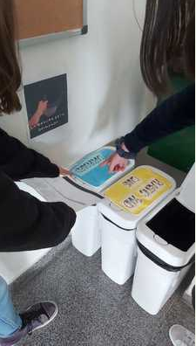
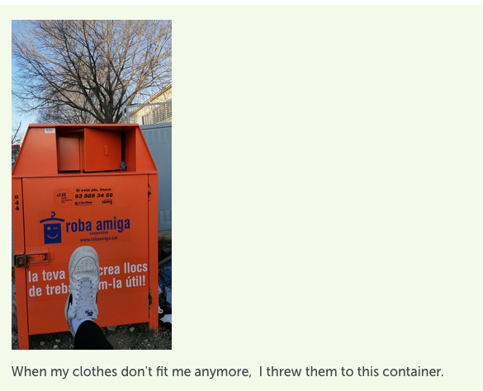
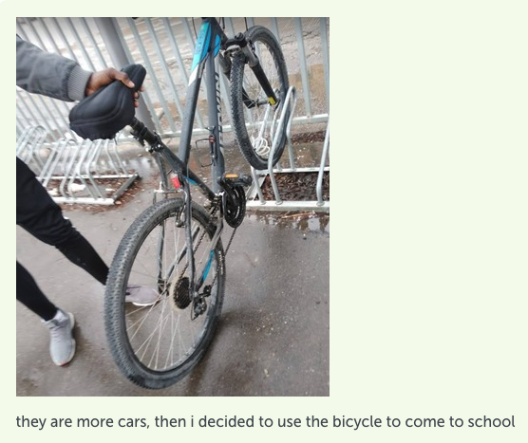
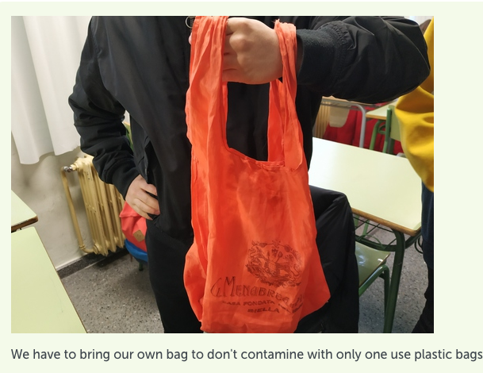
Take part in the UN Actnow Campaign

Slide 10
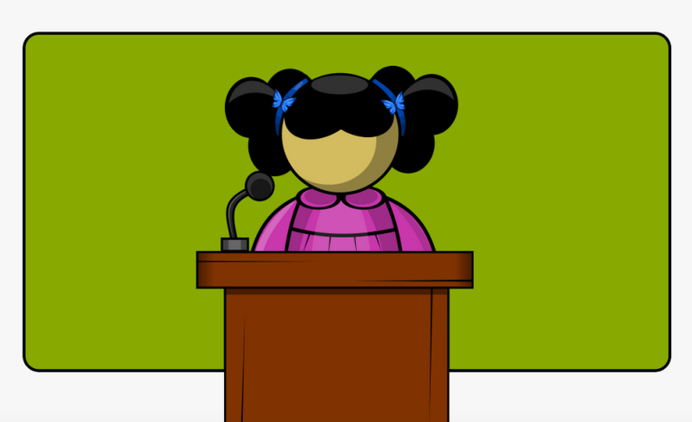
And more is to come
INTERNATIONAL SUMMIT ON CLIMATE CHANGE
Political Speeches
Persuasive Techniques
Public Speaking

Slide 11
Hope this presentation has proved interesting and inspiring for your future projects
See you in
MARTA PEY
mpey@xtec.cat
@mpeyprat

