Slide 1
INFANTE DON LUIS

Slide 2
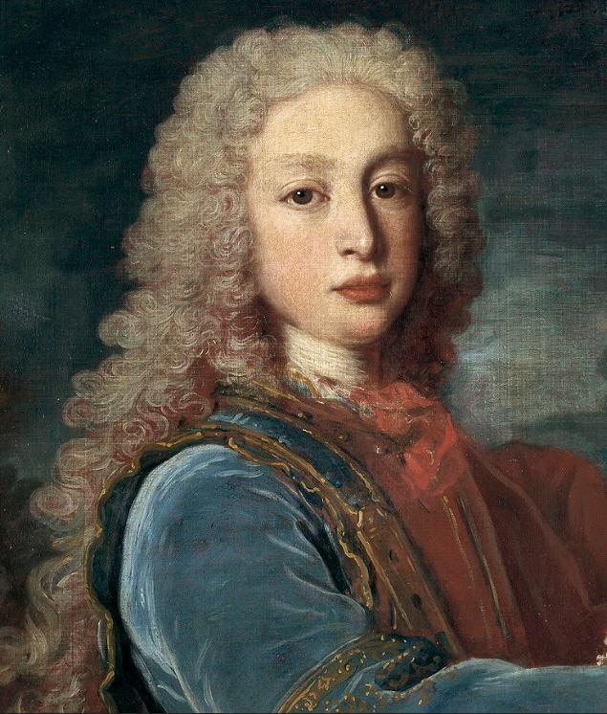
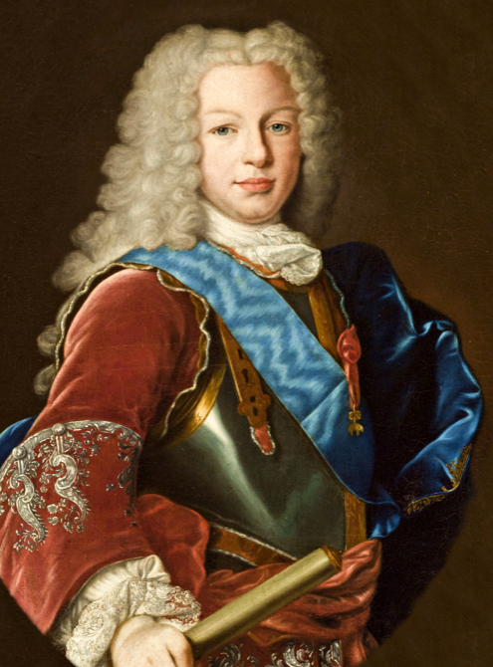
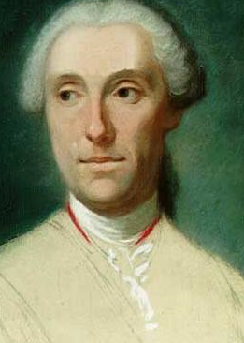
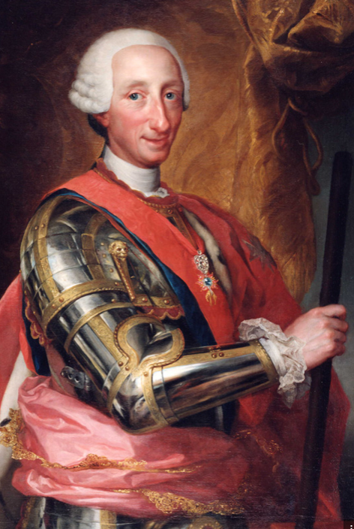
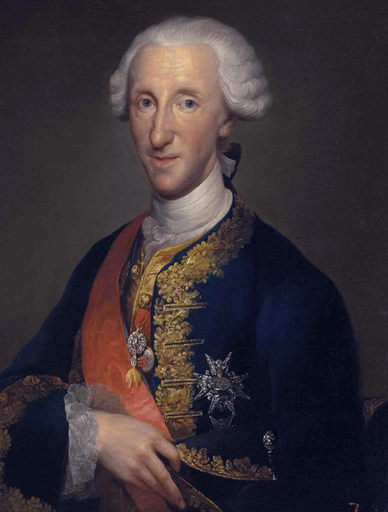
MARIA LUISA GABRIELA DE SABOYA
FELIPE V DE ESPAÑA
ISABEL DE FARNESIO DUQUESA DE PARMA
LUIS I
FERNANDO IV
FELIPE I
CARLOS III
LUIS ANTONIO JAIME DE BORBON Y FARNESIO
HIS FAMILY

Slide 3
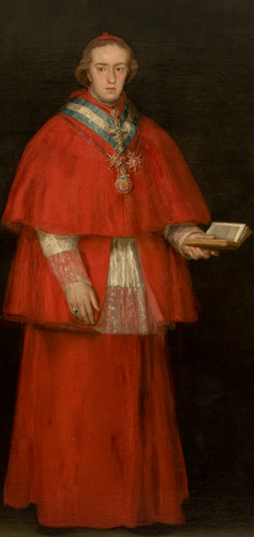
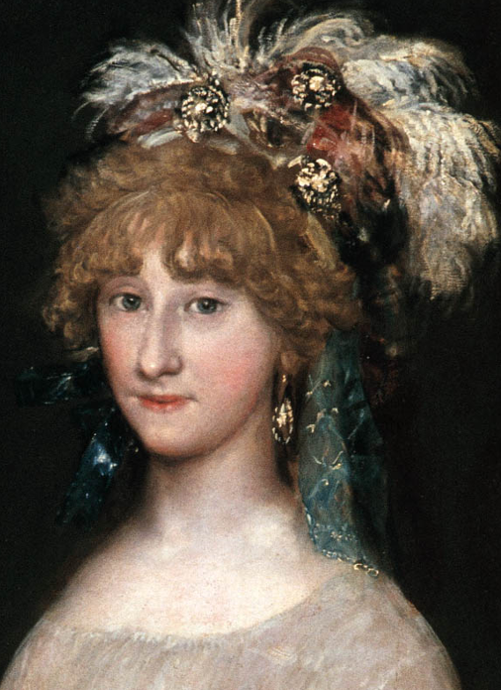
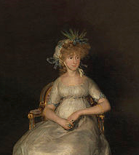
INFANTE DON LUIS
MARÍA TERESA DE VALLABRIGA Y ROZAS
LUIS MARÍA
MARÍA TERESA
MARÍA LUISA

Slide 4
HIS LIFE
His was born the 25 July , 1727.
Because he was one of the youngest brothers he would never became King , so he had to be something related with ecclesiastic career. (religion)
With 8 years he was created Knight of the Order of the Golden Fleece and ordained Archbishop of Toledo and Primate of Spain. 6 years later Archbishop of Seville.
He was bored of his religious charges so hi decided to give up.
Some years later he became count of Chinchón. Here he obtianed Morata de Tajuña , Colmenar de Oreja , Villaconejos , Villaviciosa de Odón , San Martín de la Vega and Boadilla del Monte. In Boadilla del Monte he told the architect Ventura Rodriguez to build a palace with his name.
In 1776 he got married with María Teresa de Vallabriga y Rozas. He had two daughters and one son.
Finally he died the 7 August, 1776

