Slide 1
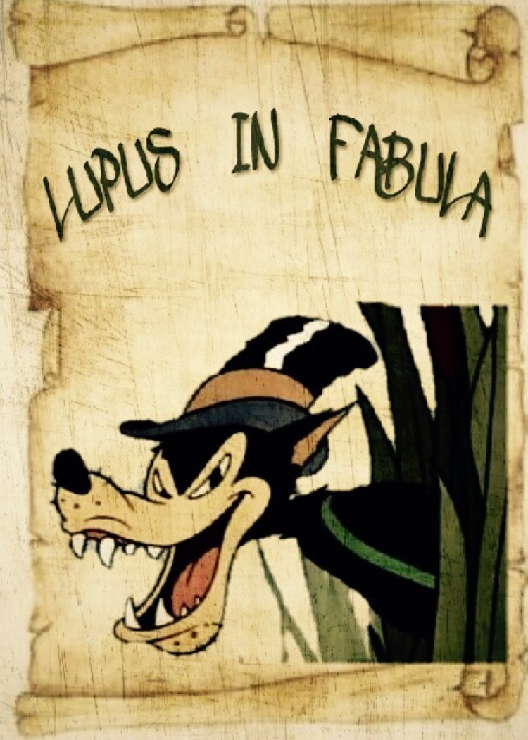

Slide 2
LES DIFFERENCES
Parli del diavolo, spuntano le corna
Quand on parle du loup on en voit la queue
Speak of angels and you hear their wings

Slide 3
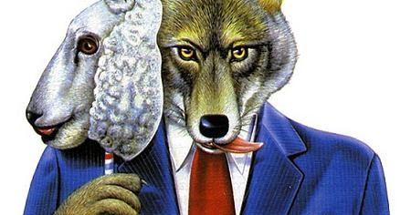
VOLPES PILUM MUTAT, NON MORES

Slide 4
Volpes pilum mutat, non mores
Il lupo perde il pelo ma non il vizio
Le loup perd le poil mais non le vice
Is it exact? Is there another locution in your language?

Slide 5
LES DIFFERENCES
Un léopard ne peut pas changer ses taches
A leopard never changes it spots

Slide 6
How do you say in your language?
What’s the meaning?

Slide 7
UT SEMENTEM FECERIS, ITA METES
Chi semina vento, raccoglie tempesta
Qui sème le vent, récolte la tempête
As you saw, so shall you reap

Slide 8
Did you know that?...
The locution in Italian and French comes from the bible
In English the expression comes from latin origins

Slide 9
We are going to look for the meaning….

