Slide 1
Vocational Educational Training For Skills, Competence And Practice For Economy ”VET4SCAPE”,
MINIDDARO
JUNIOR ACHIEVEMENT
COMPANY PRESENTATION
Coordinating teachers:
IFRIM FLORENTINA
CHESARU NICOLETA

Slide 2
General Data
Name of the company : MINIDDARO
Identification Number: CJ14-00010903
Certificate ensuing date : 17.01.2018
Legal form: SRL
Main activity : code CAEN : 1082
Production and commercialization of types of chocolate.

Slide 3
General Data
Name of the company : MINIDDARO
Identification Number: CJ14-00010903
Certificate ensuing date : 17.01.2018
Legal form: SRL
Main activity : code CAEN : 1082
Production and commercialization of types of chocolate.

Slide 4
Form of capital : private capital 100% Capital value : 200 Ron, split in social parts / 13 lei

Slide 5
NUMBER OF ASSOCIATES : 17
Number of Employees: 14
Number of external associates : 3
CLIENTS : High school students & the majority of teenager sweets consumers
SUPPLIERS : SC Kaufland SRL, SC Penny SRL, SC Fraher SRL, and more.
COMPETITION :
Our high school’s own store that sells the same variety of products;
„TIC” the store, in front of the highschool.

Slide 6
CONTACT DATA:
ADDRESS : 32, VIITORULUI ST., TULCEA City
PHONE NUMBER: 0240-534079/ FAX : 0240-534079
EMAIL : miniddaro2018@yahoo.com
WEB : https://miniddaro.wixsite.com
https://www.facebook.com/groups/148428582537003

Slide 7
The story of MINIDDARO !!!
The VET4SCAPE project in which we are parteners imposes the creation of a Mini company which helps students become future entrepreneurs , with the qualification that they gain at the ”Danube Delta” Economics College Tulcea.
After many tries of choosing the product which we could realise and enjoy, the idea of producing chocolate was born, the students still being kids and enjoying sweets.
This is how S.C MINIDDARO SRL was created, with the purpose of commercializing and selling chocolate products.

Slide 8
The team is made up of 14 students, belonging to the 10th and 11th grades,with the specialisations of tourism and cathering, coordinated by two teachers with the same specialisations mentioned above, who wanted to make their classmates or schoolmates happy with a healthy and sweet, homemade chocolate.
Little Joy has been born!!!! It will be the chocolate that we commercialize in our high school, on the occasion of various events that take place in it.

Slide 9
Little Joy can be a moment of sweet delight for any kid any day, but also when you want to make your deskmate or friend happy with a tasty, energizing homemade chocolate, made by us, the little entrepreneurs, who want to make your day better.

Slide 10
On ”Valentine’s Day”, the 14 th of February 2018 was the first day of commercialization for us, and for the first product of our company, Miniddaro Junior Company.
Little Joy, manufactured by students which are the team of the project ERASMUS+ ”VET4SCAPE” .
A” sweet” day, all the products were sold! We hope to stay on the distribution market and to increase the number of our buyers, since we are only at the beginning of our ”journey”!

Slide 11
Concerning the production of chocolate at Miniddaro, after the Training event in Vidin the situation is the following: due to the fact that Little Joy chocolate bar was appreciated by the students/buyers, the Company has decided to diversify its product. The new products can be purchased in 3 versions: small stars, flowers and bears for 1,99 lei, compared to the first product which was 3,99 lei.
Changing the wrapping of the chocolate led to lower costs for manufacturing Little Joy.

Slide 12
The first productions of our company led to the profit of 28%.
The second production raised by 2%.
Our third production was bigger and company’s profit raised to 34 %.
The new product brought us the biggest profit in the fourth production that being 47%.
After all the productions the total profit is 39%.

Slide 14
Organisational Chart
S.C MINIDDARO S.R.L
EMPLOYEES FUNCTIONS IN THE COMPANY

Slide 15
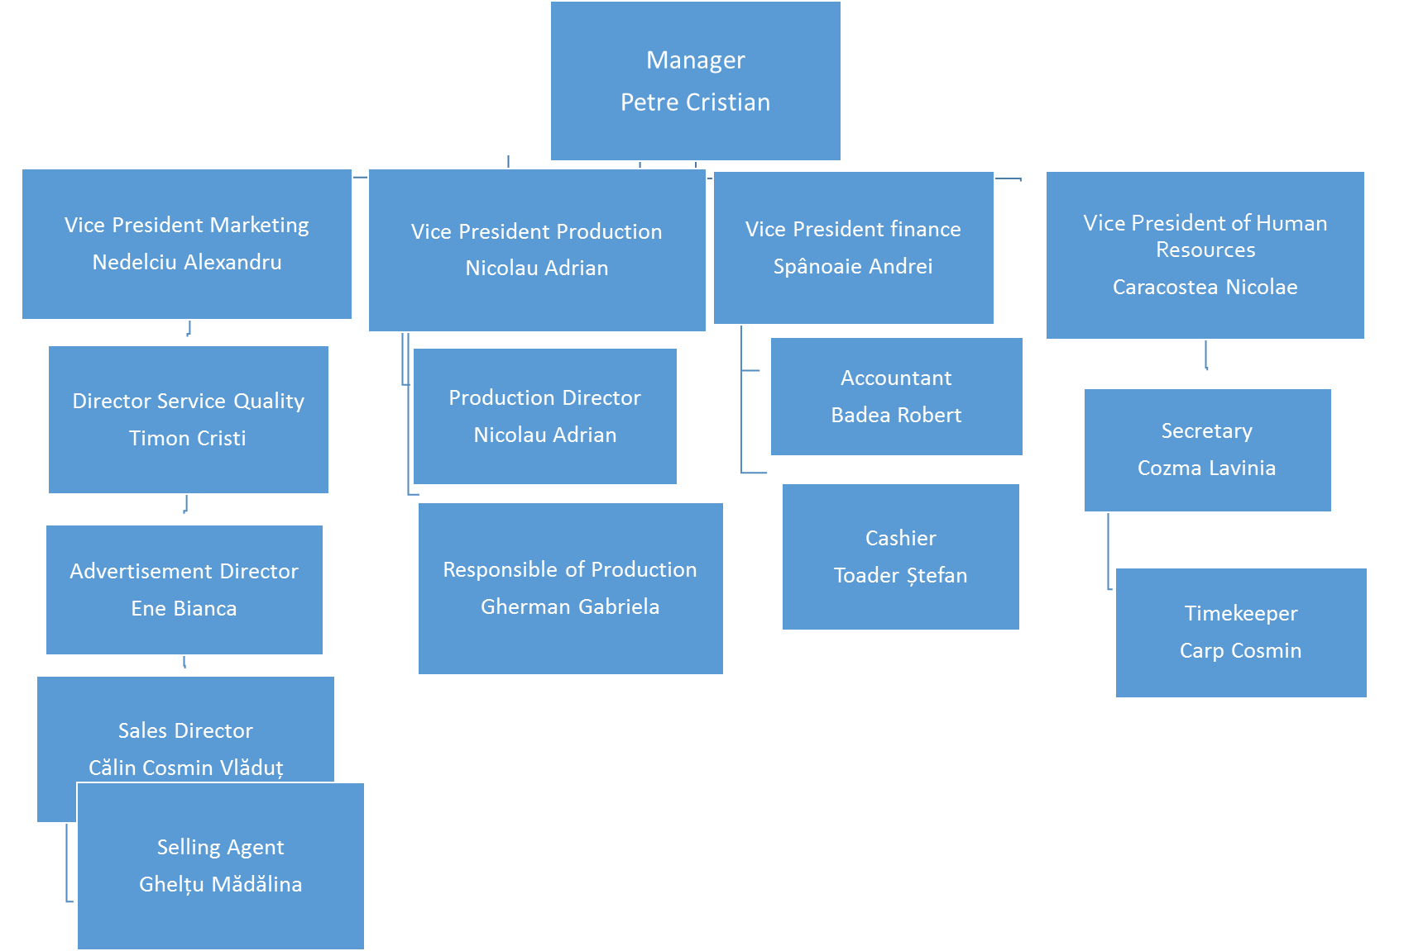

Slide 16
COMPANY’S GOALS:
Rising the number of the sales by 10%
Extending the variety of products by the second semester of activity.
Increasing the sales by 20%
Boosting satisfaction with the consumer.
Luckily all those goals were accomplished.

Slide 17
Advertising the product in the college;
Advertising ’’Little Joy ’’ in the country and in the partner countries that are in the ”VET4SCAPE ”Programme;
Development premise on the market: developing a product that meets the standards of the clients is the most important premise for the company;
We are still advertising for the products on our website: https://miniddaro.wixsite.com;
Also advertising by using posters at our school;
And the advertisement that is on our school's radio during one of the breaks, the day before the selling starts.

Slide 18
Those were the steps of making ”LITTLE JOY ”chocolate and MINIDDARO’s activity. If you want something sweet, Little Joy is what you need!!!

