Slide 1
HAKunta Junior Achievement Company
HAK Linz Austria

Slide 2
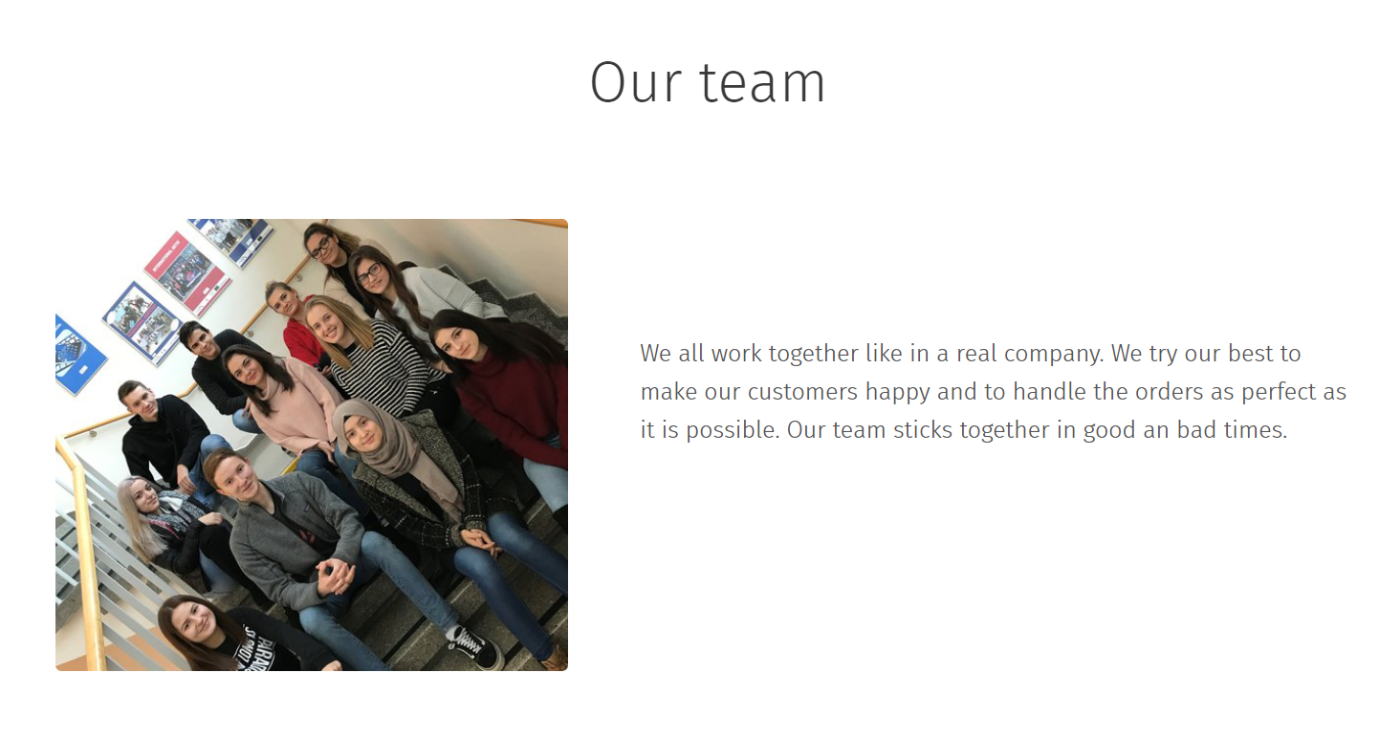

Slide 6
Web page - https://hakunta.webnode.at/

