Slide 1
Unique, JA Company Business Academy Ul. K. Kittenbergera 2, Levice Slovakia

Slide 2
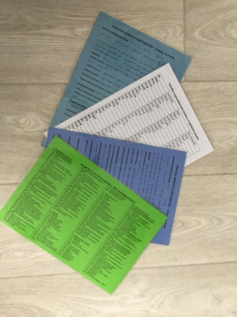
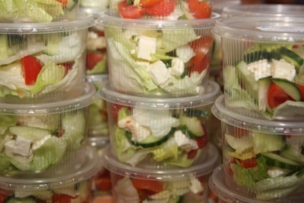
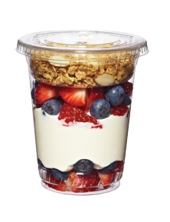
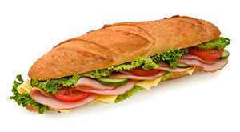
Production of Unique, JA Company
Student´s aids
Food products
Stand for pens and business cards

Slide 3
Sale and marketing
Market research
Advertising, promotion
Sale activities
production program
posters
website
facebook
Christmas markets
Easter markets
https://oalvunique.wixsite.com/unique
https://www.facebook.com/search/top/?q=unique%2C%20ja%20firma

Slide 4
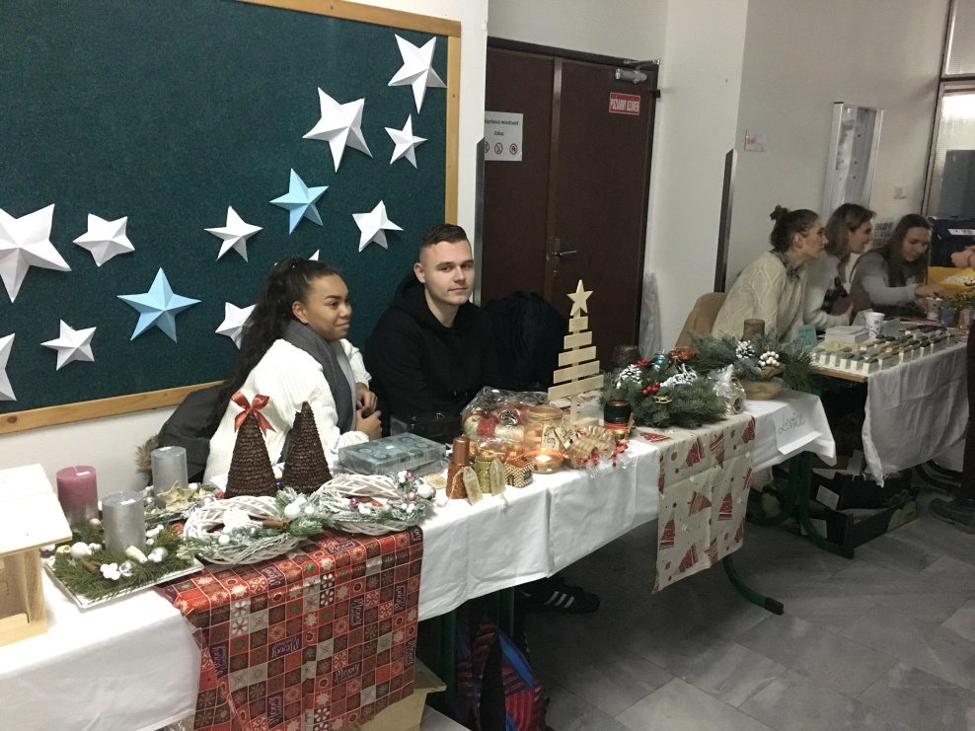
Sale activities

Slide 5
Sale activities

Slide 6
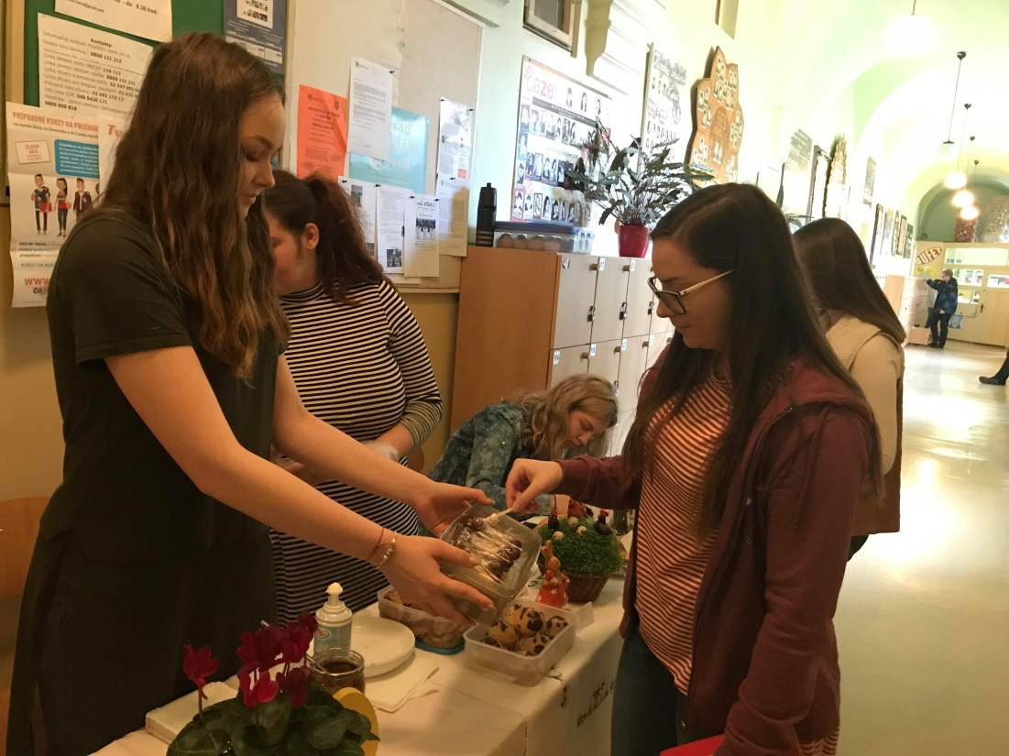
Sale activities

Slide 7
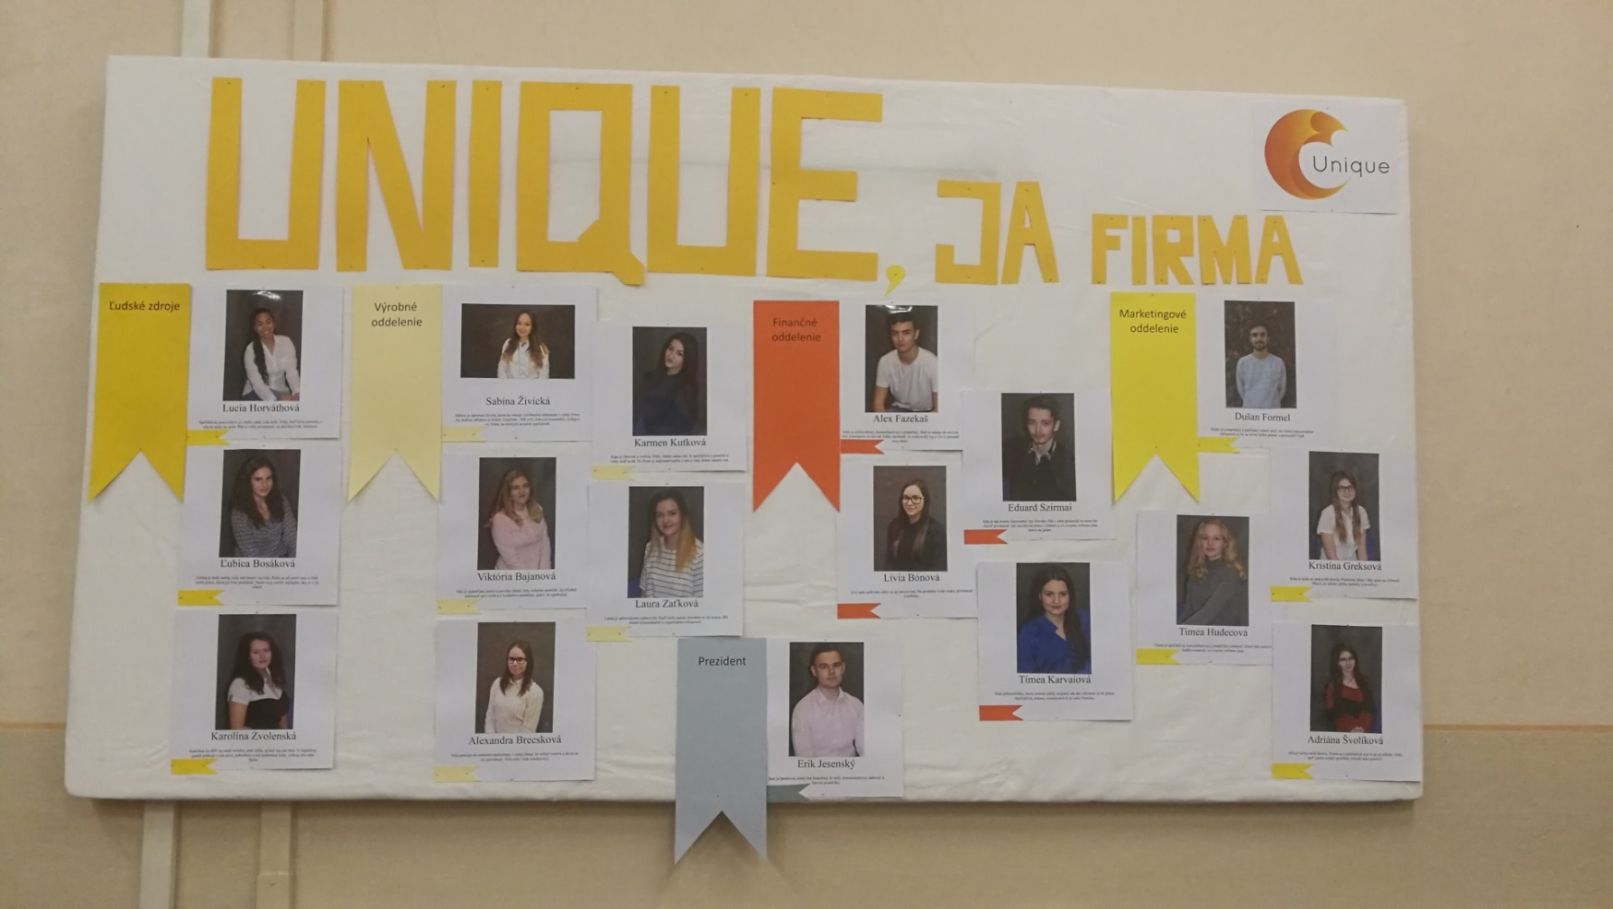
Human resources

Slide 8
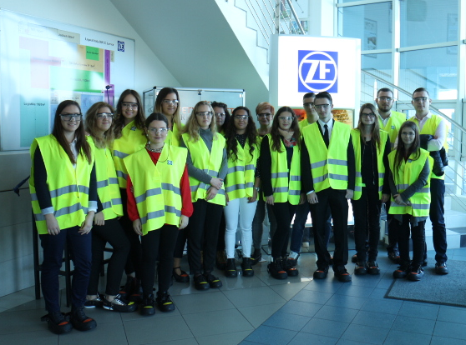
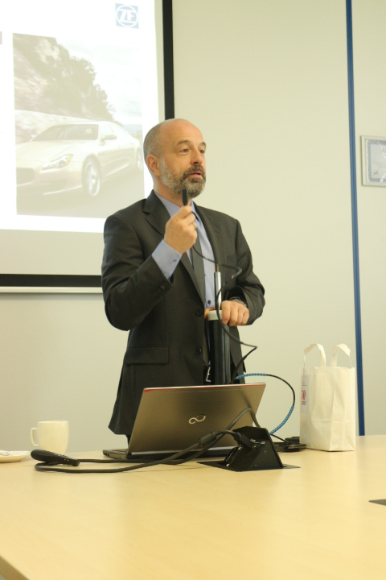
Business volunteer
ZF Slovakia, a. s. Levice

Slide 9
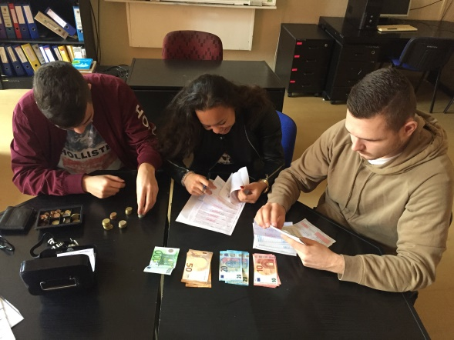
Finance and acounting
Acquiring admission capital
Ability to pay and liquidity
Capital appreciation
Acounting
100 shares/1 euro

Slide 10
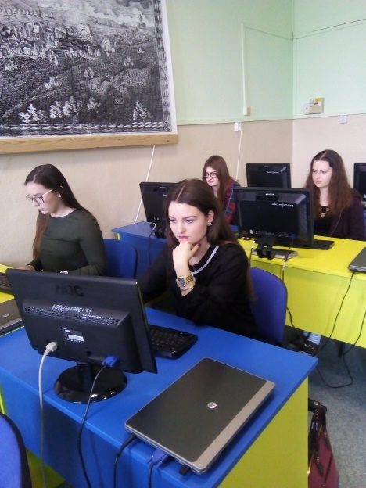
Entrepreneurial Skills Pass
an international initiative aiming to certify the knowledge, skills and competences students gain through the JA Company Programme

Slide 11
Thank you for your attention ☺

