Slide 1
UNIQUE, JA COMPANY -
GENERAL ASSEMBLY
May 2018

Slide 2
UNIQUE, JA COMPANY – GENERAL ASSEMBLY
Unique, JA Company during its operation has specified the production programme to meet customer needs, while at the same time achieving a reasonable return on the capital invested. The production programme of the company was therefore the production and sale of teaching aids, food products, gift and decorative items.
The production and sales of products were supported by marketing activities in the form of posters and leaflets in the corridors of the school and in classes, via the school radio, its own facebook page and website.
Throughout the company operation, the company has been following financial operations through simple revenue and expenditure records.

Slide 3
UNIQUE, JA COMPANY – GENERAL ASSEMBLY
In May 2018 Unique, JA Company finished the production and sale of the products, executed the closure of the financial records, prepared the annual report and convened the liquidation General Assembly. The shareholders at the General Assembly approved the profit distribution proposal proposed by the Board of Directors. At the end of the General Assembly, the Company paid dividends to shareholders. As of 15 May 2018, the firm filled the tax return, paid the income tax to JA Slovakia and applied for the cancellation of Unique, JA Company from the Commercial Register.

Slide 4
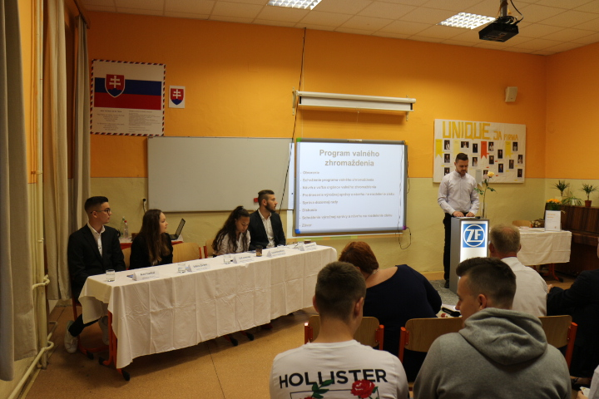
UNIQUE, JA COMPANY – GENERAL ASSEMBLY

Slide 5
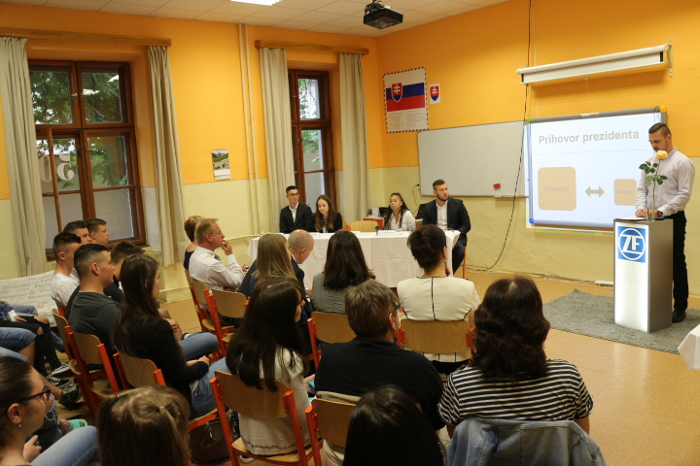
UNIQUE, JA COMPANY – GENERAL ASSEMBLY

Slide 6
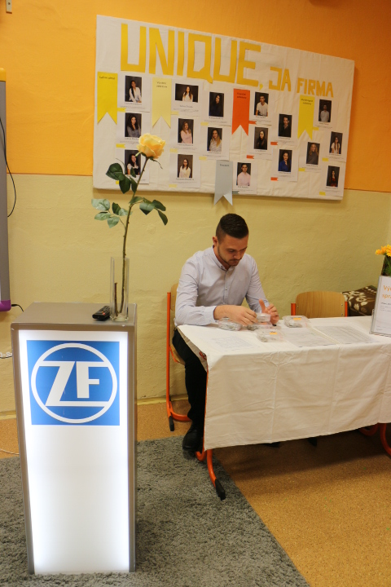
UNIQUE, JA COMPANY – GENERAL ASSEMBLY

Slide 7
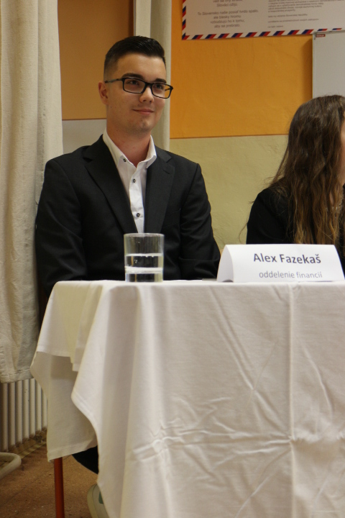
UNIQUE, JA COMPANY – GENERAL ASSEMBLY

Slide 8
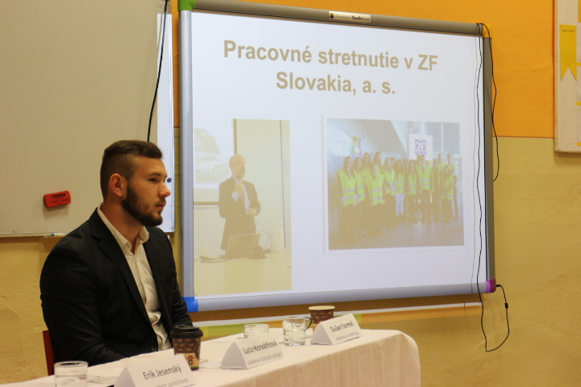
UNIQUE, JA COMPANY – GENERAL ASSEMBLY

Slide 9
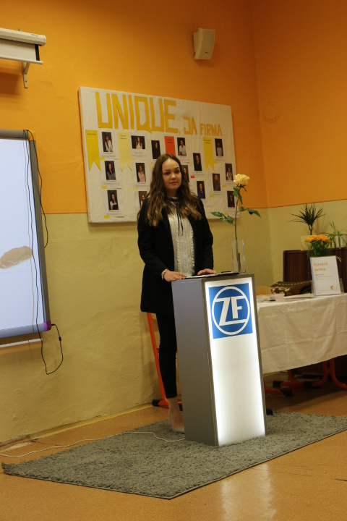
UNIQUE, JA COMPANY – GENERAL ASSEMBLY

Slide 10
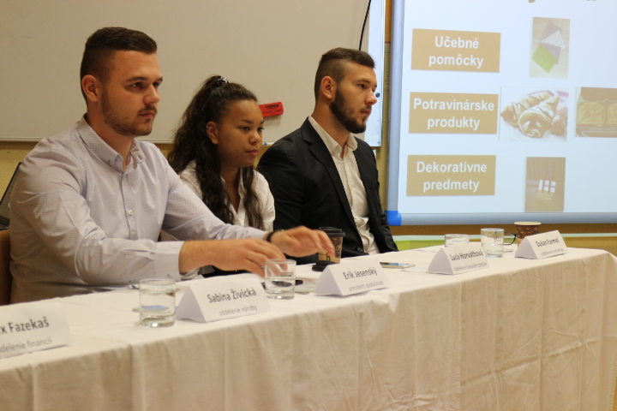
UNIQUE, JA COMPANY – GENERAL ASSEMBLY

Slide 11
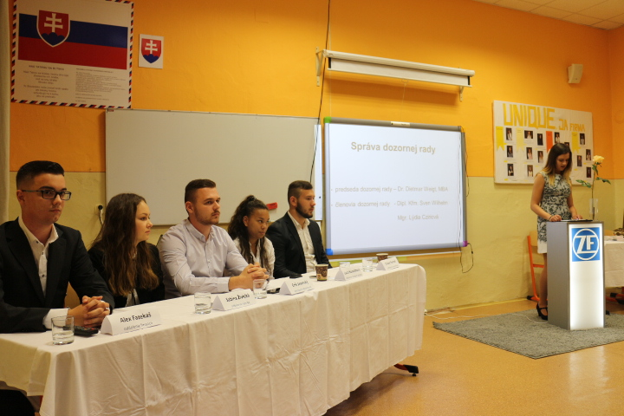
UNIQUE, JA COMPANY – GENERAL ASSEMBLY

Slide 12
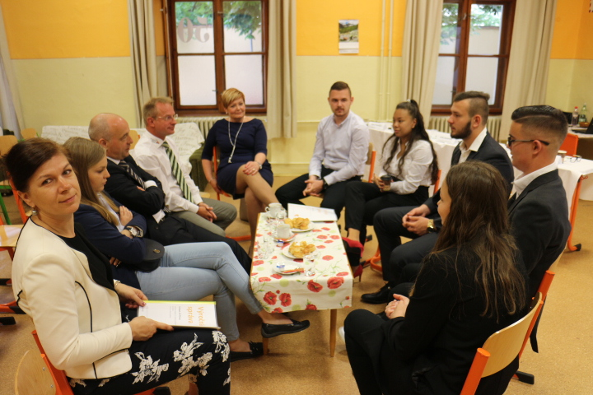
UNIQUE, JA COMPANY – GENERAL ASSEMBLY

Slide 13
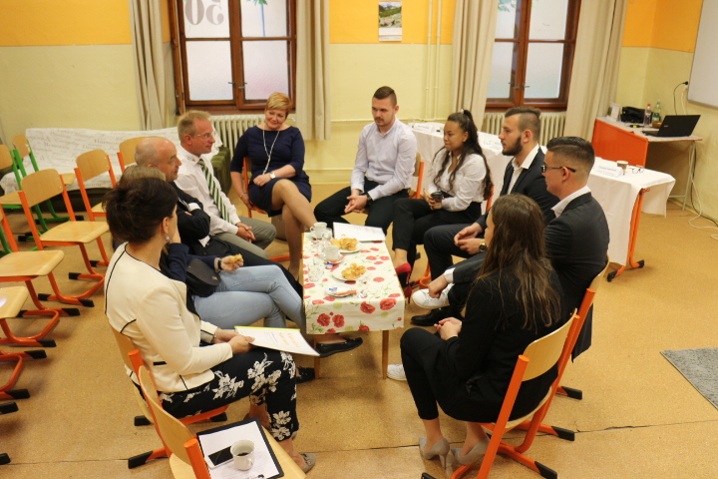
UNIQUE, JA COMPANY – GENERAL ASSEMBLY

Slide 14
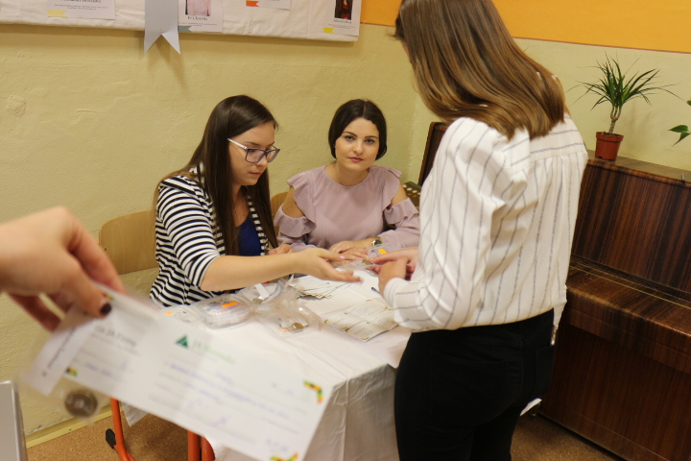
UNIQUE, JA COMPANY – PAYING DIVIDENDS TO SHAKEHOLDERS

Slide 15
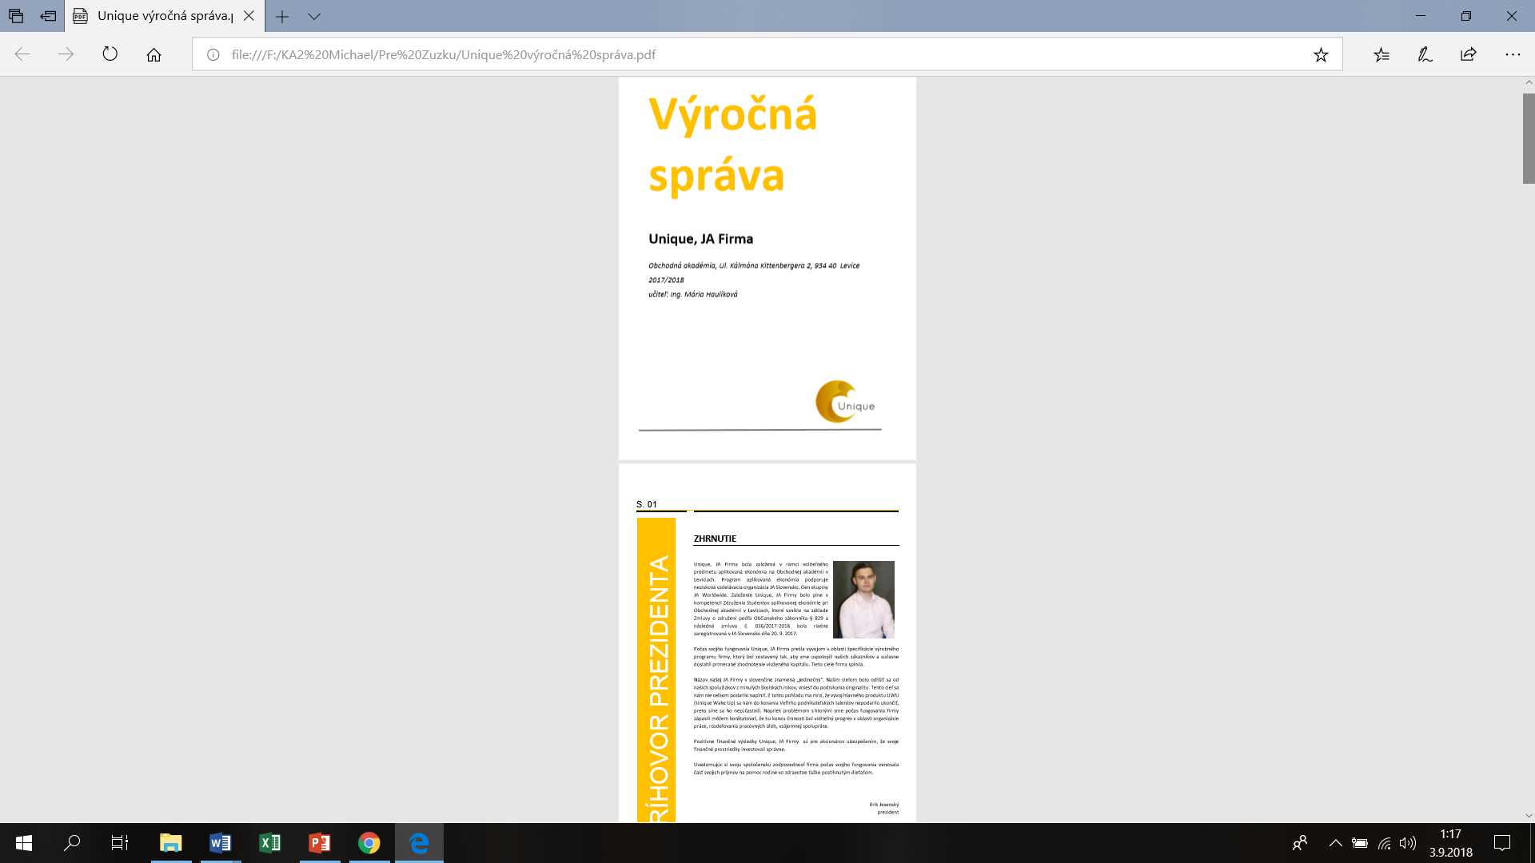
ANNUAL REPORT OF UNIQUE JA COMPANY

