Slide 1
STUDENTS COMPANY AT OUR SCHOOL

Slide 2
WHERE ARE WE FROM?

Slide 3
Czech Republic
České Budějovice
Portugal
Barreiro

Slide 4
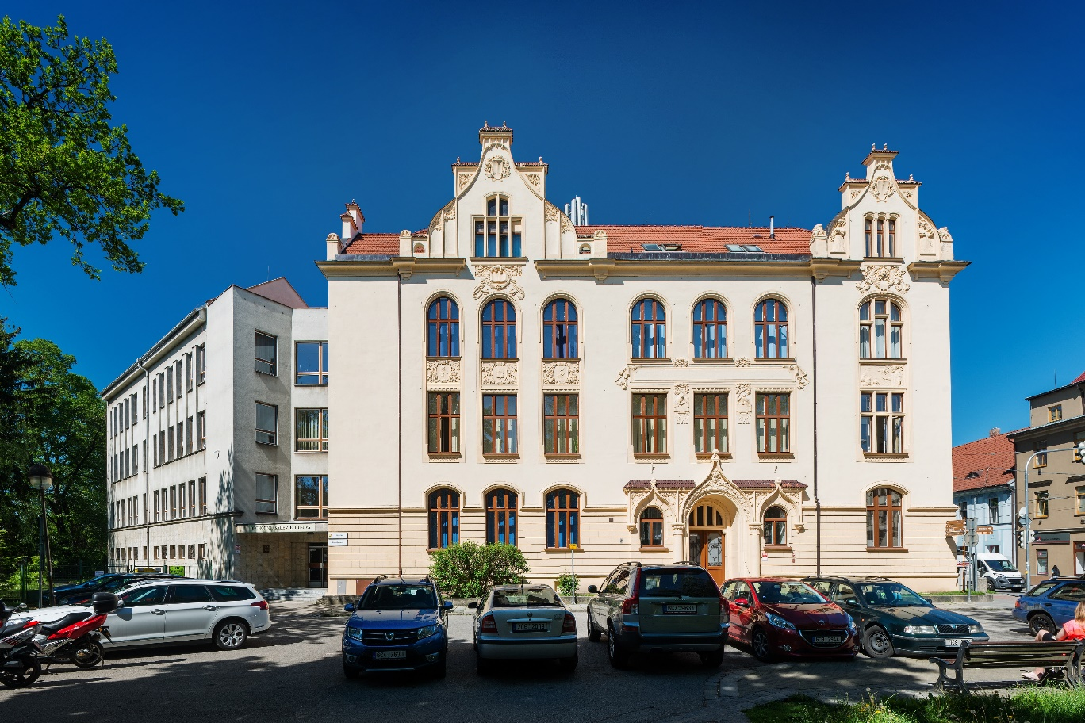
Business academy České Budějovice, Husova 1

Slide 5
OUR STUDENTS COMPANY

Slide 6
HOW DID WE START?

Slide 7
Distribution of functions
Accounting department
finances, accountancy
Marketing department
promotion, communication with customers
Productive department
production

Slide 8
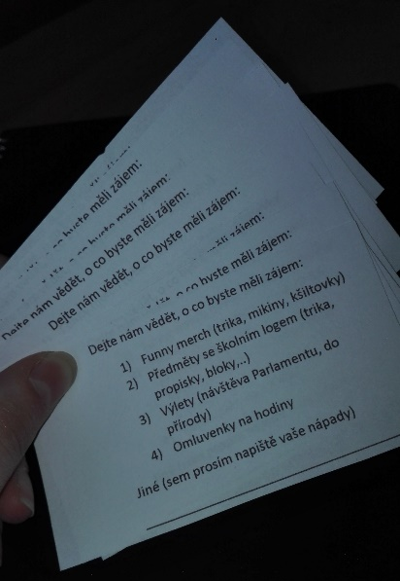
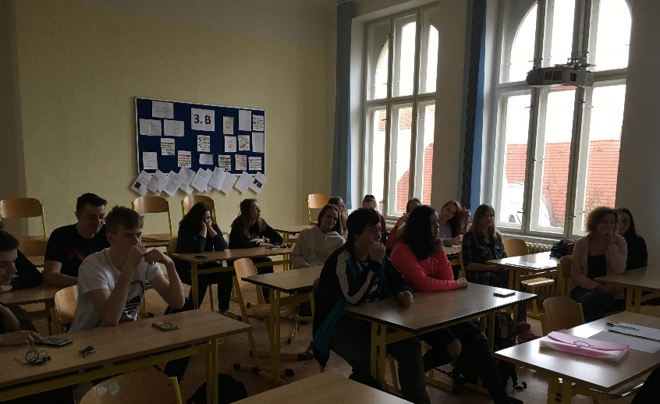
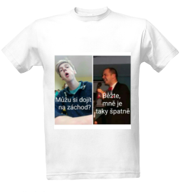
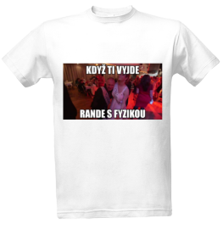
How did we choose the right product?
brainstorming (discussion about our ideas)
choosing a narrow selection of products
market research

Slide 9
OUR MAIN INTENTIONS

Slide 10
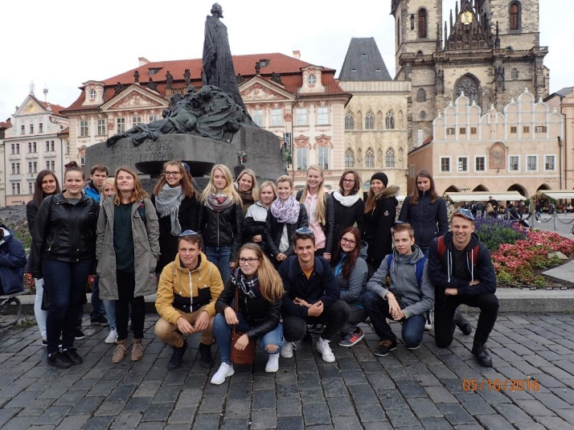
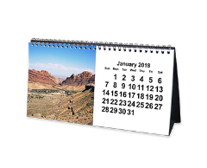
Our main intentions
Sell product
funny merchandise
- calendar with teachers
- clothes with popular catchwords
Organize trips
The Czech Parliament, National Bank
National Park Šumava
Organize school competitions
Typing
TBT

Slide 11
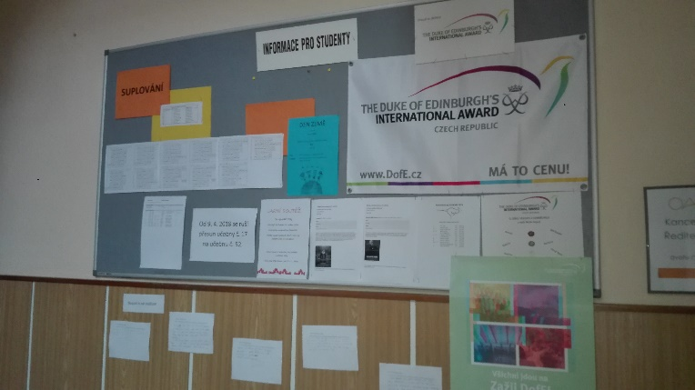
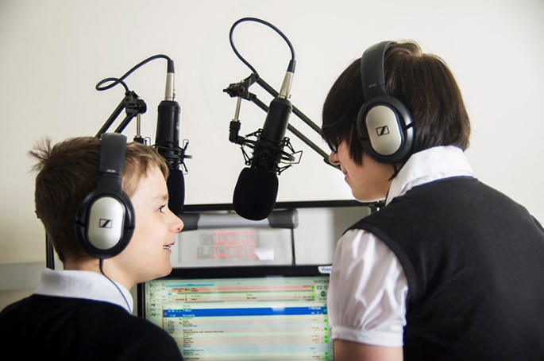
Promotion
social media
notice-board
school radio
posters

Slide 12
WHAT DO OUR MEETINGS LOOK LIKE

Slide 13
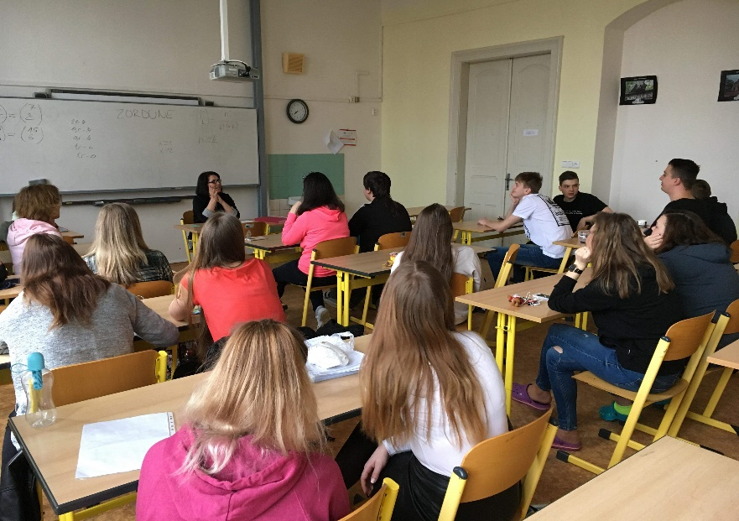
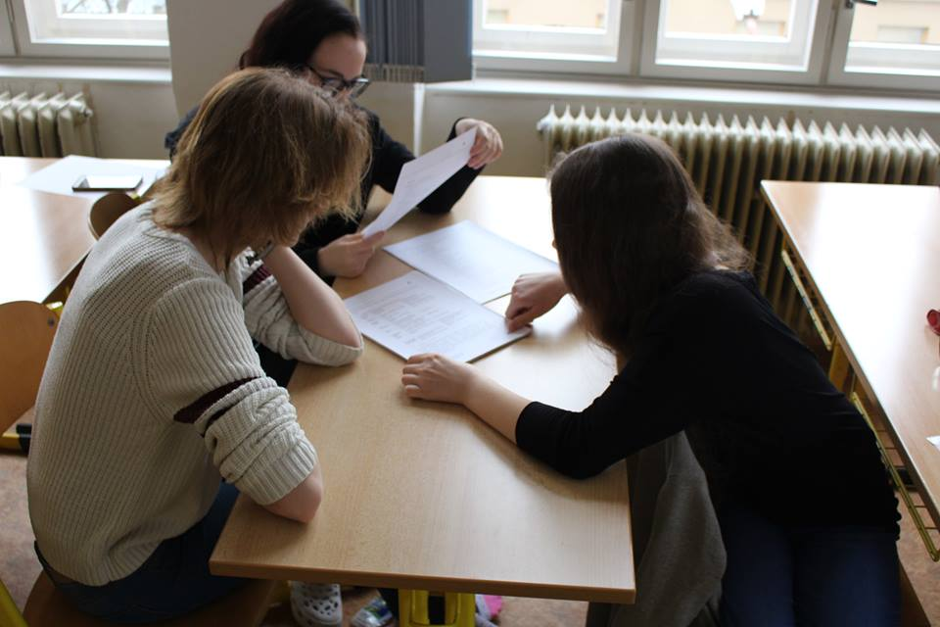
Our meetings
Every Friday at 7 o‘clock before school
Working at our current plans
Discussion about new ideas and events

Slide 14
WHAT ARE WE WORKING AT NOW?

Slide 15
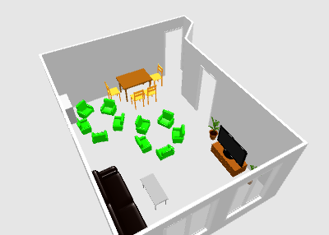
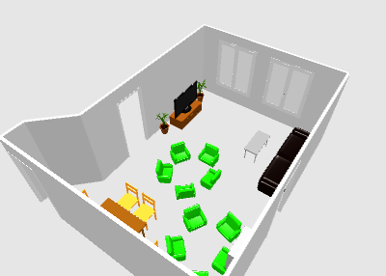
Designing room for students
Divided to groups – each one has its own design
Headmaster chooses the one that will be accomplished

Slide 16
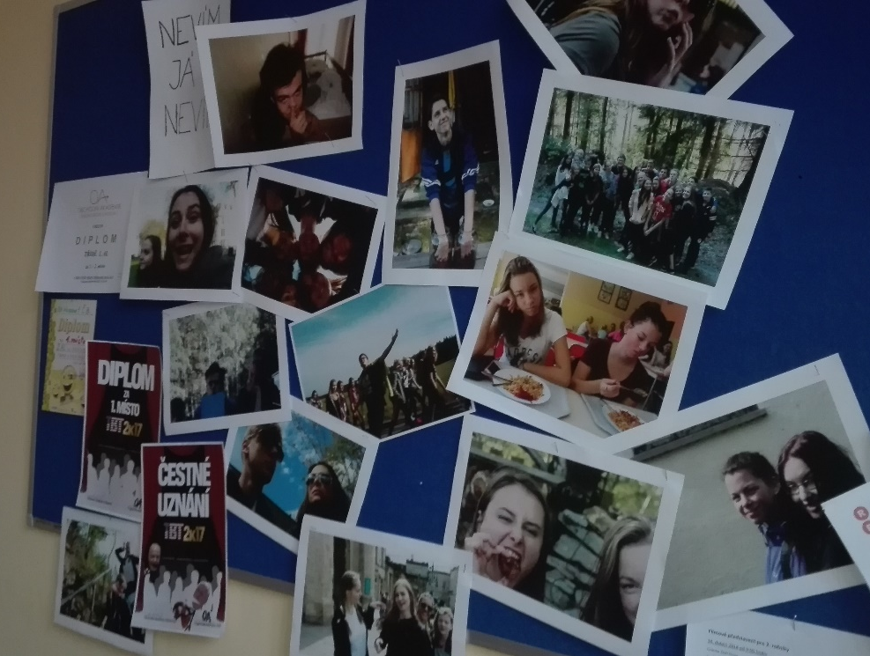
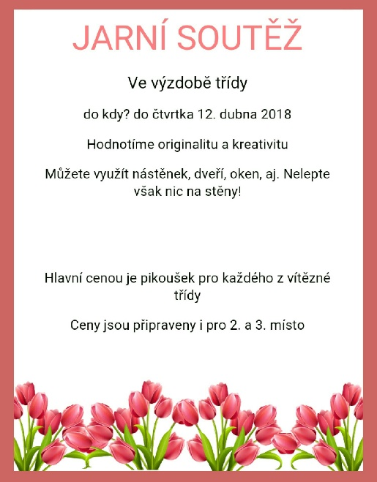
Spring competition
Students decorate their classrooms – the three best won an award

Slide 17
THANK YOU FOR YOUR ATTENTION

Slide 18
sources
https://www.google.com/search?q=obchodn%C3%AD+akademie+%C4%8Desk%C3%A9+bud%C4%9Bjovice&source=lnms&tbm=isch&sa=X&ved=0ahUKEwjk7vm86araAhUSa1AKHX2NB5wQ_AUICigB&biw=1438&bih=684&dpr=0.95#imgrc=ClxSMimZ7_KfBM:&spf=1523195519312
https://www.google.com/search?q=marketing&source=lnms&tbm=isch&sa=X&ved=0ahUKEwjug8bj8KraAhXMLVAKHakABkgQ_AUICigB&biw=1438&bih=684#imgrc=IwdT3zx0dtE7fM:&spf=1523197970094
https://www.google.com/search?q=production&source=lnms&tbm=isch&sa=X&ved=0ahUKEwjAhpbJ9qraAhVDQpoKHeycAV4Q_AUICigB&biw=1438&bih=684#imgdii=sgCr4nTcT1EjbM:&imgrc=JkqXo3g2rLBkbM:&spf=1523199034507
https://www.google.com/search?q=accountancy&source=lnms&tbm=isch&sa=X&ved=0ahUKEwi4jJrs_qraAhUMM8AKHTmLB2UQ_AUICigB&biw=976&bih=335#imgrc=WoT8aP3ZRtoc7M:&spf=1523201259477
https://www.google.com/search?q=school+radio&source=lnms&tbm=isch&sa=X&ved=0ahUKEwi36ePjgKvaAhVCCsAKHY1WCNcQ_AUICigB&biw=1438&bih=684#imgrc=oNKatFS7eBMXzM:&spf=1523201774043
https://www.google.cz/search?q=obchodn%C3%AD+akademie+%C4%8Desk%C3%A9+bud%C4%9Bjovice&source=lnms&tbm=isch&sa=X&ved=0ahUKEwiIwdehlavaAhUQElAKHXyvDMQQ_AUICigB&biw=1438&bih=684#imgdii=DQuQRy1r32RuQM:&imgrc=NV4-0H8pMMxFaM:&spf=1523207272455
https://www.google.cz/search?q=europe+map+blue&sa=X&biw=1438&bih=684&tbm=isch&source=iu&ictx=1&fir=1z0uFTBMoDJoVM%253A%252CpnS9nqVEg-g8RM%252C_&usg=__FUqQo87i6l0oAfLBl841faUHIM4%3D&ved=0ahUKEwirzNa3l6vaAhUNYlAKHUMoC8MQ9QEIMDAA#imgrc=1z0uFTBMoDJoVM:

