Slide 1



LITHUANIAN GREETINGS
Kaunas St. Kazimieras progymnasium
2020

Slide 2
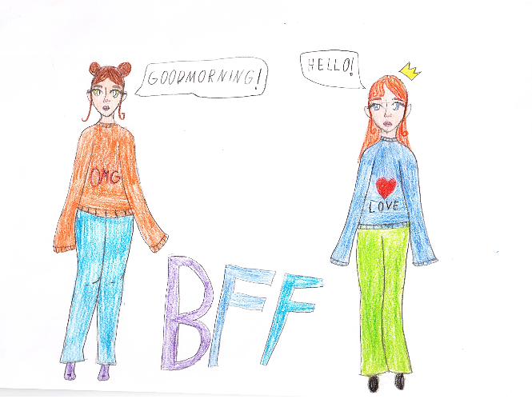

Labas! / Hello!

Slide 3
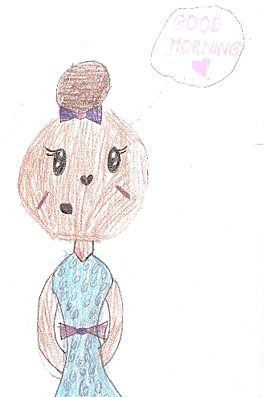
Labas rytas! / Good morning!

Slide 4
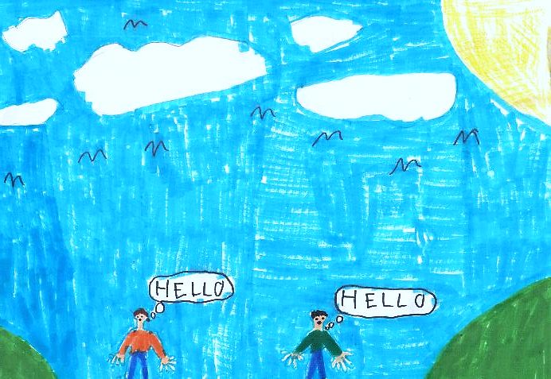
Laba diena! / Good afternoon!

Slide 5
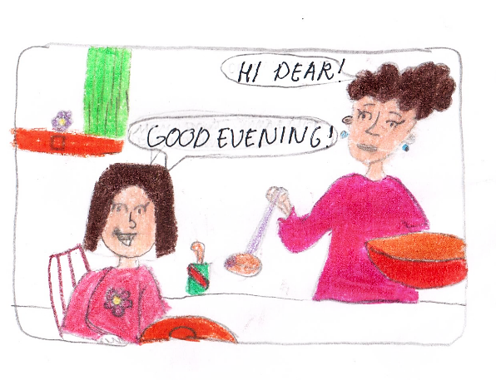
Labas vakaras! /
Good evening!

Slide 6
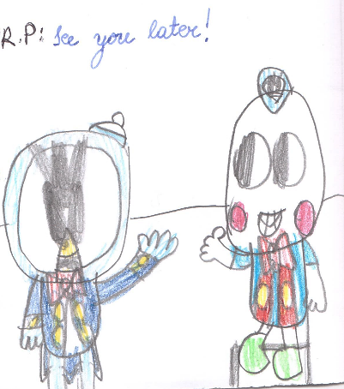
Iki! / See you soon!

Slide 7
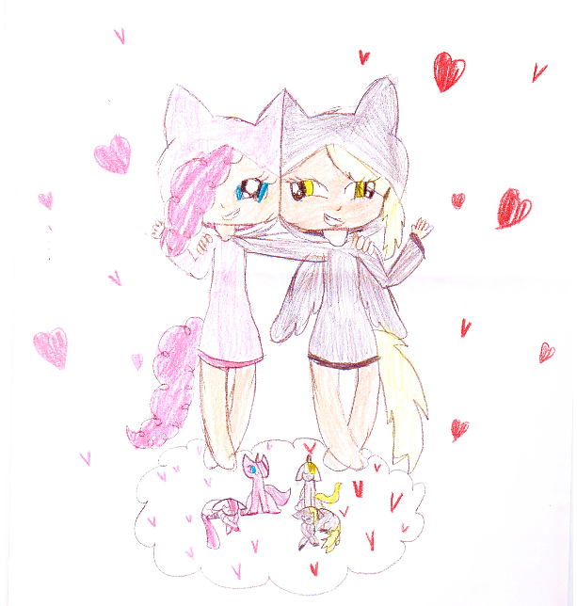
Viso gero! / Goodbye!

Slide 8
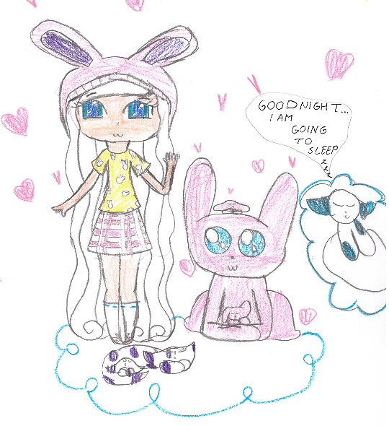
Labanakt! / Good night!

Slide 9
CREDITS
Photos and recordings
All drawings and recordings that were used in this project were created
by the pupils of Kaunas St. Kazimieras progymnasium.

