Slide 1
ITALY

Slide 2
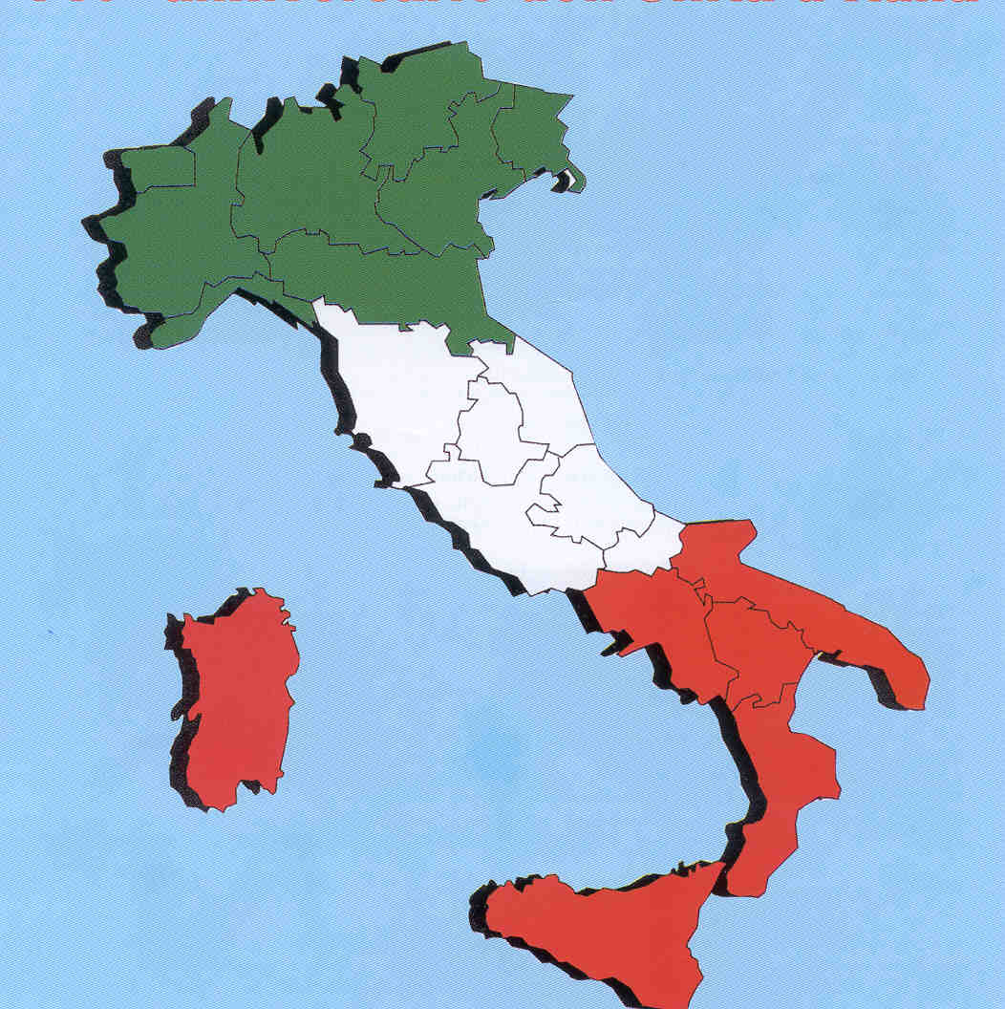
Italian physics

Slide 3
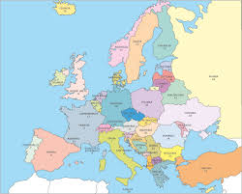
It is located in Southern Europe. It is bounded on the north by Alps and south of the Mediterranean Sea which is divided into three seas: the Tyrrhenian Sea (west), the Adriatic Sea (east) and Ionian Sea (south).
Italy is a state of the European Union which has 60.7 million inhabitants
Italy

Slide 4
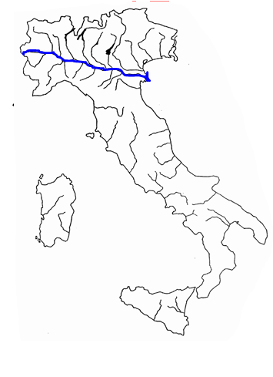
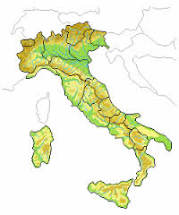
Italy is bordered to the north , from west to east, with France, Switzerland, Austria and Slovenia
SWITZERLAND
AUSTRIA
SLOVENIA
FRANCE
The longest river is the Po , which flows throughout the northeastern Italy.
The river Po is highlighted in blue.

Slide 5
Italian POLITICS

Slide 6
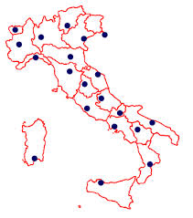
Trento
In Italy there are 20 regions; capitals are: Aosta, Turin, Milan, Trento, Trieste, Venice, Bologna, Florence, Genoa, Ancona, Perugia, Rome (the capital), L'Aquila, Campobasso, Naples, Potenza, Bari, Catanzaro, Palermo and Cagliari.
Aosta
Milan
Trieste
Venice
Turin
Genoa
Bologna
Ancona
Florence
Perugia
L’Aquila
Campobasso
ROME
Bari
Naples
Potenza
Cagliari
Palermo
Catanzaro

Slide 7
ROME, THE CAPITAL

Slide 8
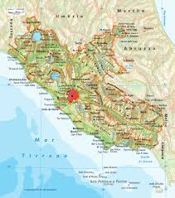
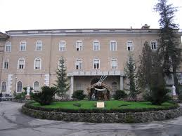
Rome is the capital of Italy, and is located in its center, in the Lazio region.
It is the city's most populous and largest in Italy, and is the seat of the papacy and of the Christian religion.
Rome is highlighted in red.
Rome is crossed by the river Tiber, where the center is the Tiber Island, where there is the hospital “Fatebenefratelli“(do good brothers)
the hospital "Fatebenefratelli".

Slide 9
U.N.E.S.C.O. IN ITALY

Slide 10
ONE MOMENT!
WHAT IS U.N.E.S.C.O.?
U.N.E.S.C.O. is: «United Nations Educational, Scientific and Cultural Organization» .

Slide 11
The list of World Heritage Sites in Italy includes 51 physical sites and 6 Masterpieces of the Oral and Intangible Heritage of Humanity Italian.

Slide 12
Theese are the sities that are in our Campania.
The Reggia di Caserta
The Amalfi Coast
The historic center of Naples - 1995
The historic center of Naples (Naples);
Capodimonte Park and Palace of Capodimonte (Naples);
Castel Sant'Elmo (Naples);
Certosa di San Martino (Naples);
Park and Villa Floridiana (Naples);
Villa Rosebery (Naples);
Public garden of Naples (Naples);
Royal Botanical Gardens (Naples);
District of Villa Manco, Our Lady of Consolation (Naples);

Slide 13
Marechiaro (light sea) (Naples);
District of Casale and Santo Strato (Naples).
Royal Palace of Caserta of the nineteenth century with the park, the aqueduct Carolino and the complex of San Leucio (Caserta and other towns)
Archaeological areas of Pompeii, Herculaneum and Torre Annunziata
Pompeii ;
Villa dei Misteri (Pompeii);
Herculaneum;
Villa dei Papiri (Herculaneum);
Roman theater of Herculaneum (Herculaneum);

Slide 14
Villa A (Poppea) (Torre Annunziata);
Villa B (Torre Annunziata);
Amalfi Coast (various municipalities) - 1997.
Parco Nazionale del Cilento, with the archaeological sites of Paestum and Velia, and the Certosa di San Lorenzo - 1998
Paestum, Velia, the Certosa di San Lorenzo, Mount Cervati and Vallo di Diano (various municipalities);
Region of Punta Licosa and Monte Stella (various municipalities);
Region of Palinuro, Punta Infreschi and Mount Bulgheria (various municipalities).
The monumental complex of Santa Sofia with the Sannio Museum (Benevento)

Slide 15
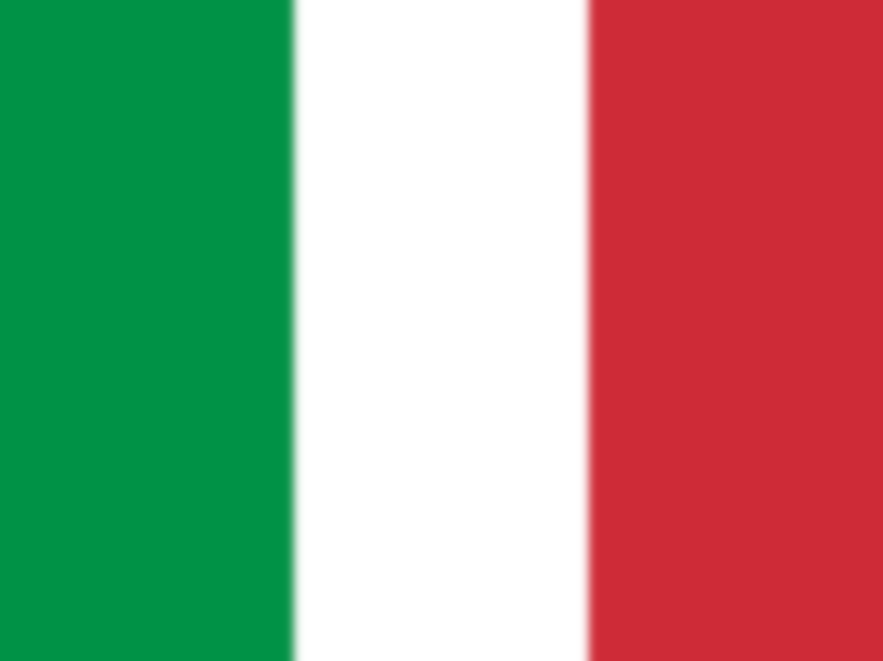
THE END

