Slide 1
VALUES EDUCATION
IN TALATPASA SECONDARY SCHOOL

Slide 2
VALUES ON BELOW ARE CARED AS A SCHOOL, AS A EDUCATIONAL INSTITUTION.
TOLERANCE AND PEACE
FRIENDSHIP
RESPECT (ESPECIALLY DIVERSITY AND DIFFERENCIES)
HELPING EACH OTHER

Slide 3
HONESTY
COLLABORATION
RESPONSIBILITY
SHARING

Slide 4
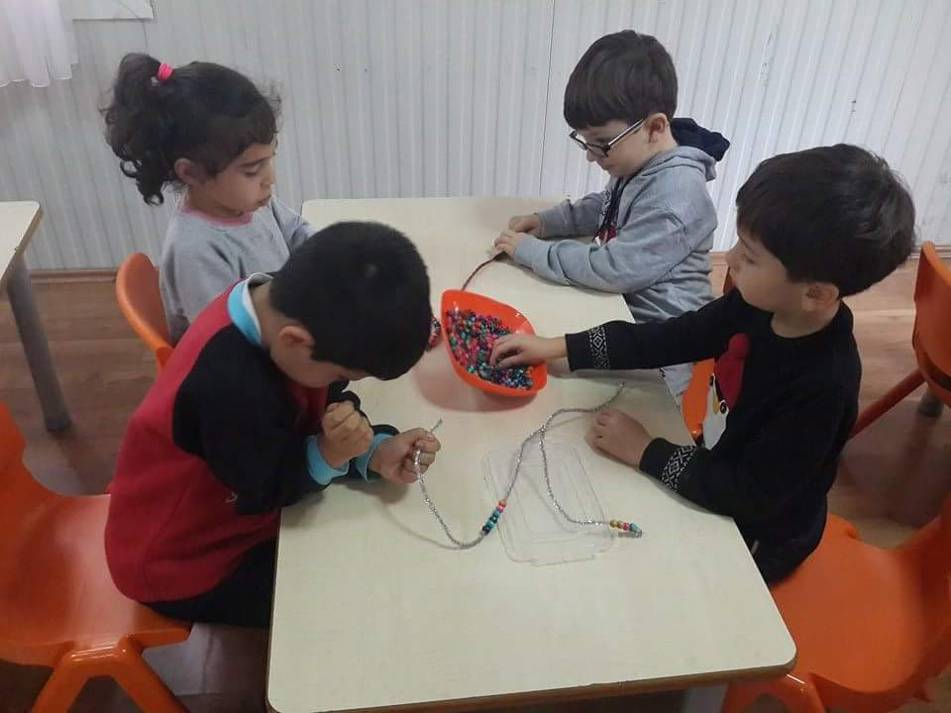
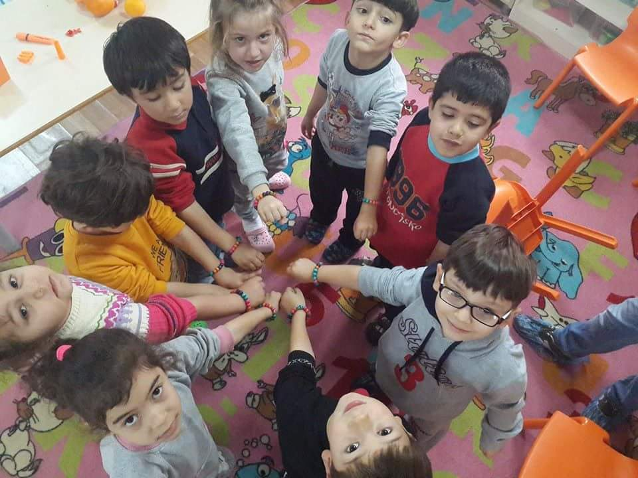
HOW DO WE TEACH THESE VALUES?
We made wristband of friendship together for teaching tolerance and friendship.

Slide 5
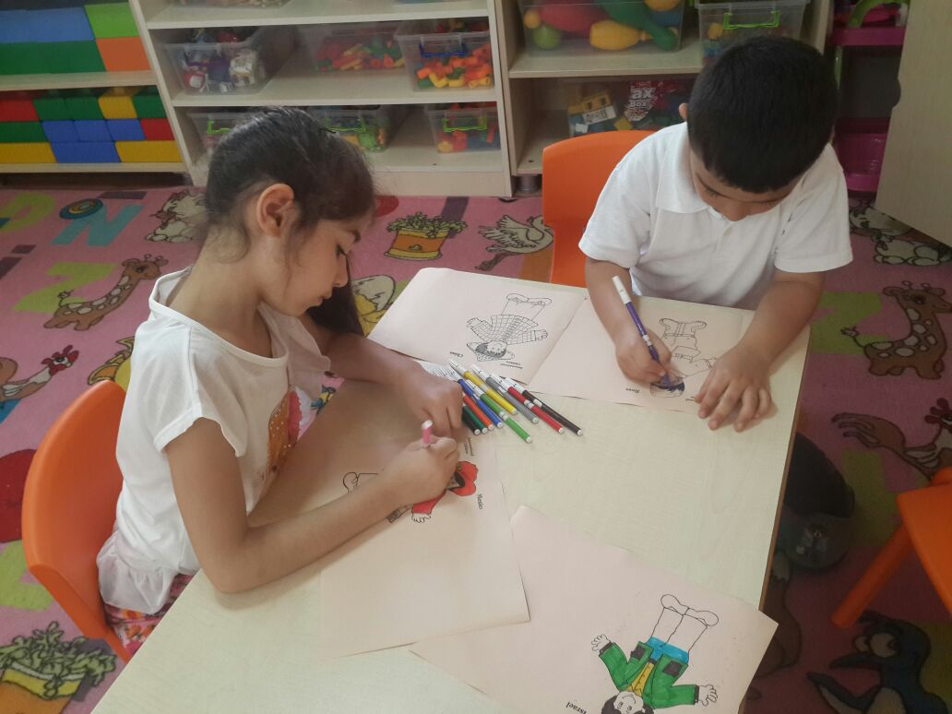
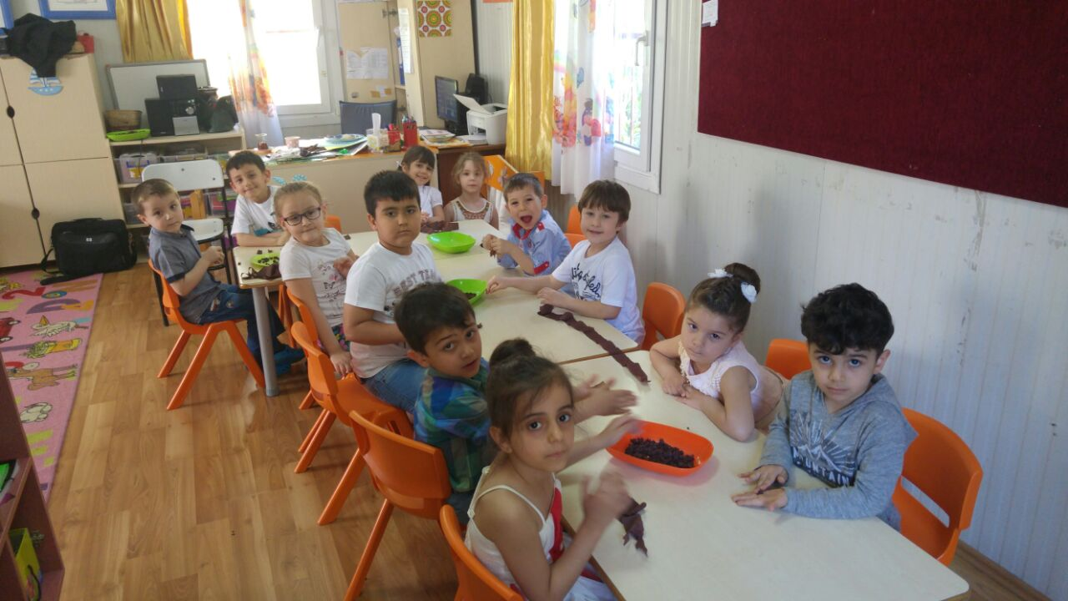
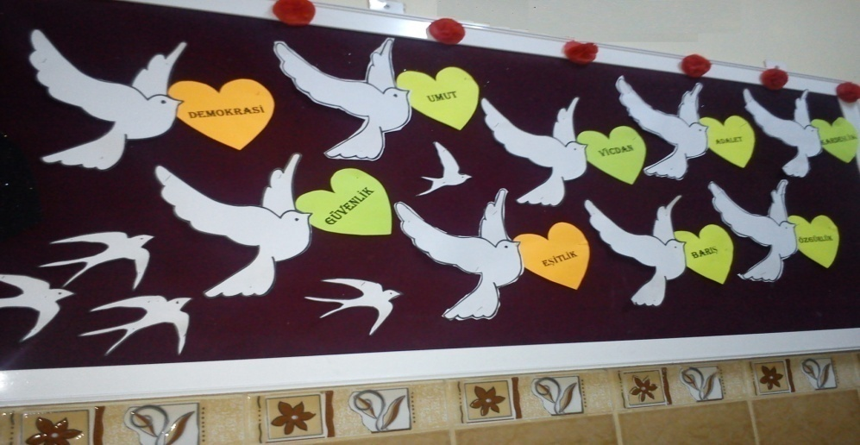
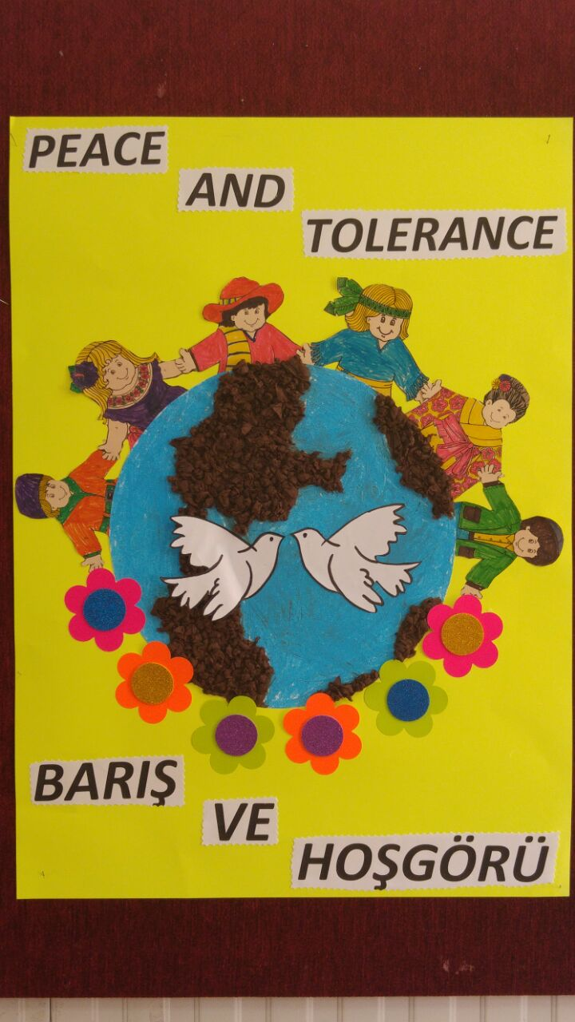
TOLERANCE AND PEACE
OUR PUPILS DID PAINTINGS BOARDS OF PEACE AND TOLERANCE.

Slide 6
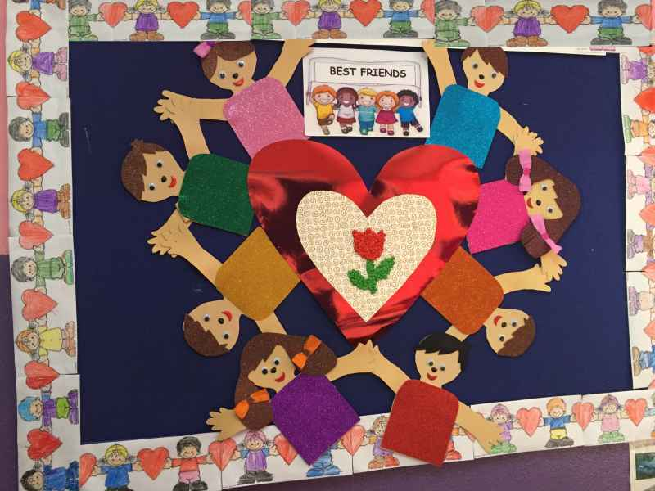
FOR FRIENDSHIP
We did BOARD OF BEST FRIEND in our classrooms.
Our pupils made friendship tree which has their handprint on it.

Slide 7
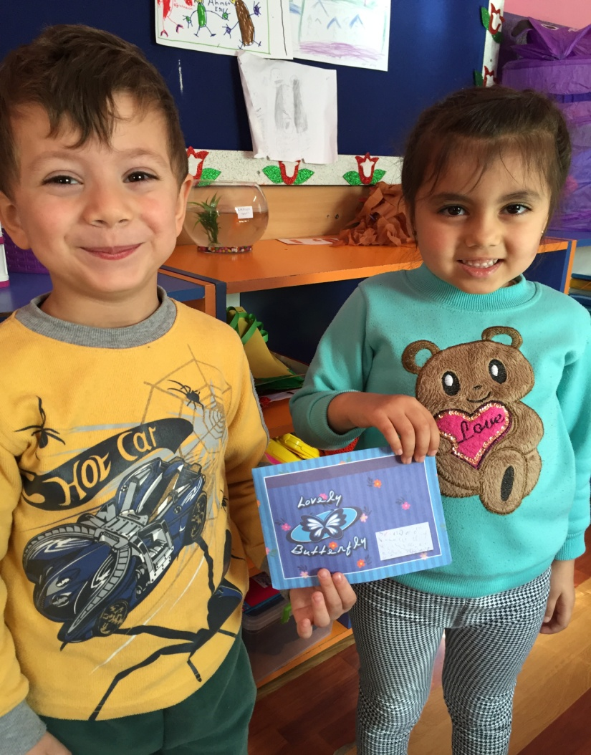
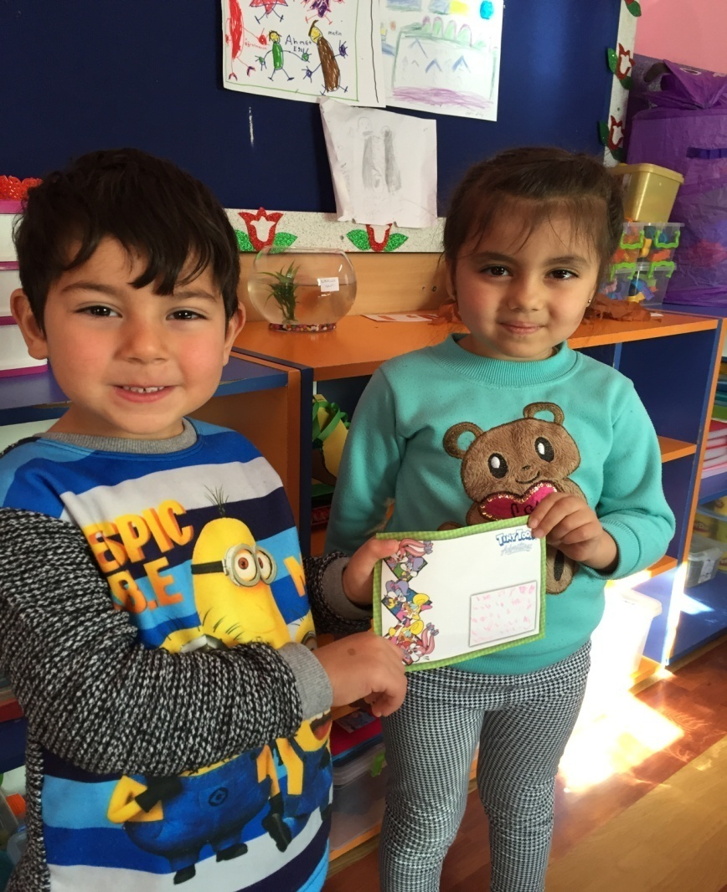
LETTERS WERE WRITTEN FROM FRIEND TO FRIEND FOR STRONG AND GOOD RELATIONSHIP.

Slide 8
RESPECT (ESPECIALLY DIVERSITY AND DIFFERENCIES)
TRAFFIC DRAMA
THEY ARE IN THE BUS
THEY HAVE BEEN TEACHING RESPECT OTHER PEOPLE

Slide 9
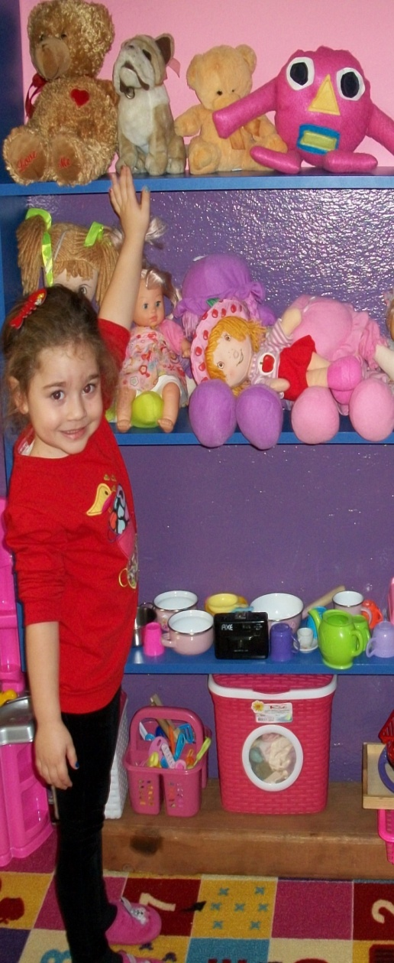
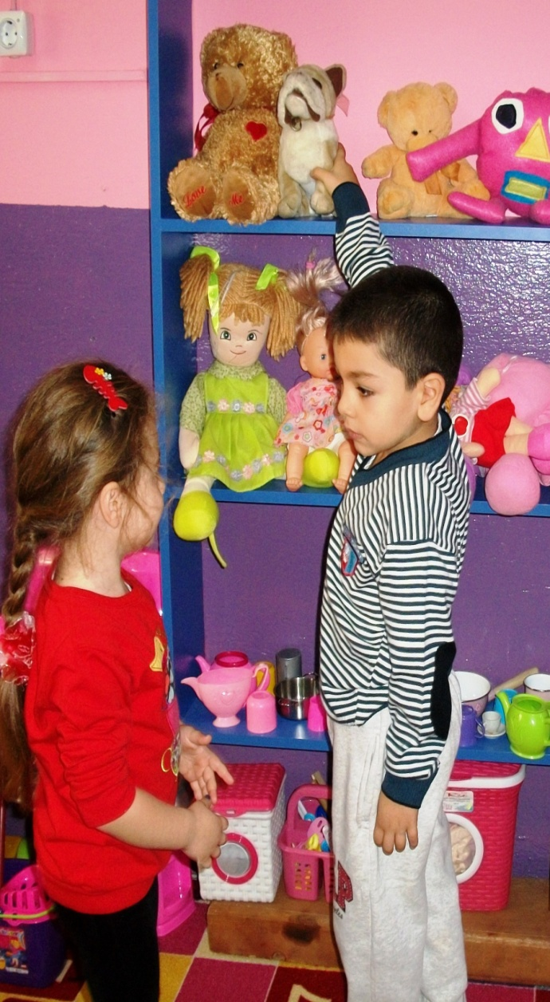
HELPING EACH OTHER
OUR PUPILS LEARN VALUES EVERY WHERE AND EVERY TIME OUR KINDERGARTEN

Slide 10
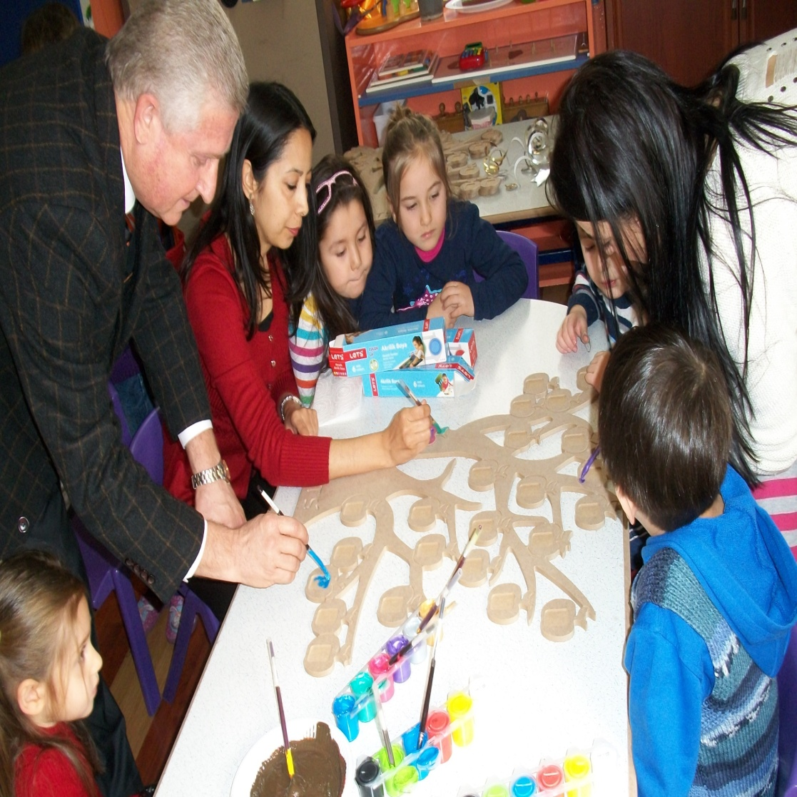
COLLABORATION
WE DID ALL TOGETHER VALUES TREE FOR TEACH COLLABORATION TO OUR PUPILS

Slide 11
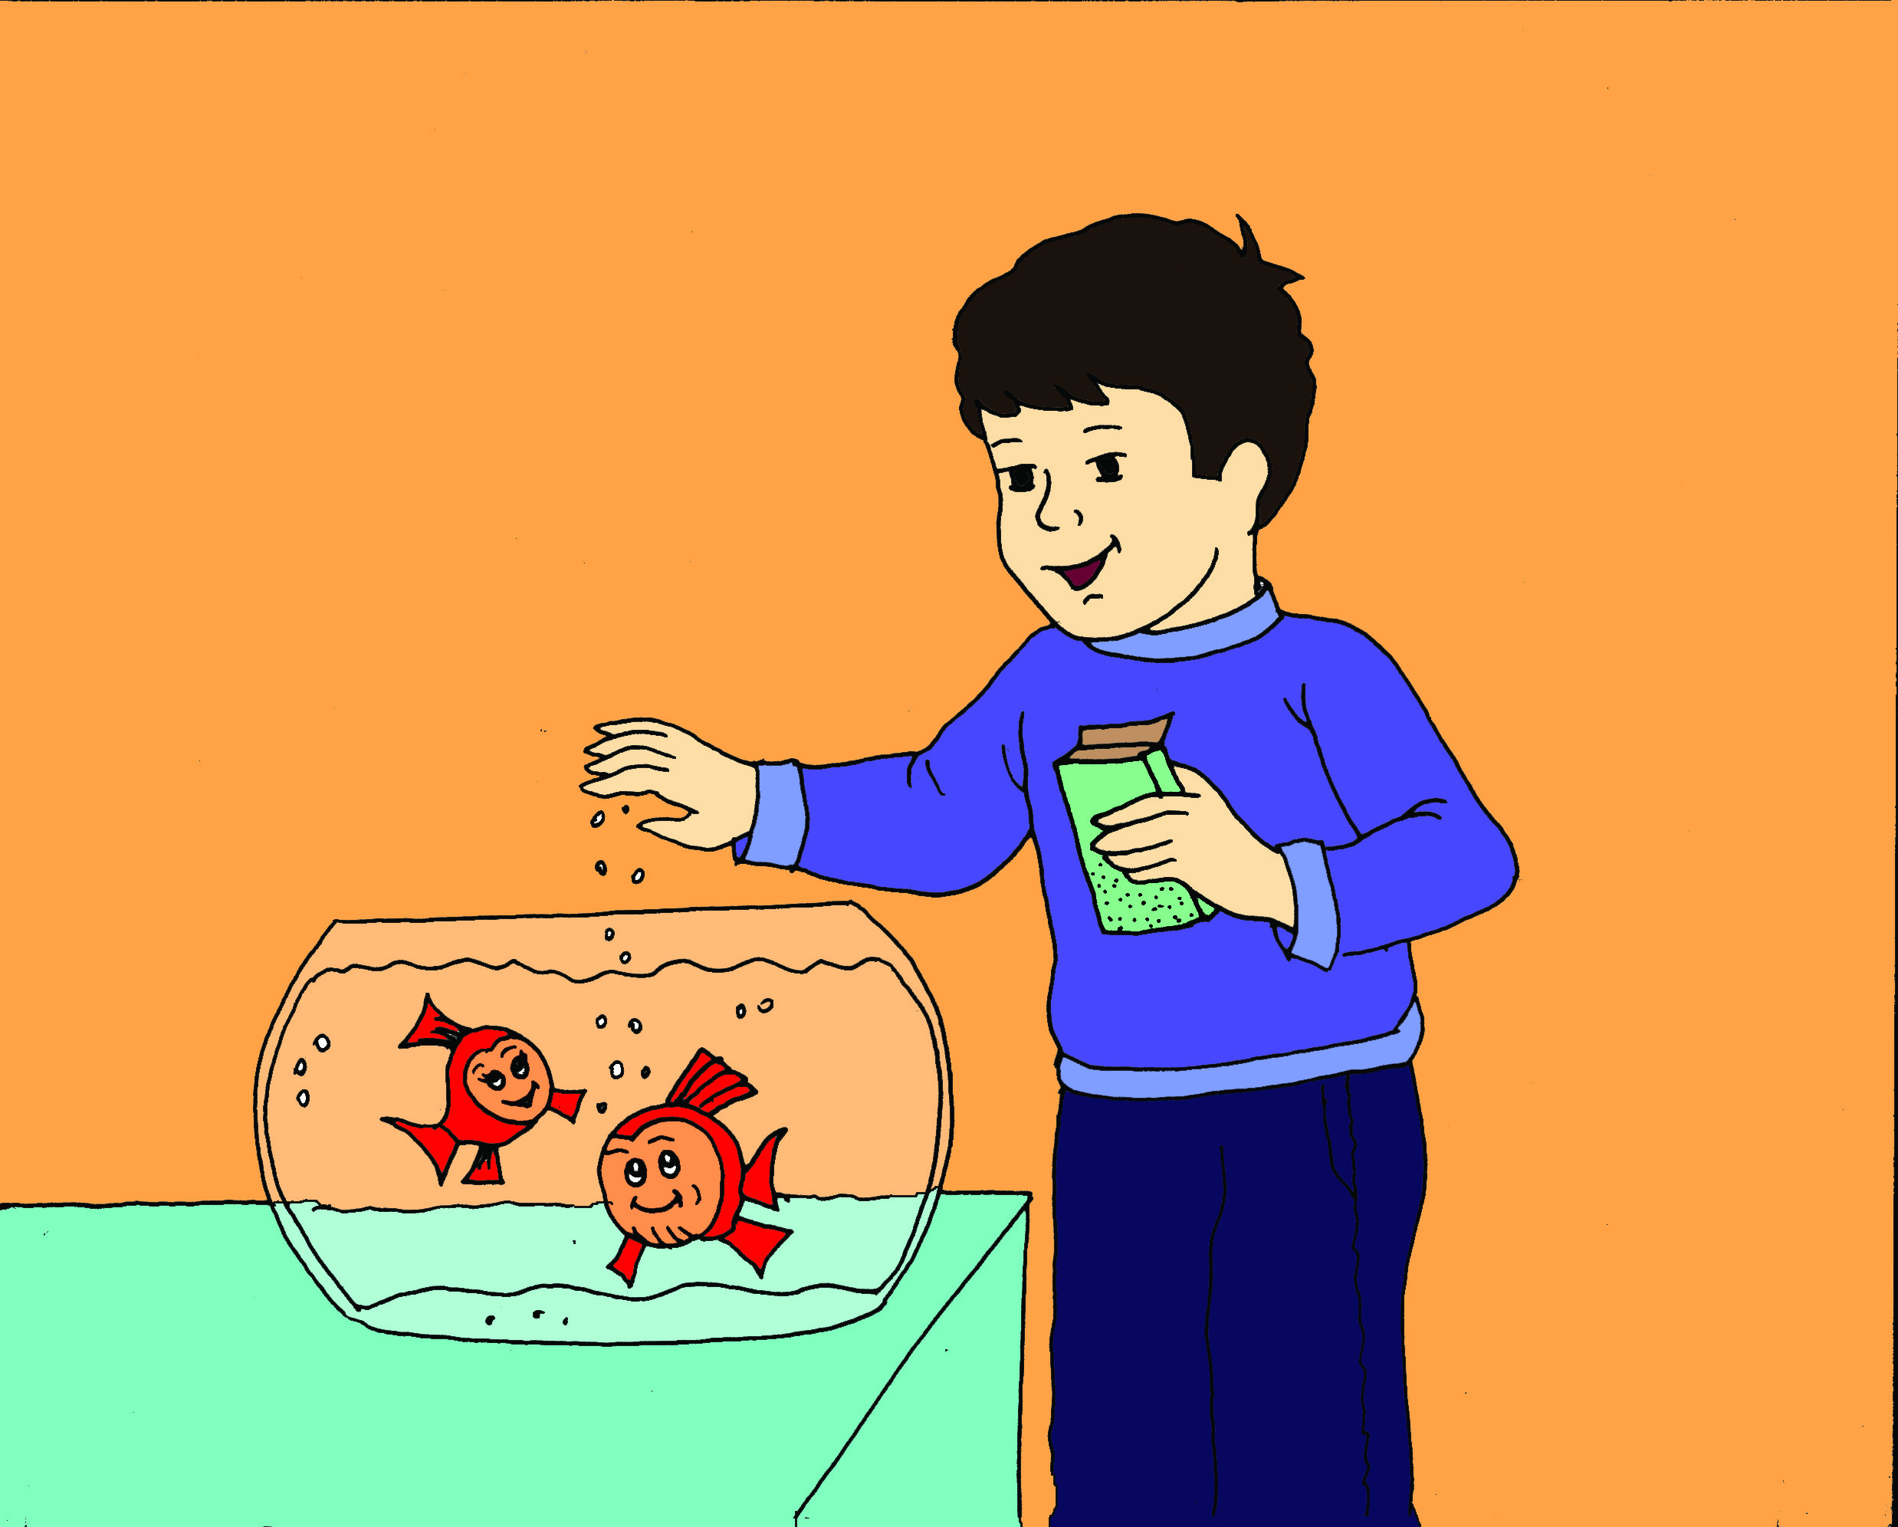
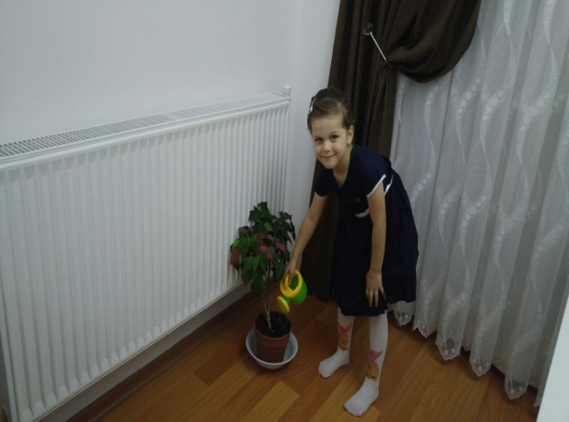
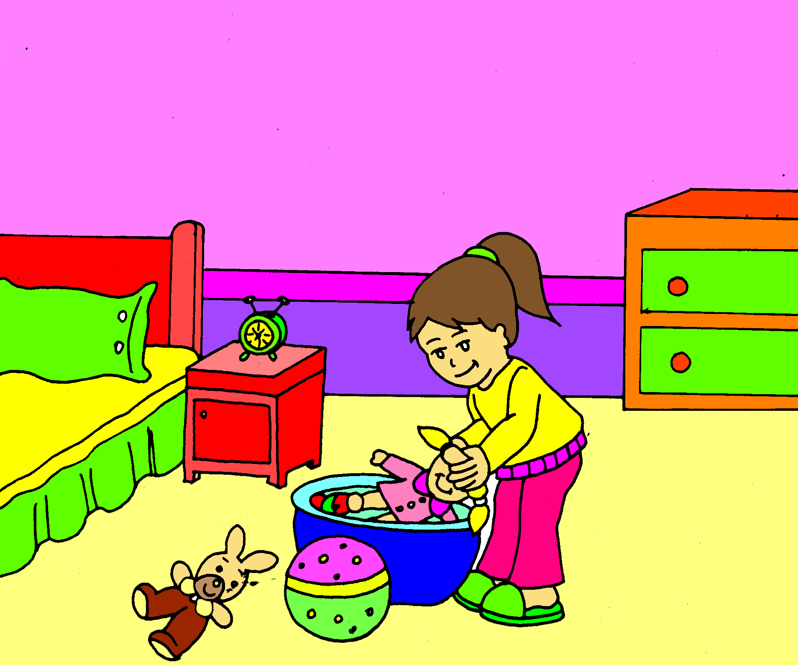
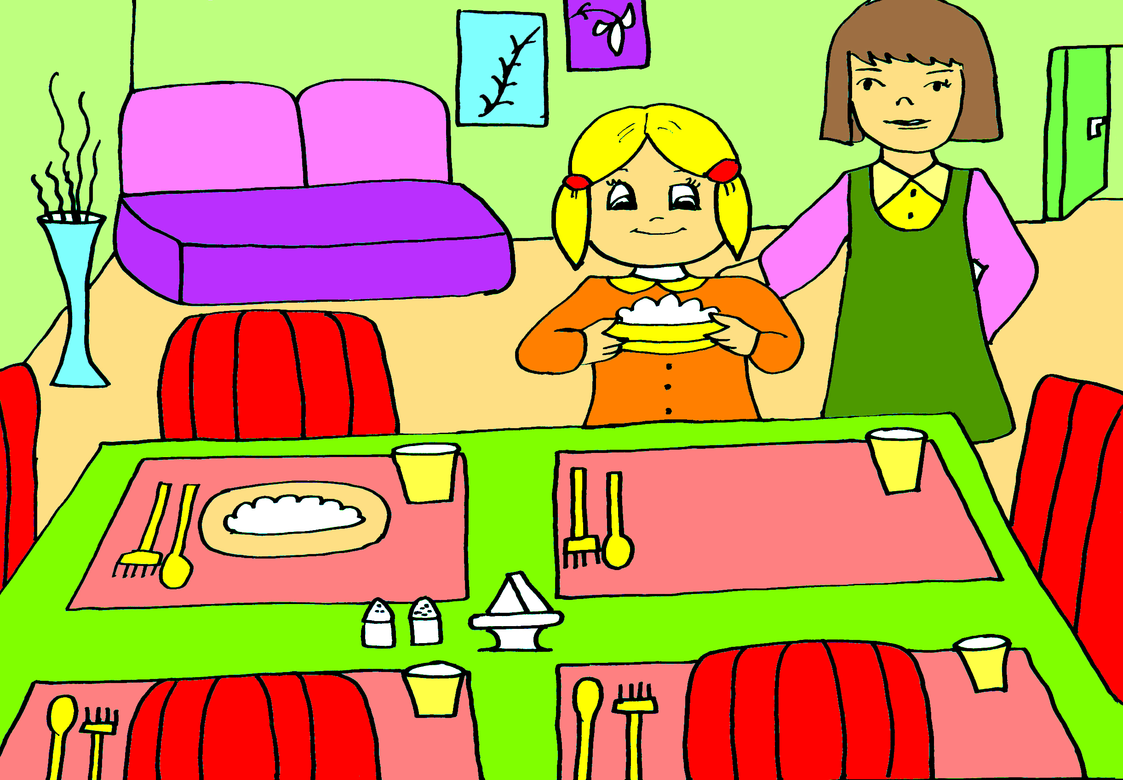
RESPONSIBILITY
THEY LEARN THEIR RESPONSIBI-LITIES WITH LITTLE THINGS
THESE THINGS ARE LITTLE FOR US BUT THESE ARE BIG THINGS FOR THEM.

Slide 12
KNOWN A STORY FOR BRAKE PREJUDICES…
SHARING AND FRIENDSHIP

