Slide 1
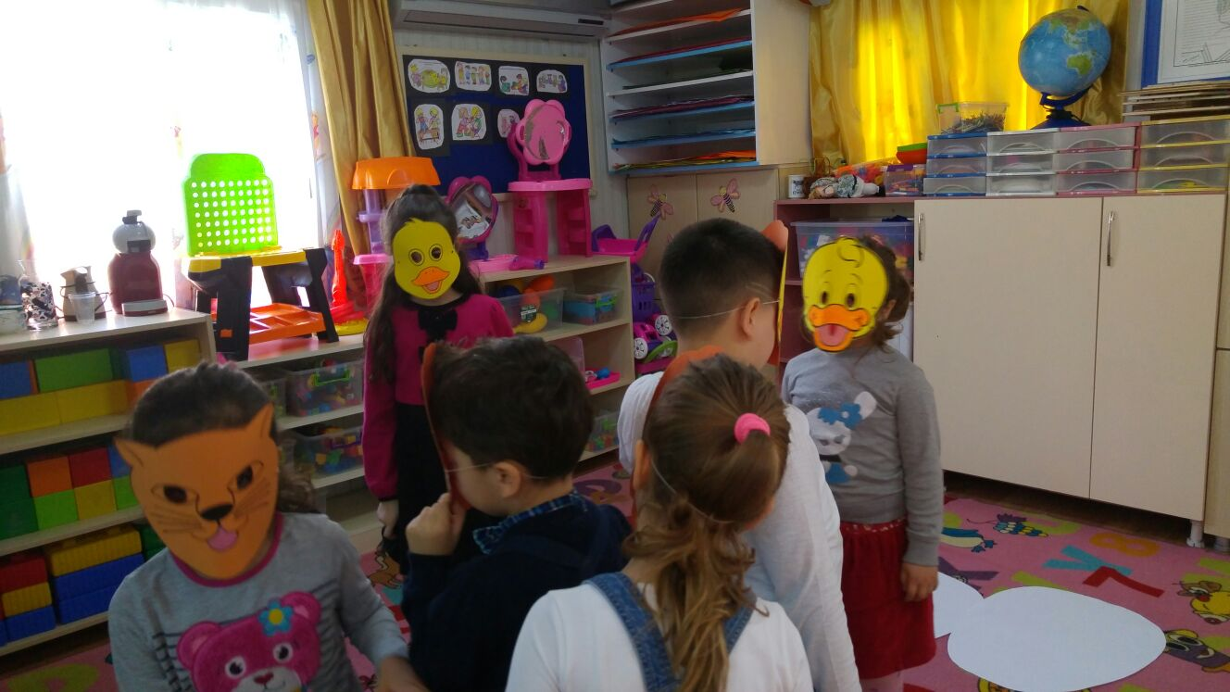
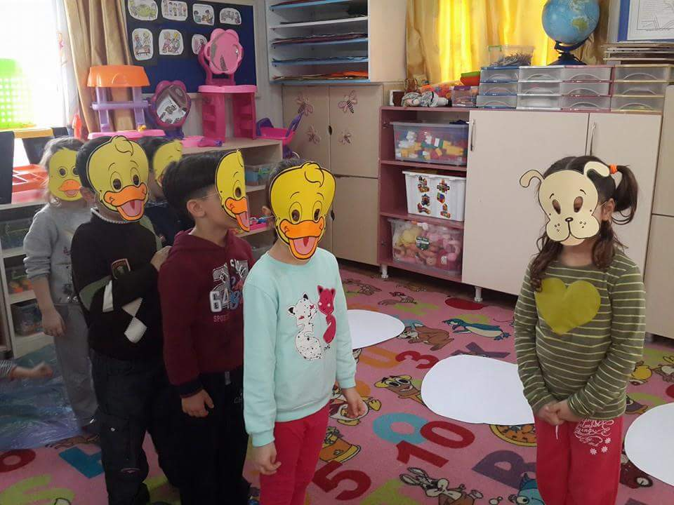
UGLY DUCKLING
IN OUR CLASSROOM

Slide 2
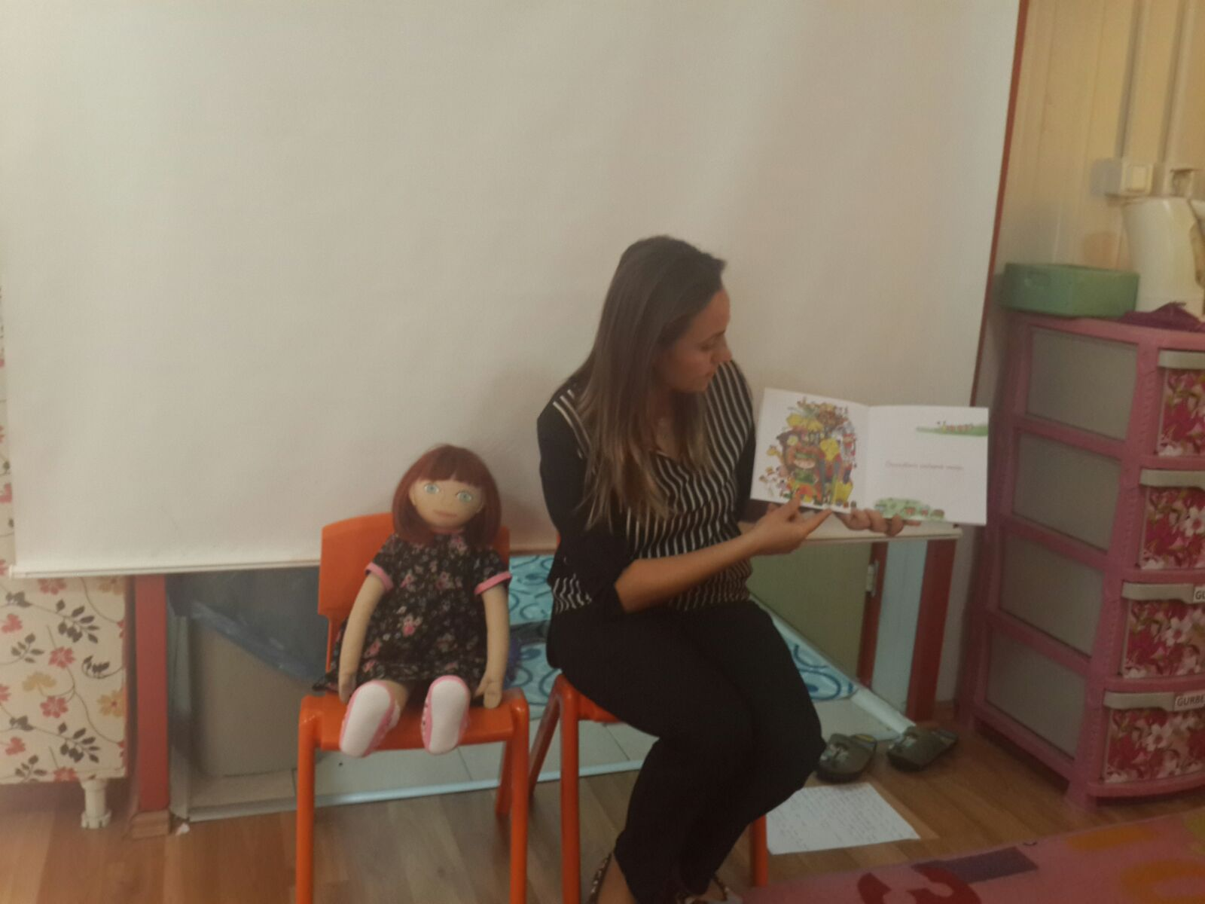
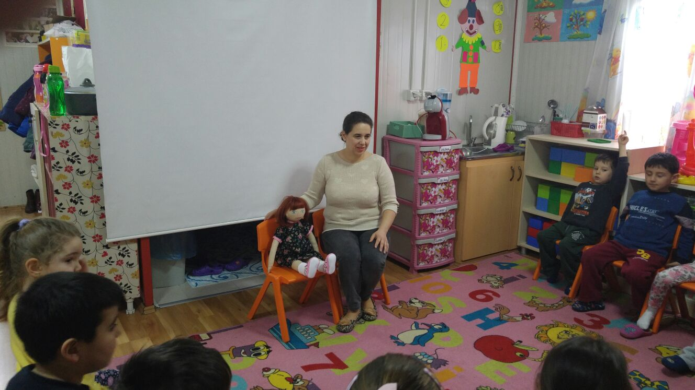
WE TOLD THE STORY OUR PUPILS.

Slide 3
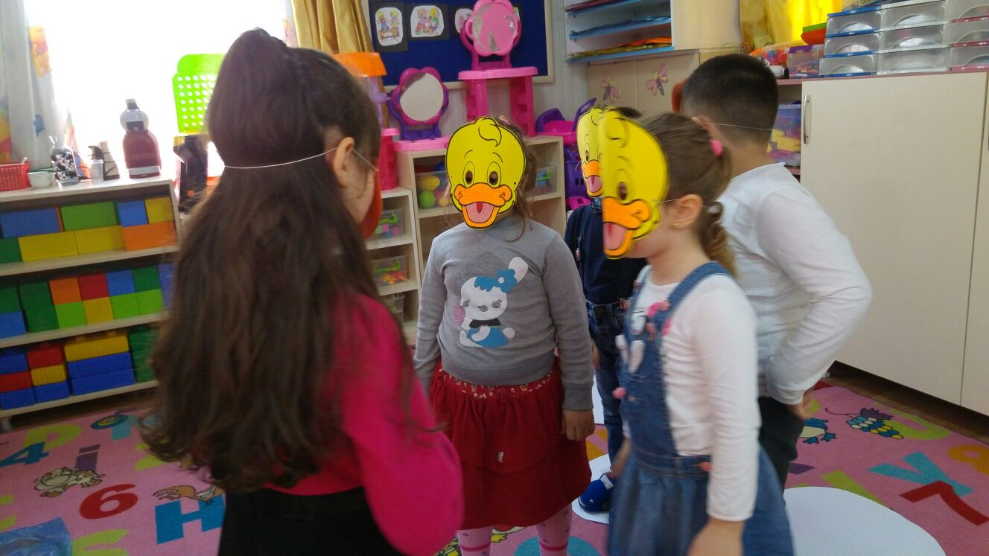
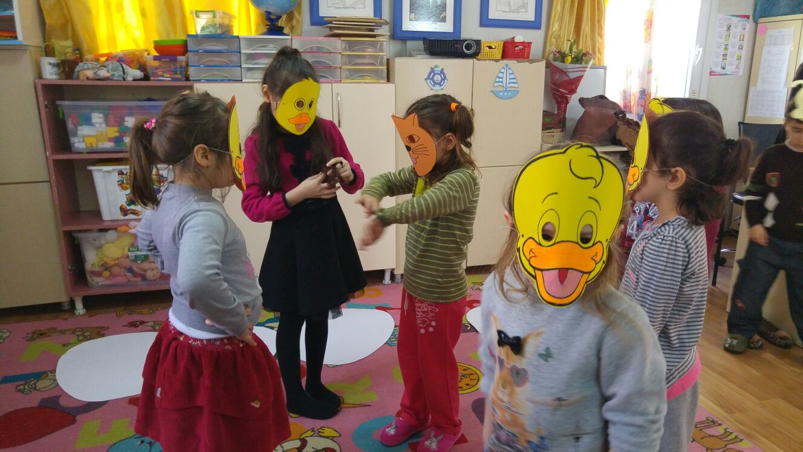
WE SHARED ROLES FOR DRAMA.

Slide 4
AND SHOW BEGINS…

