Slide 1
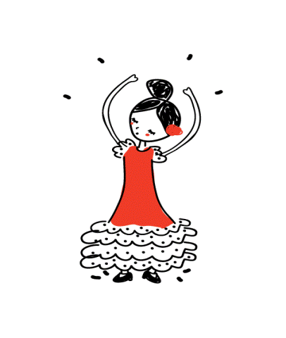
Erasmus+ “EVERY CHILD IS SPECIAL”
Activities after Spain

Slide 2
the teacher wearing traditional Spanish dress

Slide 3
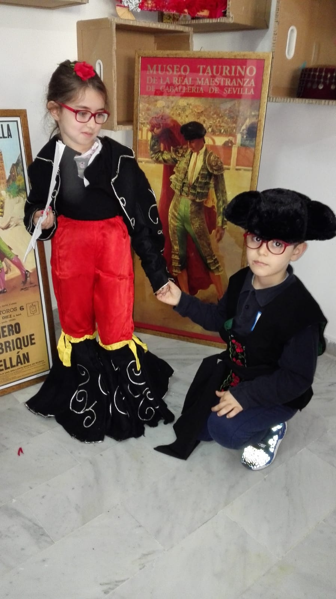
Spanish costumes

Slide 6
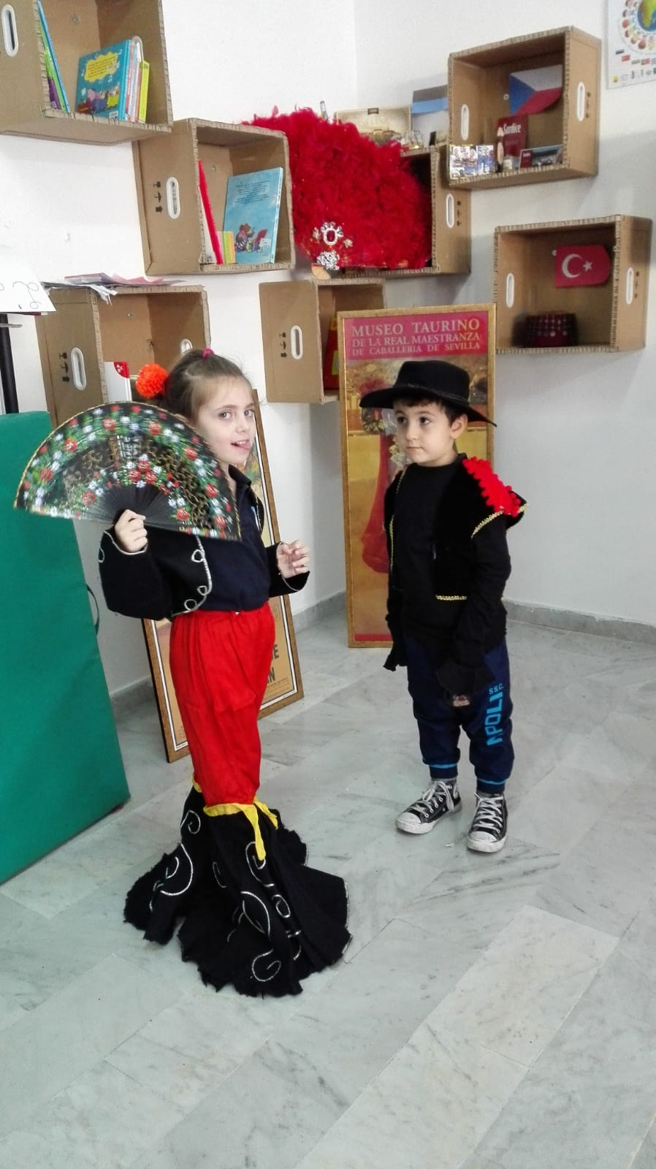

Slide 9
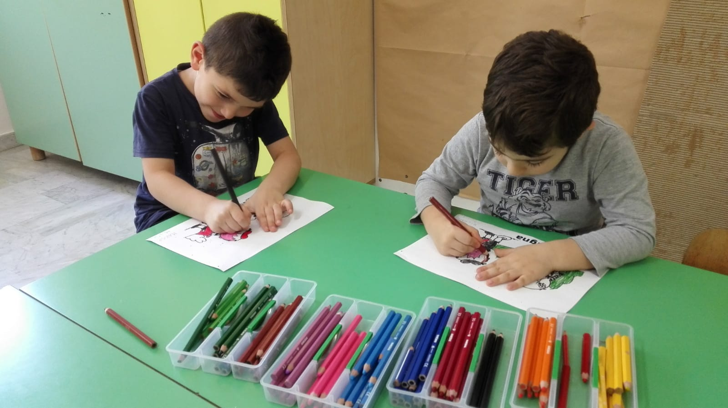
Great friendship with Bulgarian friends

Slide 10
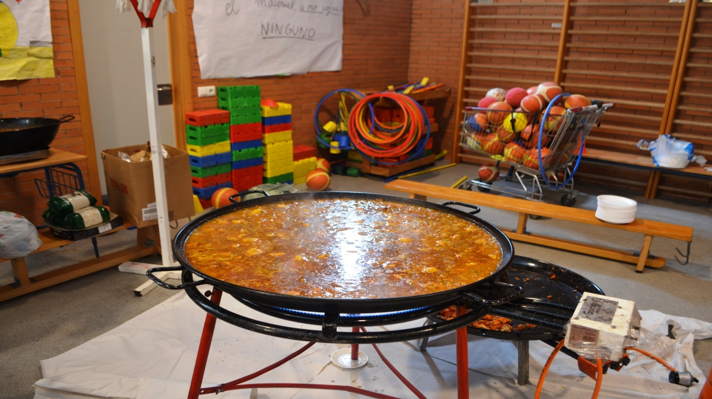
PAIELLA

Slide 11
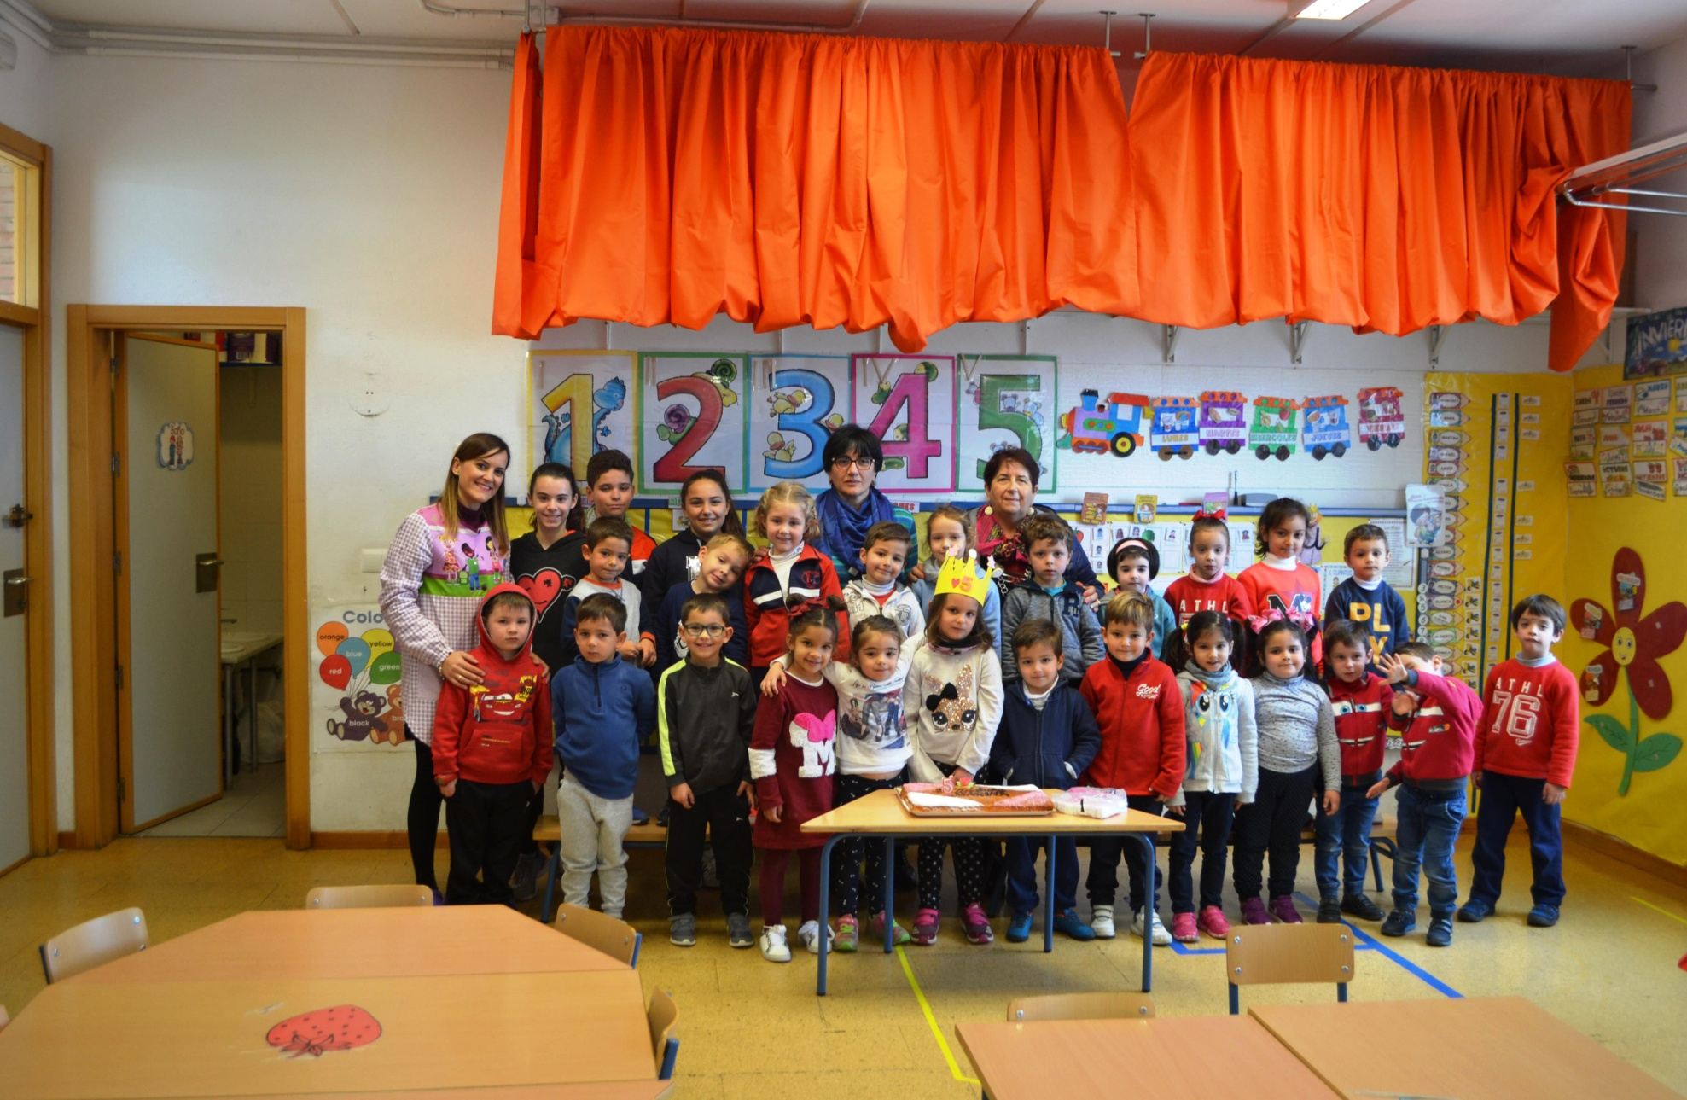

Slide 12
