Slide 1
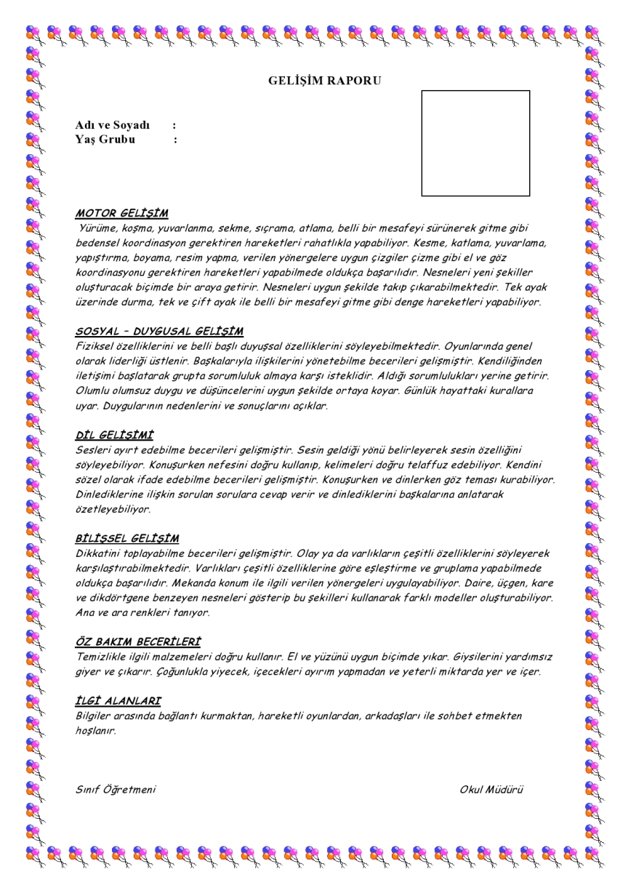

Slide 2
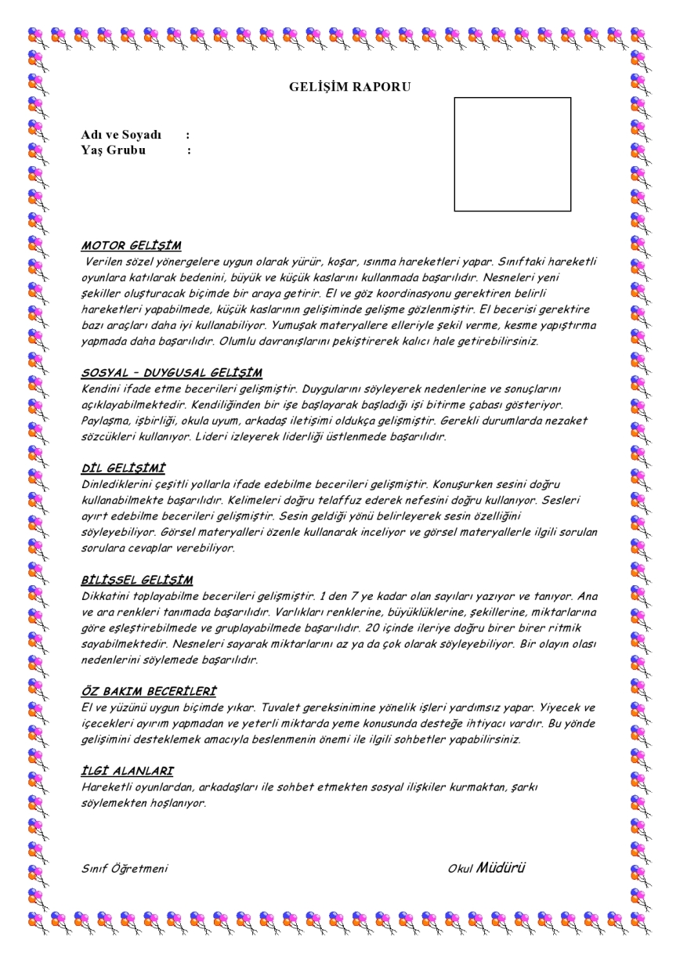

Slide 3
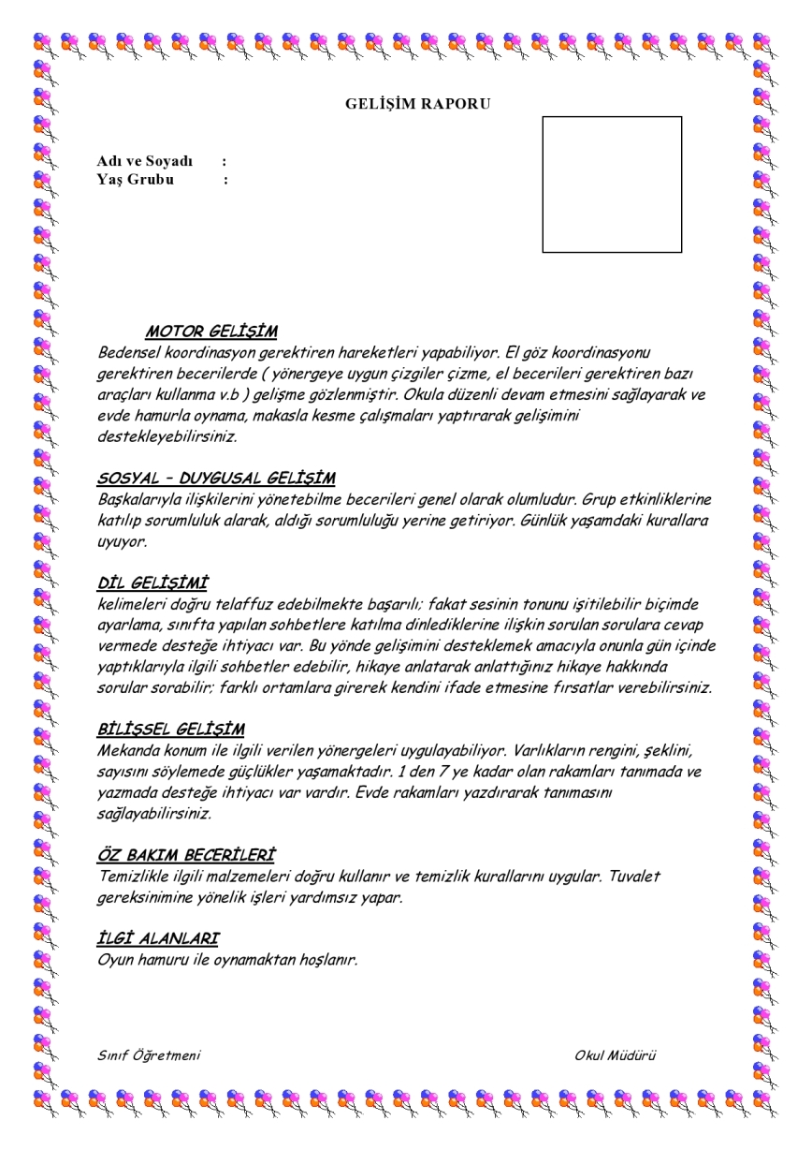

Slide 4
PROGRESS REPORT
MOTOR PROGRESS
SOCIAL – EMOTIONAL PROGRESS
ABLE TO MAKE MOVE THAT NEED TO COORDINATION OF BODY
EXAMPLES
PLAYING DOUGH
CUTTING WITH SCISSORS
ABLE TO MANAGE SKILLS RELATIONSHIP OTHER PEOPLE
ABLE TO GAIN RESPONSES IN GROUP ACTIVITIES
ABLE TO ABIDE BY DAILY RULES
EXAMPLES
GROUP GAMES,CINEMA,THEATER,DRAMA

Slide 5
LANGUAGE PROGRESS
COGNITIVE PROGRESS
ABLE TO PRONOUNCIATE
ATTEND CONVERSATION
ABLE TO LISTEN STORY
ABLE TO TELL THAT STORY
ABLE TO ASK QUESTIONS ABOUT STORY
ABLE TO PRACTISE DIRECTION THAT IS BEING GIVEN ANY PLACE
ABLE TO SAY COLOUR,SHAPE,NUMBER OF EXISTENCES.
ABLE TO COUNT NUMBERS

Slide 6
PERSONAL CARE SKILLS
ABLE TO USE TOOLS CLEANING
ABLE TO EAT OWN MEAL
ABLE TO USE TOILET PROPERLY

