Slide 1
Teaching children cultural awarenes

Slide 2
In our curriculum one of issues is patriotic education, which has to enhance cultural, historical and national adherence and cultural identity of children.
Act on the Educational System (September 7, 1991)
“Education and upbringing has to enhance responsibility, patriotic feelings and respect towards Polish cultural heritage together with openness to the values of European and global cultures. School is obliged to provide conditions needed in development of every pupil, prepare pupils to fulfill their family and civil obligations in accordance with rules of solidarity, democracy, tolerance, justice and freedom.”

Slide 3
In our work, we are trying:
to teach children respect to their country and national symbols;
to build social awareness and bonds with other people;
to develop sense of security;
develop respect for family and family traditions;
to popularize ability to cooperate;
to shape attitude of openness and understanding to other cultures.

Slide 4
We realize those aims by:
Singing songs;
Meeting cultural workers;
Participation in museum lessons;
Creating various artwork;
Reading legends from different countries;
Actions taken in cooperation with local environment;
Meetings with parents;
Excursions to historical places, important to Polish culture;
Engagement in various social projects;
Realization of international projects aiming to acquaint children with cultural variety.

Slide 5
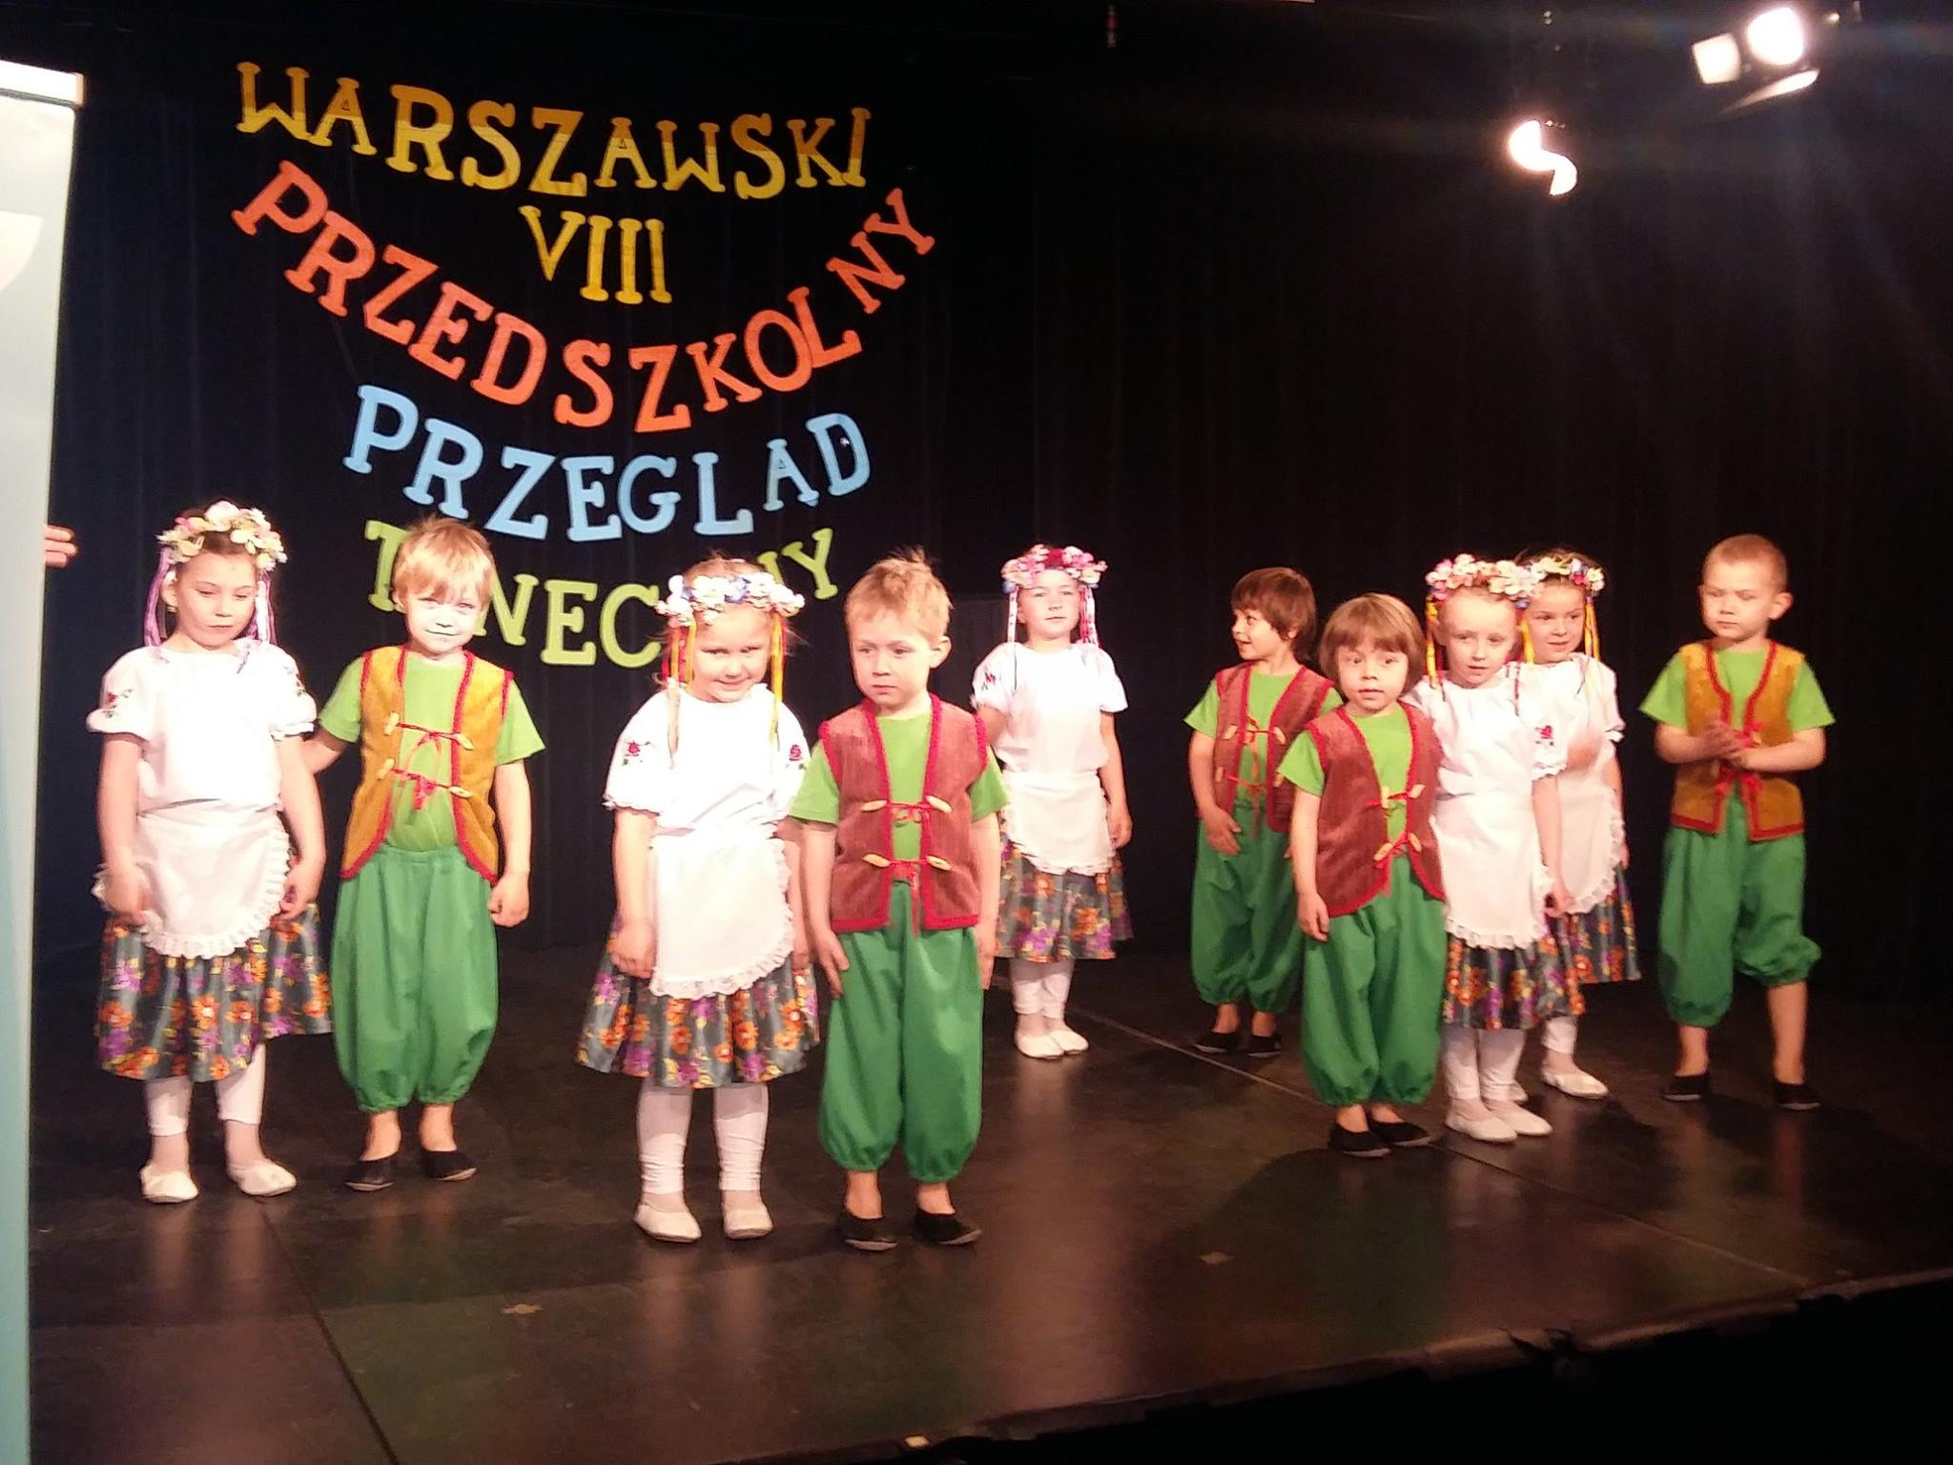
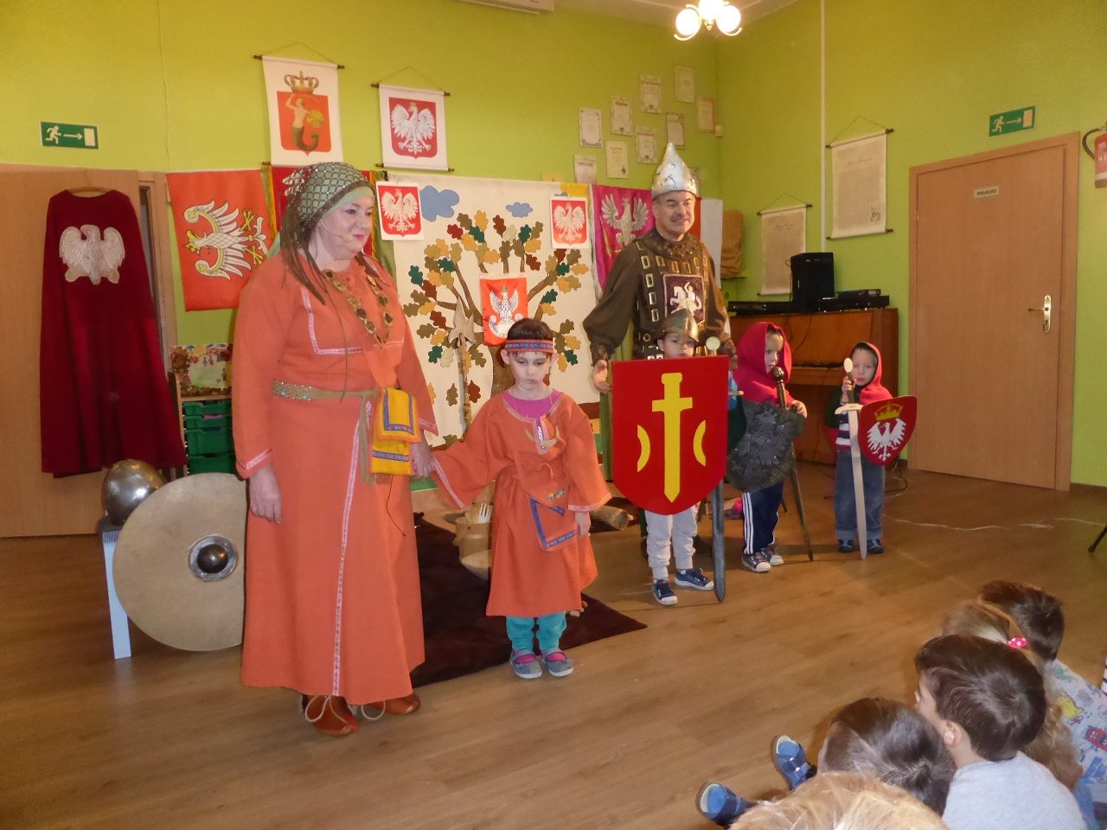
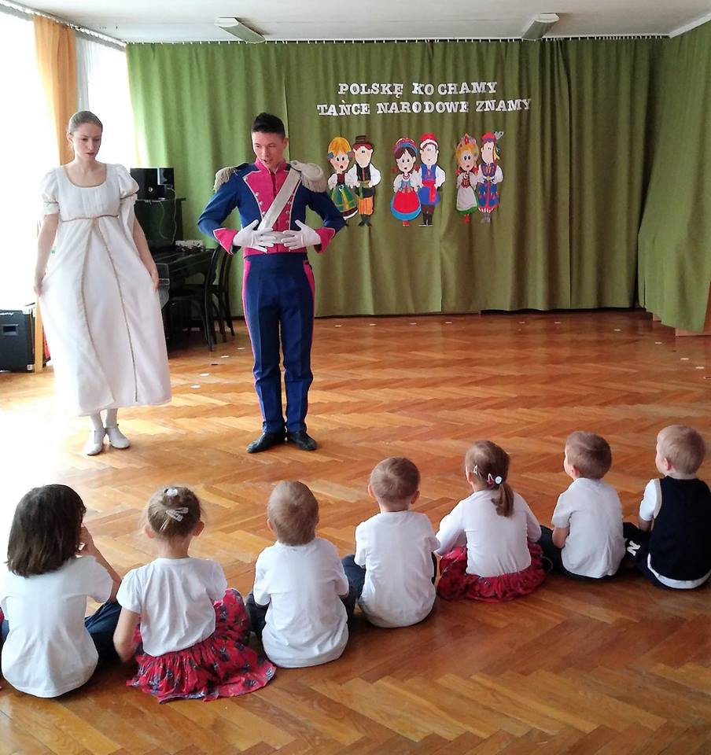
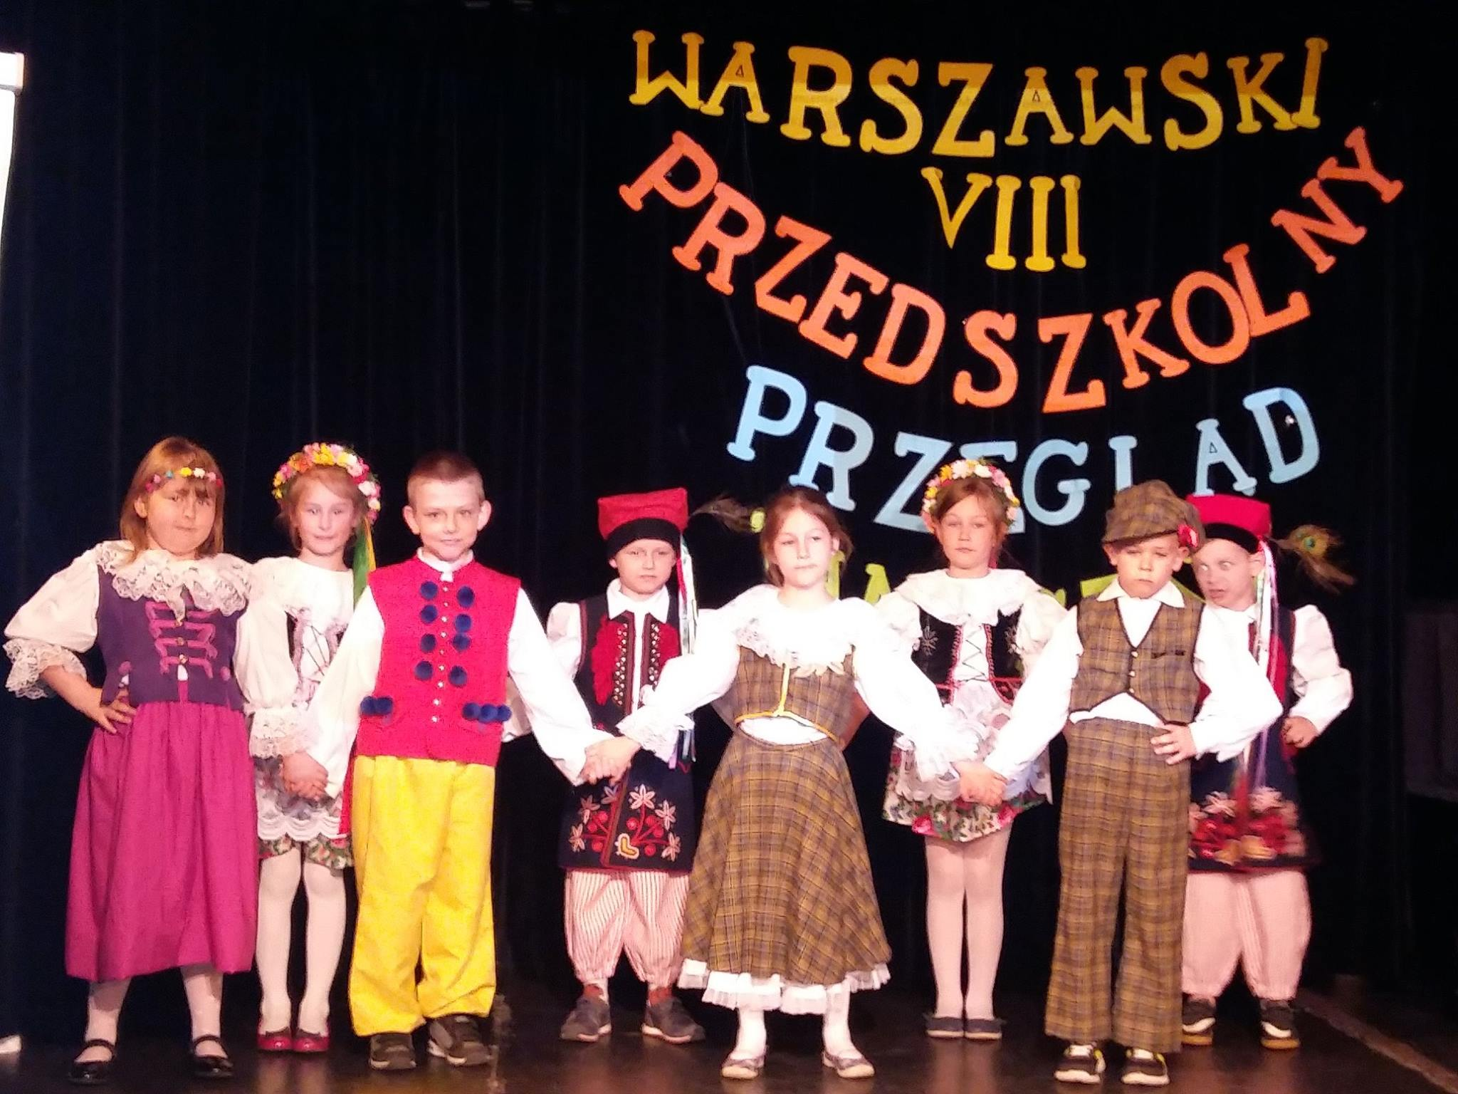

Slide 6
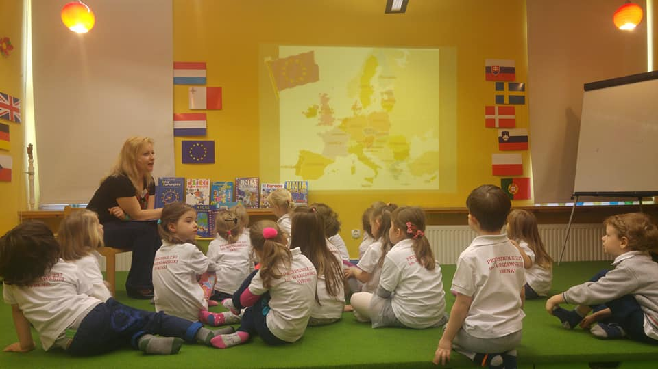
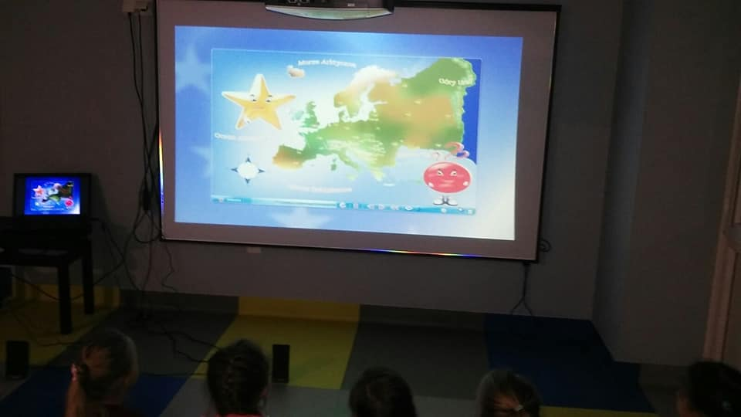
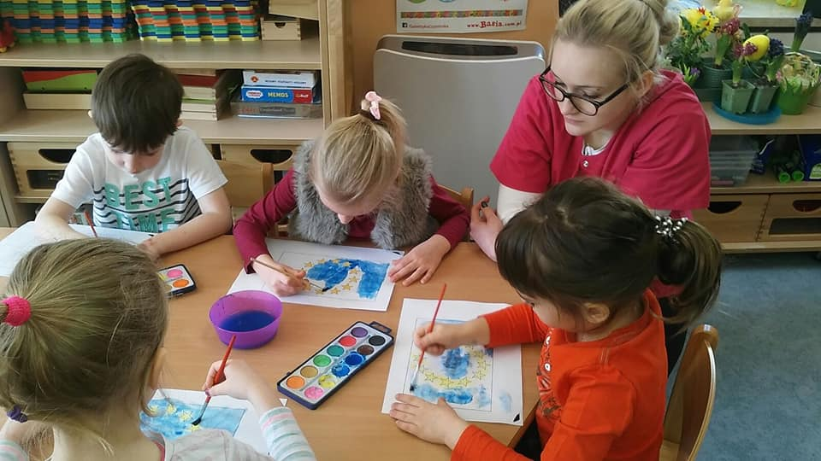
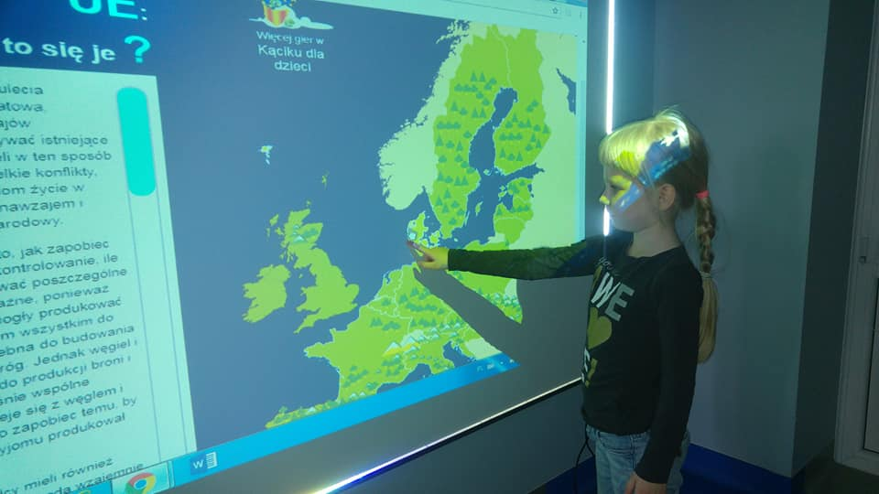
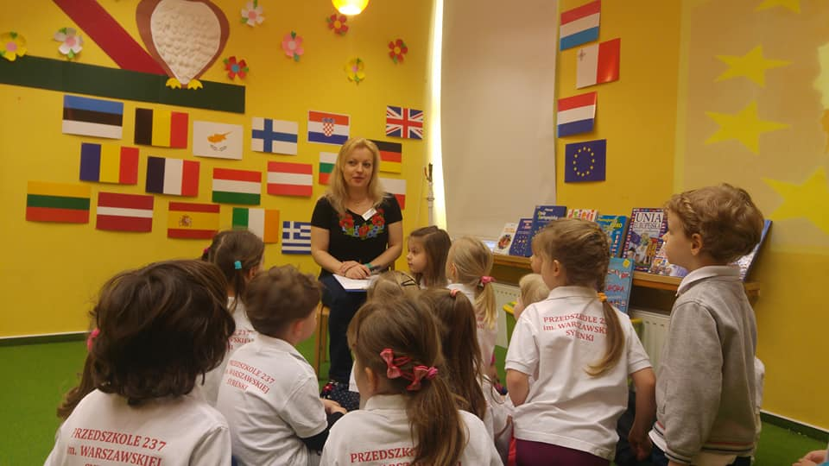

Slide 7
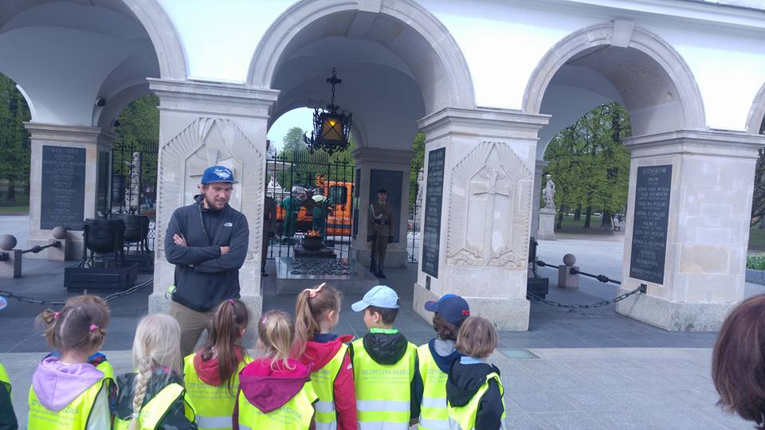
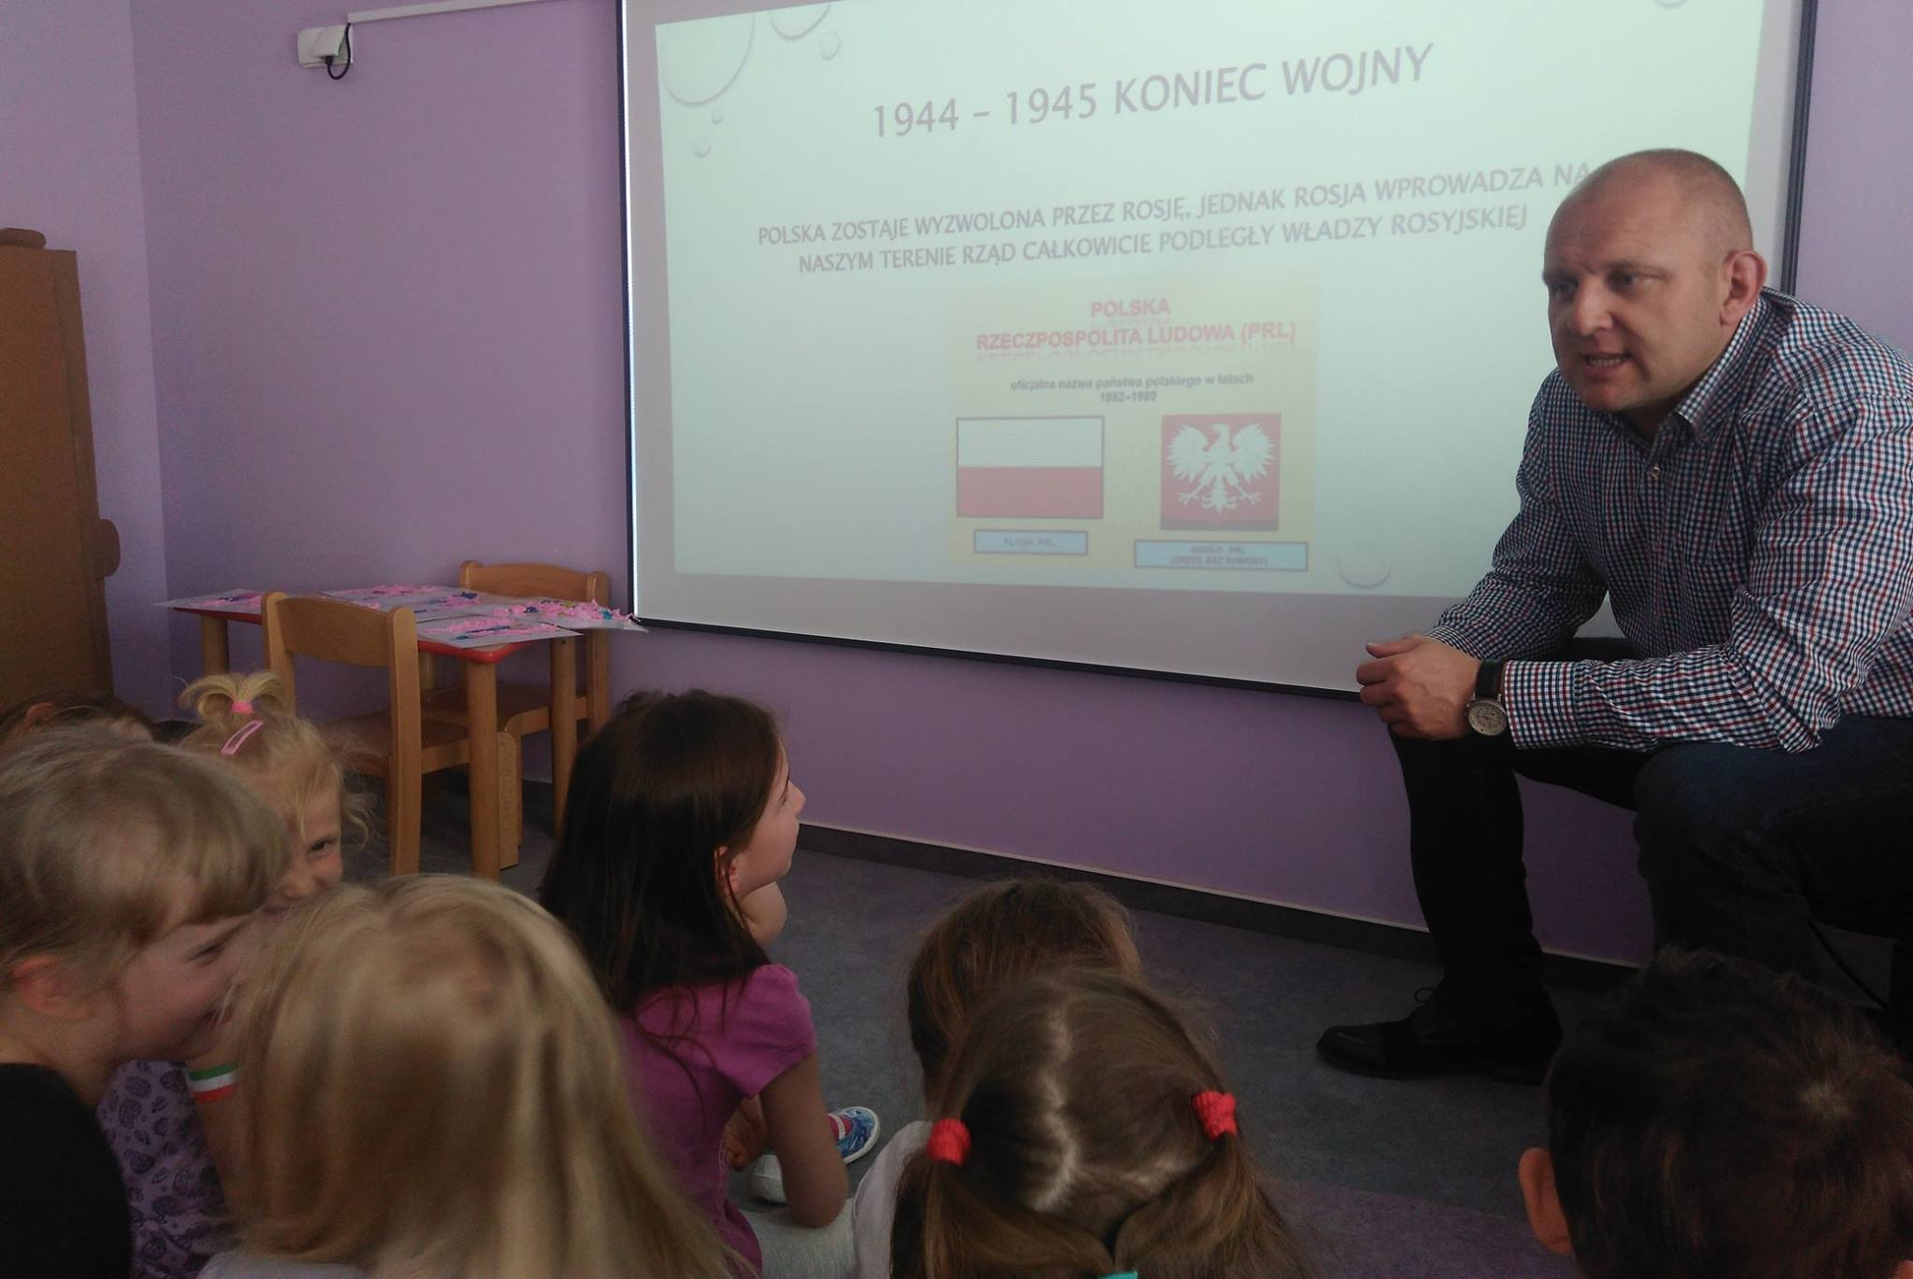
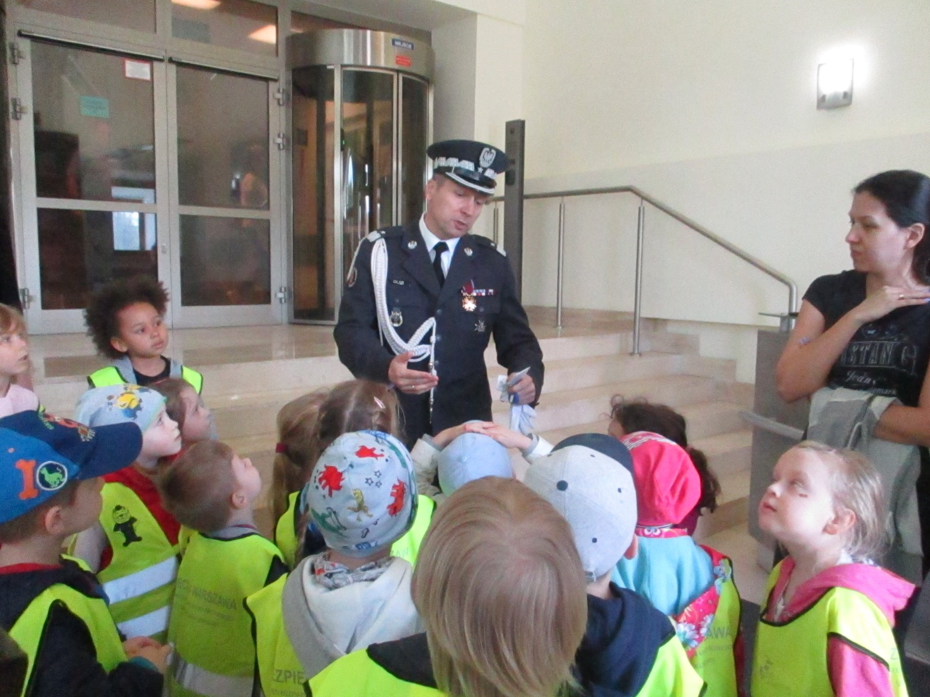
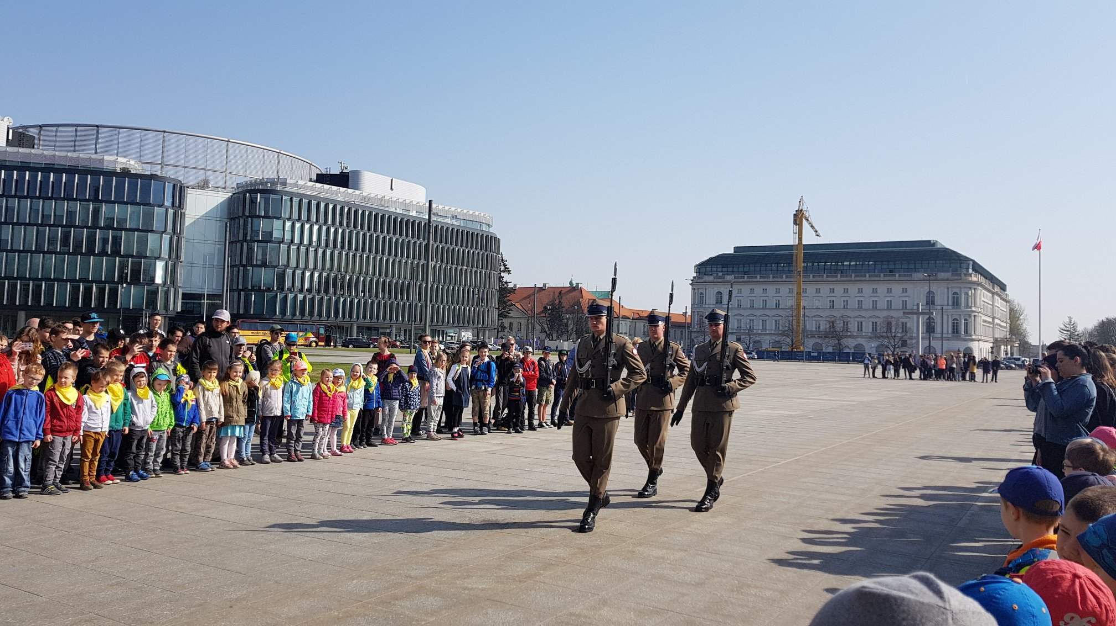
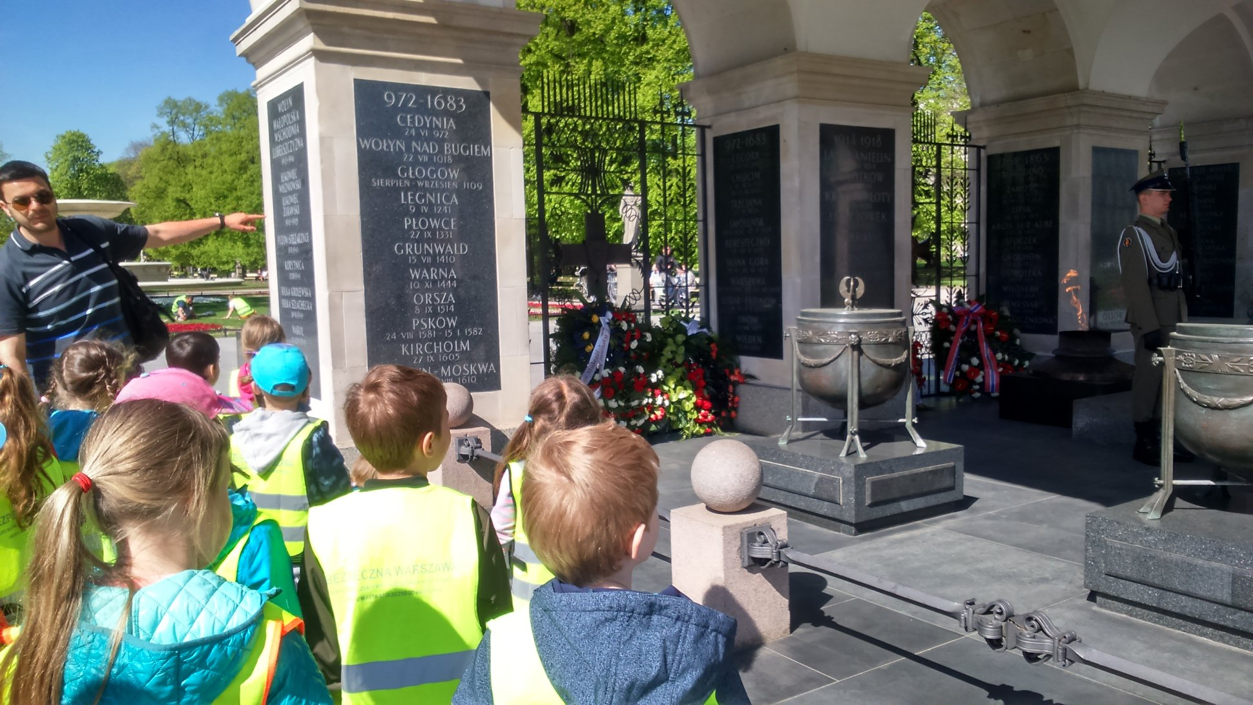

Slide 8
