Slide 1
“Teaching children cultural awareness”
Seminar in Greece
21.05 – 24.05.2018

Slide 2
We teach cultural awareness:
Everyday activities
Introducing children and families
Introducing Estonia, folk, traditions and celebrate traditional days
Projects
Methodologies

Slide 3
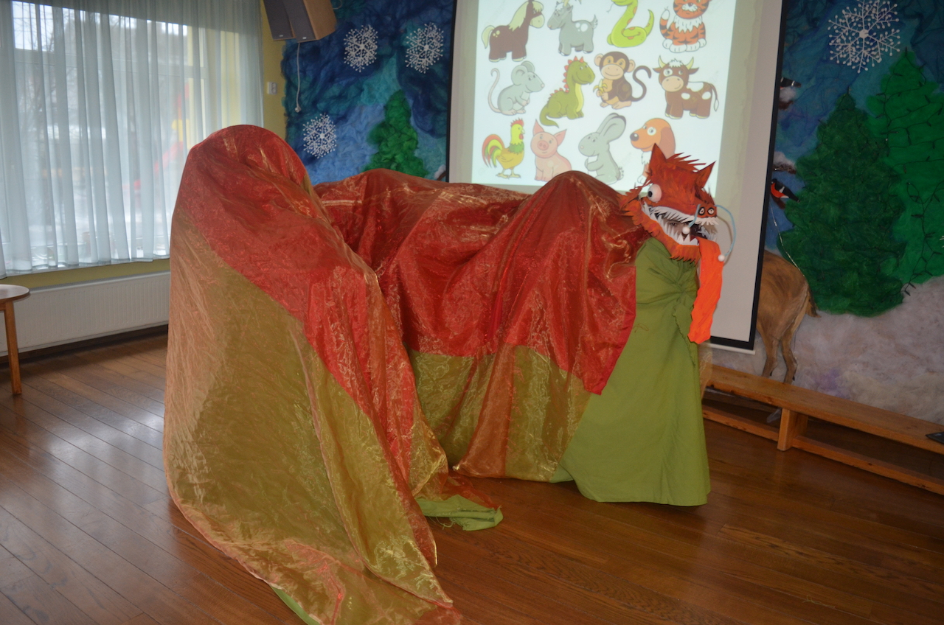
What is written in the curriculum?

Slide 4
1-3 year old children
Children understand of being different (not every person is identical).
Children are introduced differences: wearing classes and dark skincolour.

Slide 5
3-4 year old children
Children describe themselves – how do I look like?
Children comparise themselves with their mates, what are the similarities and differences.
Introducing the speciality of this grops children.

Slide 6
4-5 year old children
Children distinguish people by skincolour.
Children know the physical differences being overweight and wearing classes. Children know the reasons why people have these differences.
With children are discussed what are the differences and similarities in our group. Children point out how they are different from their mates.

Slide 7
5-6 year old children
Children understand differences.
Children point out different differences that people could have (hair colour, hair type, hair lenght, eyecolour, skincolour, hight, weight, classes, braces, physical special need, language aso. ).
Children know different languages and know few fords in other language.

Slide 8
6-7 year old children
Children make difference about, point out the specialities of different nations.
Children analyze and point out differences and similarities with different nations and tehmselves.
Children understand differences and are tolerant towards them.

