Slide 1
Czech Republic

Slide 2
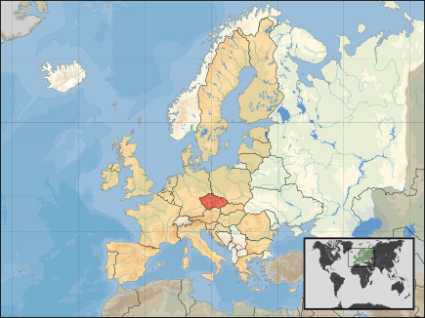
The Czech Republic is a small landlocked country in Central Europe. Its area is nearly 79 000 square kilometers

Slide 3
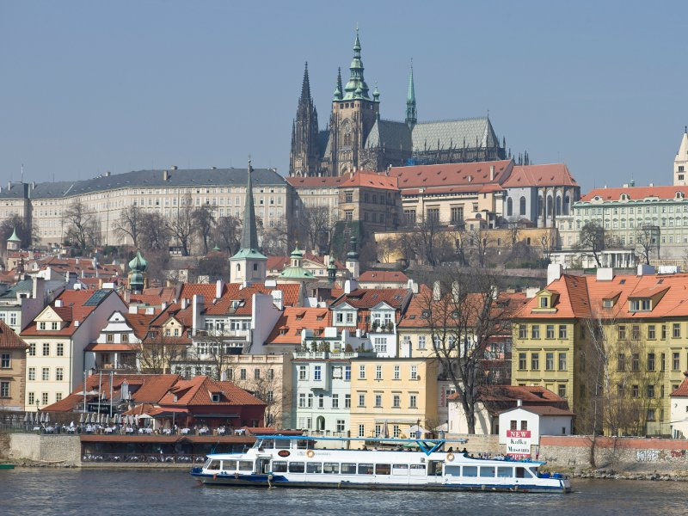
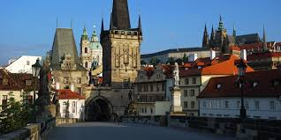
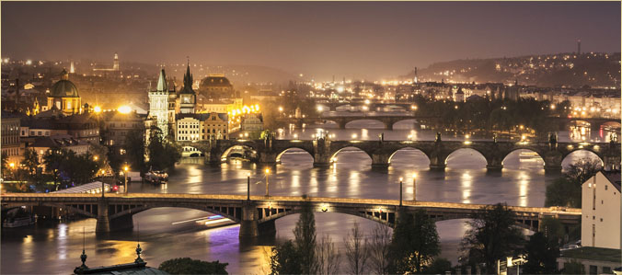
Its capital is Prague.

Slide 4
The country borders Poland, Austria,Germany and Slovakia, with which it was united in the state of Czechoslovakia until 31 December 1992.
The population of the country is 10 million people
The Czech Republic is a democratic country
Head of the state is President, elected for a five-year period by the Parliament.
The Parliament comprises two Houses - the Chamber of Deputies and the Senate.
The executive power is in the hands of the Government headed by the Prime Minister.
One of the most famous personalities of the Czech
Republic's first president of Czech Republic Vaclav Havel

Slide 5
Education system in the Czech Republic
Pre-school education provided by kindergartens usually for children aged 3 to 6 years
Primary Education (age 6-14 years)
Secondary education (age 15-17,18 years) builds on the primary and is usually of three or four years, but there are also one-year and two-year courses.
Tertiary education (age 19 and over) at universities or colleges.

Slide 6
Qualifications for the work kindergarten teacher
secondary vocational Education with leaving examination / 4 yars/
university education pedagogical direction / 3 -5 yars/
kindergarten teachers are 99% women, men working as teachers in kindergartens very rarely
Teachers working 40 hours per week of which 31 hours direct work with children and 9 hours of preparation for work

Slide 7
Our Kindergarden Šardice

Slide 9
The kindergarten Sardice is an organization whose founder is municipality Sardice with the highest allowed number of 100 children aged 3 to 6 years. The school is located in a two-storied building and there is a large , modern fitted school garden next to the building. Located in a quiet area adjacent gardens
Kindergarten has 4 classes, education ensures 7 pedagogues . Pre-school education is provided under the School Education Programme, which profiling enhances the activity, civil and communicative competence of children and leads to the acquisition of knowledge , skills, habits of healthy living and ecology.

Slide 10
We naturally get children to know folk customs and traditions which are maintain in the village for a long time. Children are placed in mixed-age classes, they learn to live in a group where it is necessary to respect each other. During educational activities the experiential learning is preferred - the principle of " be there " - being able to hear, see, touch, experience .
Our kindergarten is working according to the program Step by Step
Step by Step program is aimed at practicing these skills :
communication
cooperation
problem solving
Principles of the program Step by step
The emphasis on an individual approach to each child
Emphasis on self-determination and choice of the child and taking responsibility for it
The emphasis on family participation
Inclusion of children with special educational needs
Start with the entire program is designed on the basis of mutual tolerance, children
They are routed to a healthy lifestyle, resistance to stress and health
the harmful effects that can lead to abuse and dependence on addictive substances and it is in full compliance with the Framework Programme for Preschool Education.

Slide 11
Principles of the program Step by step
The emphasis on an individual approach to each child
Emphasis on self-determination and choice of the child and taking responsibility for it
The emphasis on family participation
Inclusion of children with special educational needs
Start with the entire program is designed on the basis of mutual tolerance, children
They are routed to a healthy lifestyle, resistance to stress and health
the harmful effects that can lead to abuse and dependence on addictive substances and it is in full compliance with the Framework Programme for Preschool Education.

Slide 12
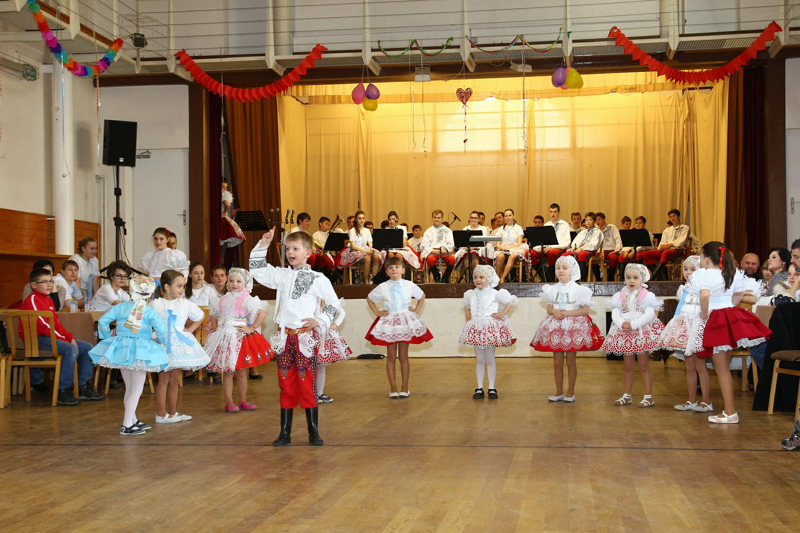
t

Slide 13
traditional dances

Slide 14
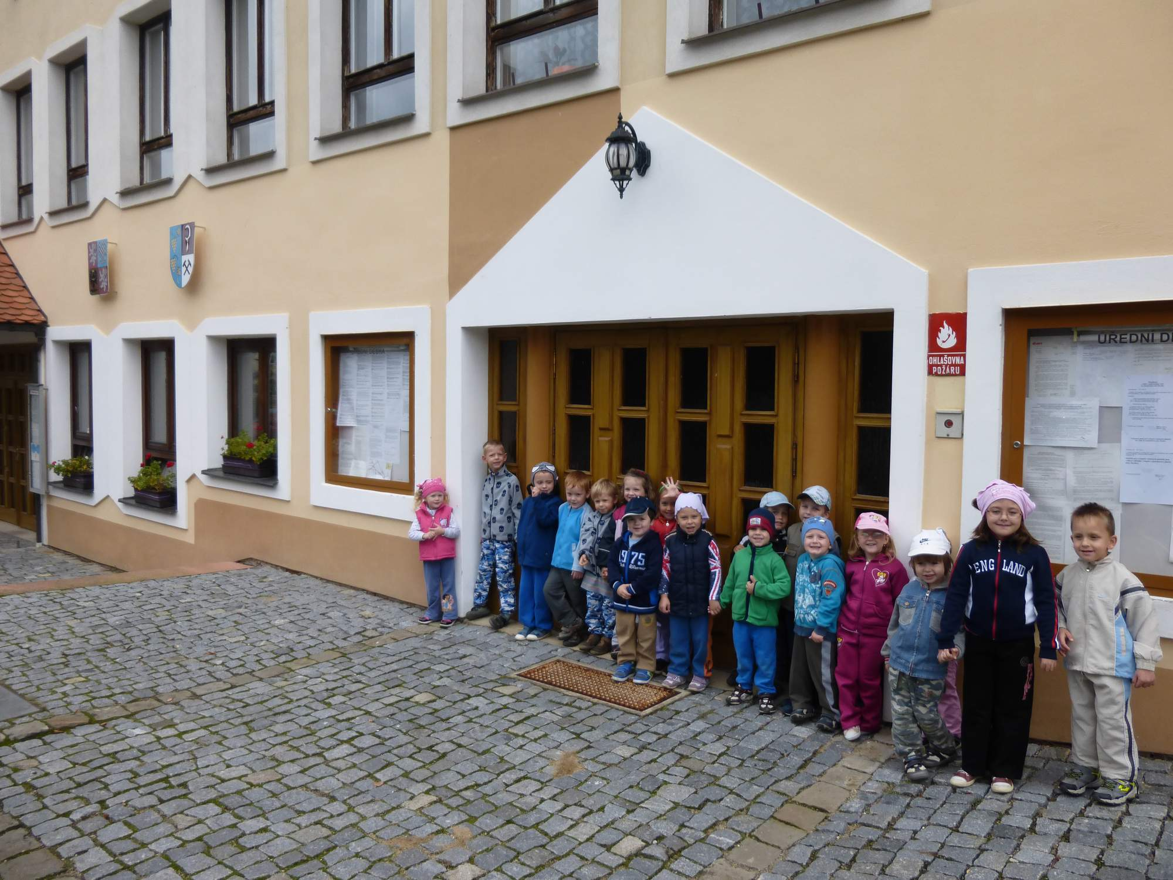
municipal office

Slide 15
Historical building-cellar wine

Slide 16
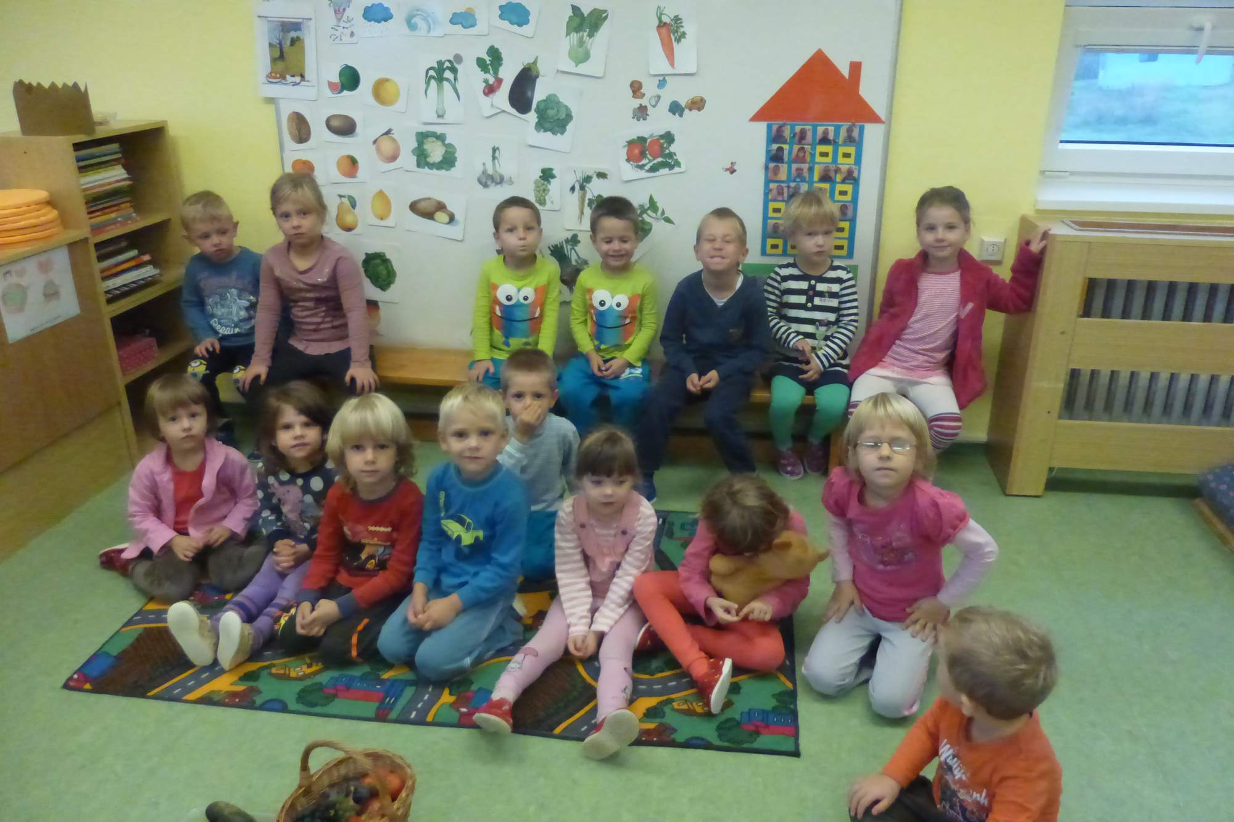

Slide 17
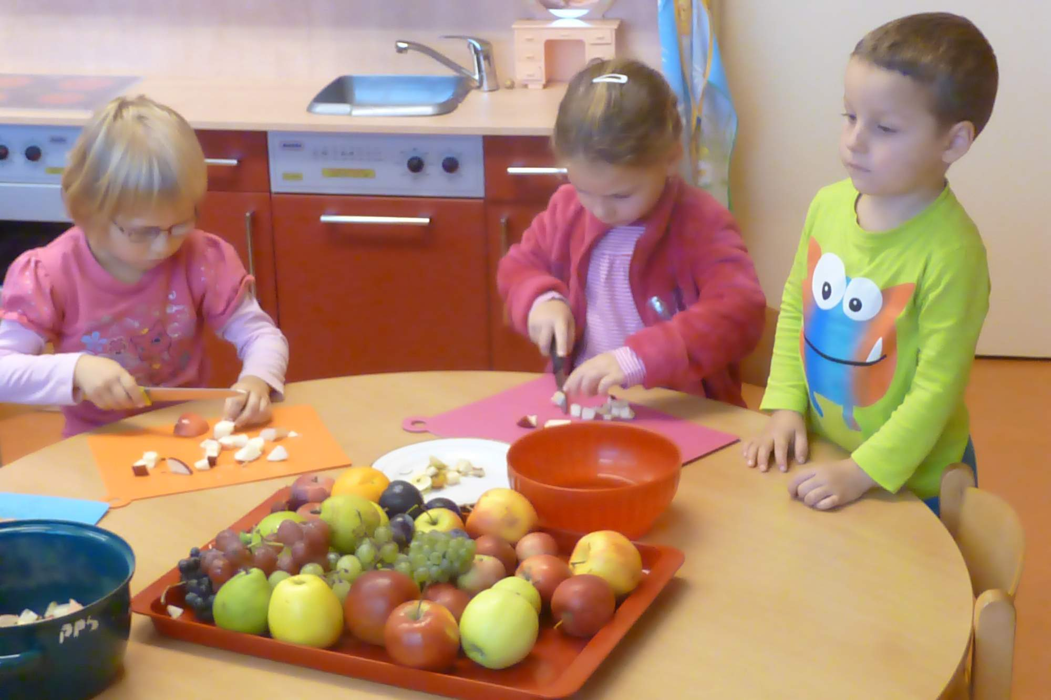

Slide 19
Mother's day celebration

Slide 20
Thank you for your attention

