Slide 1
VALUING FAMILY AND INCLUDING FAMILIES TO EVERYDAY ACTIVITIES IN PARTNER INSTITUTIONS
IZMIR / TURKEY

Slide 2
WHY IS FAMILY AND FAMILY VALUES ?
Values of family are very important for us because children gain firstly values in family.
For example socializing, respect and love each others, collaboration, share, cooperation etc.
Children need to grow up in a happy and safe environment.
This environment can not be found anywhere else except family.

Slide 3
THAT IS WHY WE CARE ABOUT OUR CHILDREN’S FAMILIES.
DOING ACTIVITIES WITH THEM TOGETHER IS SO IMPORTANT.
WE DO LOTS OF KIND ACTIVITIES WITH PARENTS FOR IMPROVE OUR RELATIONSHIP.
HERE ARE ACTIVITIES….

Slide 4
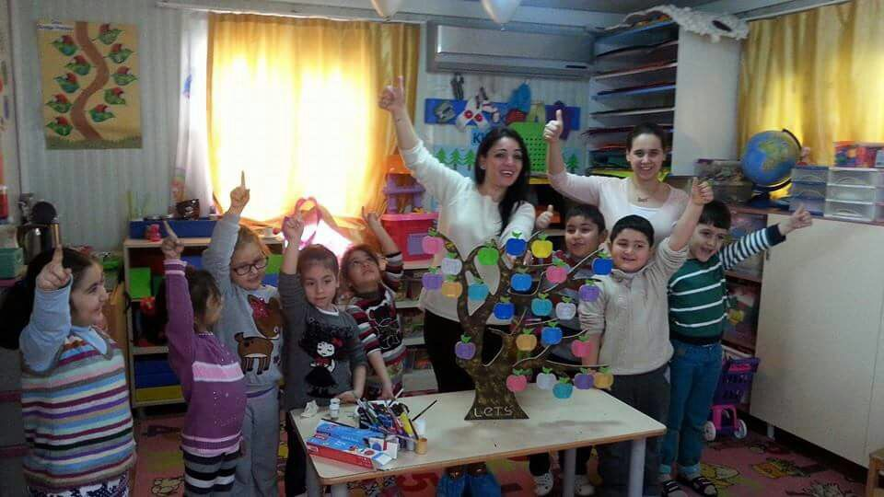
PAINTING ACTIVITIES…

Slide 5
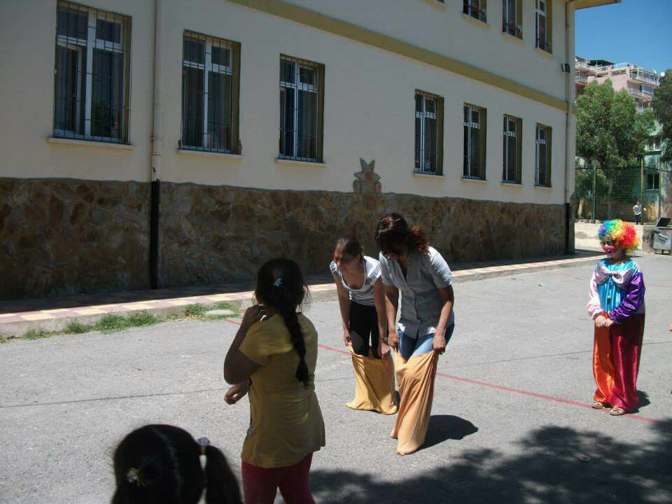
COMPETITION FOR FUN
PARENTS ARE COMPETING…

Slide 6
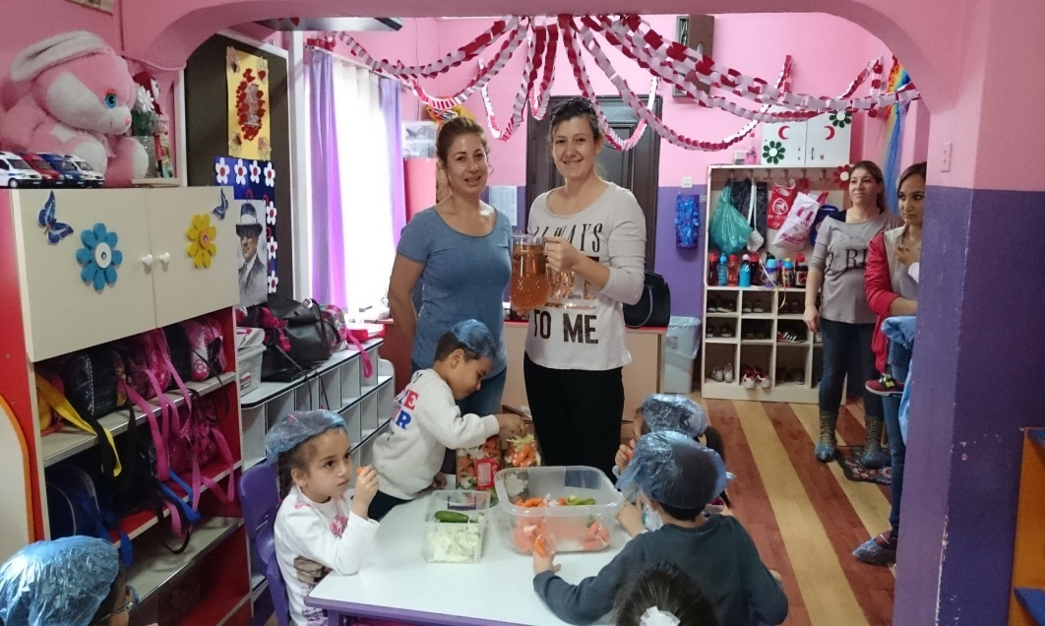
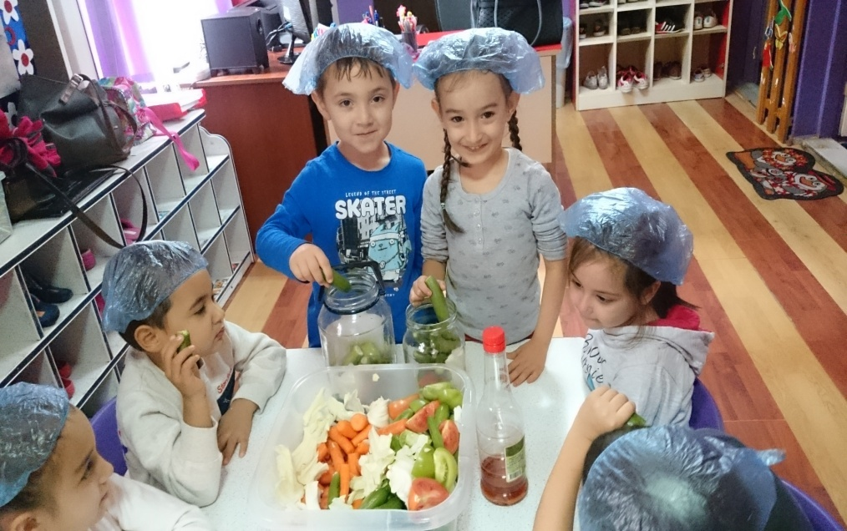
LET’S DO PICKLES

Slide 7
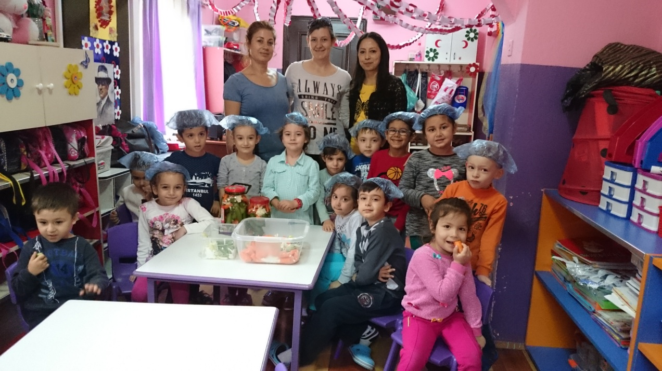

Slide 8
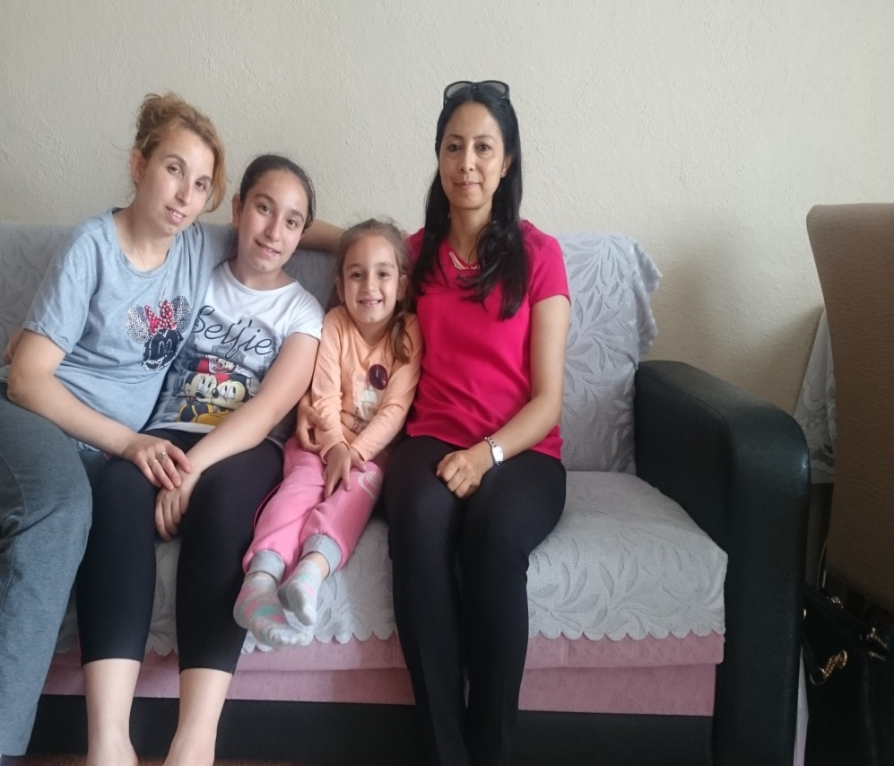
VISITING THE PARENTS IS ONE OF ACTIVITIES THAT IMPROVES SOCIAL RELATIONSHIPS.

Slide 9
SOME PARENTS CAN PLAY MUSIC INSTRUMENT AND WE INVITED THEM TO OUR SCHOOL FOR SHARING AND ENJOYING

Slide 10
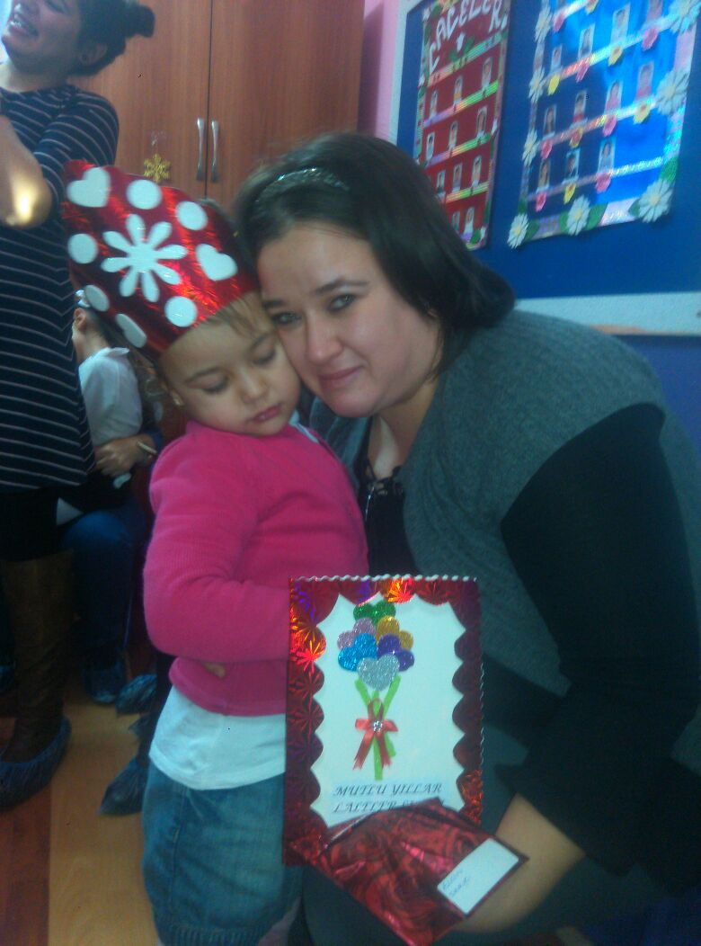
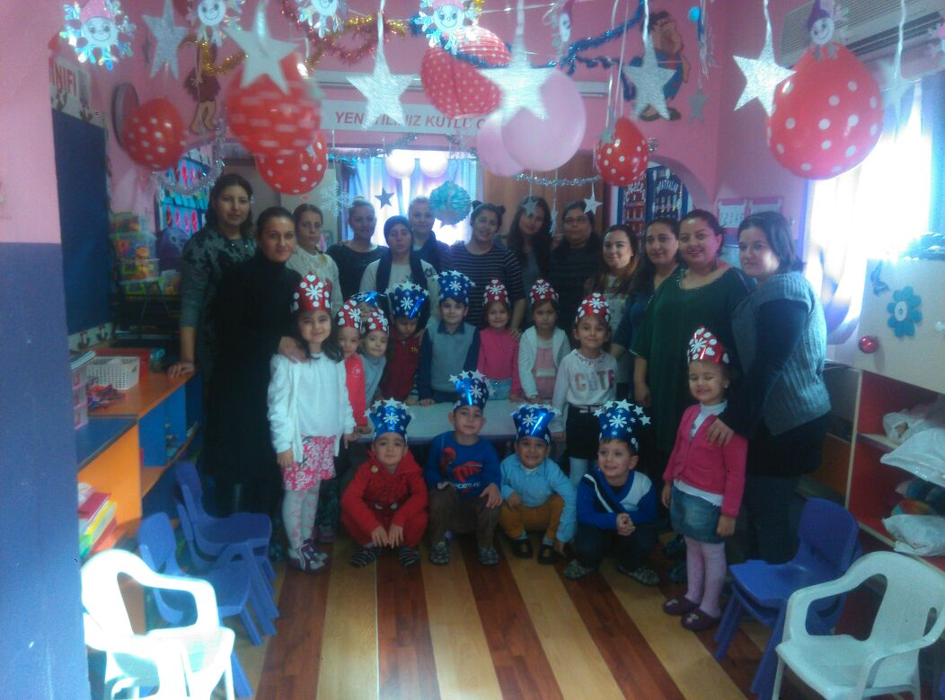
PARTY TIMES….

