Slide 1
Structure and development of primary education in Bulgaria
Doctor Galina Blagomilova

Slide 2
Georgi Zhivkov bulgarian politician
Born:
In 1844 in Tarnovo,
Otoman Empire
Passed away:
On the 6 of may 1899 in Sofia, Bulgaria
In 1891 – He accepts the
Law on Public Education,
also called the Law of Zhivkov, which regulates free of charge and compulsory pre-school and basic education.

Slide 3
Ministry of Education
and Science
Regional Inspectorate of Education & Science
Municipalities
Municipal experts on preschool education
Full-day
kindergartens
Half-day kindergartens
United children
institutions

Slide 4
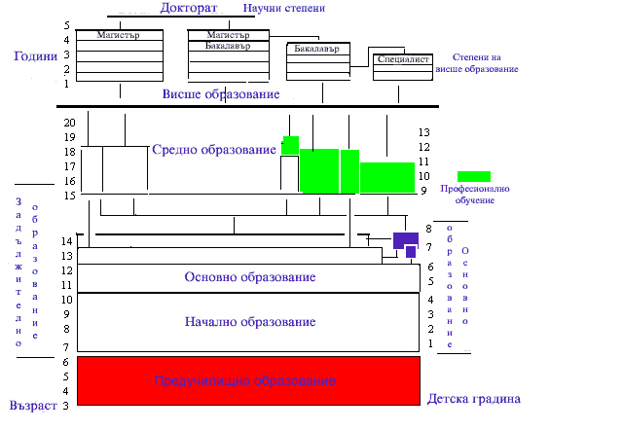
Doctorate
Scientific degrees
Master
Master
BA
Years
BA
Degrees of Higher Education
specialist
University education
Secondary
education
compulsory education
Vocational education
basic education
Elementary education
Primary education
Kindergarten
Age

Slide 5
Programs and programming systems for children from 3 to 7 years old
In Bulgaria, the education of children from 3 to 7 years old takes place in kindergartens. It is implemented in different programs and systems.
Some of them are:
Program for education of children from 2 to 7 years old - Authors: Elena Russinova, Dimitar Gurov, Maria Baeva, Merry Gyurova and others.
The activity of the child in the kindergarten – Authors: Nadejda Vitanova, Bozhidar Angelov, Nikolina Coleva, Elena Popova.
Programming system "Hello School" - Authors: St. Zdravkova, Ts. Ilieva, M. Bogdanova, V. Yancheva, M. Galcheva-Stoitsova, K. Galcheva, T. Burdeva, O Hristova, V. Kuzmov, G. Ivanova, E. Djambazova.

Slide 6
Programming system "Hand in Hand"
The programming system "Hand in Hand“ from the Publishing house “ Prosveta” is one of the few guide systems that implements from the start till the end, with a good succession, the cohesion and upgraded preparation of the child of preschool age for entering into the first grade of school /within the norms of secondary education for our country/.
In the past two years the program system has been diversified with new textbooks called "ABC Games."
Teachers in kindergartens are free to choose which program or programming systems and what textbooks to use in their everyday work.

Slide 7
Copyright academic model for kindergarten № 1 “Bell”, city of Shumen 1993-2015
Since 1993 Kindergarten №1 “Bell" is working with a special program, developing the intelligence of the child. The program is written specifically for this childcare. Its creation is based on a long term observations on the children, who are a contingent of this kindergarten, which in consequence leads to its approbation and subsequent application, which is especially effective today. It does not limit the application of aid materials, corresponding to the different programs and systems in the preschool education in Bulgaria.
The main emphasis of the work is the reflexive absorption of knowledge passing through the four levels of reflection.

Slide 8
A full-day children's shelter in 1934, city of Shumen
The children at the shelter during lunch with their teacher and assistant.

Slide 9
Daily children's shelter in 1934, city of Shumen
The first children of the teacher Dimitrina Kojuharova during activities

Slide 10
Full-day kindergarten “Bell” 1934. - 2015.
Some of the buildings in which the kindergarten has stayed through the years.

Slide 11
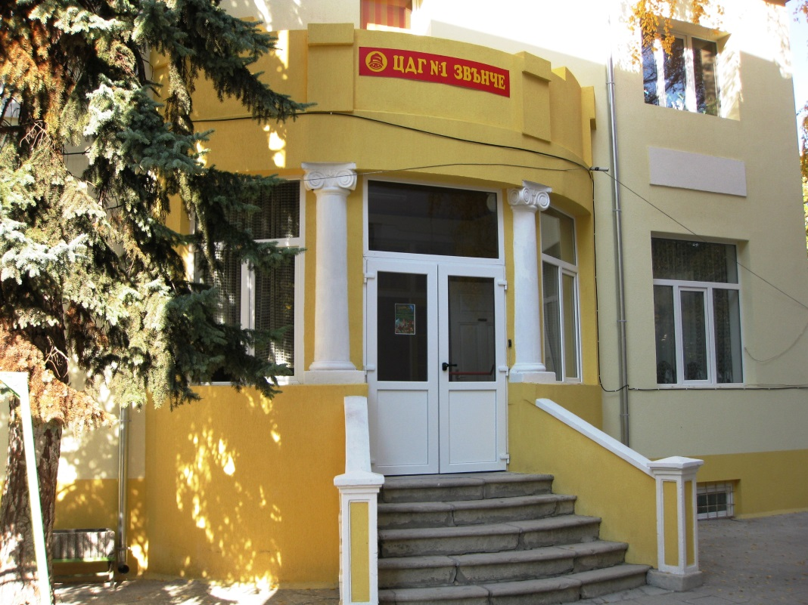
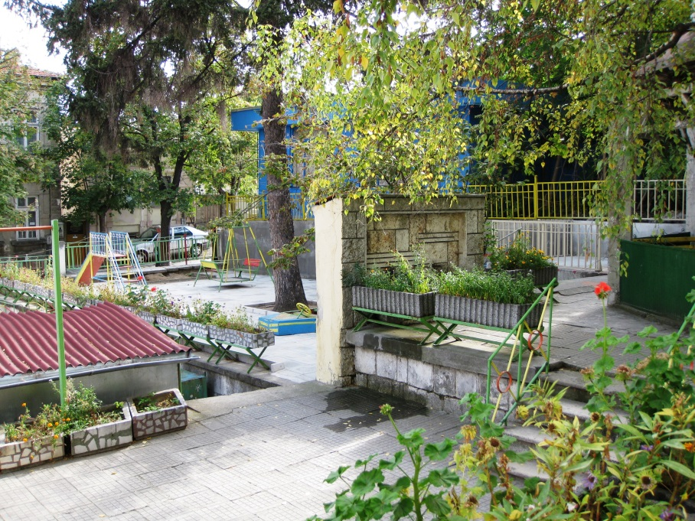
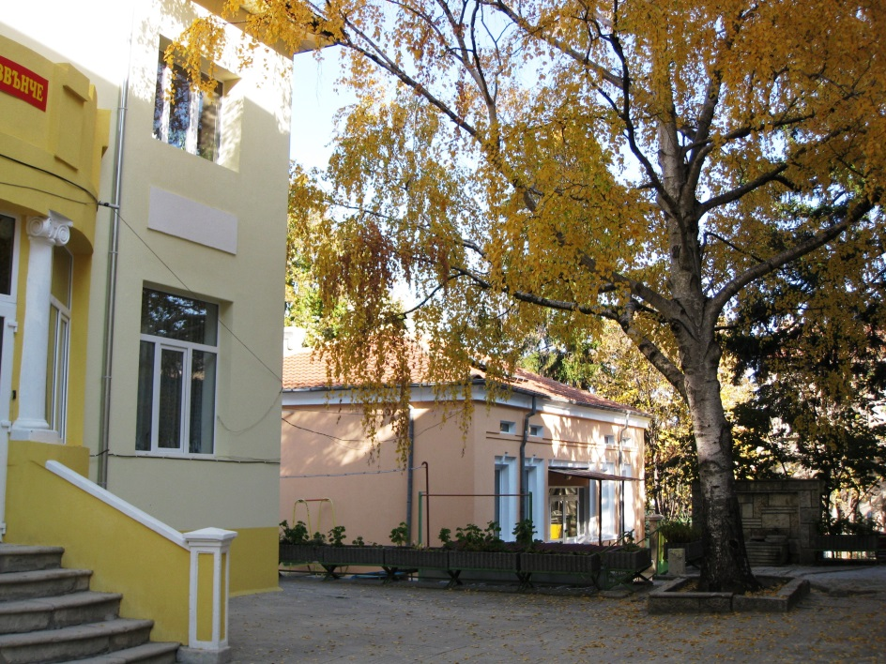
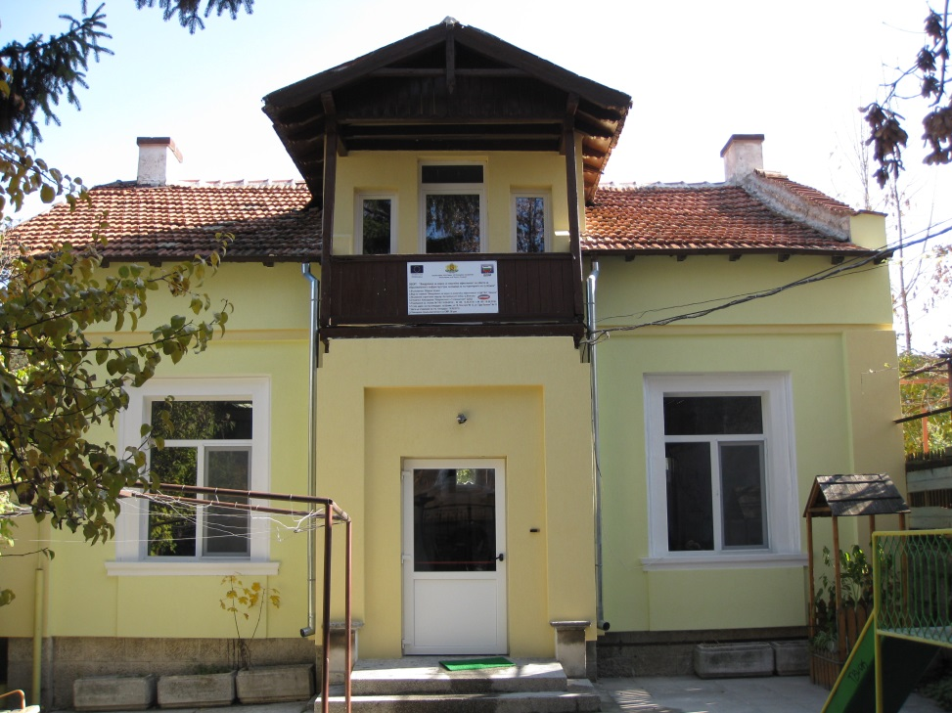
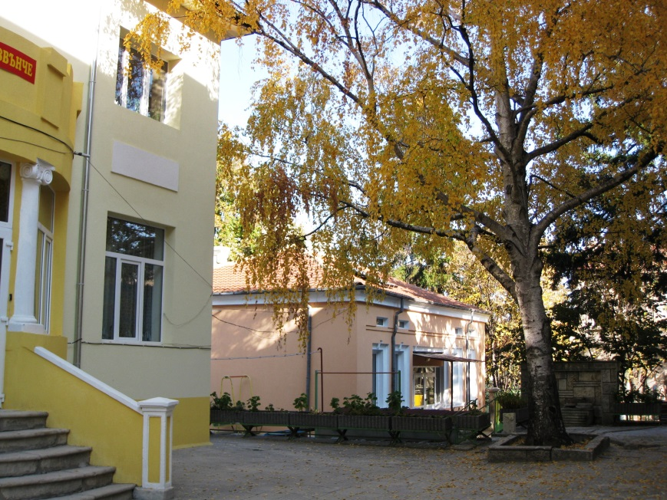

Slide 12
