Slide 1
TEACHING CHILDREN SOCIAL SKILLS
MARCH 2016, TURKEY

Slide 2
NATIONAL CURRICULUM
In our national curriculum the most important is to teach children building a system of values and developing social skills.
We teach children:
What is good and what is wrong
Gives attention to children and adults to understand what they say and what expect;
politely asks the other at home, in kindergarten, on street
Respect the rules
Respect social differences
Listen when someone speaks
Cooperate in a play and situations task
Communicate in understandeble way about their needs
Introduce myself: gives name and address
Talk to adults using phrases Mr, Mrs.
Help others

Slide 3
ACTIVIIES WITH CHILDREN
THROUGH THE ALL SCHOLL YEAR WE TALKED WITH CHILDREN ABOUT:
Respect others
Respect other feelings
Helping others
Caring for others
Our rules and agreements
We remember about this skills by organizing every activities for children

Slide 4
DALTONS PLAN
CHILDREN LEARN HOW TO BE RESPONSIBILITY FOR THEY TASKS AND DUTYS
HOW TO COOPERATE WITH OTHERS (CHILDREN AND ADULTS)
HOW TO SOLVED THE PROBLEMS WITHOUT TEACHERS HELP
HOW TO TAKE QONSEQUENCES OF THEIR BEHAVIOUR

Slide 5
CHILDREN LEARN WHAT does it MEAN „DIFFERENCES” ANd TOLERANCE TRYING TO FIND SOLUTION They increase their knowledge about cultures differences ERASMUS - EVALUATION
PERSONA DOLL METHODOLOGY

Slide 6
WE TAKE PART IN CHARITY EVENTS
We collect books for children in hospital
We collect coins for children who are in Child Care Home.
In christmas time we collect some clothes, toys, food and we pack it for poor famillies.
We visite senior’s house
By this activities children learn:
What does it mean to be poor or sick
What does it mean to be lonely
How important is helping and how much does it mean to others

Slide 7
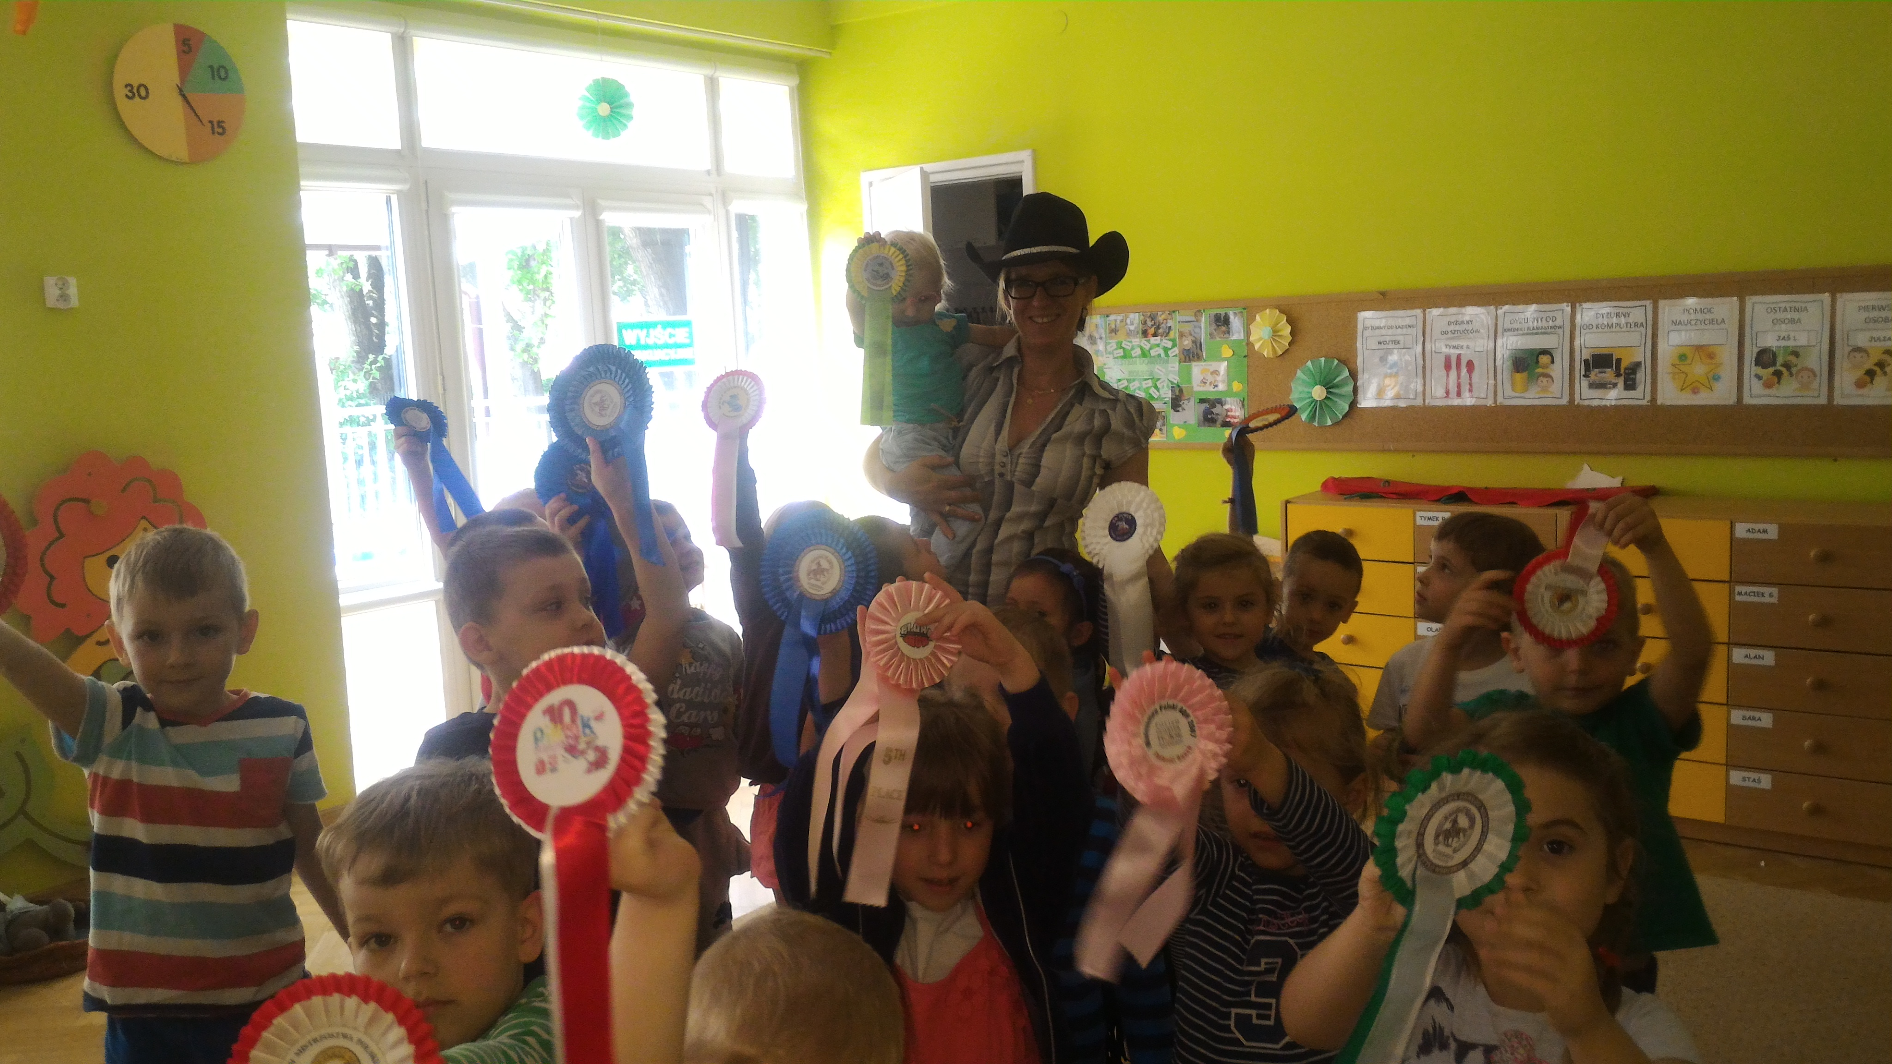
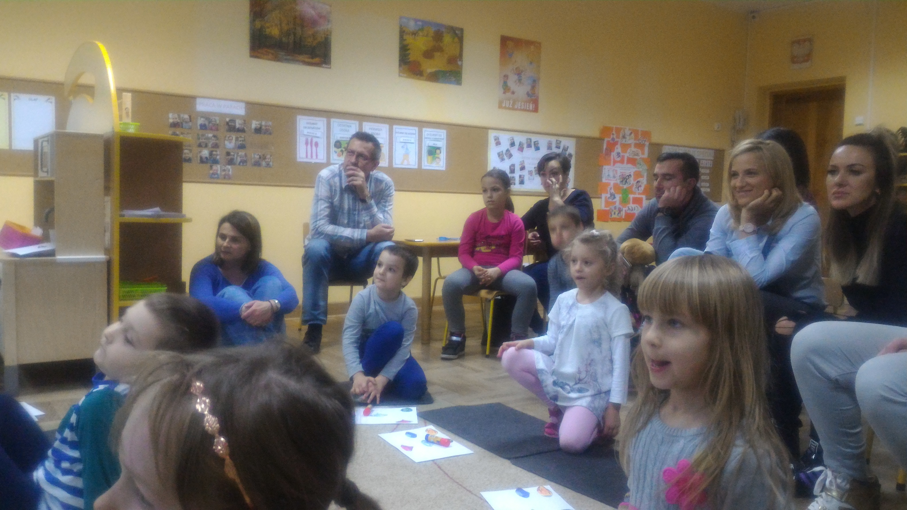
Meetings with parents
We organized:
Family picnic
Christmas/Holidays meeting
Mother’s and Father’s day
Grandmother’s and Grandfather’s day
Children’s Day
By this activities children learn:
Respect for adults
Learn about family traditions
We cooperate with parents in teaching values and respect rules for everyone – the same in kindergarten and home.
We treat parents as our partners we include them to kindergarten life.

Slide 8
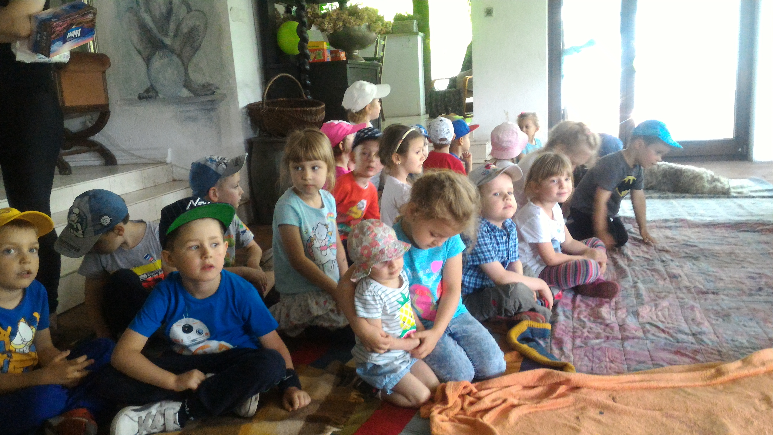
THANK YOU

