Slide 1
Children questionnaire
Seminar in Italy, Battipaglia
14.03 – 16.03.2016
Erasmus+ project 2015 – 2018 “Every child is special”

Slide 2
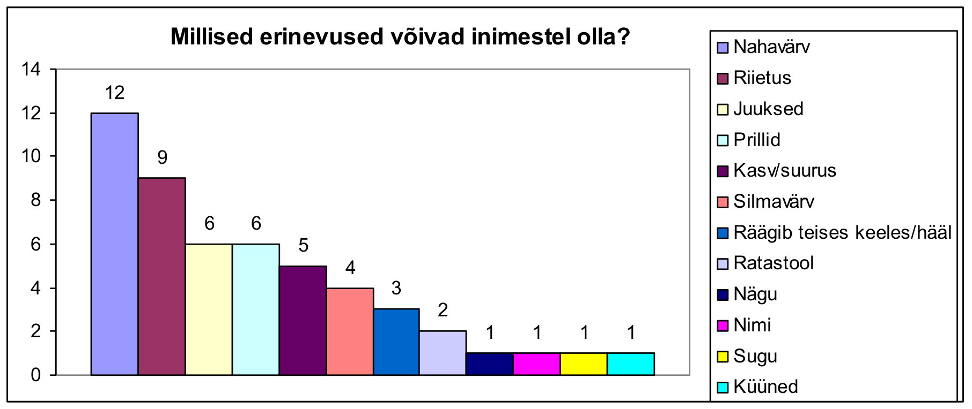
1. What differences could people have
Children pointed out mostly skin color, clothes, hair, wearing glasses.

Slide 3
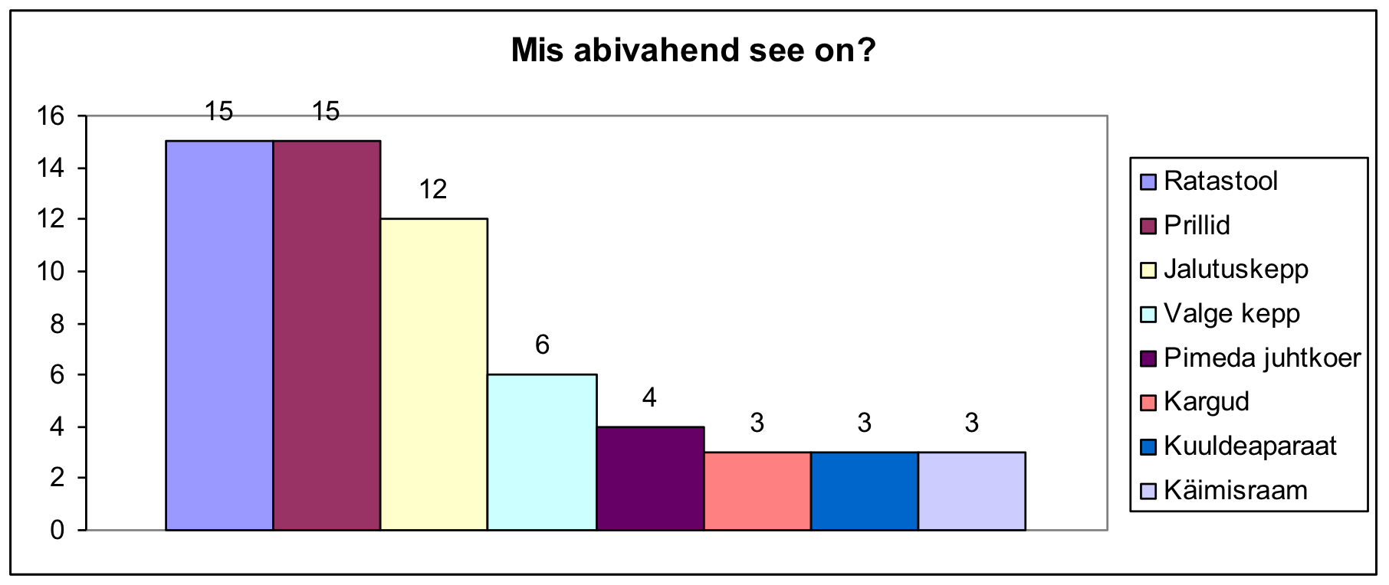
2. What is this? When are these aid articles used?
Most children knew wheelchair, glasses, walking cane.

Slide 4
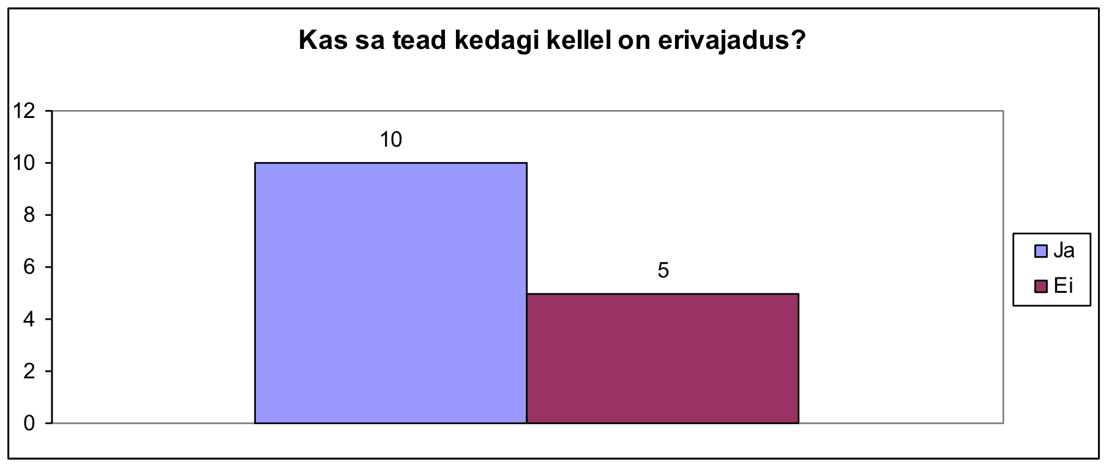
3. Do you know someone who has a special need?
Children pointed out special needs as: crutches, wheel chair, glasses.

Slide 5
4. How can you help a child who has a special need
2 children out of 15 did not know how to help a child who has a special need.
What they pointed out:
Woukd have helped to sit to wheel chair and help to push it 3
He/she would say how he/she need help and I would do that 3
To say where he/she goes or would like to go 2
Help to bring he/she crutches or wheel chair 2
Give a hand to a blind child and help to move around 2
Help to get up
Help to put “machine” by the ear
If he/she can not reach something, I give it to he/she
Help to ask mommy and daddy to help he/she
Invite him/her to my game
Help he/she all the time
Help he/she to walk

Slide 6
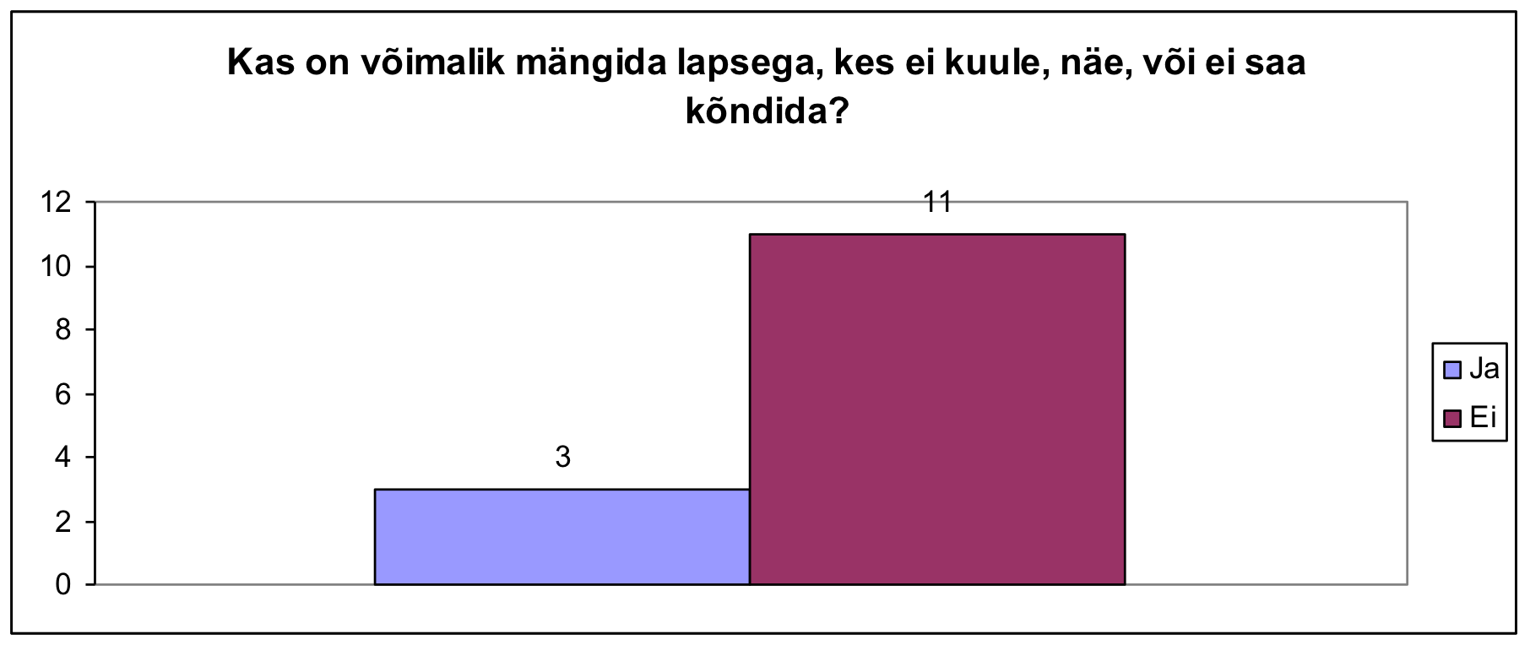
5. Is it possible to play with a child who does not hear, walk, see? What are these games we can play together?
Why we can not play together: he/she can fall and hurt himself/herself, they can not hear what we have to do, they can not see that we are playing, maybe he/she is sik, they don’t know what we have to do.

Slide 7
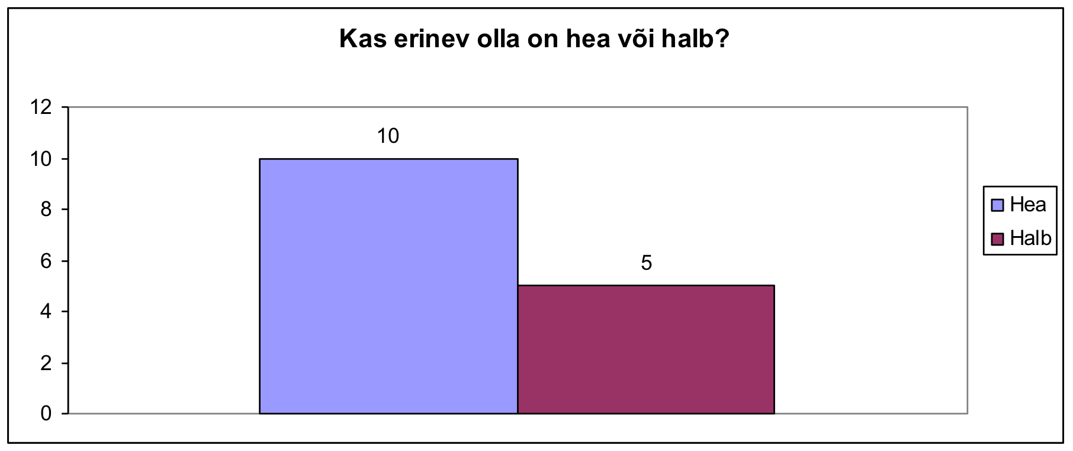
Is being different good or bad thing?
Why it is good to be different: we don’t have to be like everyone else, because this is fun, otherwise everyone would call children by the same name, then everyone knows who you are.

