Slide 1
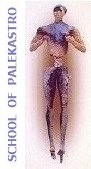
Presentations of 3rd and 4th Persona Dolls
Erasmus+ project, 2015 – 2018
“Every child is special”

Slide 2
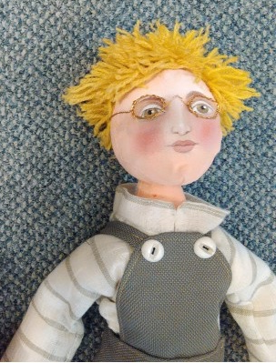
I AM YURI

Slide 3
Yuri’s Profile
He comes from Ukraine and he came with his family to Greece just after the war.
He has one sister, younger than him.
His parents were teachers in Ukraine.
His family came to Crete because they heard that it’s easier to find a work on Crete and they found work in travel agency. They live in Sitia.

Slide 4
Yuri’s Profile
He likes to spend his time playing basketball in his school playground.
He loves to take part in every school activity .
He doesn’t speak greek, but he speaks a little English. It is a little difficult for him to find friends and to communicate with others, but he learns fast so in little time everything will be better.
He likes eating with the other kids but because he wears glasses some kids are mocking him, sometimes even for his hair’s color.

Slide 5
School of Palekastro
What have we done?
We have talked with children about migration and problems migrants face in their new home and about some personal characteri-stics which have to do with color, physical or kinetic difficulties.
We are trying him to learn better greek and being closer to him and his difficulties.

Slide 6
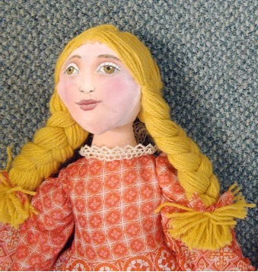
Ι ΑΜ ΑΝΝΑ

Slide 7
Anna’s Profile
She comes from Ukraine and she came with his family to Greece just after the war.
She has one brother, older than her.
Her parents were teachers in Ukraine.
Her family came to Crete because they heard that it’s easier to find a work on Crete and they found work in travel agency. They live in Sitia.
She does not like playing with other kids due to her difficulty in communication, because she doesn’t speak Greek or English, but mostly because she has kinetic problem on her left leg due to a war injury.
He likes to read books and to play with her brother.

Slide 8
Anna’s Profile
She likes greek weather and the sea. Very often she walks next to the seaside.
She likes cretan diet.
She can play piano very well and she wants to participate in school music activitiesn soon after she is getting better and learning some more greek.
She looks different comparing to greek girls because of her blonde hair and as her brother sometimes she has problem with some of her classmates.
She wants to be in health again and she wants to study in America when she will be older.

Slide 9
School of Palekastro
What have we done?
Greek language lessons for better and faster communication, medical and psycological support just to overcome her leg’s problem.
Giving more opportunities to be as an equal member in our school society.

Slide 10
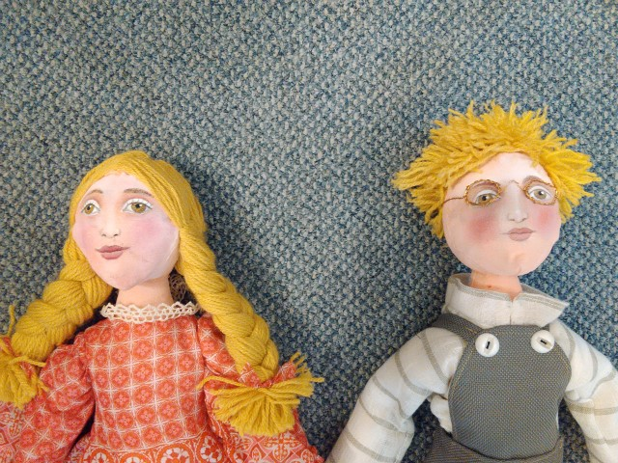
Sister and Brother

Slide 11
