Slide 1
Bullying and children aggressive behavior
Erasmus+ seminar in Bulgaria
15.10 – 21.10.2016

Slide 2
What is bullying?
Bullying is aggressive act towards one certain child more then one time - systematic!

Slide 3
Punishment or discussion?
What is more efficient punishment or discussion with children:
Long term impact
Every child can say how they feel
Children say how it is right to solve this problem
Every problem in a group affects all children who witness the problem

Slide 4
Who bully more: boys or girls

Slide 5
Secret bullying
Boys: more physical aggressive behavior and bullying – YOU CAN SEE AND HEAR
Girls: more hidden bullying – talking bad about someone, judging, excluding, avoiding, whispering.

Slide 6
This is most important!
Notice
Act, intervene
Prevention

Slide 7
How we deal with it?

Slide 8
What has changed
“You have to be everybodys friend”
Don’t complain all the time
Child is not alone with the problem

Slide 9
Stand out for myself and others

Slide 10
To notice and care about others
“I am not indifferent”

Slide 11
Courage
“I am a superhero”

Slide 12
Good values
“Our children reflect our behavior”

Slide 13
Through these activities we:
Develop children social skills
Children have better realations between eachother
Finding new friends
We are not indifferent

Slide 14
How?
Kindergarten free of Bullying

Slide 15
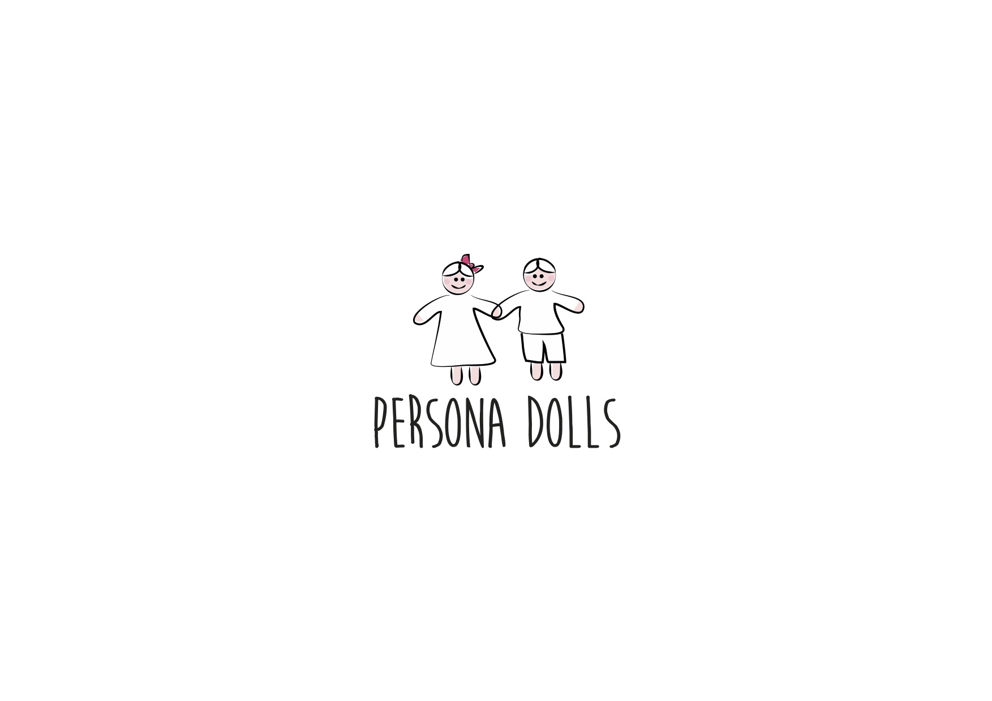
Persona Dolls

Slide 16
Therapy with clay

Slide 17
Robotics

Slide 18
At school – 2 programs
KIVA
TORE

Slide 19
And if all of this won’t help:
We approach every child and problem individually
Involve specialists
We gather a meeting: teachers, parents, management aso.

