Slide 1
Good mate rules 2015
Mateřská škola Šardice

Slide 2
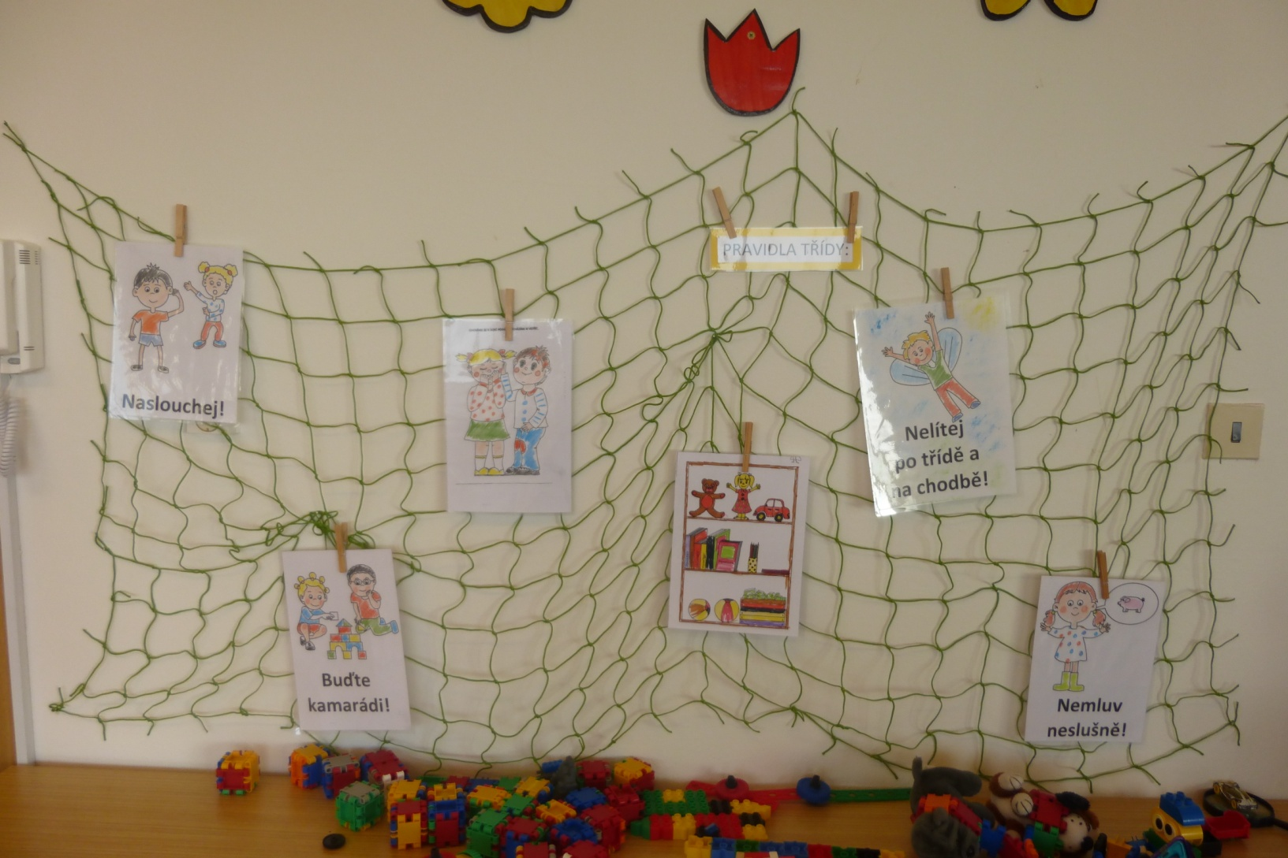
Class rules

Slide 3

listen

Slide 4
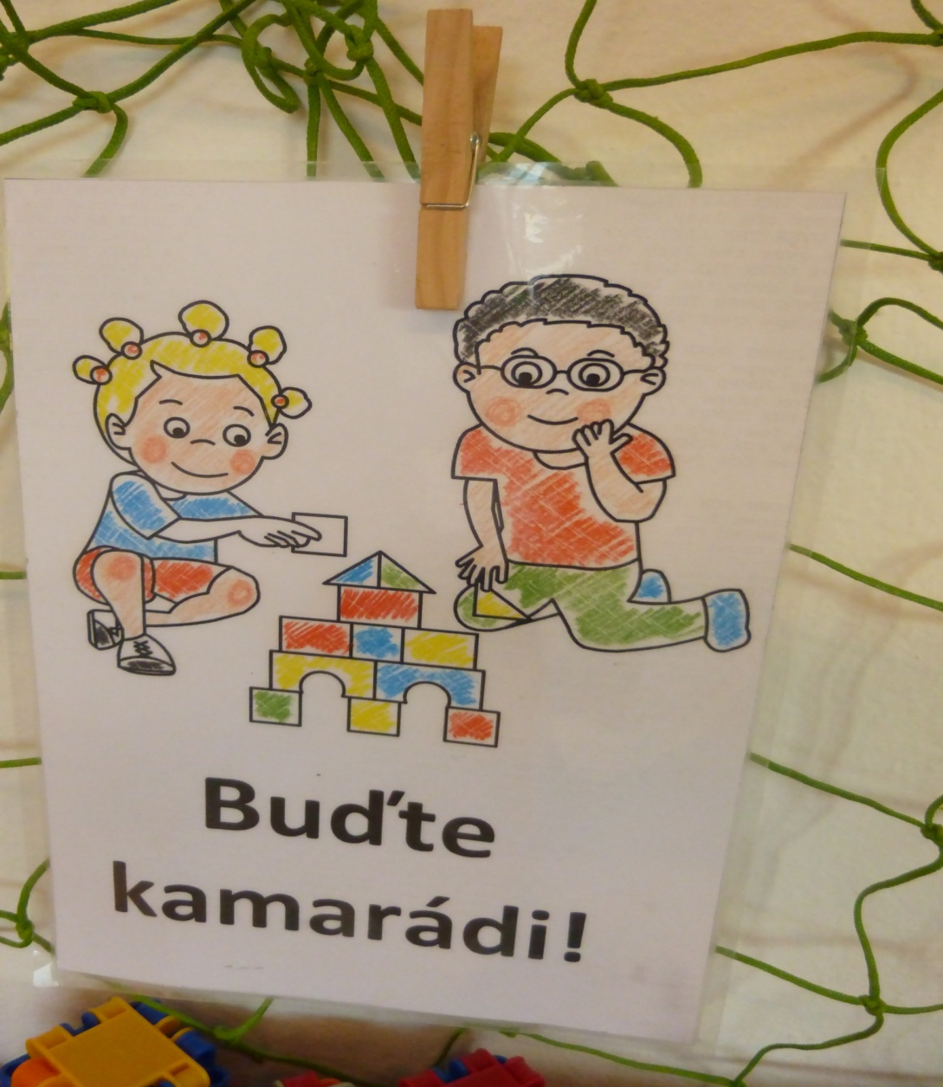
we try to be friends

Slide 5
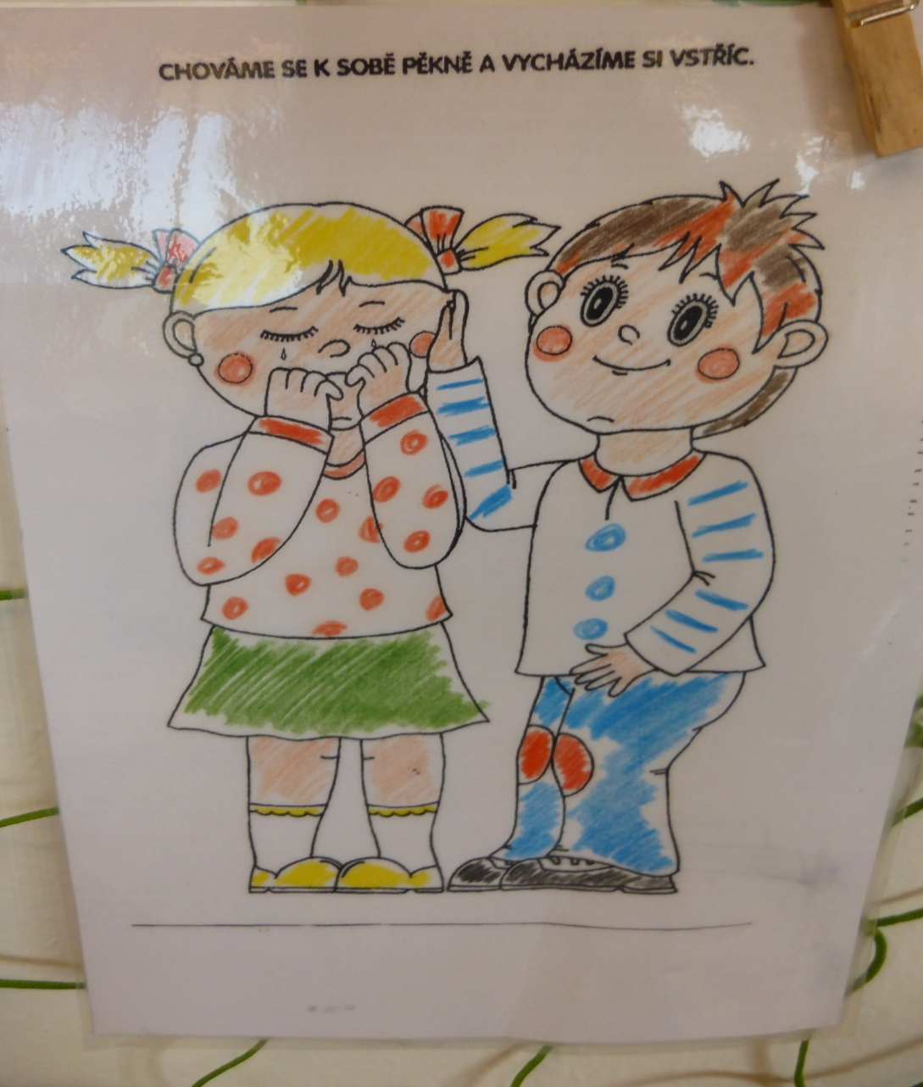
Hurting you

Slide 6
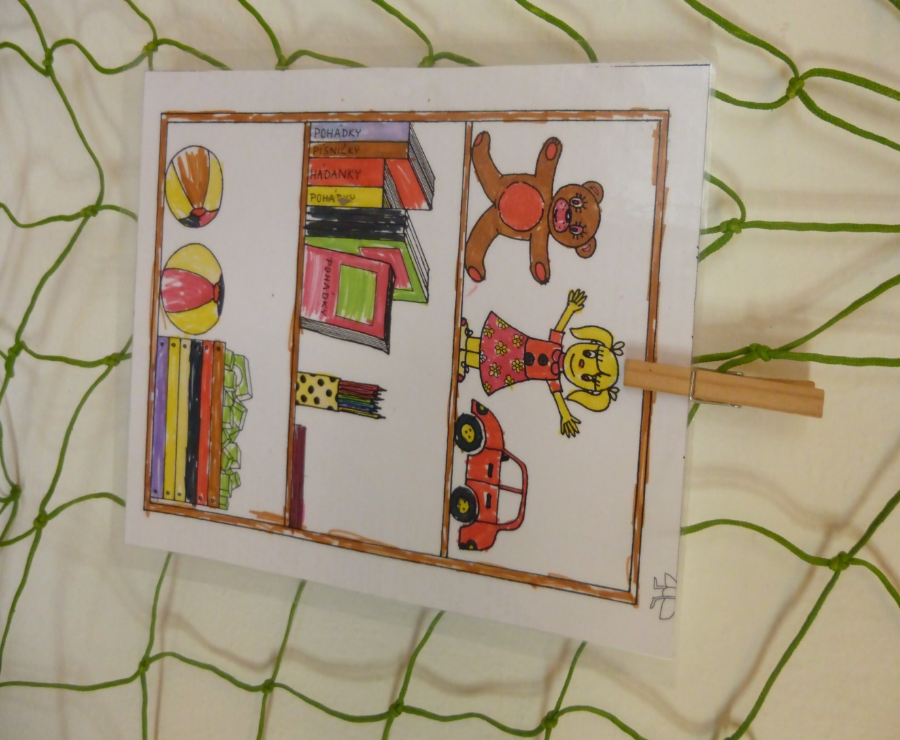
Do you clean

Slide 7
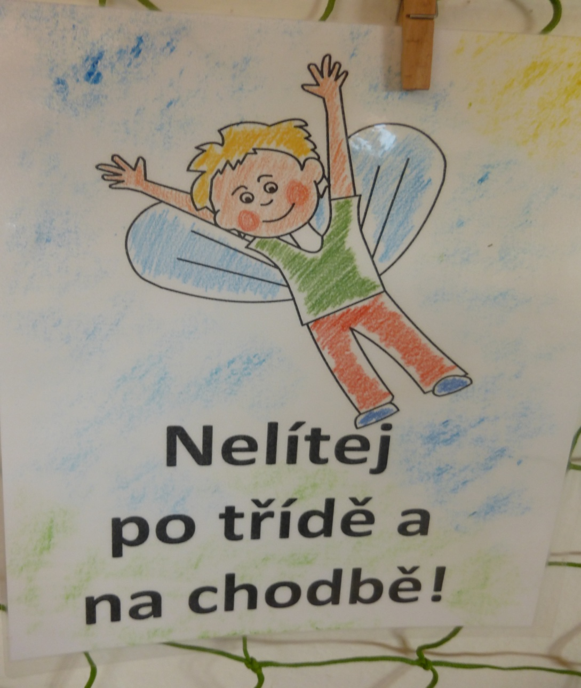
Do not run

