Slide 1
Children with special needs
and support system in Bulgaria
Project "Every child is special"

Slide 2
Inclusive education

Slide 3
Inclusive education - Leading concepts
1. General support for personal development
2. Additional support for personal development
3. Team for support for personal development
4. Coordinating Team for Support for Personal Development
5. Regional Support Team for Personal Development
6. Early assessment
7. Action Plan
8. Support Plan
9. Individual curriculum
10. Resource Assistance

Slide 4
1. General support It is an activity of pedagogical specialists in educational institutions aimed at developing the strengths of children and ensuring optimal presence and participation in the educational process. General support is provided to each child from the beginning to the end of his / her training.
It includes:
1. Teamwork between teachers and other pedagogical specialists. 2. Additional modules for children who do not speak Bulgarian. 3. Additional training on subjects of study. 4. Counseling on subjects of study. 5. Interest activities. 6. Health care. 7. Activities to prevent violence and overcome problematic behavior. 8. Early assessment of needs and prevention of learning difficulties. 9. Logopedic work.

Slide 5
2. Additional support
Additional support is the work of pedagogical specialists in educational institutions aimed at overcoming the difficulties that children and students in pre-school and school age have.
Additional support for personal development is provided to children and students: 1. with special educational needs. 2. at risk. 3. with prominent gifts. 4. with chronic diseases.
3. Team for support for personal development
The support team for personal development is created at the school, assesses the individual needs of children and students and performs the activities for the additional support for personal development.
4. Coordinating team for support for personal development
The director of the school with an order appoints a coordinating team in the school at the beginning of each school year.

Slide 6
5. Regional support team for personal development
The Regional support team for personal development is established at the Regional Center for Supporting the Inclusive Education Process and implements activities related to approving, rejecting or re-evaluating the decisions of school coordinating Team for support for personal development.
6. Early assessment
The assessment is individual and is carried out by the pedagogical specialists in the kindergarten.
7. Action Plan
The Action Plan identifies activities of general support aimed at: 1. Children and students with prominent gifts - to stimulate their abilities; 2.Children and pupils who are lagging behind but who do not have special educational needs.

Slide 7
8. Support Plan
The support plan fixes the main activities, structure and form of training in providing additional support.
9. Individual curriculum
For each subject from the educational plan is developed an individual curriculum which contains detailed information about learning content.
10. Resource Assistance
"Resource Assistance to Children and Students" is to provide general and additional support based on the assessment of the needs of children and pupils, including the implementation of activities by specialists focusing on the personal development of children and pupils with special educational needs in order to achieve goals set in plans and support in their individual curricula.
Resource support is provided by resource teachers.
It takes place in individual and group form.

Slide 8
ORDER OF ACTIONS, RELATED TO PROVISION ADDITIONAL SUPPORT FOR
PERSONAL DEVELOPMENT IN SCHOOL

Slide 9
Additional support
Parents of children with special educational needs submit an application to the director of school for evaluation
The Team for support for personal development evaluates the child
Team members write reports to chairman of the Team for personal development
Director of the school notifies the director of Regional support team
The Mobile team proposes to approve or reject the decision of the school team
The director of Regional support team sends a Mobile team to review the papers, to meet the evaluated children and their parents
The school team began providing additional support for each child and prepares documents with the following sequence:
1. Action Plan
2. Support Plan
3. Individual curriculum

Slide 10
Children with Special Educational Needs
in Kindergarten "Zvanche"
1.Autism
2. Atypical autism
3. Hydrocephalus
4. Child Cerebral Palsy
5. The medical problems associated with growth hormone
6. Speech deficit

Slide 11
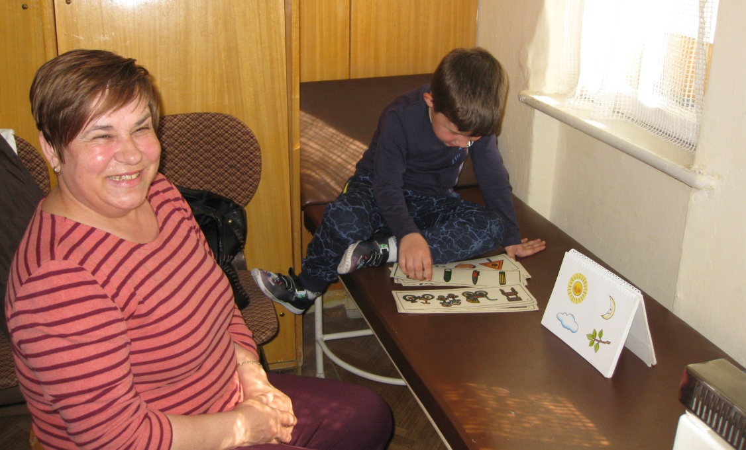
Logopedic activity in kindergarten "Zvanche"
Overcoming the difficulties in speech formation and proper pronunciation

Slide 12
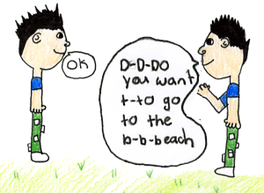
In the kindergarten there are children with
stuttering
dislalia
and general underdevelopment of speech.

Slide 13
All children have normal physical and mental development and show the opportunity to learn. They are aged 4 to 6 years and are willing to attend logopedic activities.
Different techniques and methods are used in view of child offenses: - Logopedic massage - forehead, cheeks, soft palate, wrists. - Exercises - hands, feet, body. - Breathing exercises. - Articulation exercises: to move the lips, to move the tongue, to move the soft palate, to combine the exercises. All exercises are supported by appropriate texts.

Slide 14
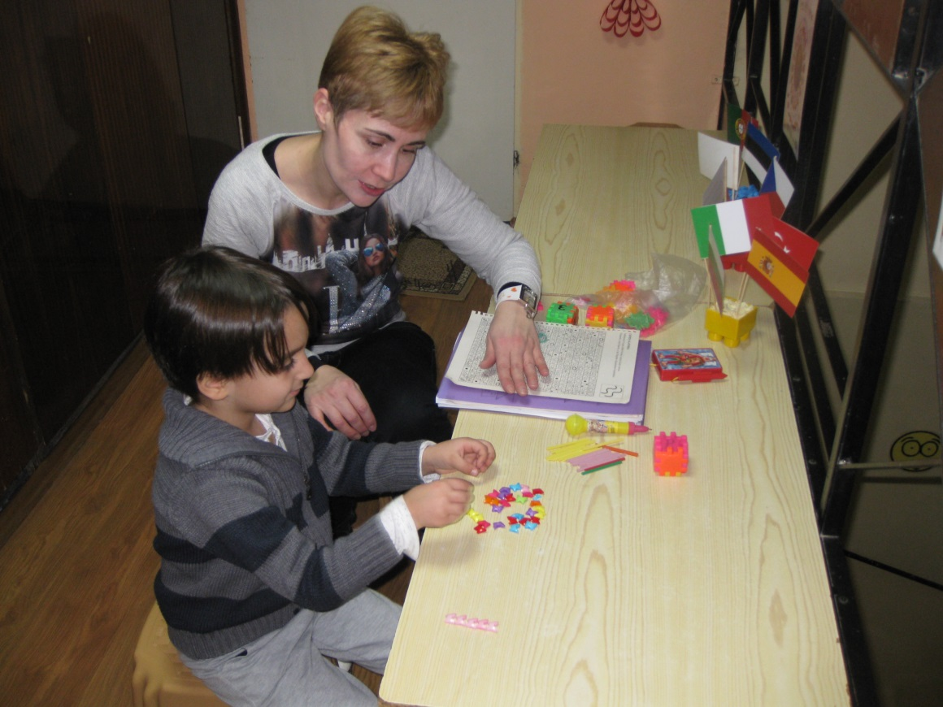
Psychological activity in kindergarten "Zvanche"
The psychologist's activities are as follows: 1. Diagnostics 2. Correctional development 3. Advisory activity 4. Mediation activity

Slide 15
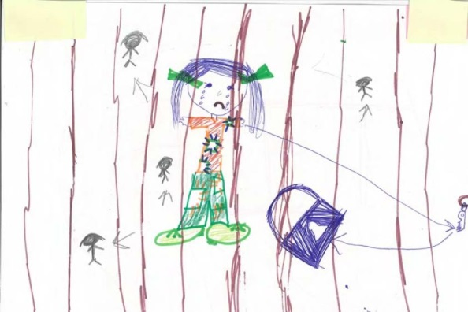
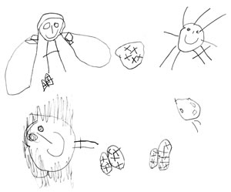
In kindergarten “Zvanche “ children with SEN have
social
communicative
and cognitive deficits.

Slide 16
Diagnostics: Diagnostic methods - observation, interview, questionnaires, talk, projection methods, tests, drawing.
Advisory activity: Consultations with parents on issues related to their relationship with their children.
Mediation activity: Between the child and his / her parents, between the child and his / her teachers. Between the parents and the leadership of the kindergarten.
Correctional development activity: Detecting deficits in cognitive, social and emotional development. Drawing up a personal development plan. Tracking these processes in dynamics is a priority.

Slide 17
Thanks for your patience!

