Slide 1
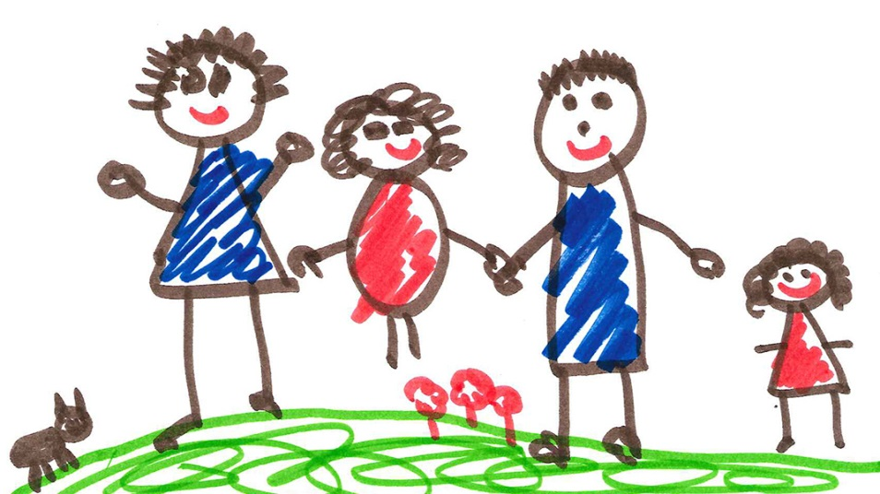
Valuing family and including families to everyday activities

Slide 2
Pre-primary education in Bulgaria as a process of schooling, socialization and education of children takes place in interaction and cooperation with parents. Parents are participants and partners in pre-school education along with children, teachers, directors, and other pedagogical staff specialists. Through:
Individual consultations
Parenting meetings
Trainings
Whenever a particular situation or behavior of the child makes it necessary
Participation in projects

Slide 3
Rights:
1. To receive periodic and timely information on the success and development of children
4. Attend and, if they wish, be heard when addressing issues affecting the rights and interests of the child
6. To elect and be elected to public Board of kindergarten
7. To express opinion and make suggestions for the development of the kindergarten
2. To meet the director, teachers and other pedagogical specialists at the appointed reception time or in another time convenient for both sides
3. To get acquainted with the school curriculum or with the educational system in kindergarten
5. At least once a year receive information, support and counseling in kindergarten on issues related to education and the personal development of their children

Slide 4
PUBLIC BOARD
The Public Board is a body to support the development of kindergarten and civic control over its management.

Slide 5
1. It approves the strategy for the development of the kindergarten and adopts the annual report of the director
2. It participates in the work of the Pedagogical Board when discussing the programs
3. It offers policies and measures to improve the quality of the education process
4. It has an opinion on the breakdown of the budget by activity and the amount of capital expenditure
5. It coordinates the school curriculum
6. It participates with representatives in committees for evaluation and professional development of teachers, director and other pedagogical specialists
7. It approves the selection of textbooks and school kits
8. It shall notify the competent authorities when it finds violations of normative acts
9. It gives an opinion on the school reception plan

Slide 6
SCHOOL BOARD
School board is an independent voluntary association to support the activity of the educational institution. It includes parents and people who are not parents of kindergarten children.

Slide 7
1. It helps to provide additional financial and material resources for the kindergarten and controls their expense
2. It supports the building and maintenance of the material and technical base of the kindergarten
3. It helps in solving other social and household problems of children
4. It contributes to the realization of programs on the problems of children, for activities of interest, organized recreation, tourism and sports with children
5. It organizes and assists parents' education on the issues of the education and development of their children
6. It organizes citizens to support kindergarten
7. It alerts competent authorities to violations committed

Slide 8
Parents can every day …

Slide 9
Collaboration and interaction between teachers, directors and other pedagogical specialists and parents create the conditions for achieving the goals of The Law on Pre-school and School Education, as well as to develop a positive attitude towards kindergarten and motivation for learning.

