Slide 1
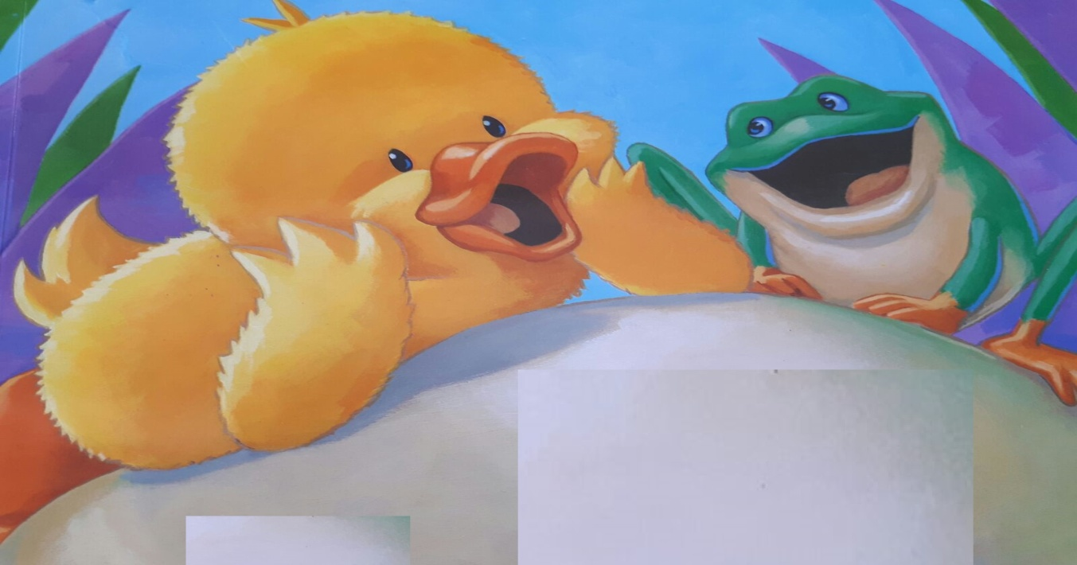
EVERY CHILD IS SPECIAL 2017
DIFFERENCIES BOOK
TALATPAŞA ORTAOKULU

Slide 2
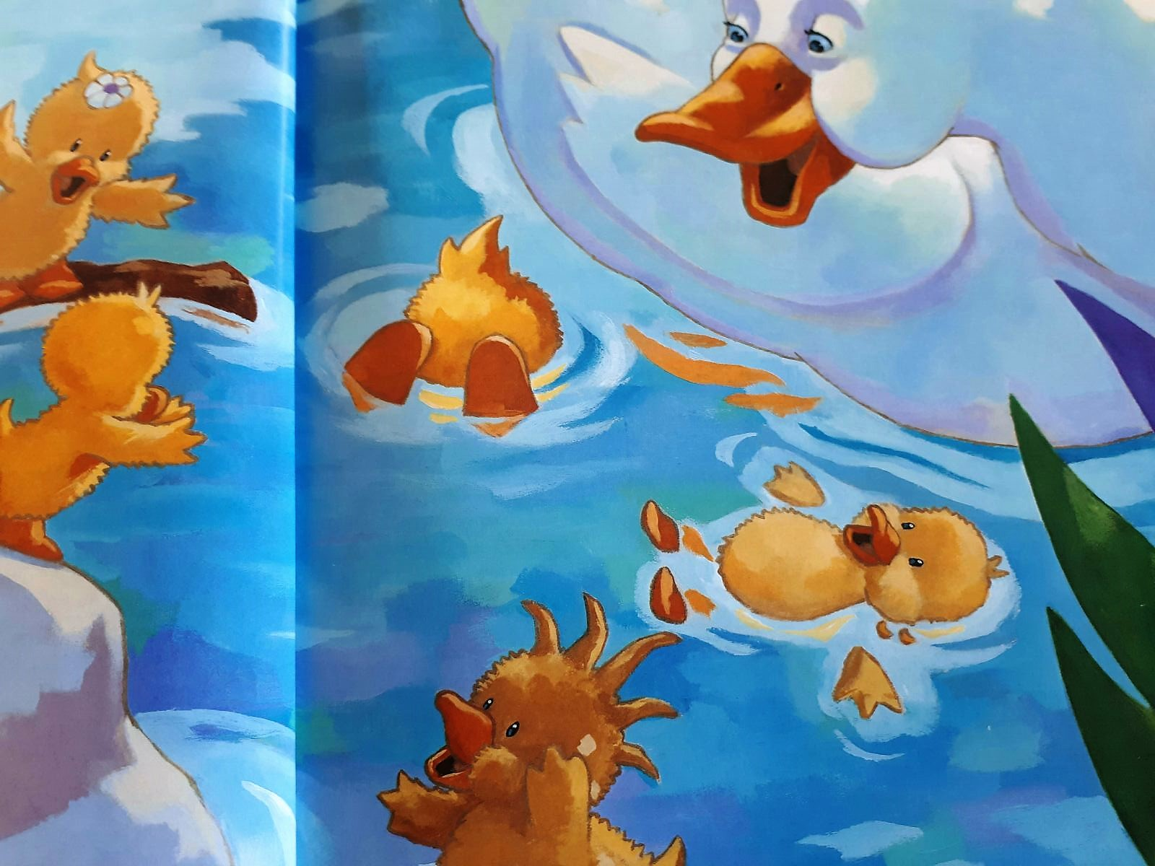
LITTLE QUACK QUACK AND NEW FRIEND
Mother duck and five ducklings plays in the water.

Slide 3
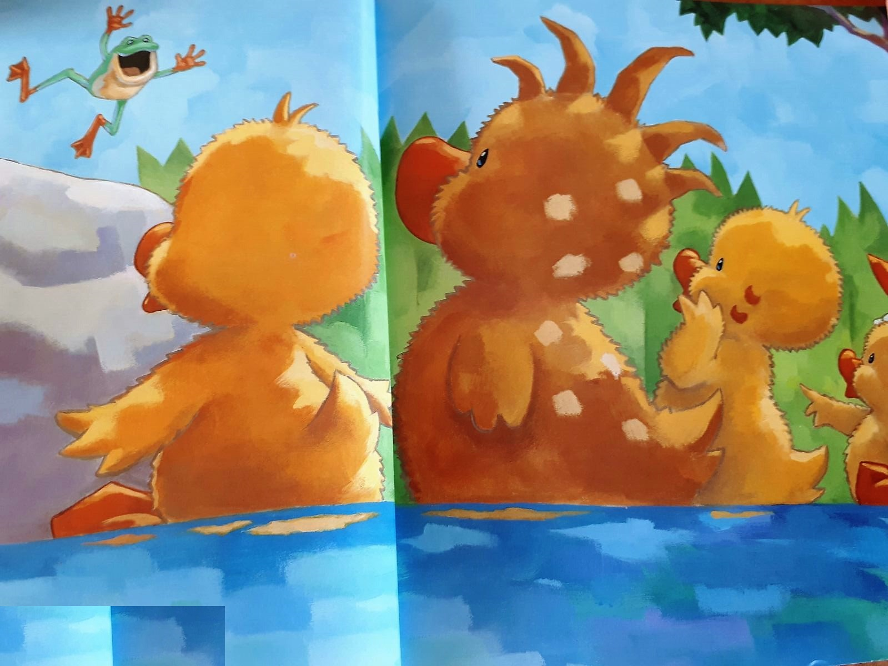
A little frog from behind the rock says that :
Croack , Would you get me to your game?
One of the ducklings says : No, you are too little!
One of the ducklings says : No, you are green!
One of the ducklings says : You can’t say “quack” like us!
Little quack quack says : Don’t worry little frog I play with you.

Slide 4
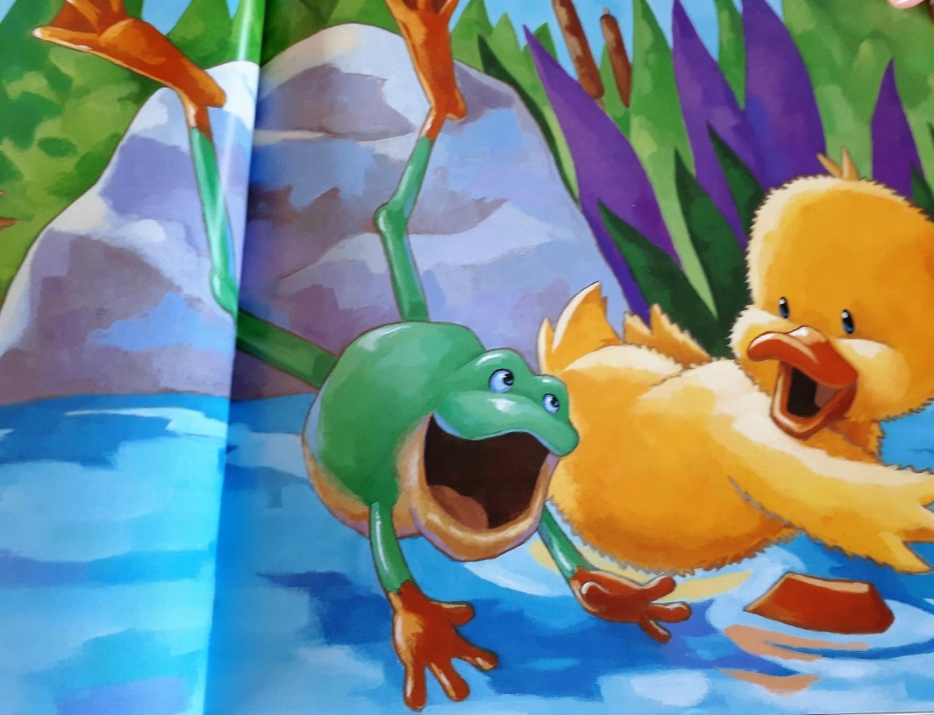
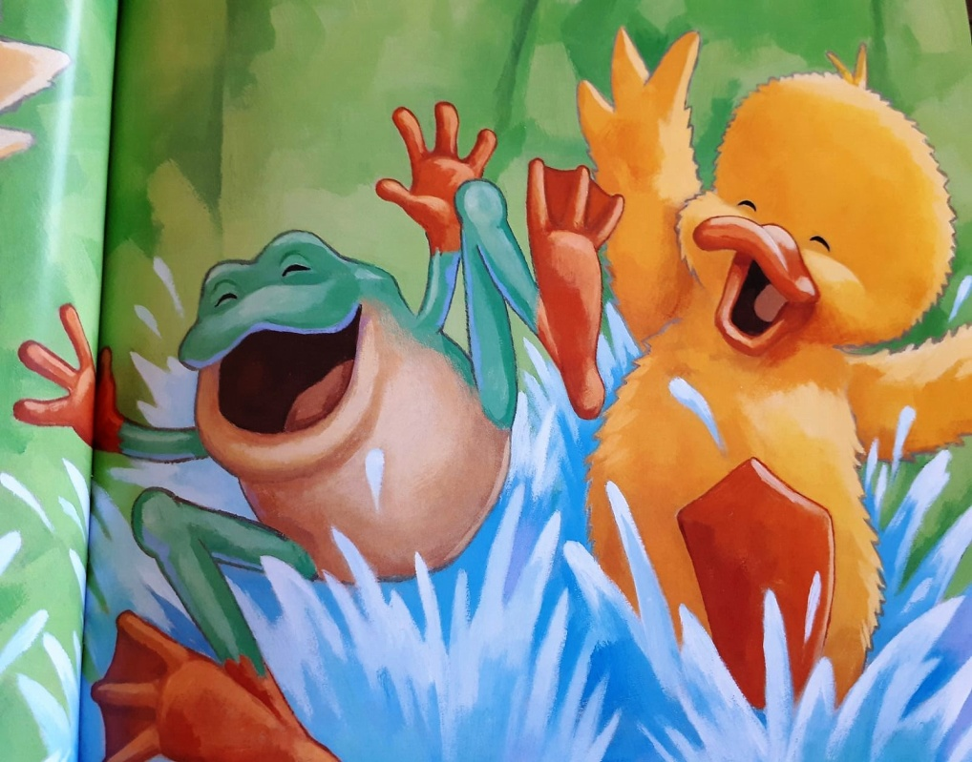
They begin to play saying quack quack and croack croack.
Little frog says that : Let’s play water fight.
One of the other ducklings wants to play with them and asks : Can I play with you?
Little friends say that : Yes , come on.

Slide 5
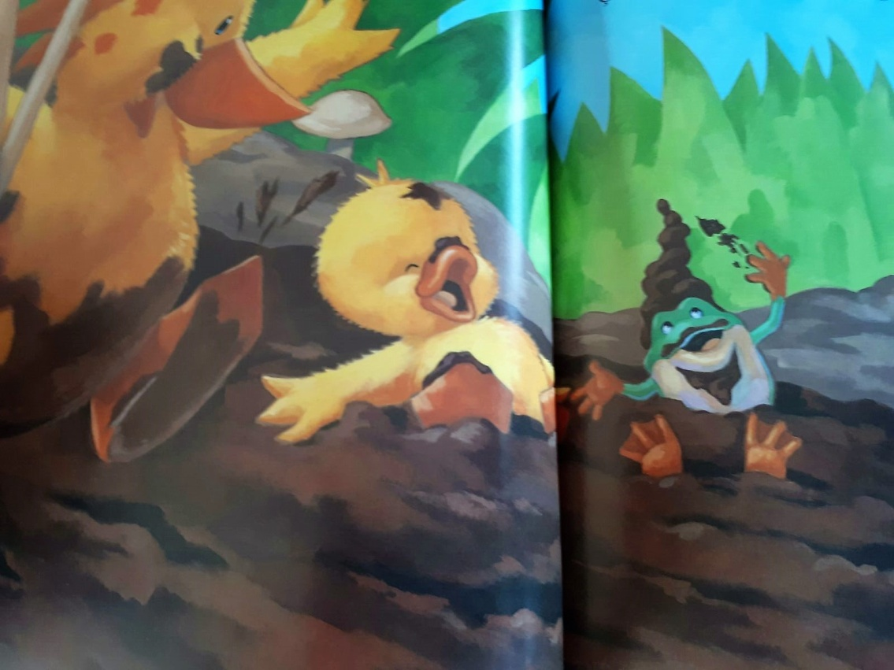
They submerges in mud. One of the other duckling who loves mud says that:
Can I come to you ?
Little frog :
Of course come on!
They have enjoy so much on that game.

Slide 6
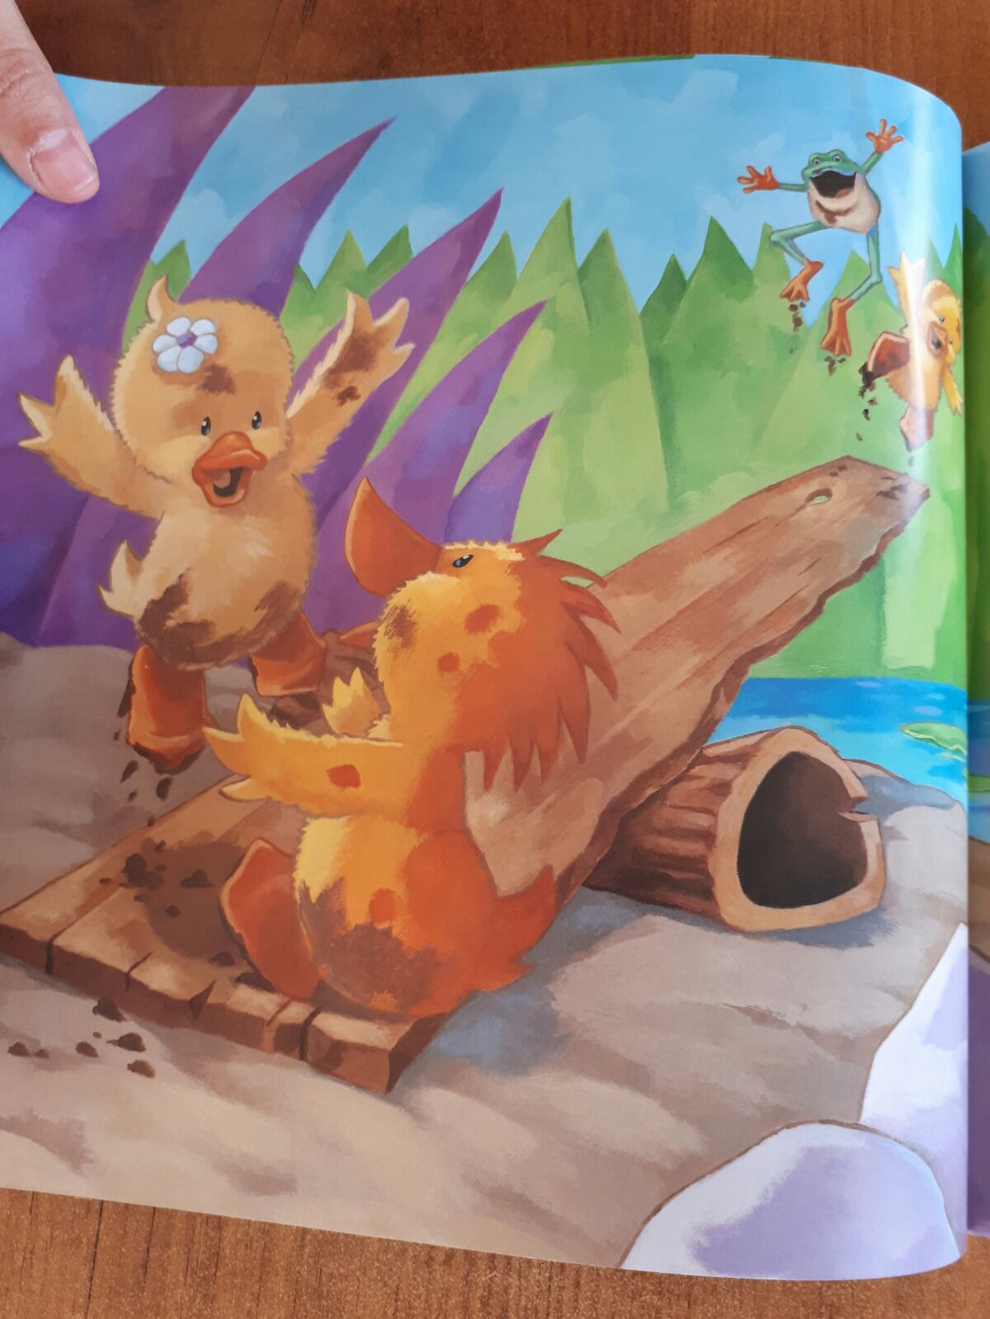
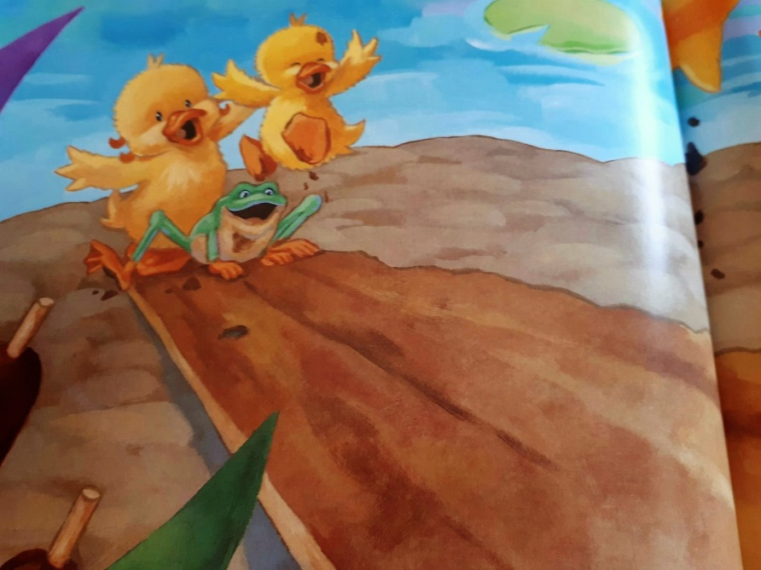
Now there is a game which name is launching.
They start to play launching and they launch each other in water and in mud.
So other duckling also wants to play with them.
Can I also play with you ?
Little friends say that :
Hurry up come on!

Slide 7
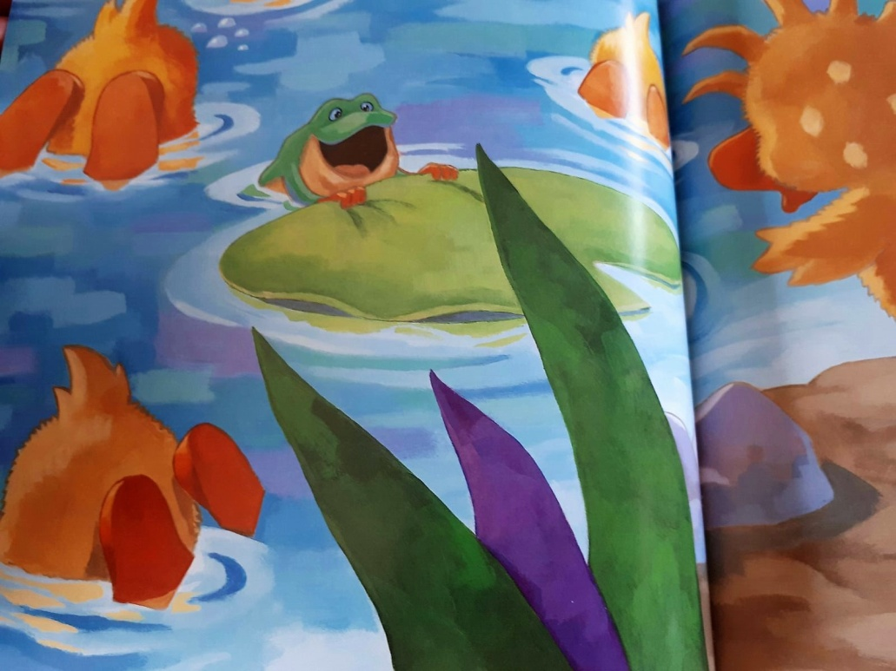
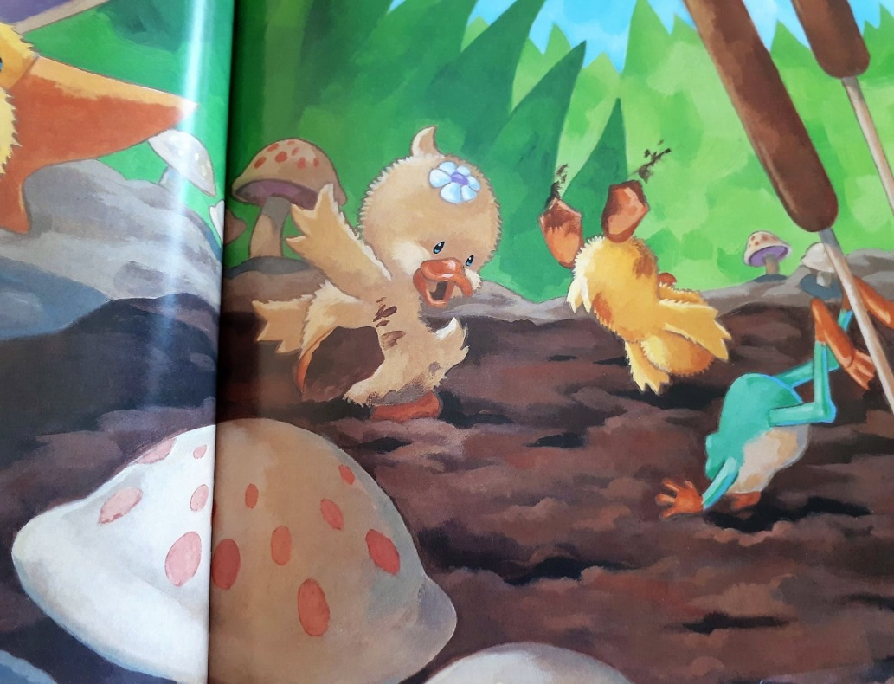
Together they swim in the lake. All duckling and little frog are in the lake to play.
Ducklings say to little frog that:
You are too little but it’s ok.
You are green but it’s ok.
You can’t say quack but it’s ok.
You are different but it’s ok because we can play together and you are our friend.

Slide 8
Mother duck looks proudly to her ducklings and thinks :
“My ducklings learn to be friend despite their differencies.

