Slide 1
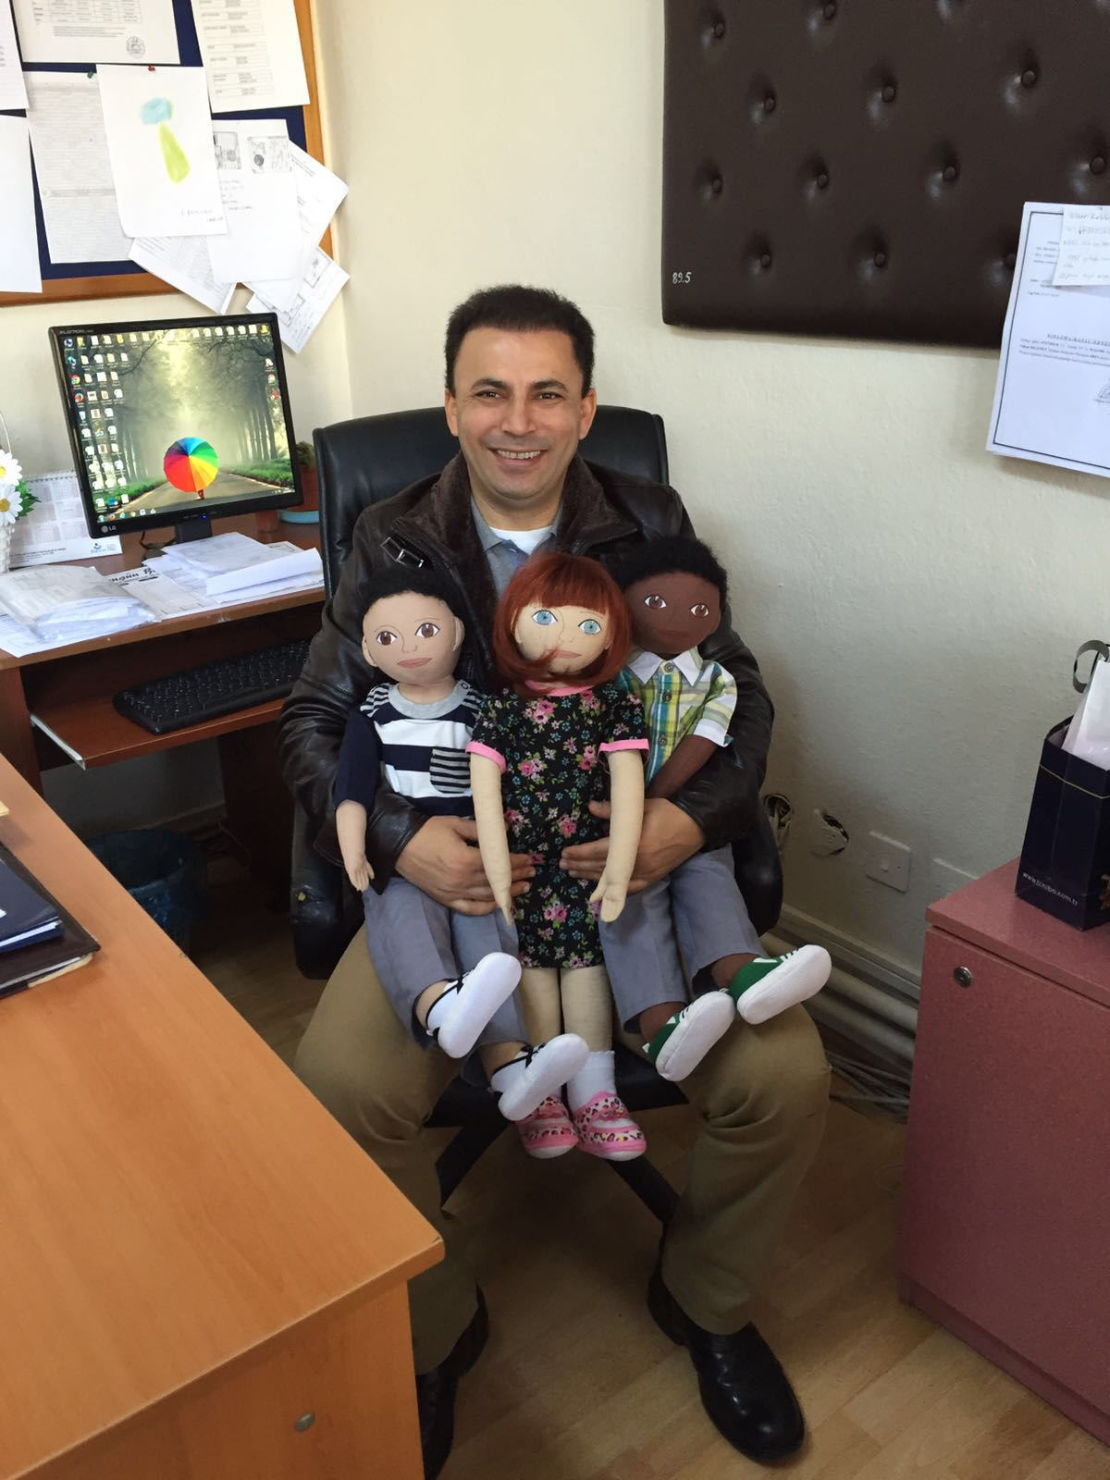
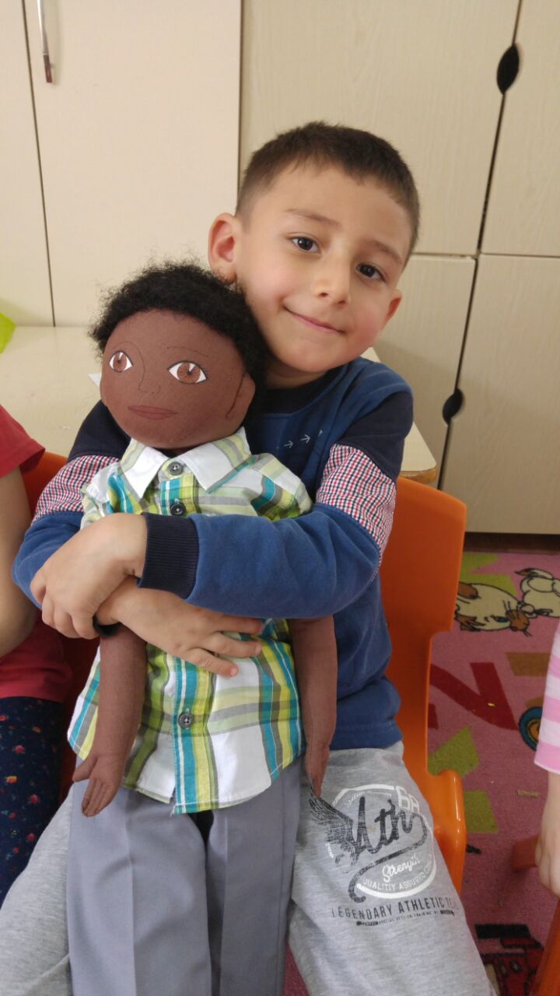
SECOND DOLL’S NAME IS SUPHI

Slide 2
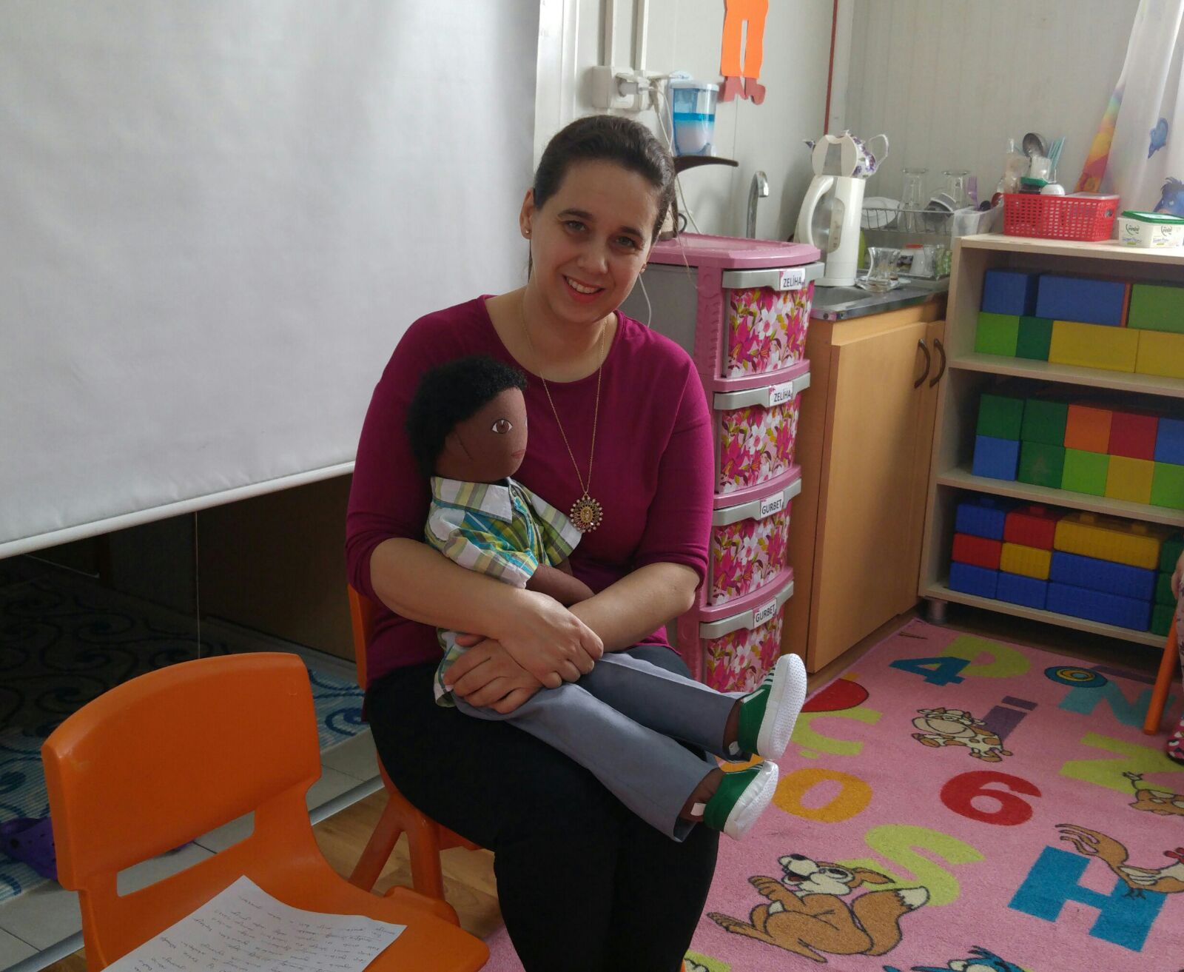
SUPHI IS HALF PERSIAN AND HALF TURKISH ☺

Slide 3
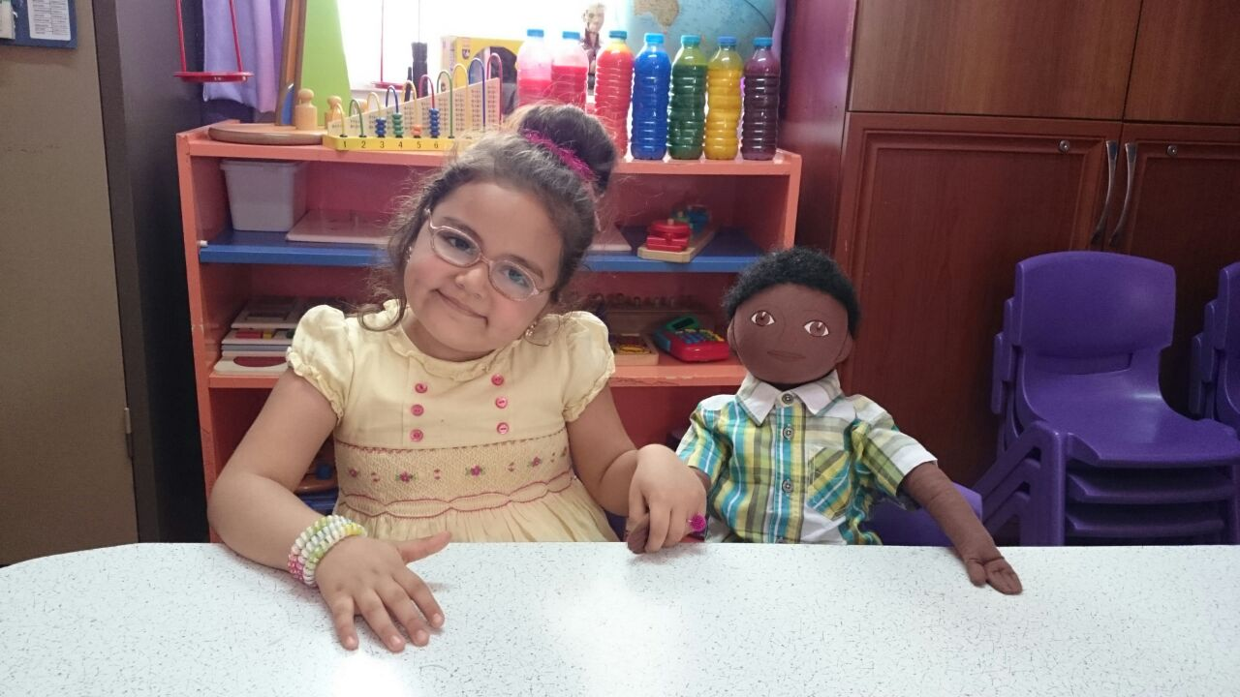
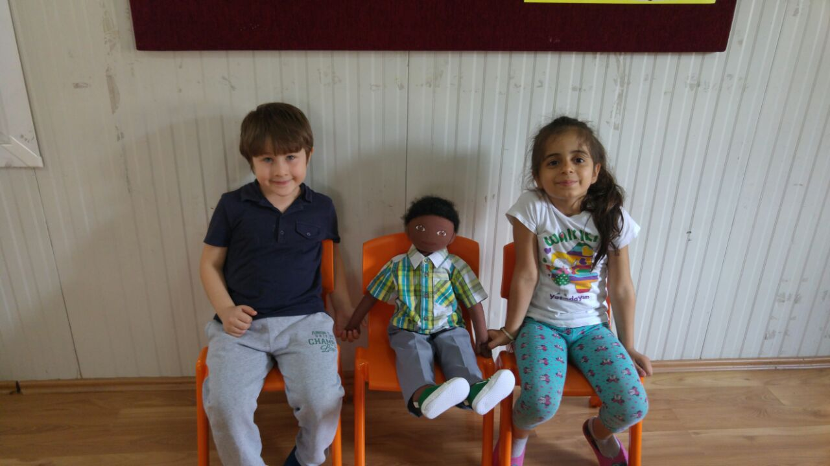
CULTURAL BACKGROUND
HIS MOTHER IS PERSIAN
HIS FATHER IS TURKISH
HE HAS AN OLDER BROTHER, TWO OLDER SISTER AND A YOUNGER SISTER.
HE LIVES IN SUBURB OF IZMIR.
HE SPEAKS PERSIAN LANGUAGE VERY WELL BUT CAN’T SPEAK TURKISH.

Slide 4
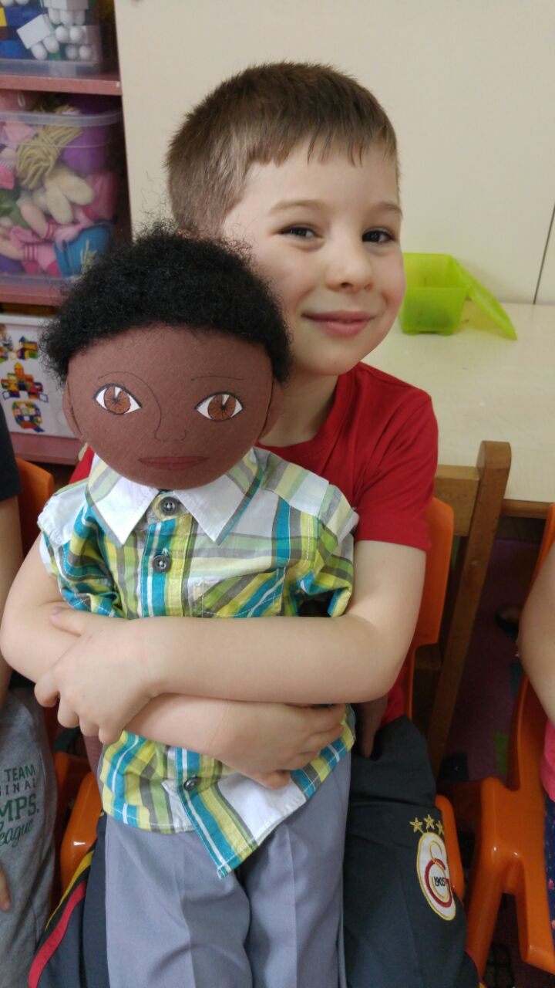
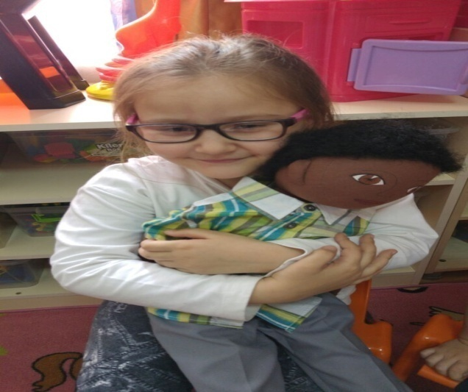
THINGS HE LIKES
THINGS HE DOES NOT LIKE
PLAYING TOY CARS.
PLAYING LEGO.
HE LIKES PERSIAN FOOD.
PLAYING GROUP GAMES.
ASKING QUESTIONS BY HIS TEACHER.
DOESN’T LIKE GIRLS. BECAUSE THEY TEASE HIM FOR SKIN COLOUR.
HE DOESN’T LIKE EATING FISH AND VEGETABLES.

Slide 5
DIFFICULT TO DO
HE CAN’T SPEAK TURKISH, THAT’S WHY HE DOESN’T LIKE BEING GROUP ACTIVITIES.
HE CAN’T JOIN HIS FRIENDS ON GAMES.
HE MISSES IRAN AND WHERE HE LIVED.
HE LOVES IRAN MORE THAN TURKEY AND IZMIR. BECAUSE HE HAS FRIENDS AND GRANDPARENTS, PEOPLE RELATED HIM.

Slide 6
HIS RECENT STORY
HE USED TO LIVE IN IRAN.
THEY CAME TO IZMIR BECAUSE OF HIS FATHER’S JOB.
HIS FATHER WORKS CONSTRUCTION FIRM.
THEY HAVE ECONOMIC PROBLEMS AS A FAMILY.
SO THEY HAVE TO LIVE IN SUBURB.

Slide 7
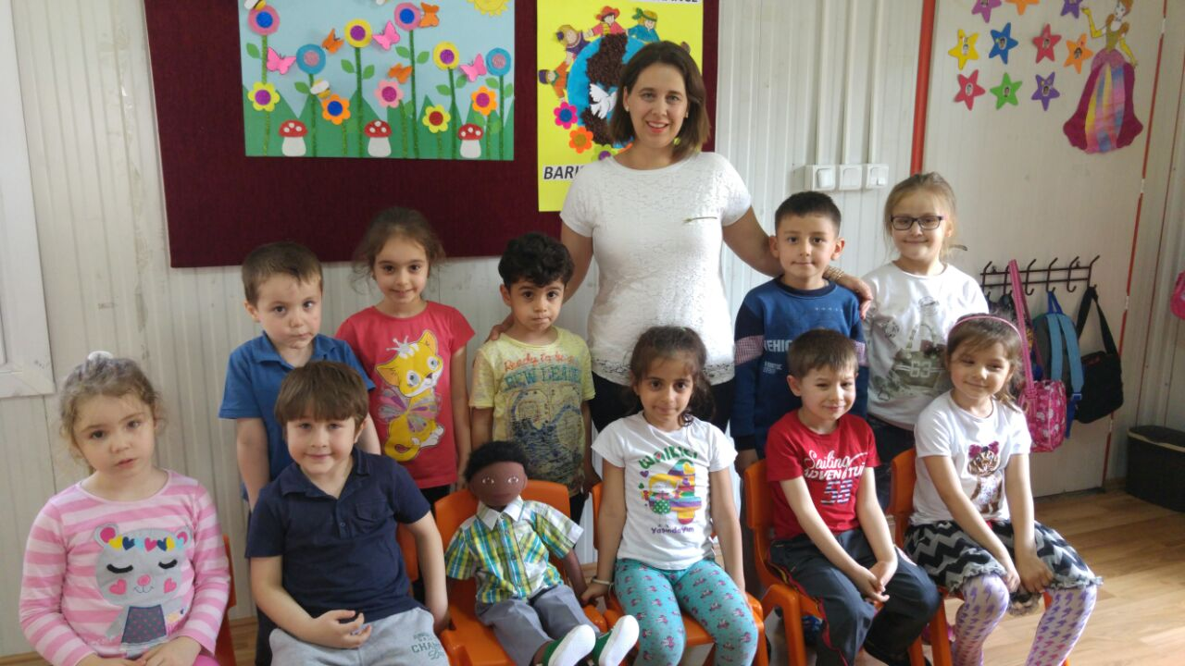
HE DOESN’T FEEL WELL IN OUR KINDERGARTEN , BECAUSE HE CAN’T SPEAK TURKISH FLUENTLY.
WE DECIDED HIM TO JOIN AMONG US.

Slide 8
WE ARE SURE THAT WE WILL GAIN HIS FRIENDSHIP…

