Slide 1
Differences book 2

Slide 2


Slide 3


Slide 4


Slide 5
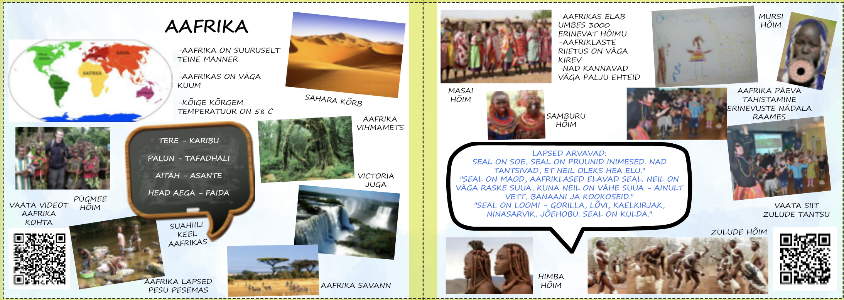

Slide 6


Slide 7


Slide 8
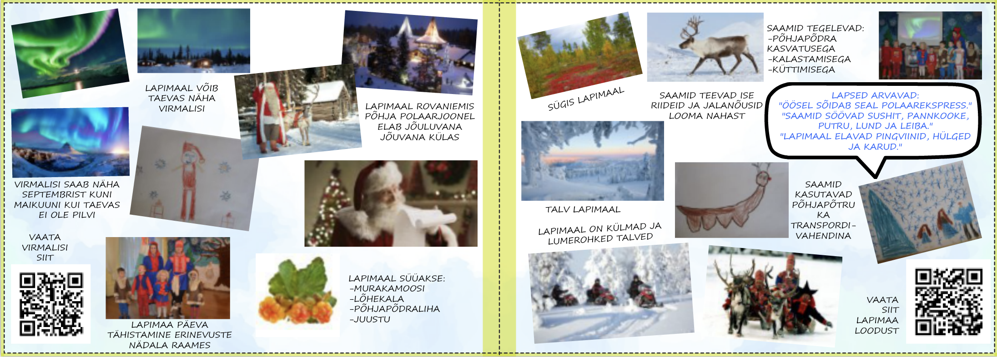

Slide 9
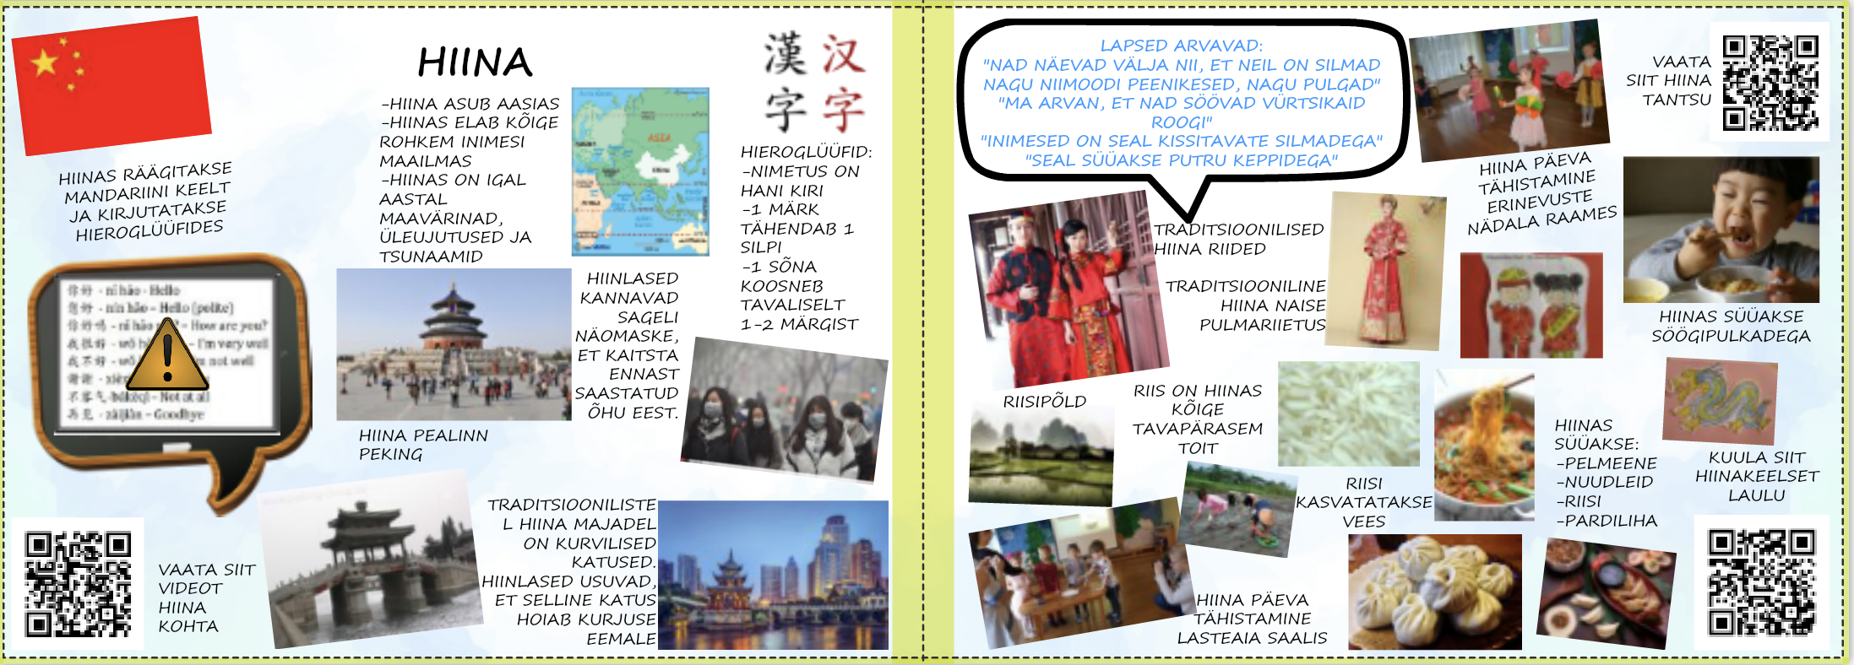

Slide 10


