Slide 1
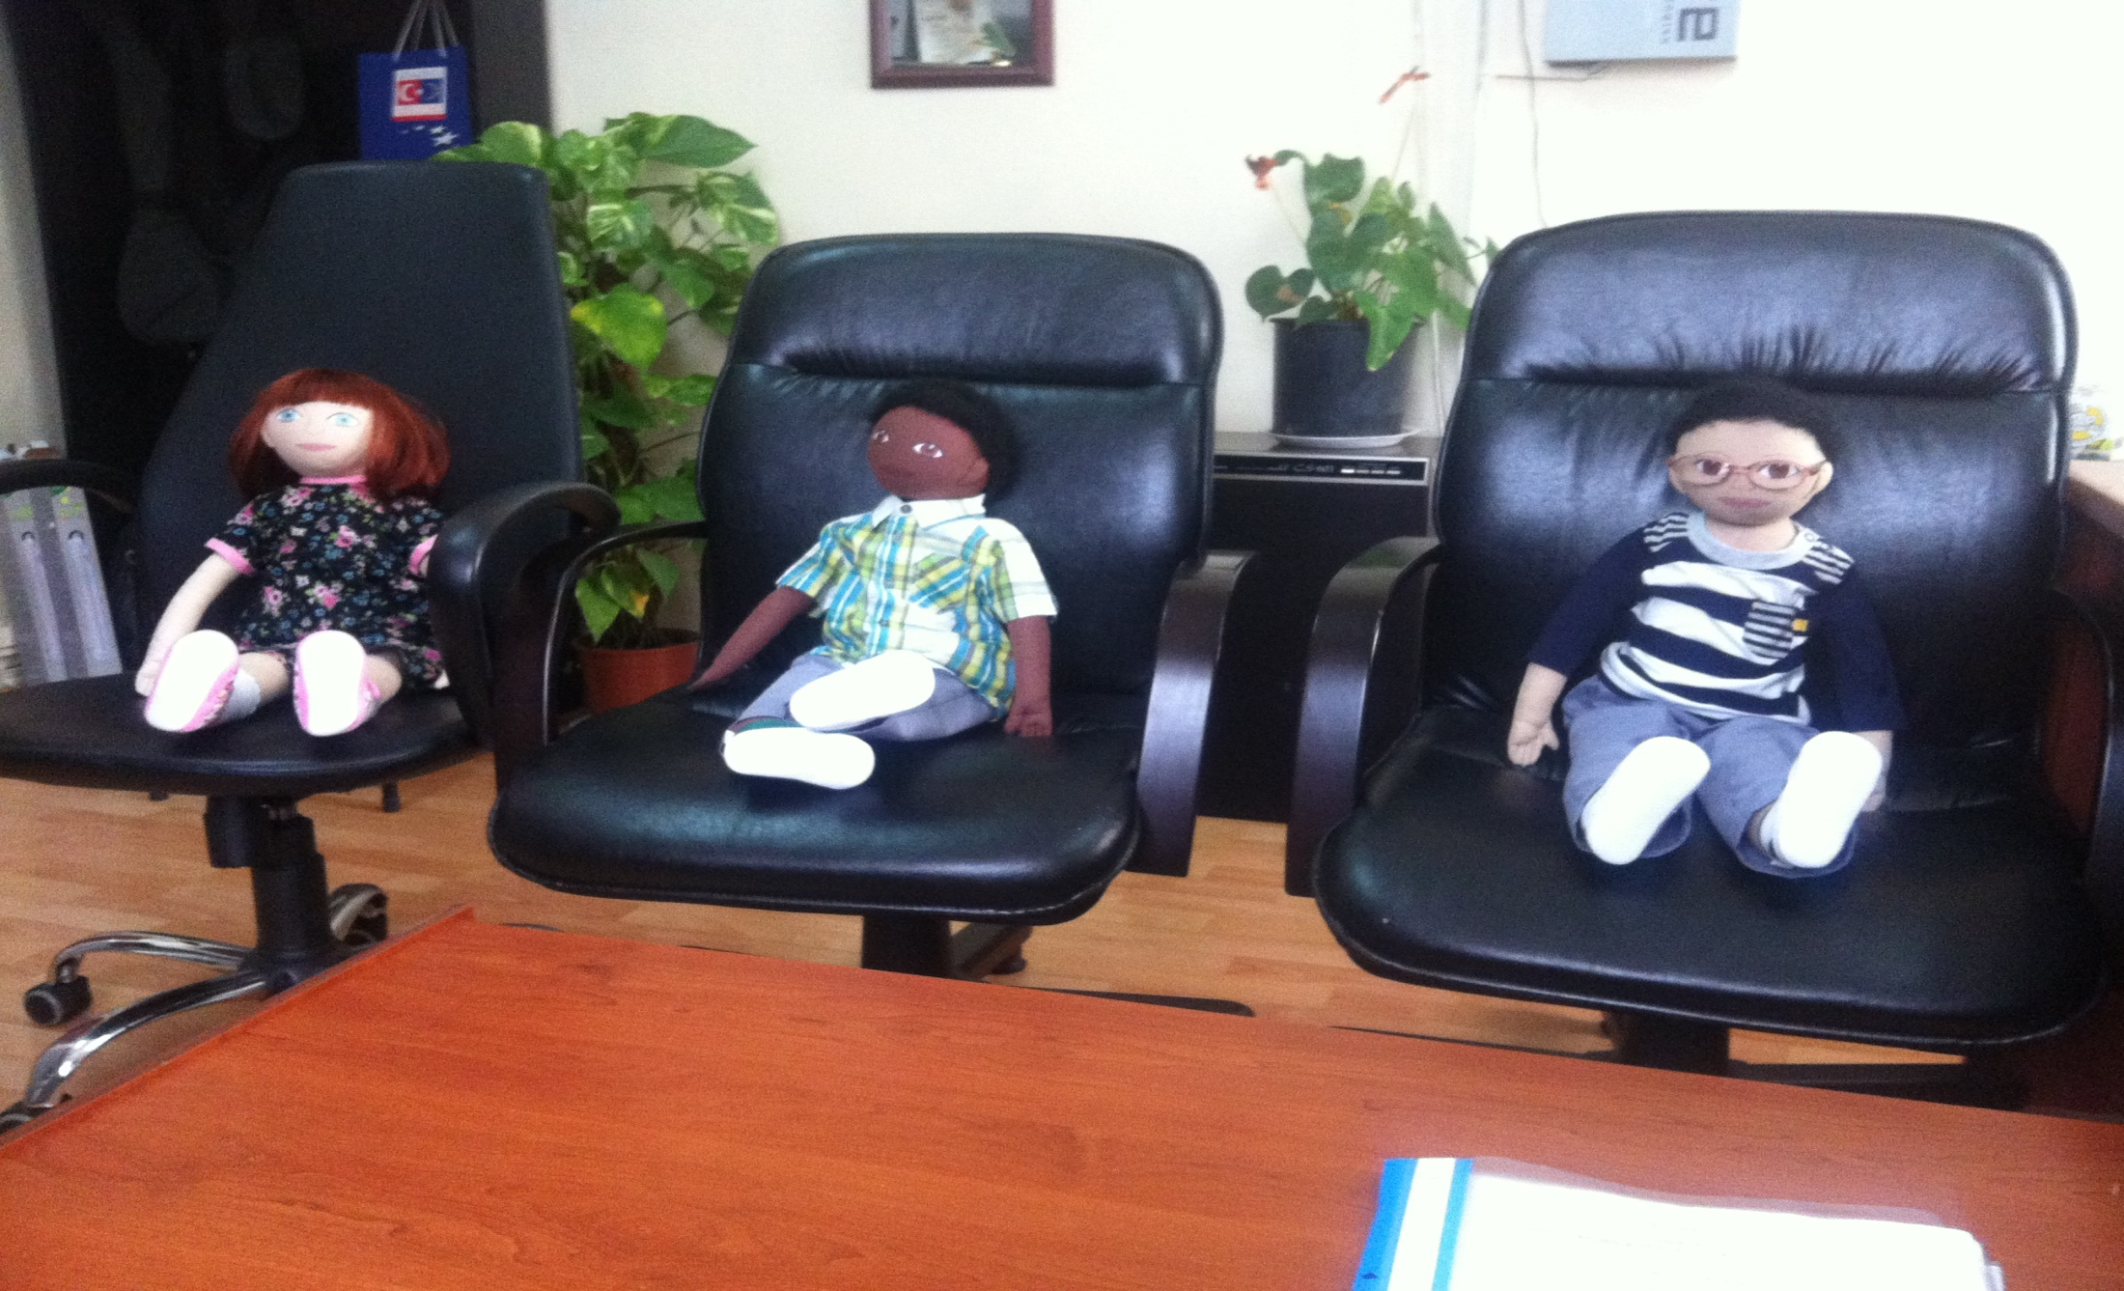
FIRST DOLLS IN TURKEY

Slide 2
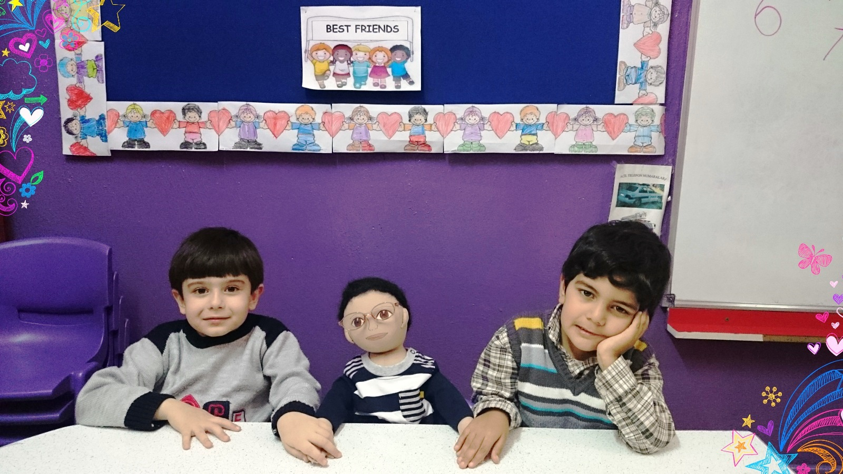
HERE IS OUR FIRST BABY

Slide 3
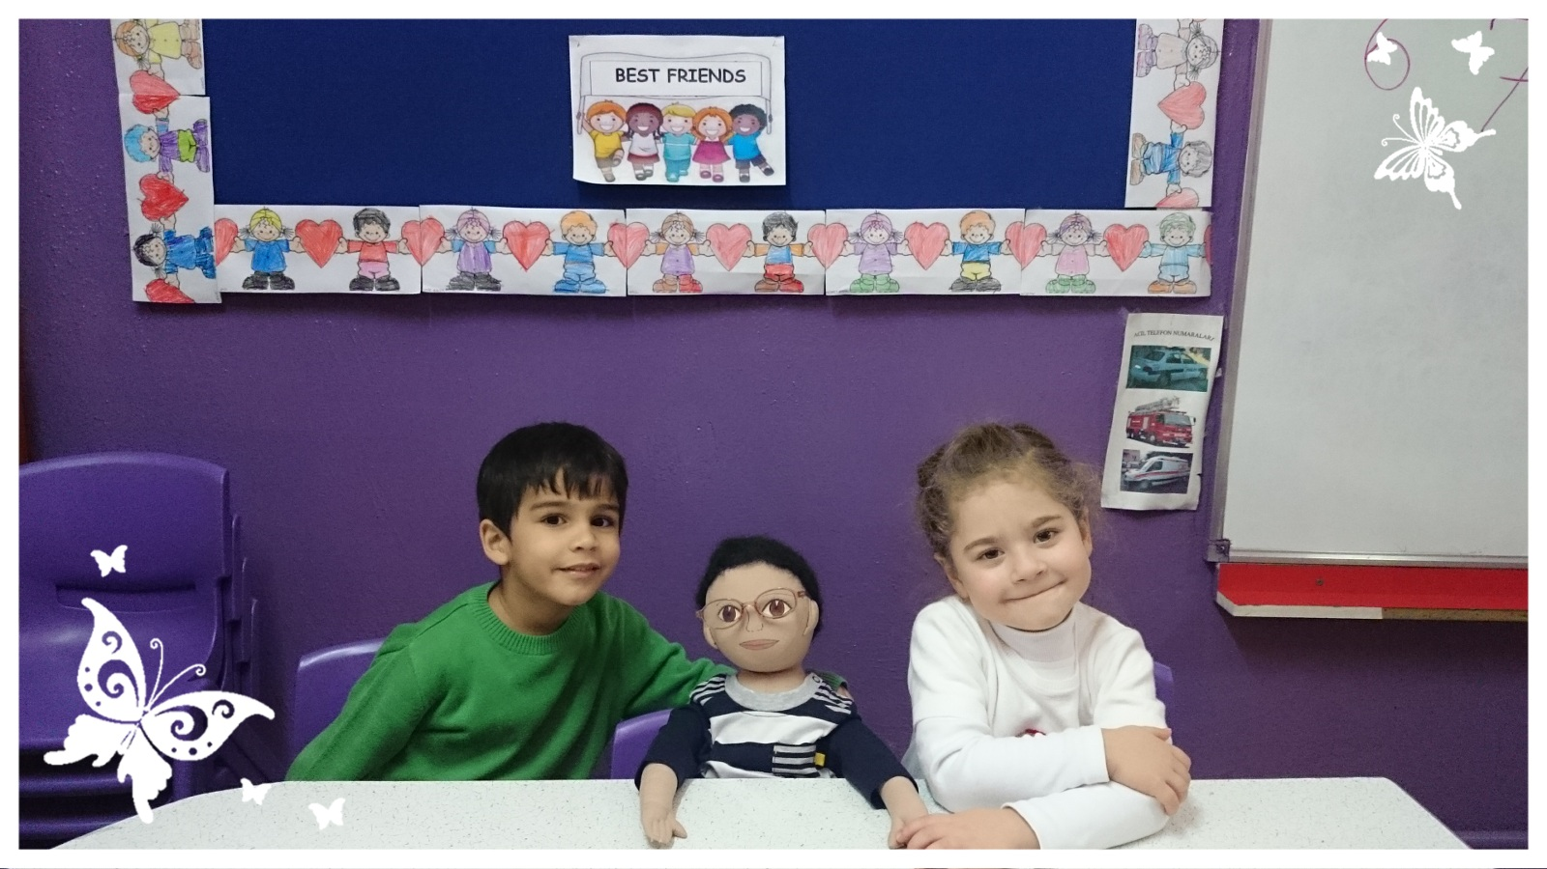
HIS NAME IS BORA

Slide 4
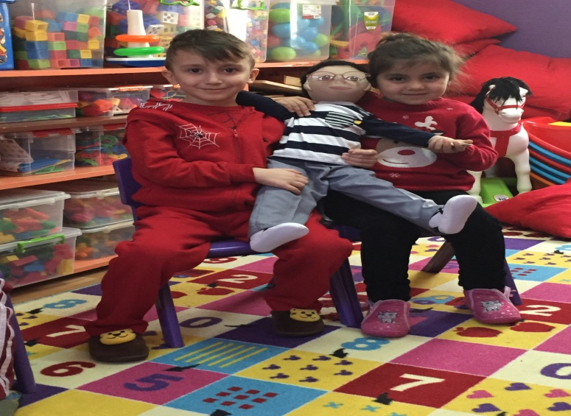
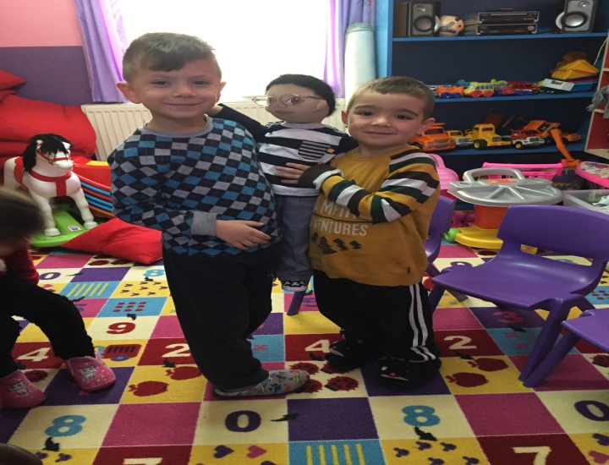
PROFILE
HIS PARENTS ARE DIVORCED.
HE HAS ELDER BROTHER AND YOUNG SISTER.
HE LIVES WITH MOTHER AND HIS SISTER.
HE LIVES IN APARTMENT IN IZMIR.
HE SPEAKS ONLY TURKISH.
HIS GRANDPARENTS LIVES TOO FAR CITY.

Slide 5
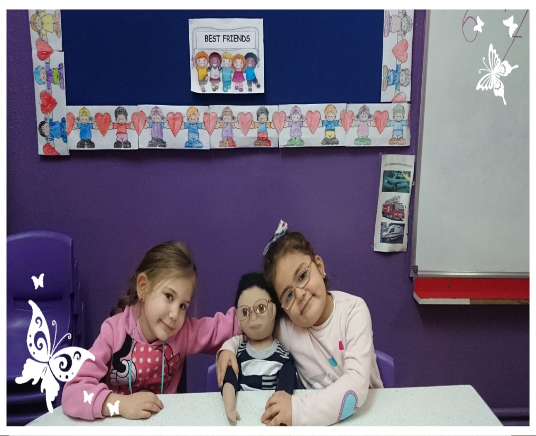
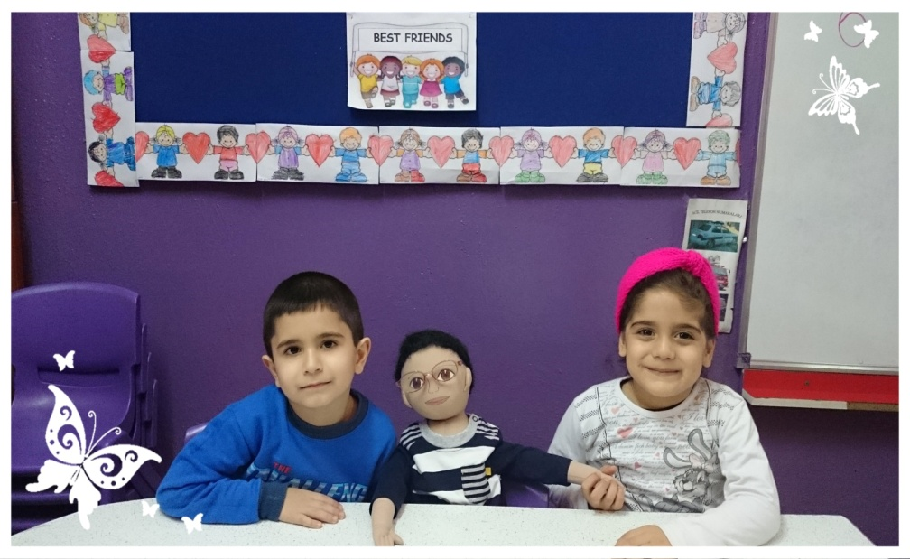
THINGS HE LIKES
THINGS HE DOES NOT LIKE
PLAY FOOTBALL
PLAY LEGO
HE LIKES SWIM
SHARE AND HELP HIS FRIENDS
HIS FAVOURITE COLOR IS BLUE.
WEARING EYEGLASSES.
EATING VEGETABLES.
LOSING ON GAMES.

Slide 6
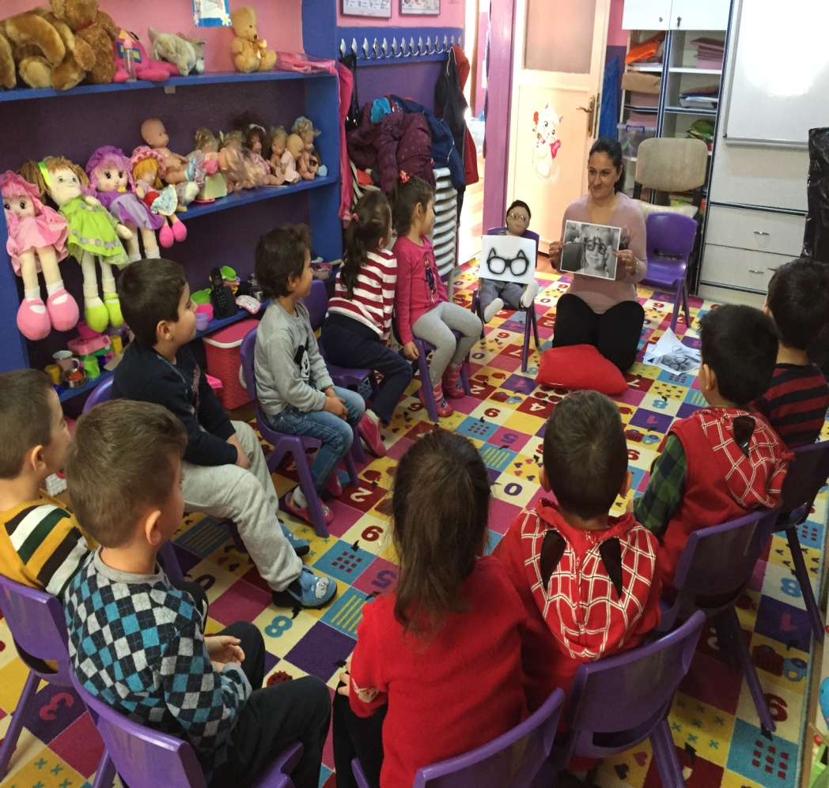
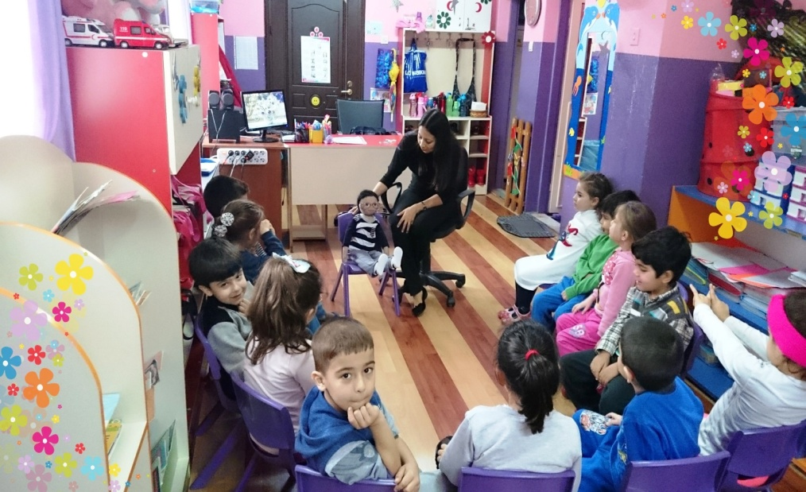
DIFFICULT TO DO
HE CAN’T PLAY FOOTBALL BECAUSE OF HIS EYEGLASSES.

Slide 7
HIS RECENT STORY
HIS FAMILY USED TO LIVE IN SMALL TOWN IN ADANA THAT ONE OF THE CITY OF TURKEY.
THEY HAVE COME TO IZMIR FOR JOB OPPORTUNITIES.
THEY HAVE TO LIVE IN APARTMENT AFTER THEY CAME TO IZMIR.
BORA DOES NOT LIKE THIS BECAUSE HE CAN’T PLAY OUTSIDE.
BORA MISSES SO MUCH HIS FRIENDS.

Slide 8
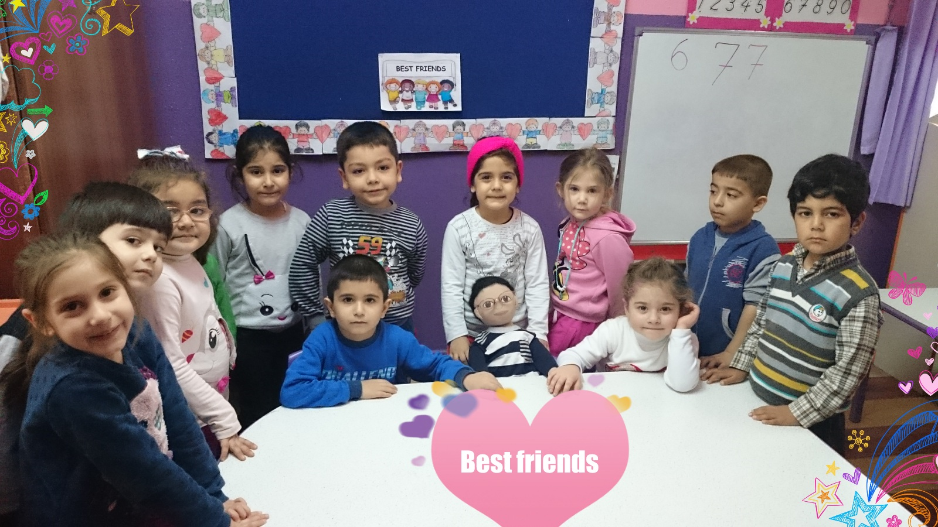
NOW HE IS IN OUR KINDERGARTEN. CHILDRENS IN KINDERGARTEN LIKE BORA SO MUCH. THEY ARE GOOD FRIENDS.

