Slide 1
Persona Doll number 4
Erasmus+ seminar in Turkey
26.03 – 31.03.2017

Slide 2
Hello, my name is Loviise

Slide 3
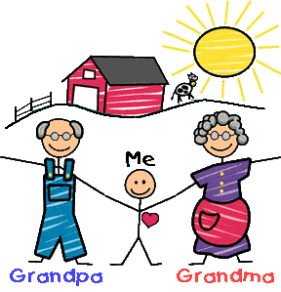
Family
Loviise lives with her grandmother and grandfather.
Loviise has not lived with her parents since the age of 2.
She has very few memories about her parents.

Slide 4
Where she lives
She is estonian and speaks estonian language.
She lives in a old house in quiet part of city for private houses.

Slide 5
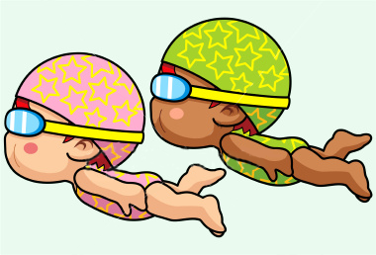
What she likes, dislikes
She likes sport activities: running, swimming.
She does not like to eat in kindergarten.
She usually eats in kindergarten only: bread, rice and drinks water.

Slide 6
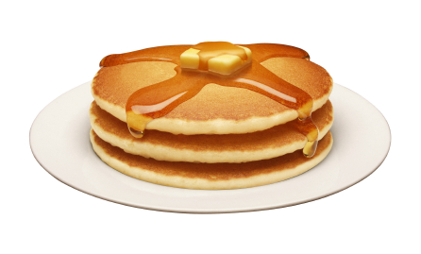
Food she likes and dislikes
She eats only pancakes, dumplings, rice, ryebread, white bread, fishfingers.
All other foods Loviise refuses to try.

Slide 7
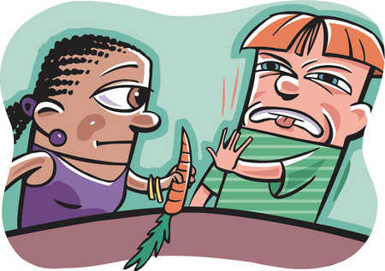
Fears
She is afraid that somebody forces her to eat.

Slide 8
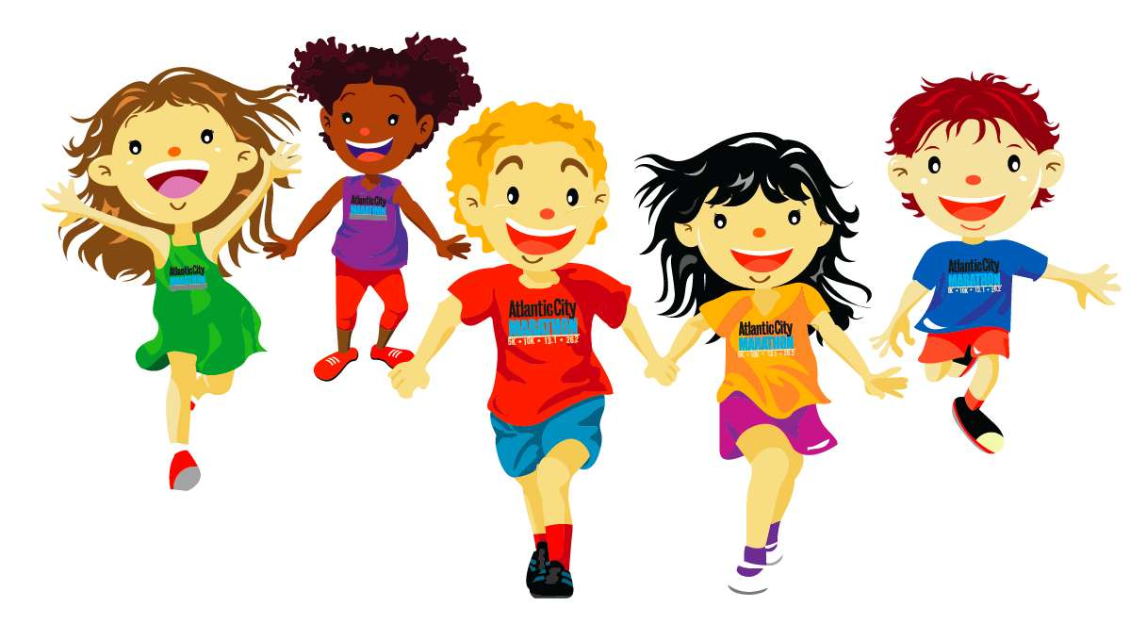
Physical peculiarity
She is very active and athletic.
She is very thin and has very light skin.

Slide 9
Recent history
Recently something serious happened with Loviise in the swimming pool. She had not eaten almost anything for a whole day and when she went swimming in the pool she felt very bad: she was dizzy and weak.
Grandmother is now very worried about her health. They are visiting psychologist.
Loviise now has a lunch box with her every day in kindergarten.

