Slide 1
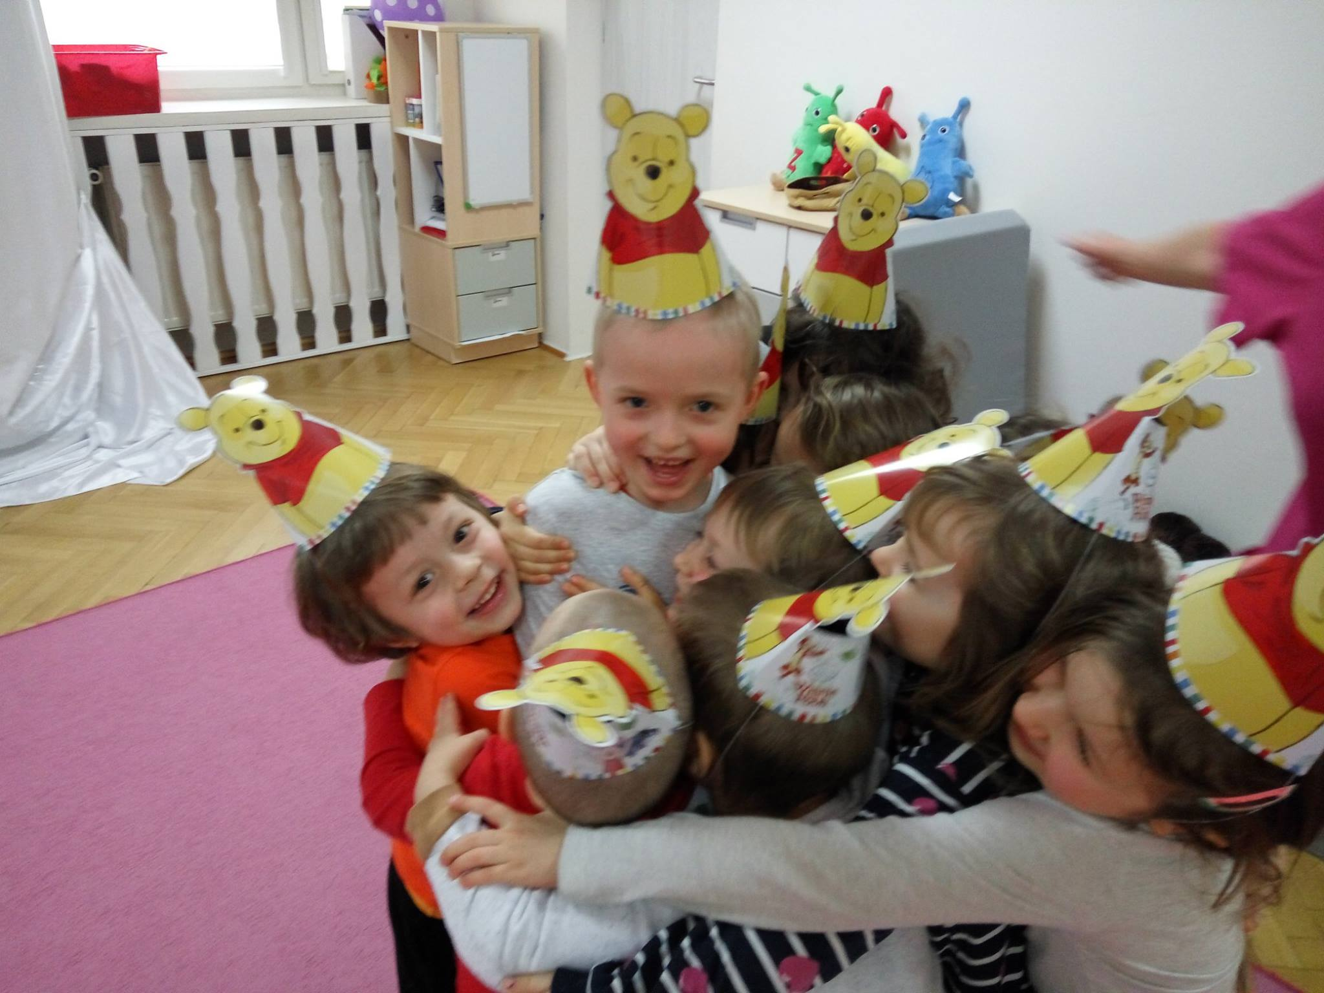
Teaching differences

Slide 2
WE ARE THE BEST EXAMPLE
Children are constantly watching our behaviour, thanks to their observations, they draw conclusions and know, how to behave in similiar situations.
Children imitate behaviour of significant person.
In our behaviour towards children, we are tolerant, we accept and respect their needs and ideas, we are listening to them.
We encourage parents to follow our example – our efforts should be consistent.

Slide 3
WE TALK AND EXPLAIN
We talk with children about differences among people.
We watch educational movies and read stories about differences.
We explain differences, emphasising respect to other people and their needs.
We teach that „Different” doesn’t mean „Worse”.
In our explanations, we use everyday situations, concerning issue of differences.
We encourage curiosity of our children, we invite them to explore the world.
Working with children on topics related to cultural differences, we are showing them the beauty and variety of the world
We are engaging children in social activities, inviting students from foreign countries, realizing project „Every child is special” - our children gain knowledge and experience associating with different people

Slide 4
WE REACT TO LACK OF TOLERANCE
We react to manifestations of lack of tolerance and we strongly oppose them
We explain children, that intolerant behaviours are wrong
We encourage children to express their opinions, we ask them „Why do you think your friend is stupid?”, „Why don’t you give your hand to him?”
Lack of reaction of teachers and parents to intolerant behaviour is their concession to such behaviour

Slide 5
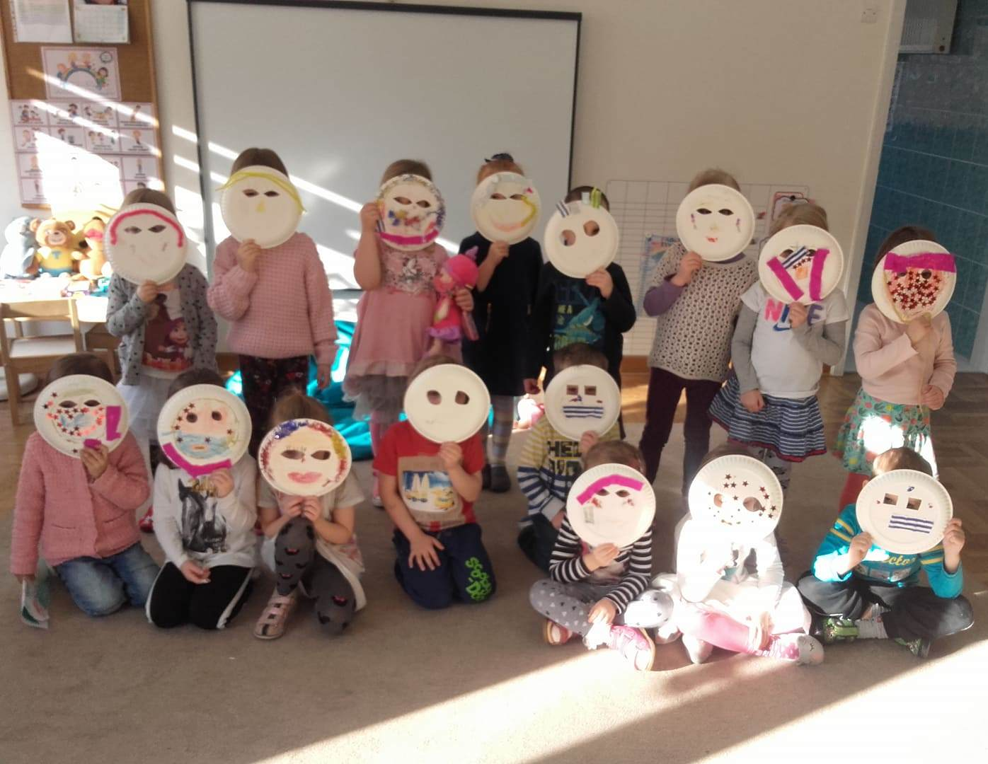
WE HELP TO DENOMINATE AND WE PAY ATTENTION TO WORDS
We teach, how to name „Different” with neutral, non- evaluative words
We talk about people, their different traditions and cultures
We show (on examples of movies, books etc.) divrsity of languages, religions, clothes and culinary traditions

Slide 6
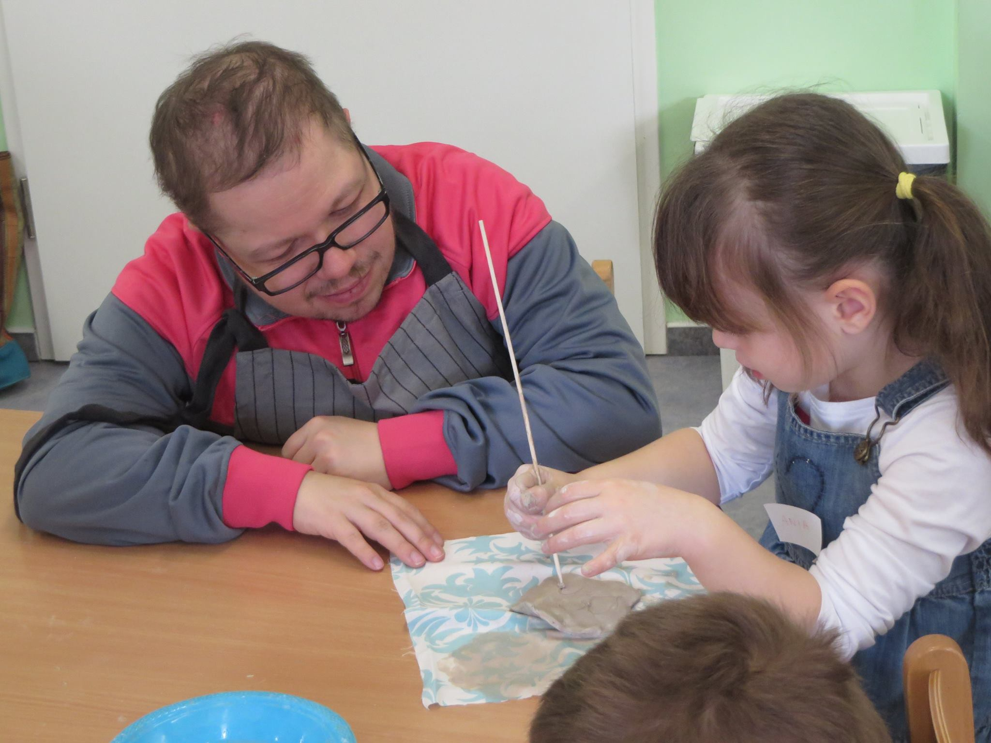
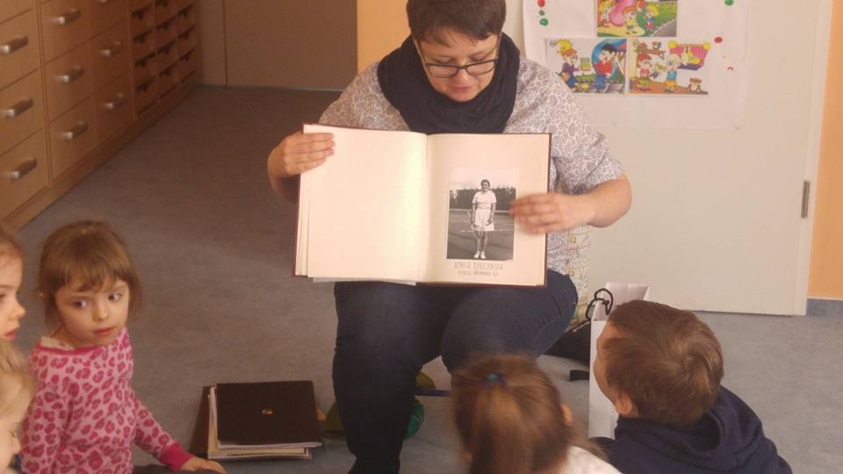
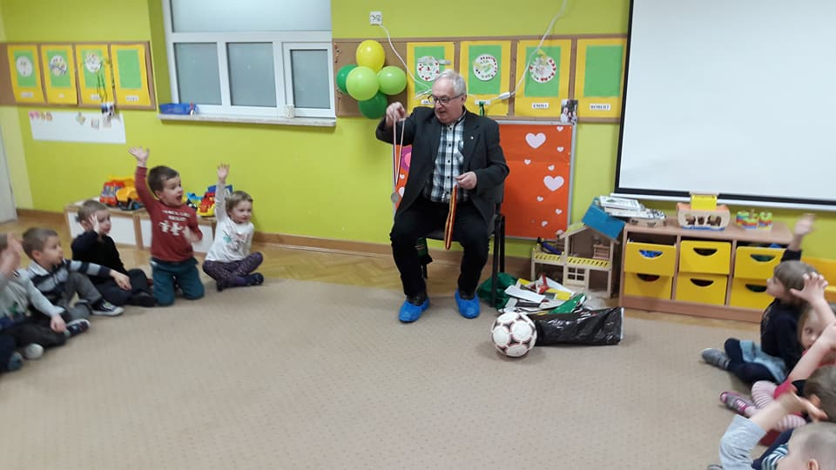
WE PROVIDE CONTACT WITH DIFFERENT PEOPLE
We cooperate with institutions working with people with disabilities and seniors: senior’s club, nursing home, integrational school and kindergarten, occupational therapy workshops)
We organize meetings with seniors and people with disabilities: together we can do many things: play, bake cakes, stick with clay.

Slide 7
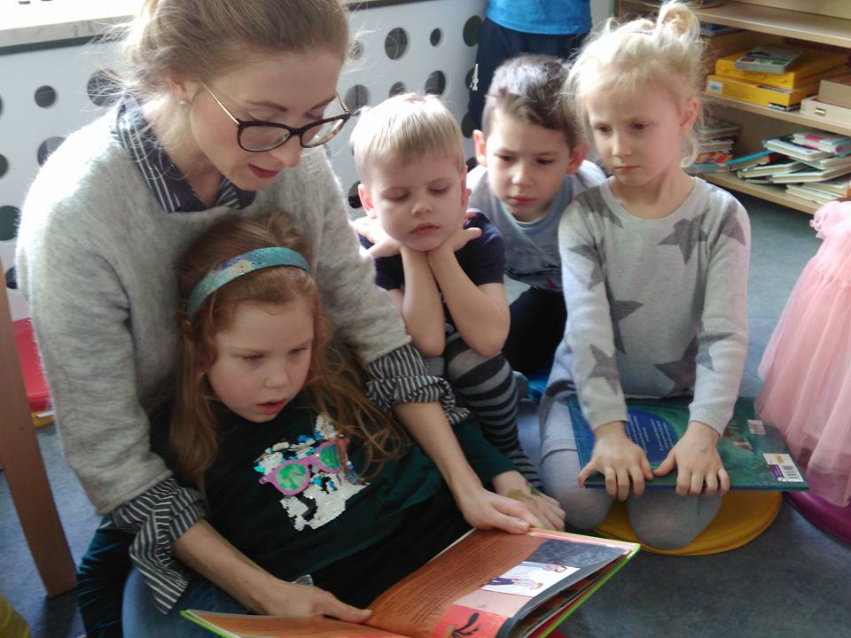
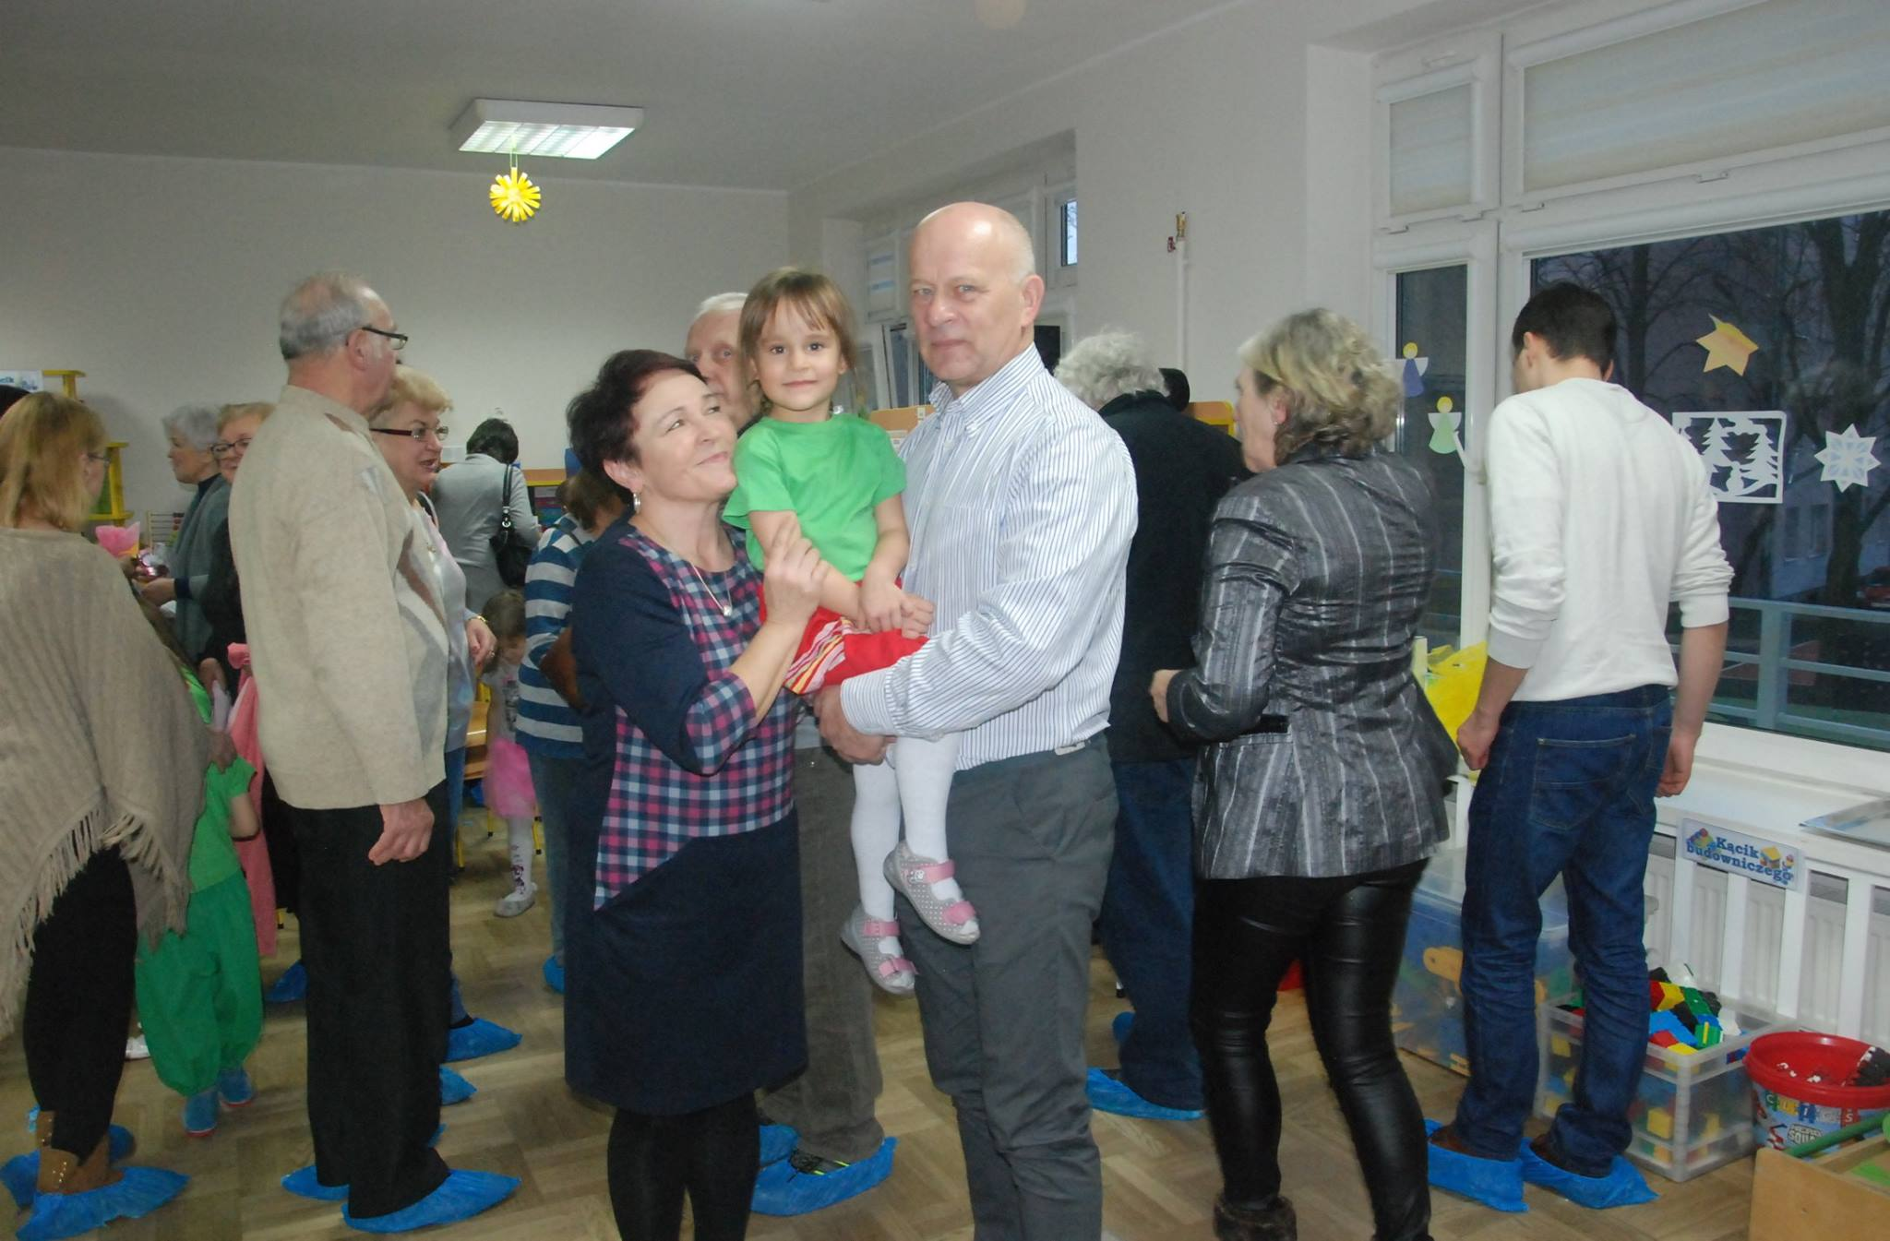
THE MOST IMPORTANT IS
personal example of closest people

