Slide 1
TEACHING DIFFERENCIES
TALATPAŞA ORTAOKULU
İZMİR

Slide 2
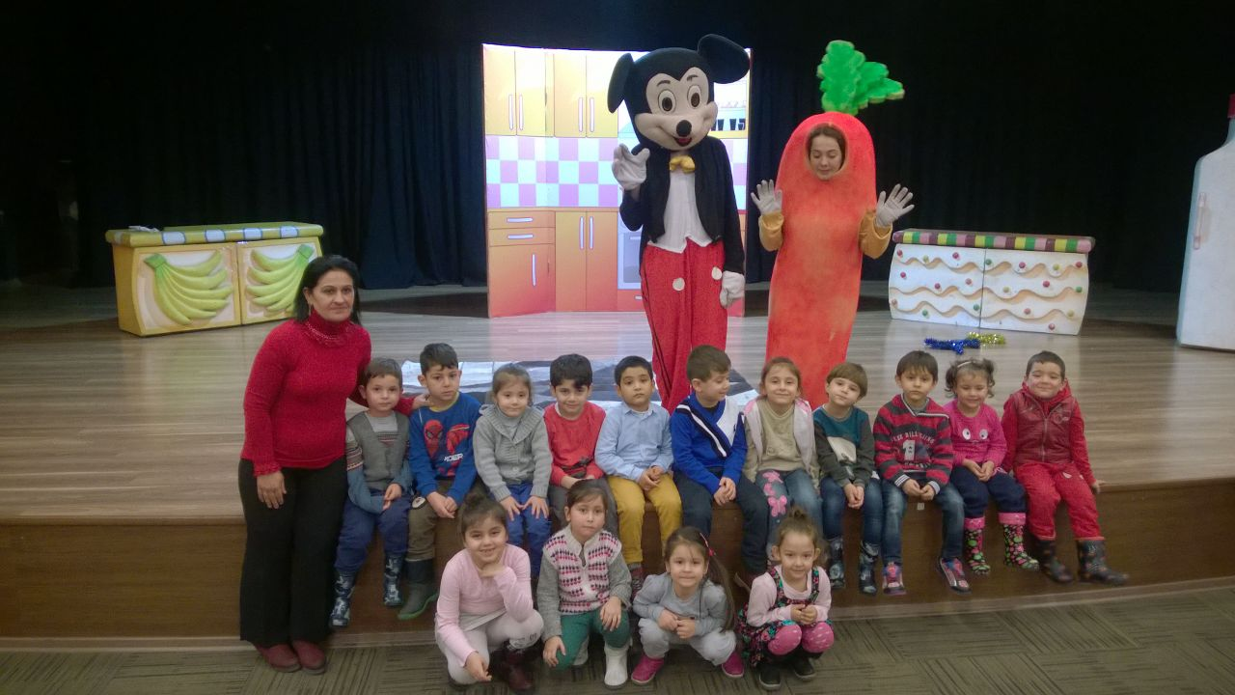
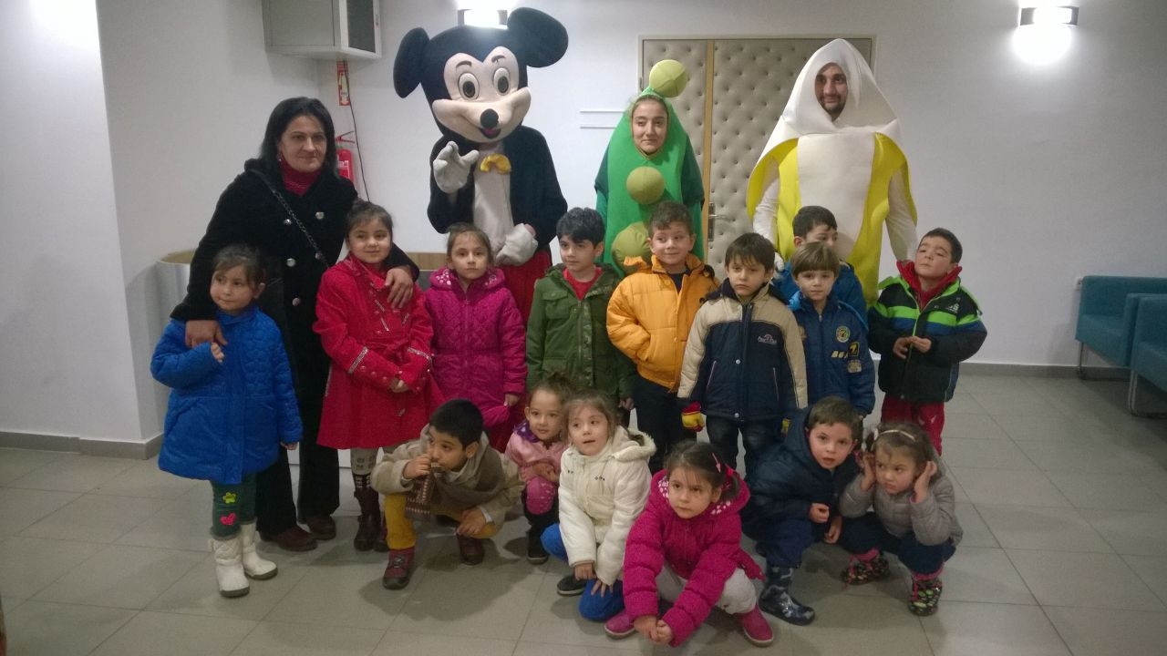
INTRODUCE OF DIFFERENCES
OUR STUDENTS ATTENDED TEATHER ACTIVITIES ABOUT DIFFERENCES.

Slide 3
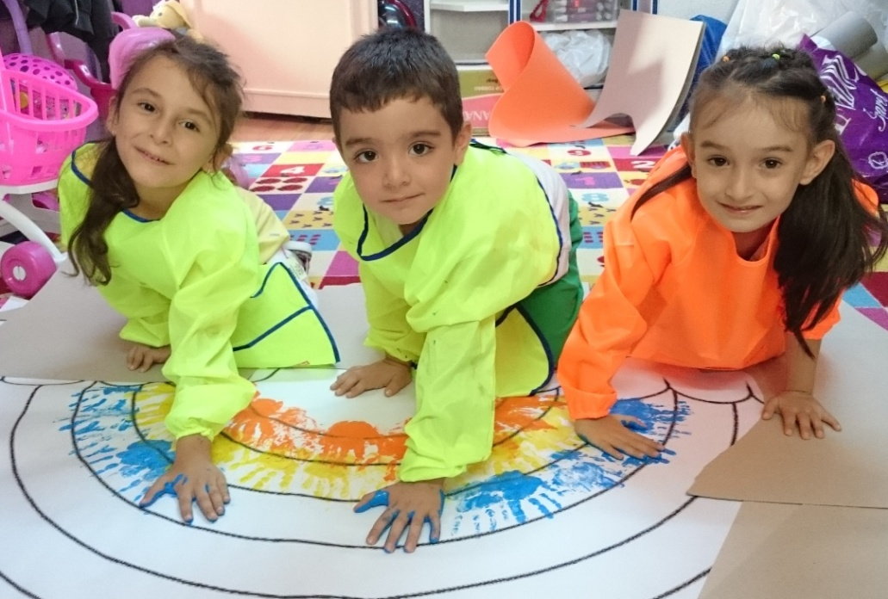
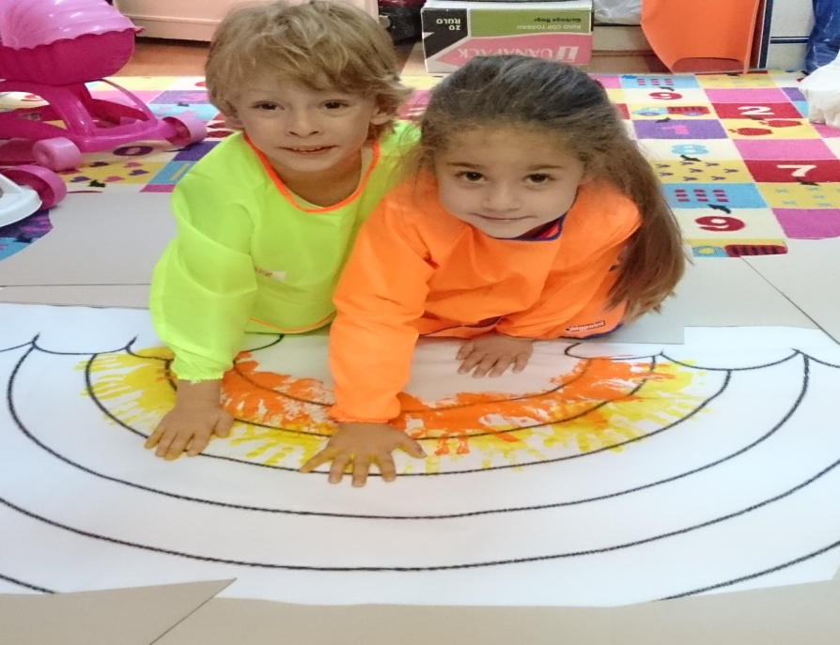
WE MADE RAINBOW FOR UNDERSTAND THAT LIFE IS BEAUTIFUL WITH DIFFERENCES…

Slide 4
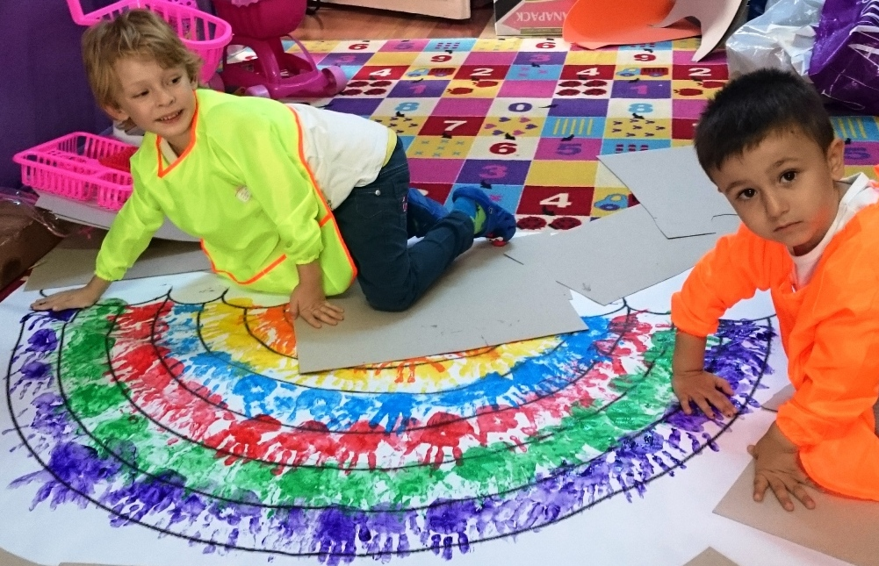
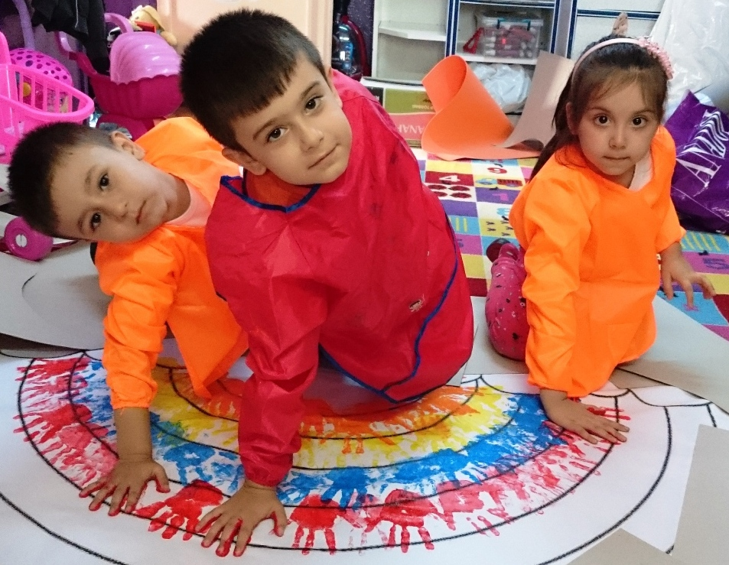
WE ARE LIKE COLOURS, DIFFERENT BUT WE ARE BETTER AND MORE BEAUTIFUL TOGETHER. WE TRIED TO GIVE THIS CONSCIOUSNESS.

Slide 5
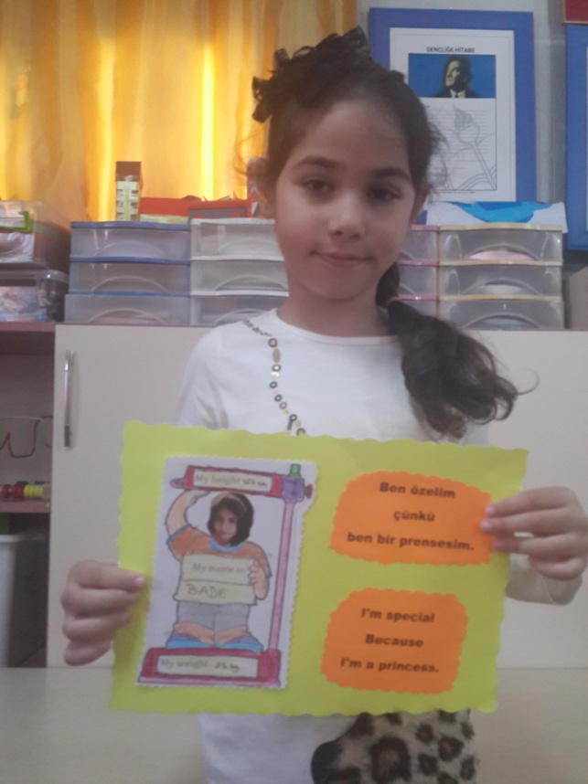
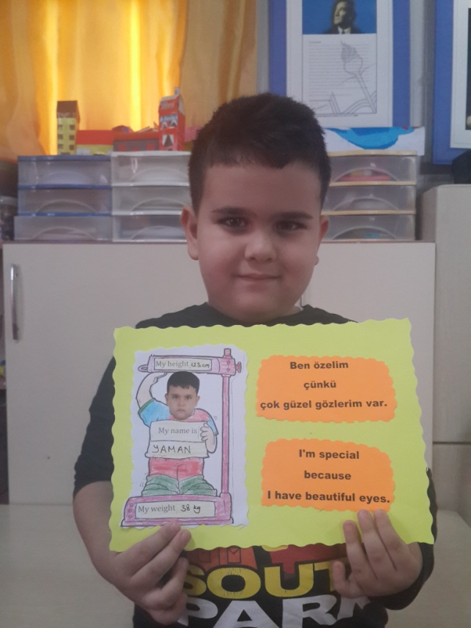
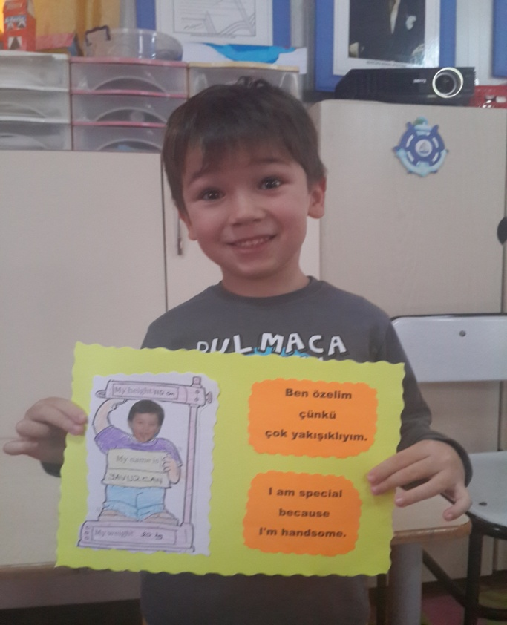
I’M SPECIAL ACTIVITIES

Slide 6
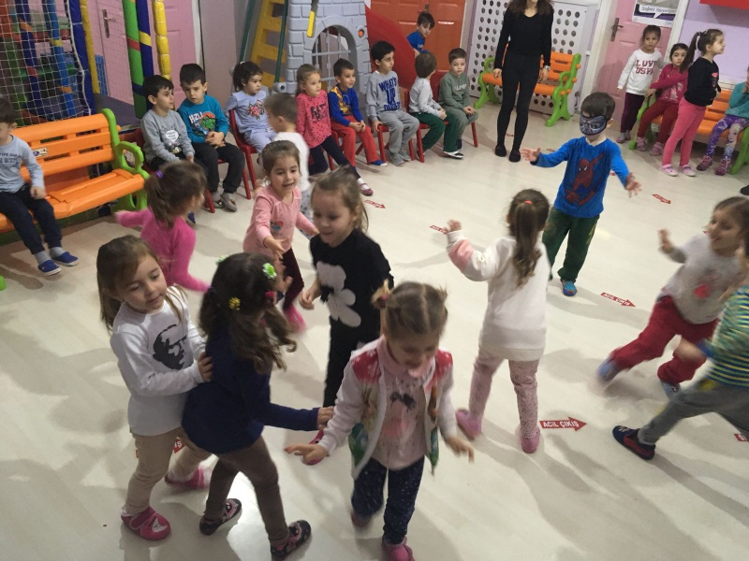
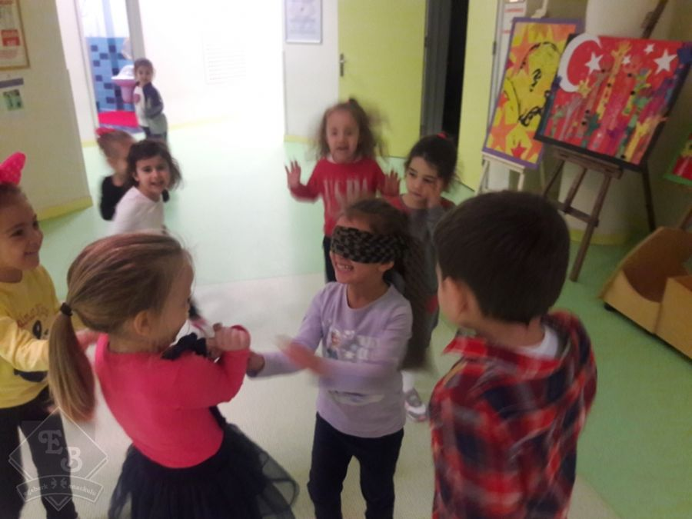
UNDERSTANDING HUMANS WHO ARE SPECIAL NEEDS…BLIND MAN’S BUFF

Slide 7
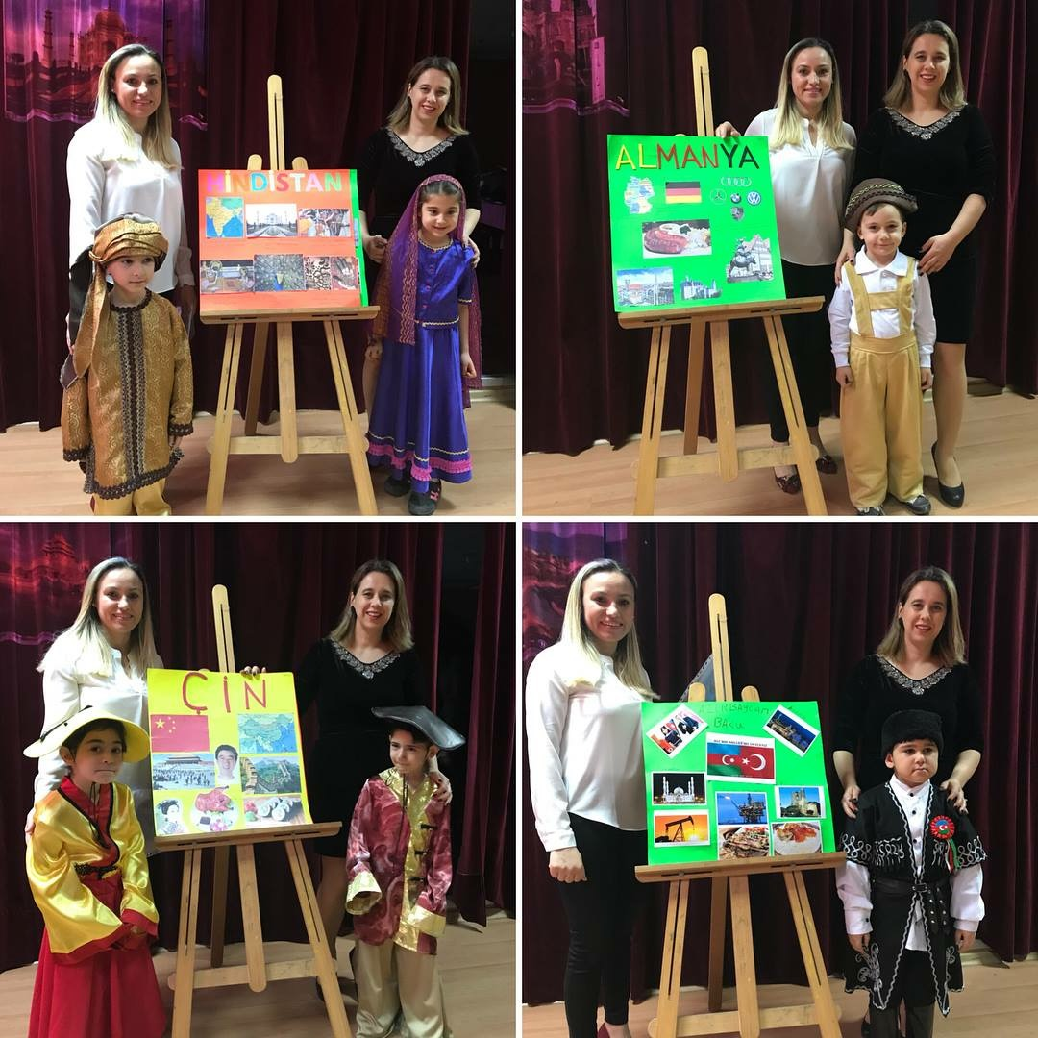
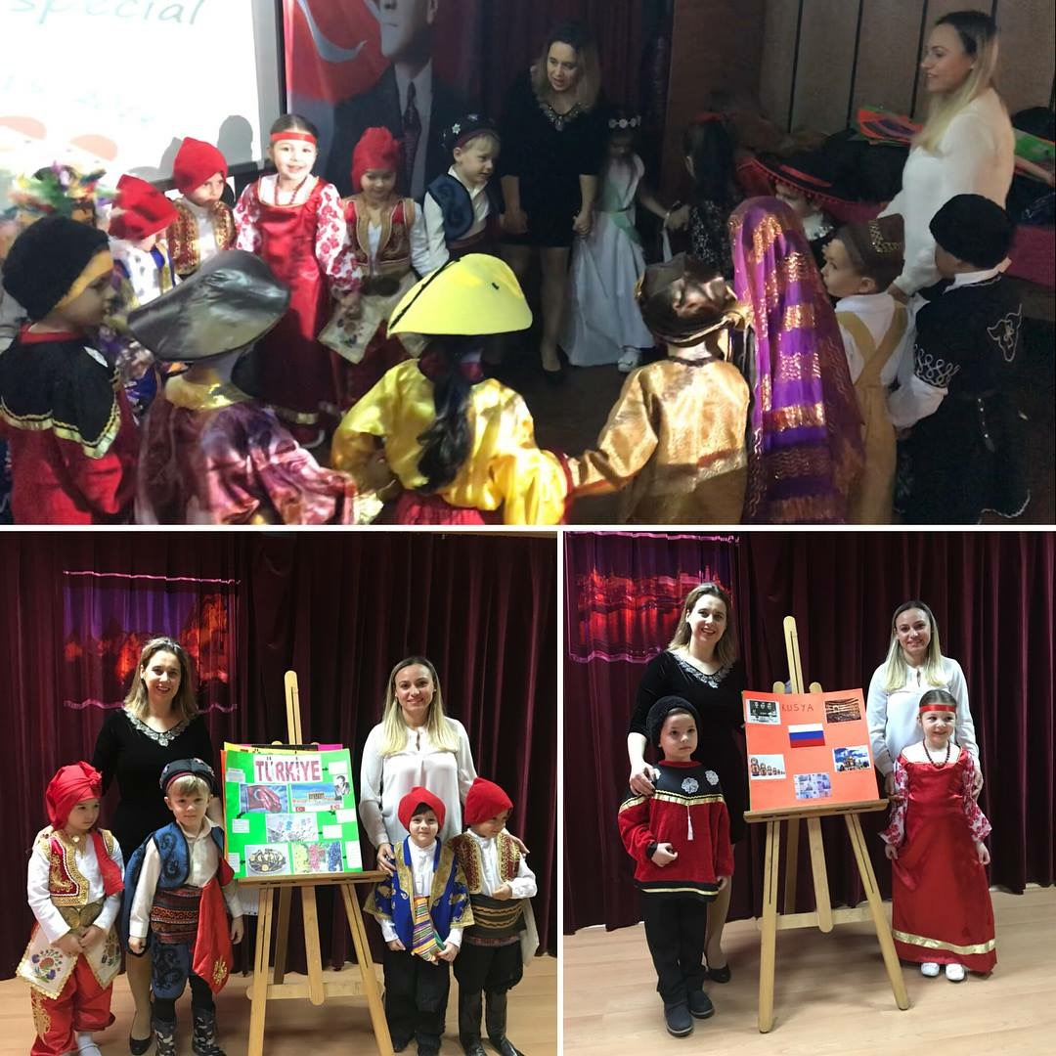
CULTURAL DIFFERENCES ACTIVITIES

Slide 8
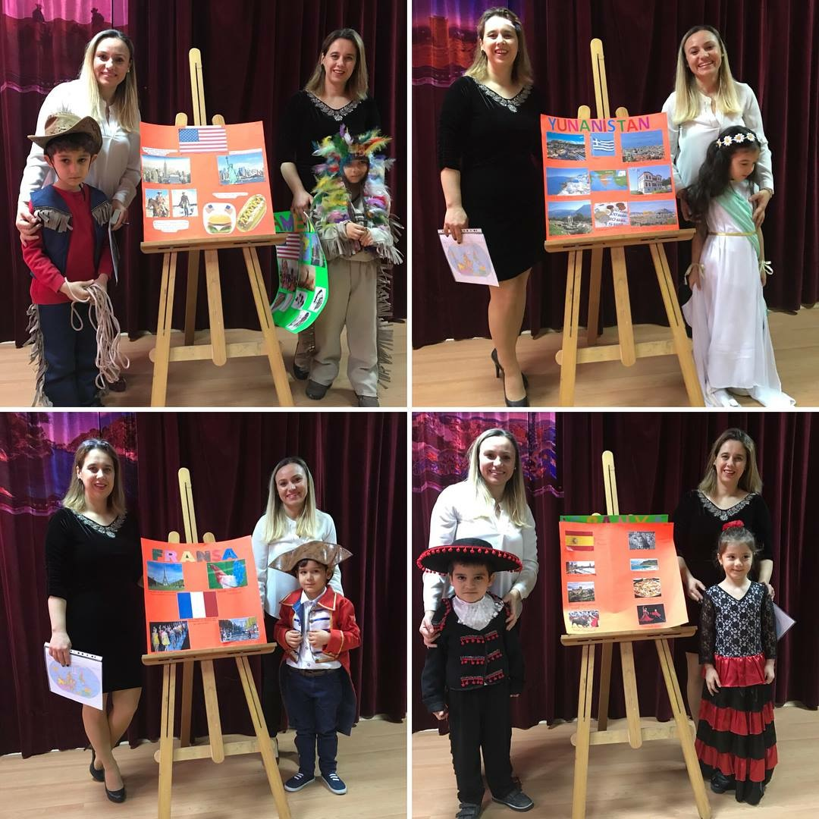
CULTURAL DIFFERENCES ACTIVITIES

