Slide 1
Erasmus+ “EVERY CHILD IS SPECIAL”
Activities after Bulgaria

Slide 2
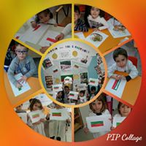

Slide 6
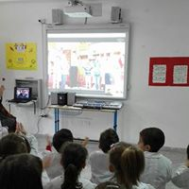

Slide 7
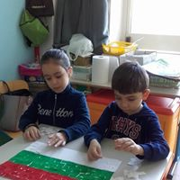

Slide 8
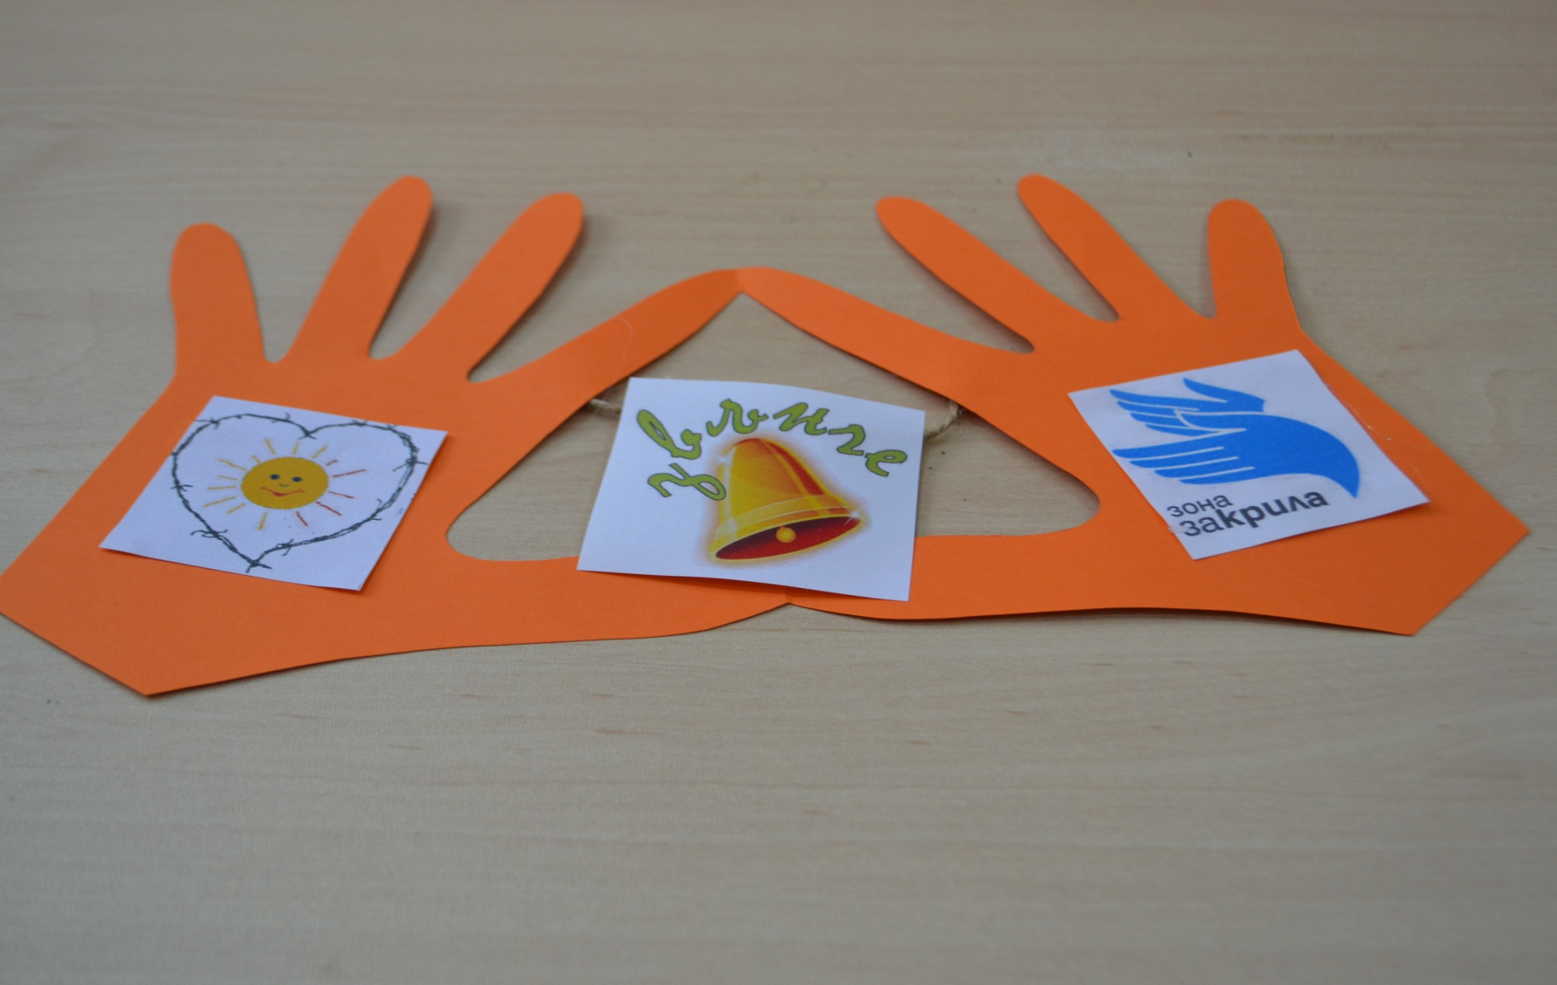
Great friendship with Bulgarian friends

