Slide 1
Teaching differences
Almeria, Spain 19.03 – 23.03.2018

Slide 2
1. Differences activities with children
Introducing differences
Differences walls
I am special
Diffrences books
Persona dolls methodology and “Kindergarten free of bullying”

Slide 4
2. Differences weeks
Introducing countries
Intorducing people physical differences
Teaching differences through tales, stories

Slide 5
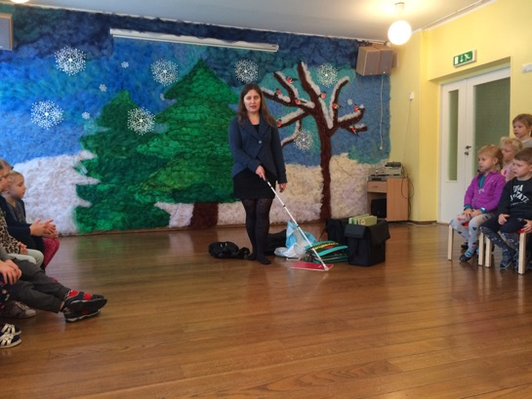
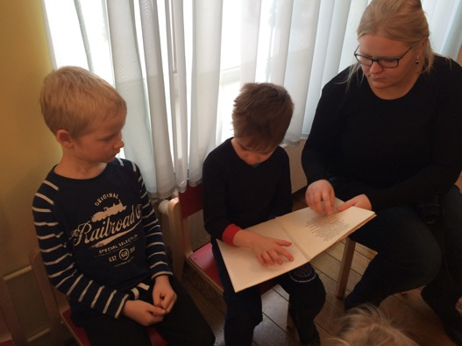
Diffrence week, January 2018
Day to introduce blind people

Slide 6
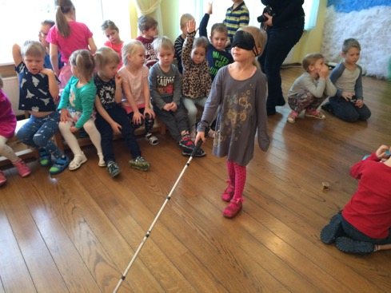

Slide 7
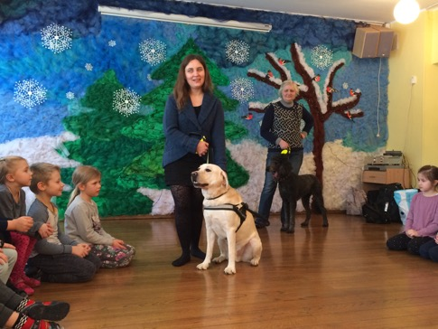

Slide 8
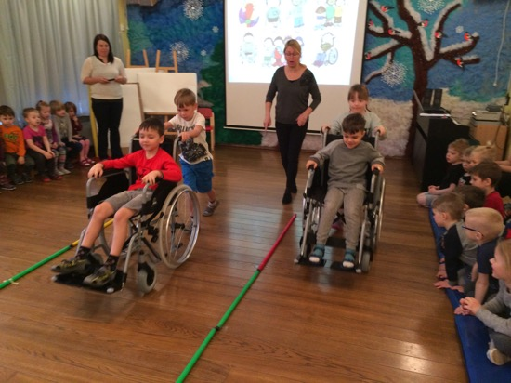
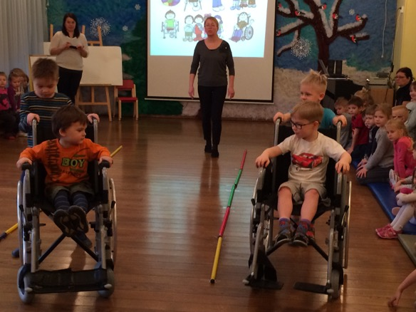
Day to introduce people with physical special need

Slide 9
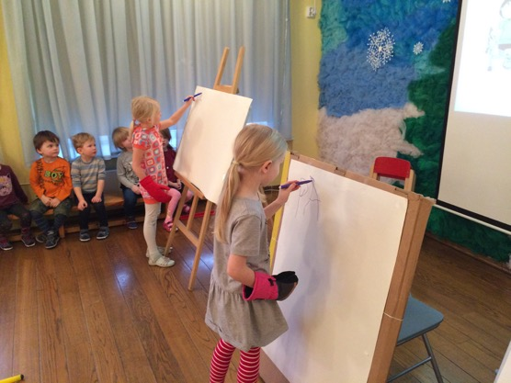

Slide 10
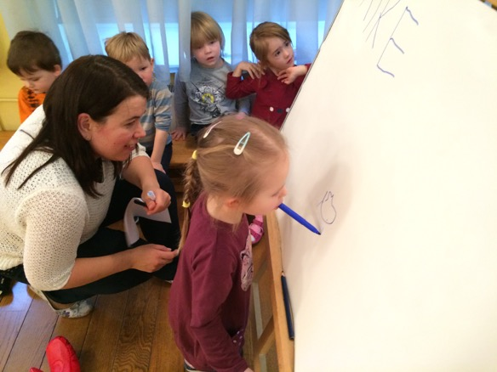

Slide 11
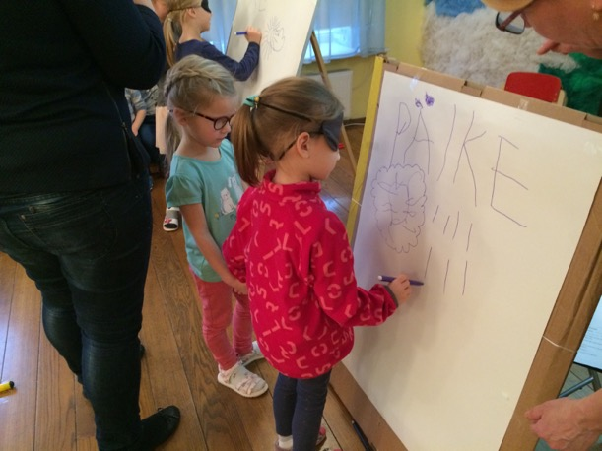

Slide 12
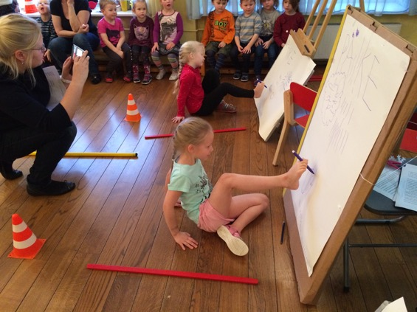

Slide 13
3. Introducing other countries
Introducing countries where our children are from
Introducing neighbor countries
Introducing European countries
Introducing different countries around world
Parents participation

Slide 20
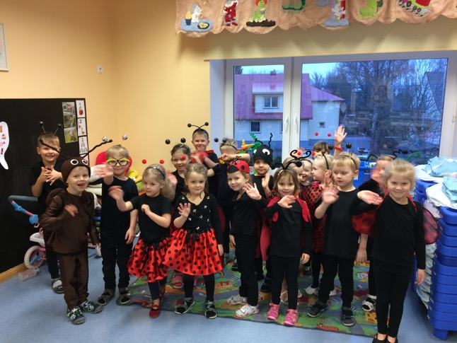
Czech day with children

