Slide 1
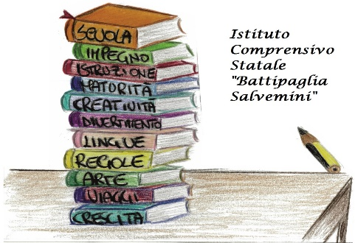
Teaching differences
Spain 19.03 – 23.03.2018
Every child is special

Slide 2
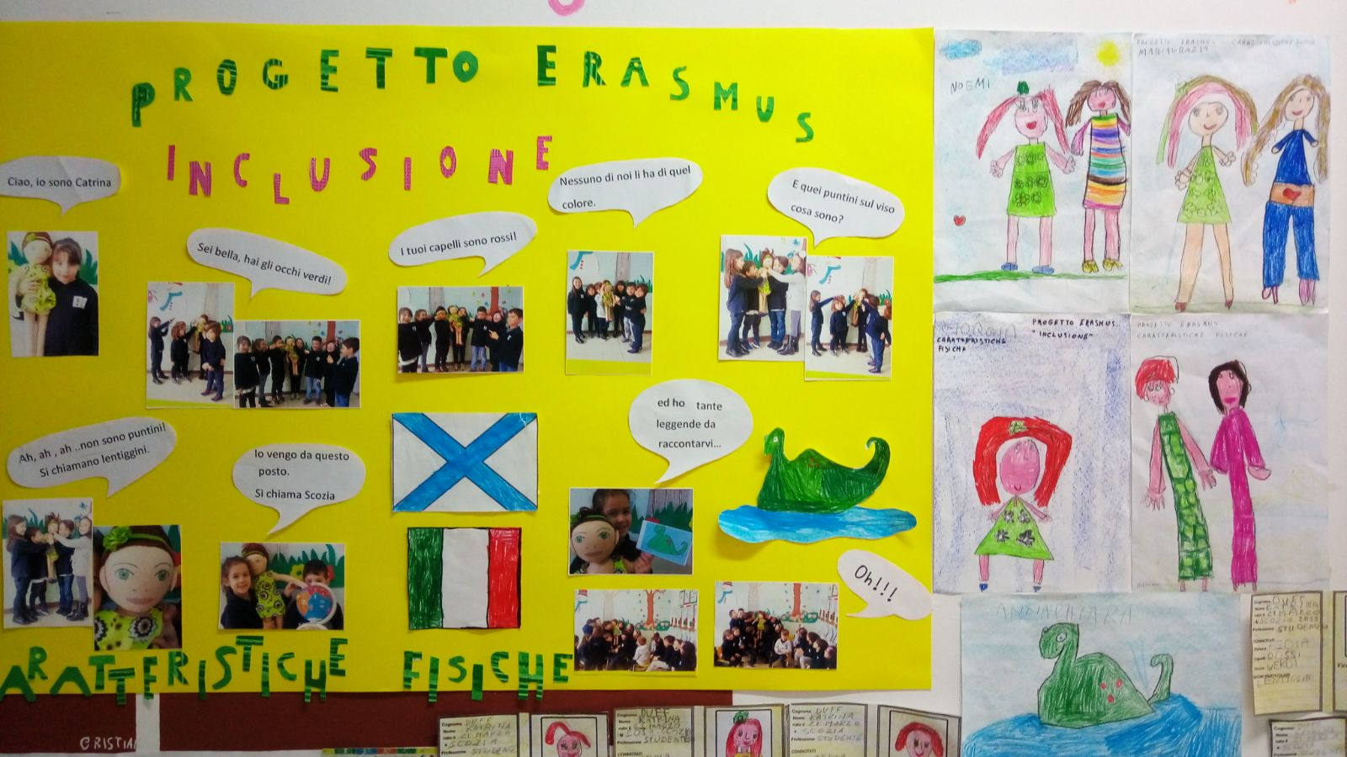
1. Differences activities with children Wall of difference

Slide 3
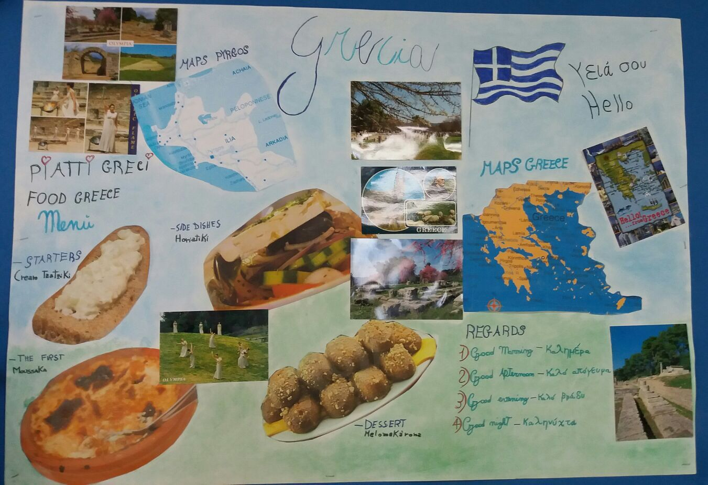
2Difference week We know New countries

Slide 4
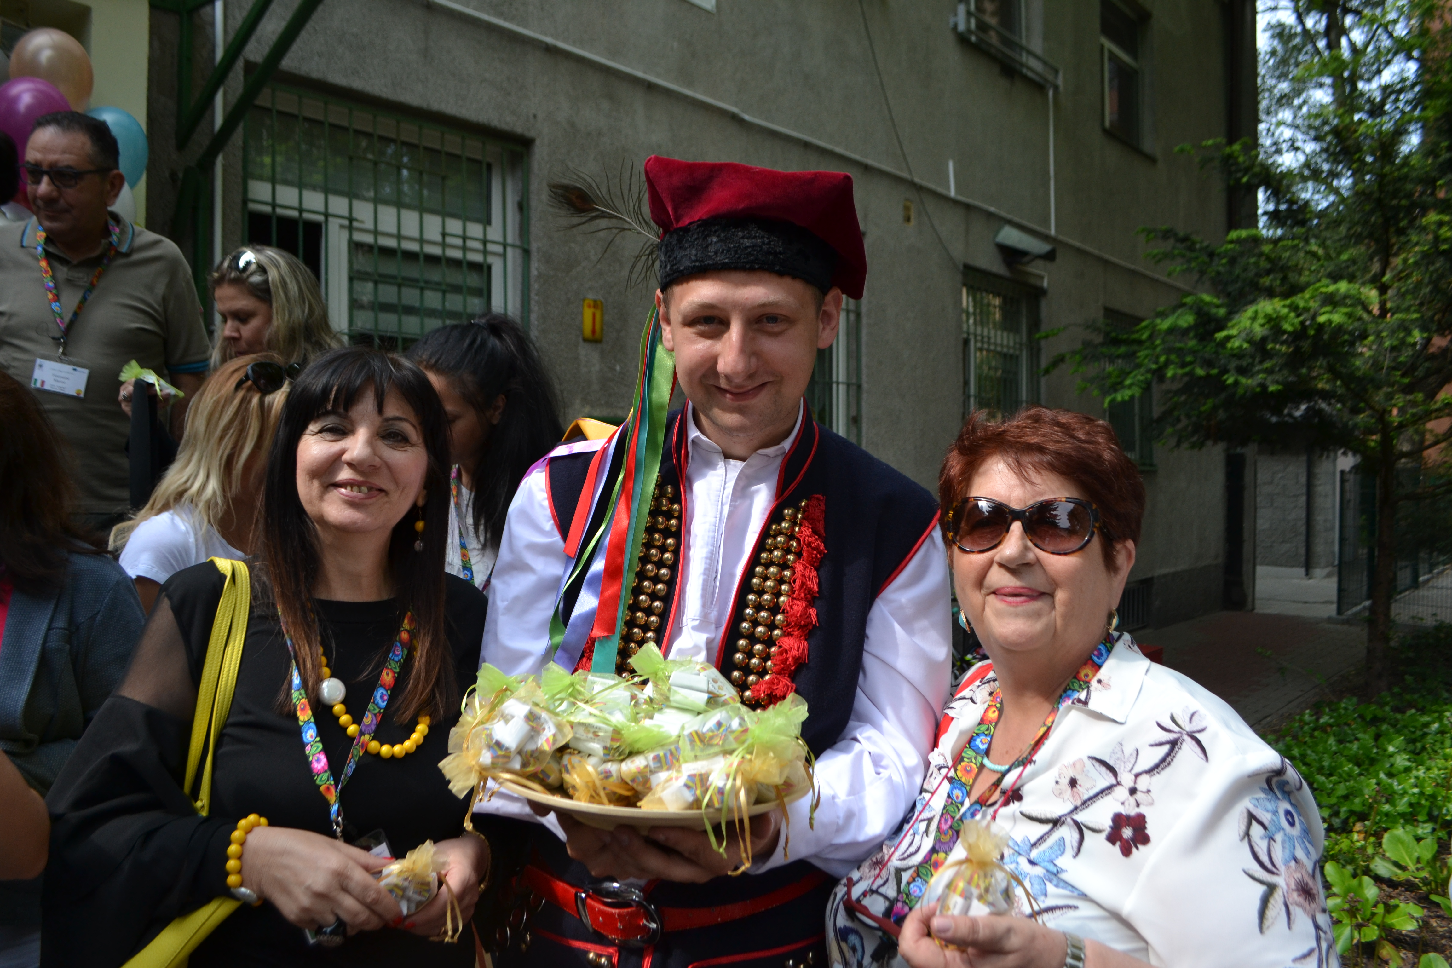

Slide 5
Czech Republishing presentation

Slide 6
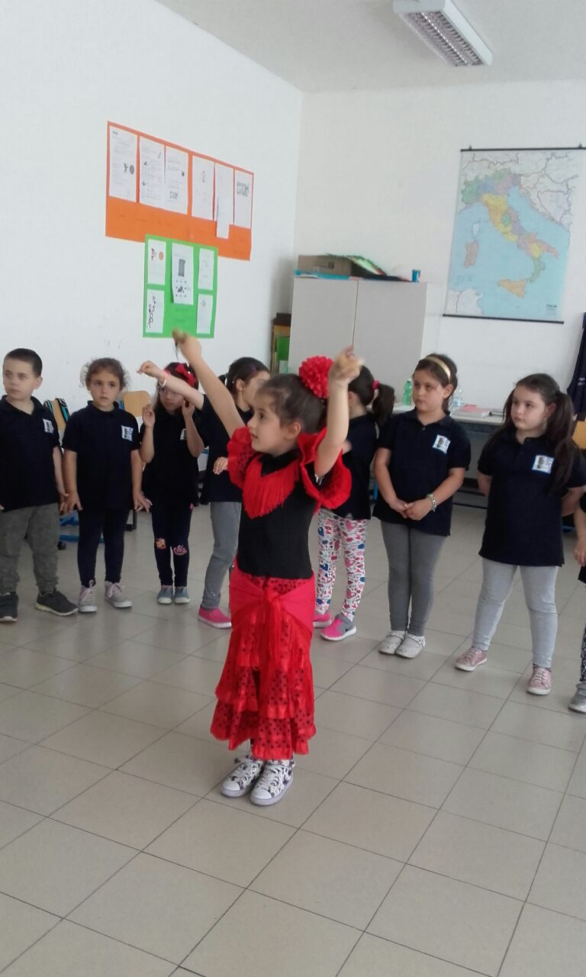

Slide 7
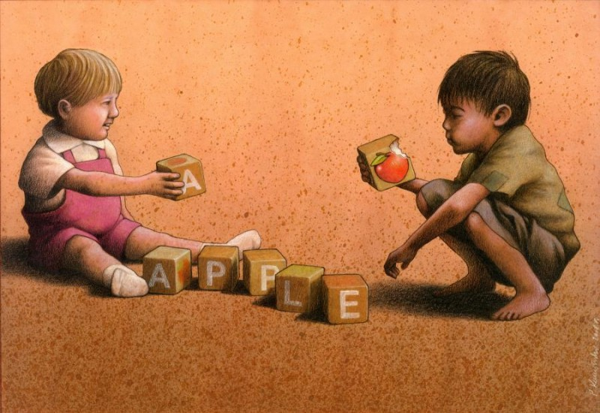
Difference week, January 2018 Physical differences

Slide 8
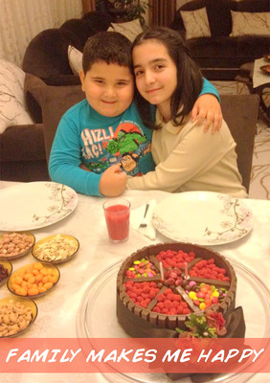

Slide 9
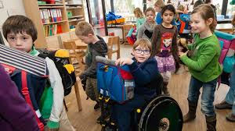
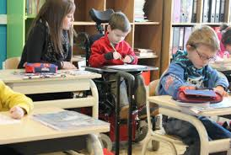
different disability

Slide 10
people with physical special need

Slide 11
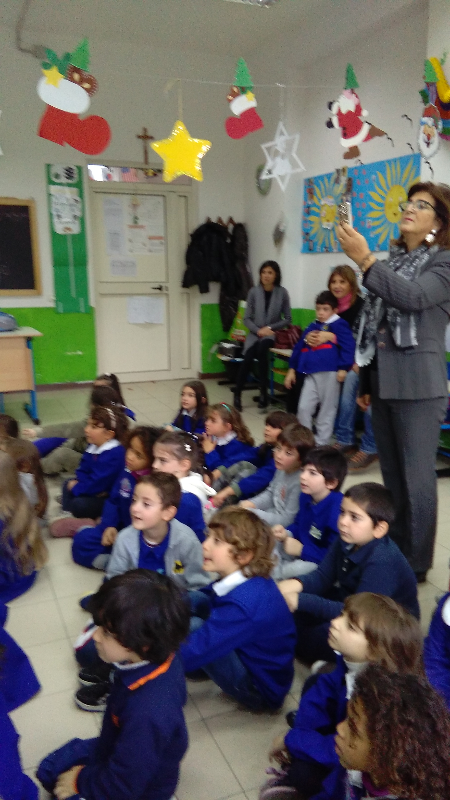

Slide 12
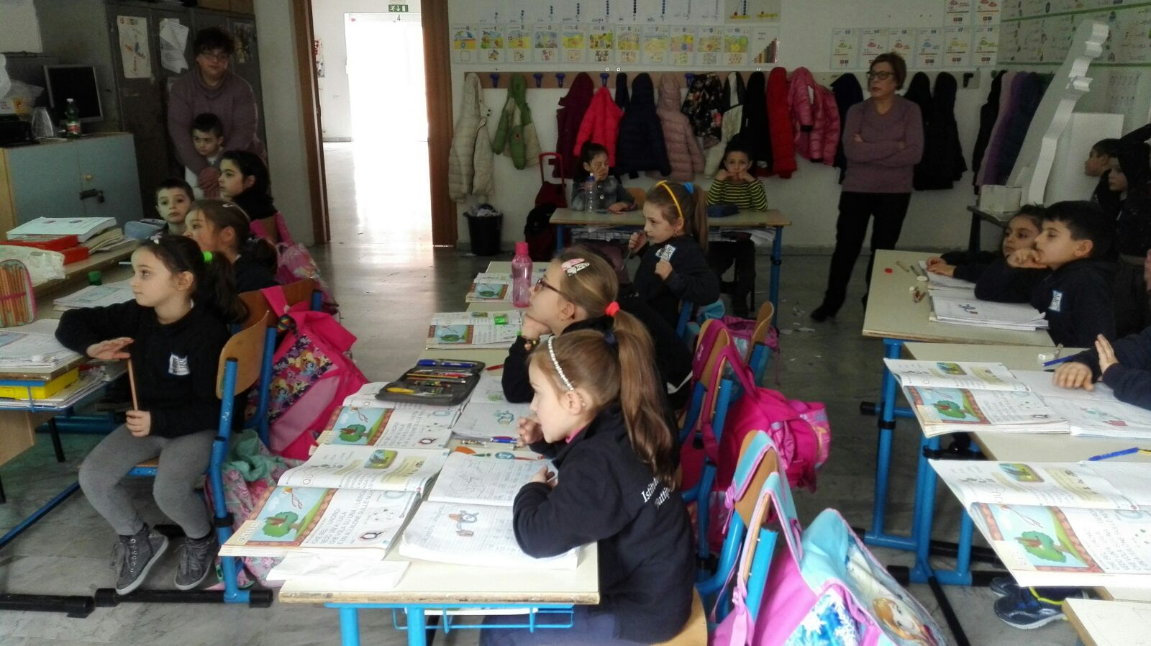
lesson on disability

Slide 13
language of the deaf

Slide 14
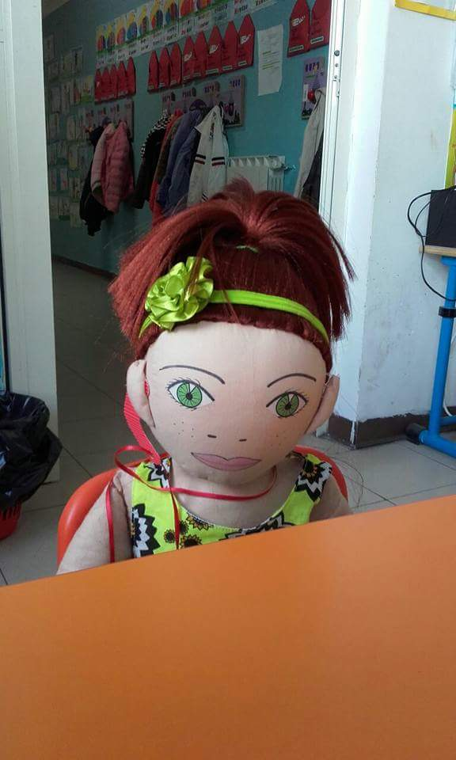
Roberto and Teresa are deaf

Slide 15
dance of the 5 senses

Slide 16
Thank you all
We are a good team

