Slide 1
SPECIAL EDUCATION AND SUPPORT SYSTEM IN TURKEY
OUR SYSTEM AIMS THAT ARE :
To carry out their roles in society, to establish good relations with others, to work in a business association, to adapt to their environment, to grow up as a productive and happy citizen.
To develop their basic life skills for self living in society and self-sufficient condition
Using appropriate training programs and special methods, personnel and equipment; Training needs, competencies, interests and skills in the upper learning, business and professional areas and to prepare for life
The availability of educational services accessible and equally accessible to disabled persons has great importance in ensuring that they are self-sufficient, productive individuals within the community and able to lead a quality life.

Slide 2
STATISTICS ABOUT SPECIAL EDUCATION IN TURKEY
According to Turkey Disability Survey data; Approximately 12,29% of population in our country is disabled population. 10 % of this population is 0-14 age group. 36% of the disabled population aged 6 and over are illiterate and 14.8% have not finished a school; In other words, half of the disability population aged 6 years or older was not trained. 33% of the disabled population aged 6 and above is in primary school, 1.5% in primary school, 5.4% in secondary school or vocational school, 6.9% in high school or vocational school, 1.9% has finished higher education.
Persons with disabilities who have language and speech difficulties, visual impairment, hearing impairment, somatic insufficiency, autism, special learning difficulties, attention deficit hyperactivity impairment, persistent illness, mental impairment and multiple inadequacies benefit from special education services in our country.

Slide 3
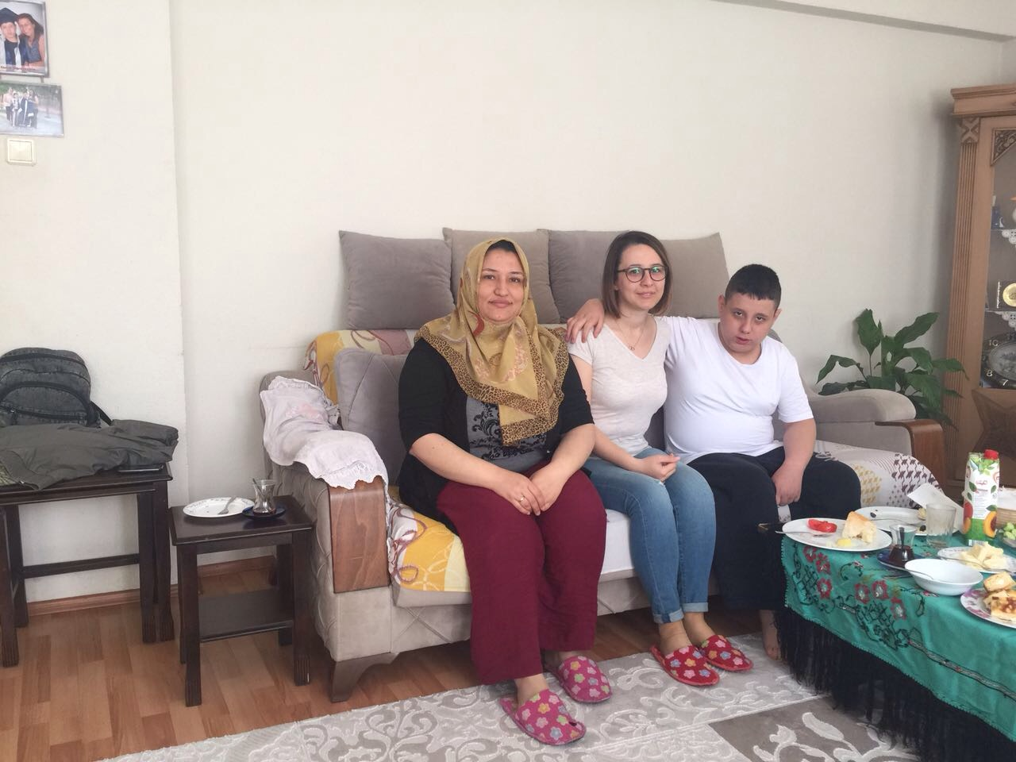
SCHOOL PARENTS COOPERATION
The importance of benefiting from education and support services in order to integrate the disabled person into the society is also important for the effective informing, directing and awareness-raising of the families, implementation of effective family education programs and active participation in the education of the disabled person. With family education, parents are beginning to see what they can do as part of their children's education, learning about their children's development, strengths and weaknesses. The inclusion of children with disabilities in their education, the recognition of the most important resources of the child now and in the future, and the support of the child through family-specialist co-operation, psychologically comforts the family.

Slide 4
Special education services for individuals who need special education are provided through official or private education institutions. These services include;
In special education schools opened depends on different disability types,
In the special education classes of general education schools and in the classes of integration education,
are given in private special education and rehabilitation centers opened to real and legal persons.
Hospital primary schools,

Slide 5
The placement of students who need special education services into appropriate training programs begins with the diagnostic process. Persons with disabilities who will benefit from private education or support special education should firstly have medical diagnosis in hospitals authorized to submit a health board report for disabled persons

Slide 6
Medical diagnosis is made according to the principles of the Regulation on the Disability Criterion, Classification and Health Board Reports to be given to the disabled. Persons with disabilities who are diagnosed with medical conditions need to apply to the Guidance and Research Centers (GRC) located in all provinces and districts in order to benefit from educational evaluation and diagnosis services. Early diagnosis is essential in both diagnoses. In 2012, the number of (GRC) reached to 212, an average of 250 thousand applications are examined and directed.

Slide 7
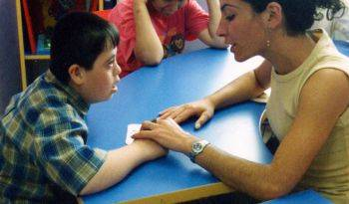
In the process of educational evaluation and identification, disabled individuals whose educational needs are identified with their qualifications in all areas of development . Their academic discipline and their educational needs are directed to the educational setting, special education school / institution, hospital primary school, special education and rehabilitation centers or educational environments at home .

Slide 8
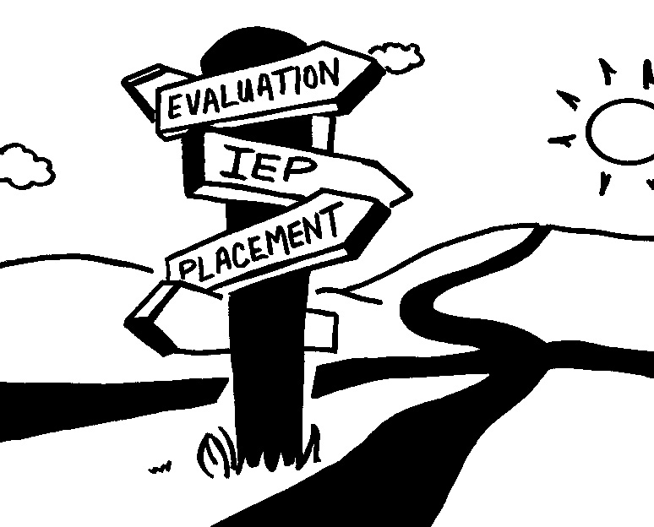
Special education services board; In the direction of the special education evaluation board report, places the individual in need of special education in the appropriate official school or institution. Placement is the closest possible school or school according to the address of residence, taking into account the status of the school or institution in which the individual will be placed, student status and educational environment, the type and level of disability, the performance in all areas of development and academic discipline, Trying to dry out.

Slide 9
In preschool period; Pre-school education for those individuals who need special education between 37-72 months is compulsory and pre-school education is based on the principle of continuing within the scope of mainstreaming practices in pre-primary education institutions.

