Slide 1
Activities
done after seminar in Turkey
Project "Every child is special"

Slide 2
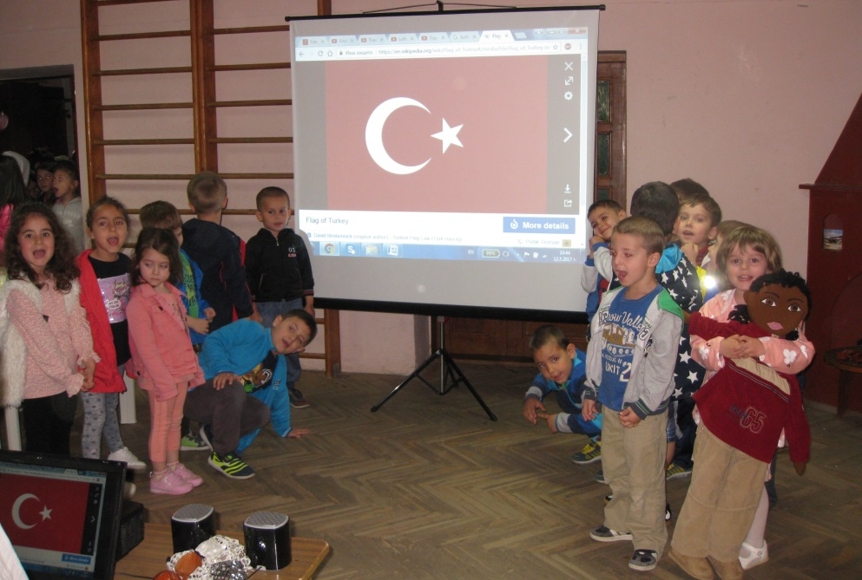
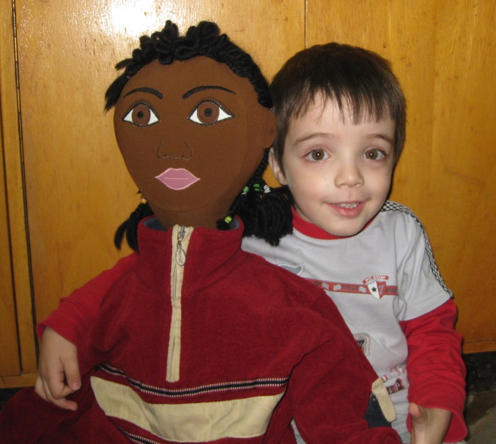
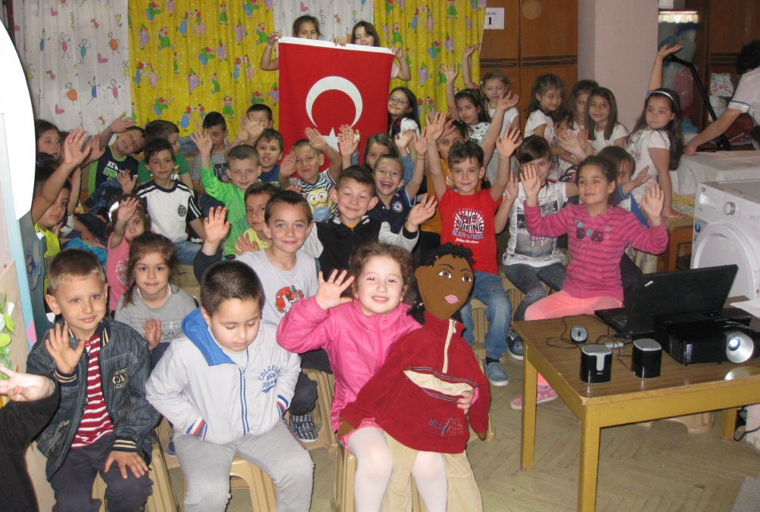
Introduction of Turkey and Turkish culture
Session with Kelvin

Slide 3
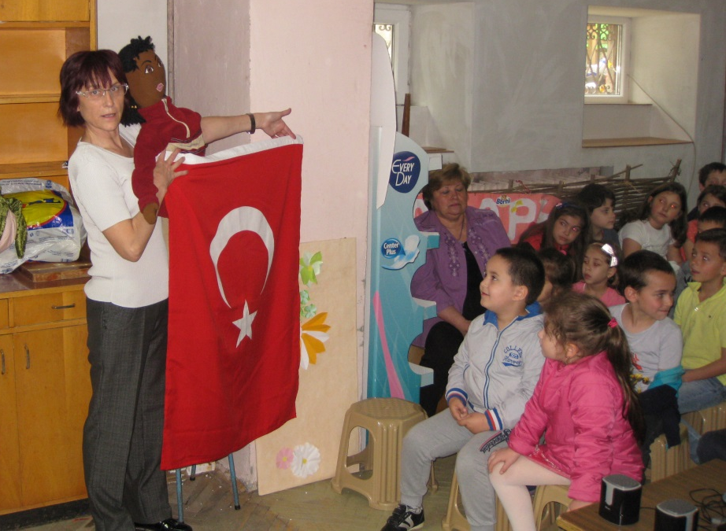
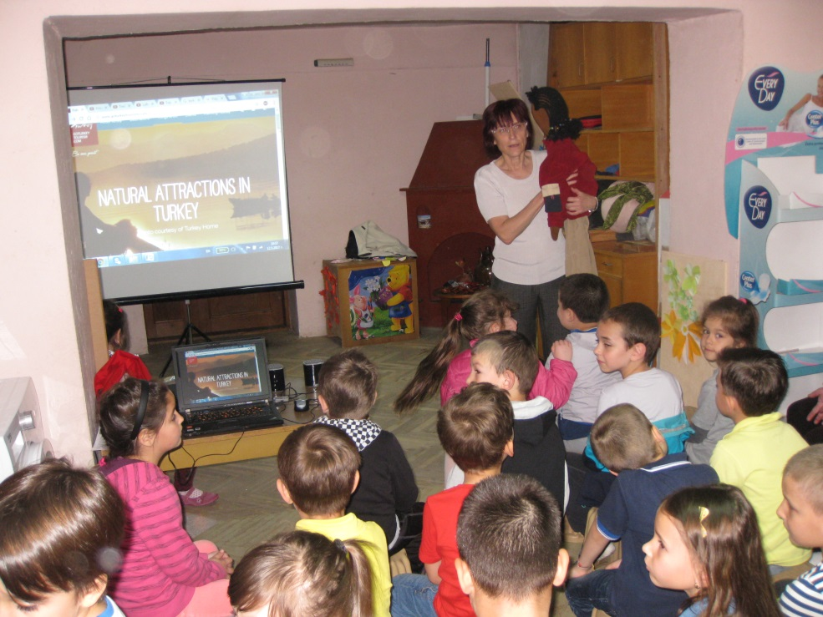
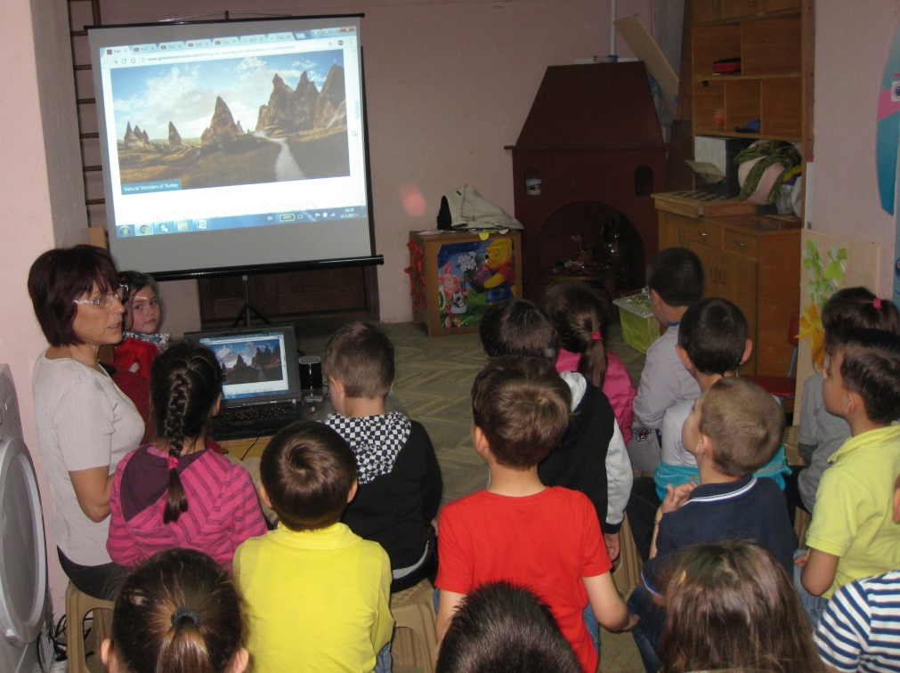
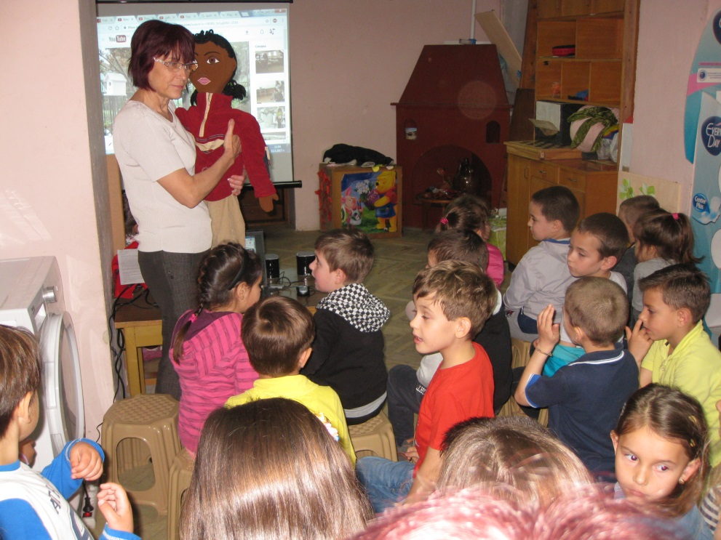

Slide 4
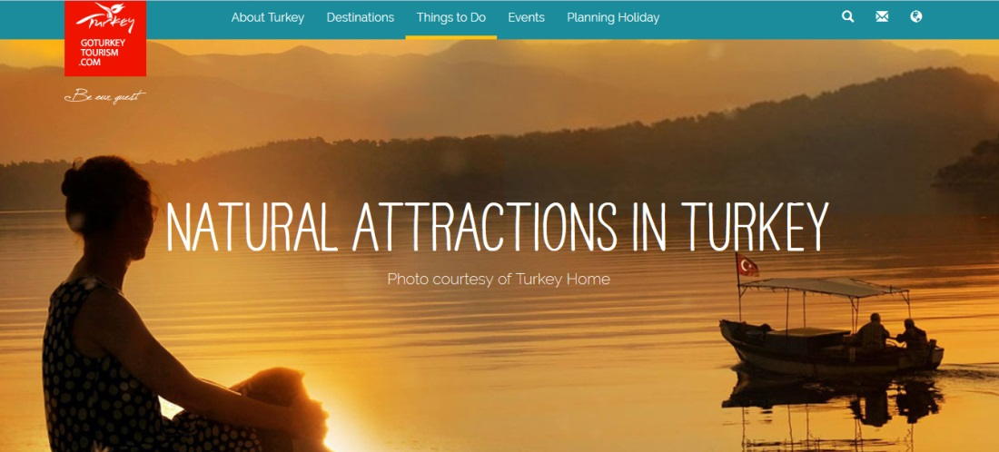
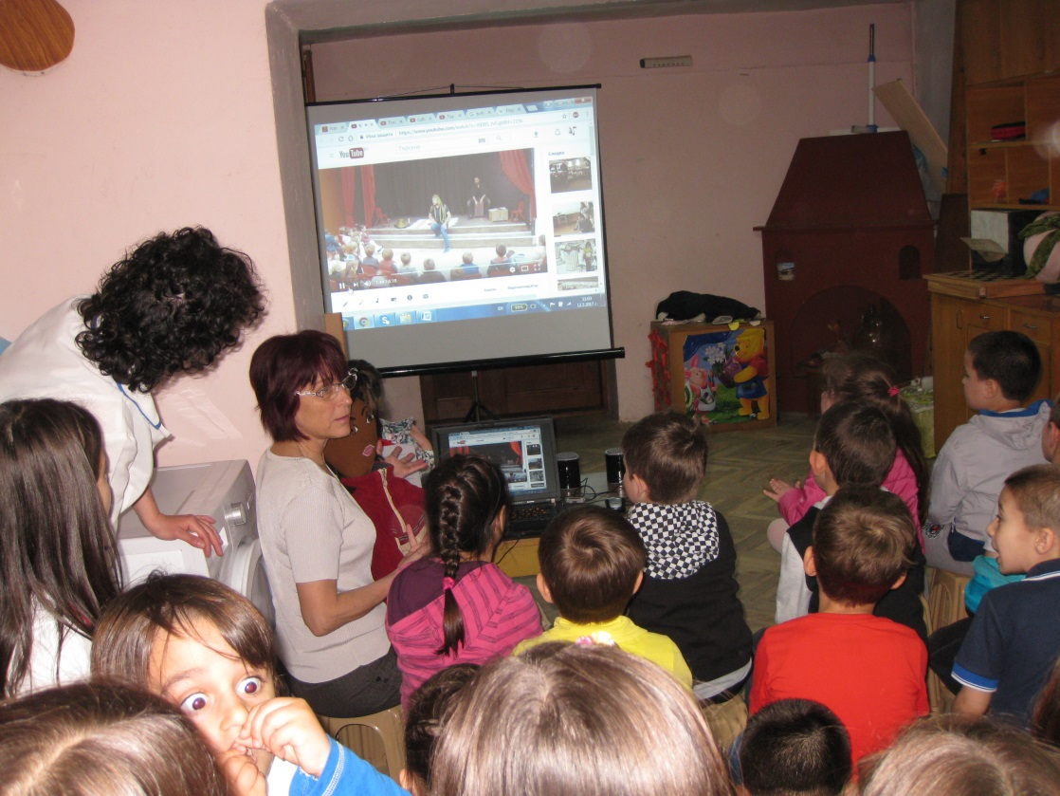
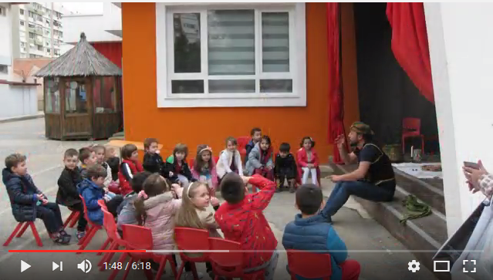
The Nature of Turkey
Kindergarten in Izmir-https://youtu.be/YID8S_fvGg0

Slide 5
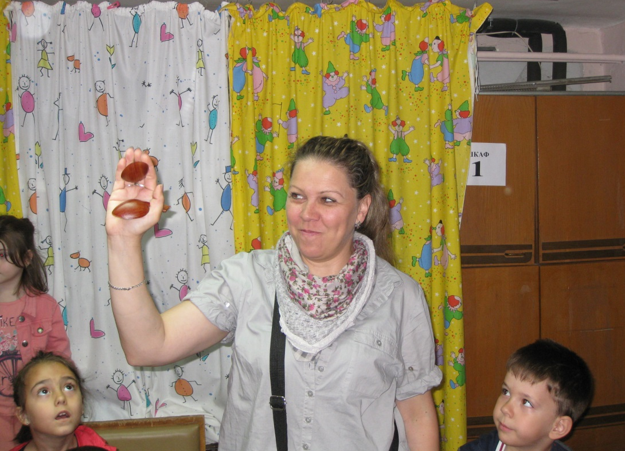
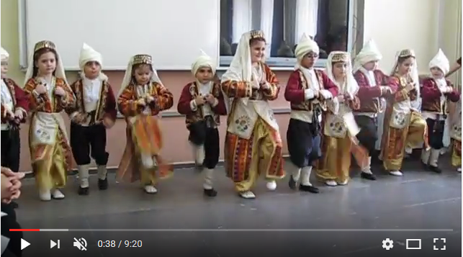
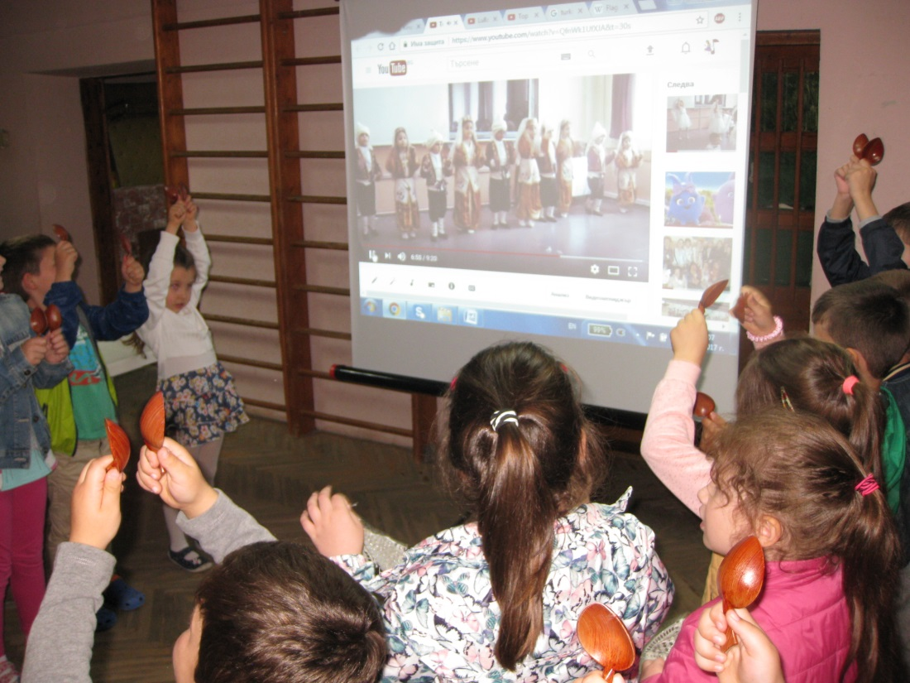
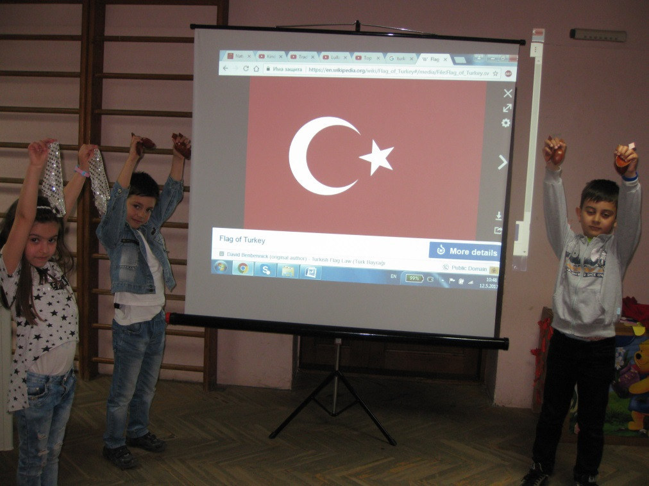
Traditional Turkish dance-https://youtu.be/QfnWk1UfXJA

Slide 6
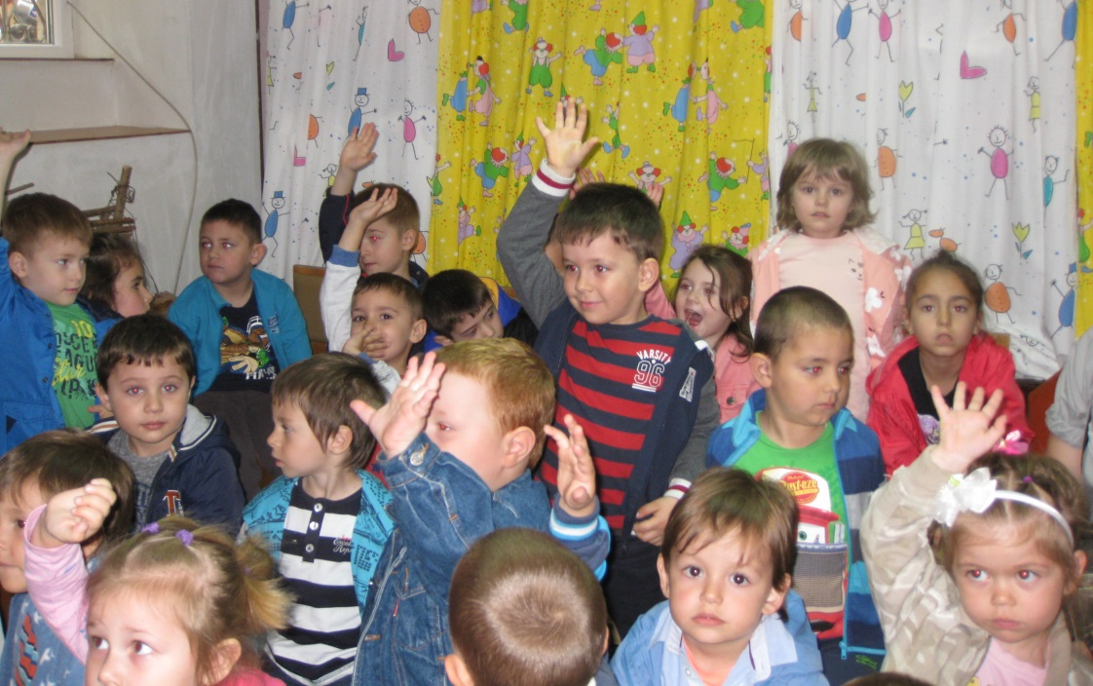
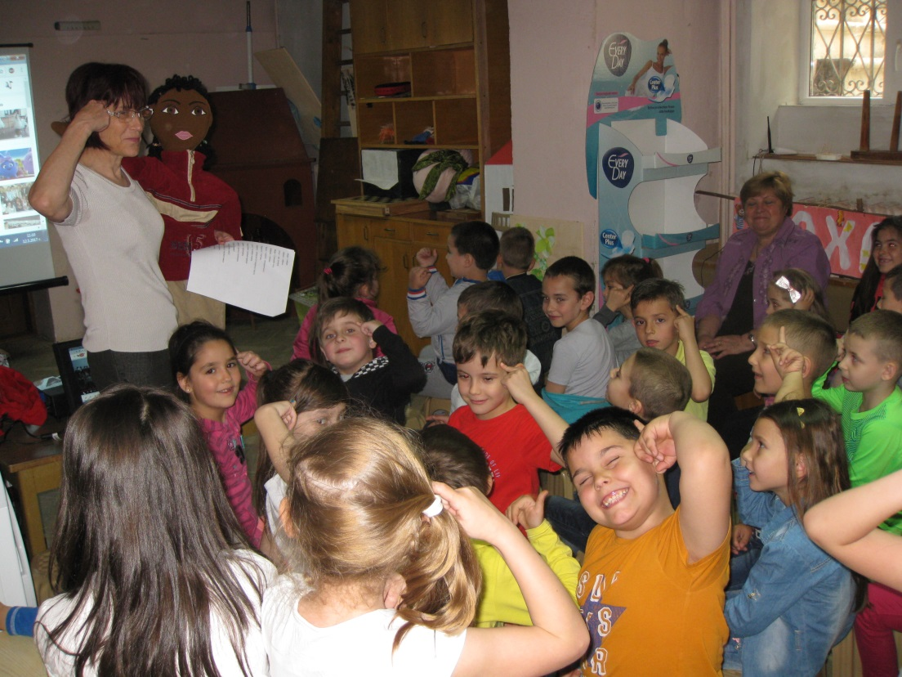
Kelvin said different words in Turkish, which are also used in the Bulgarian language
Evala! Giurultia
Merak Diuchek
Manja Budala
Aver Sevda
Aide Sarma
Akal Hich
Belia Tenjera
Gevrek Airan

Slide 7
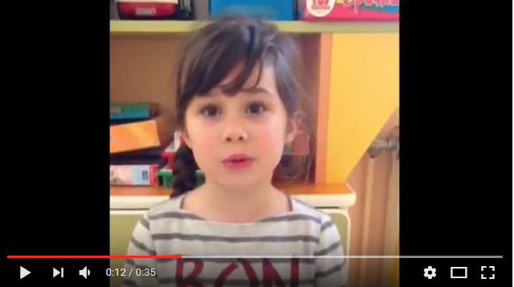
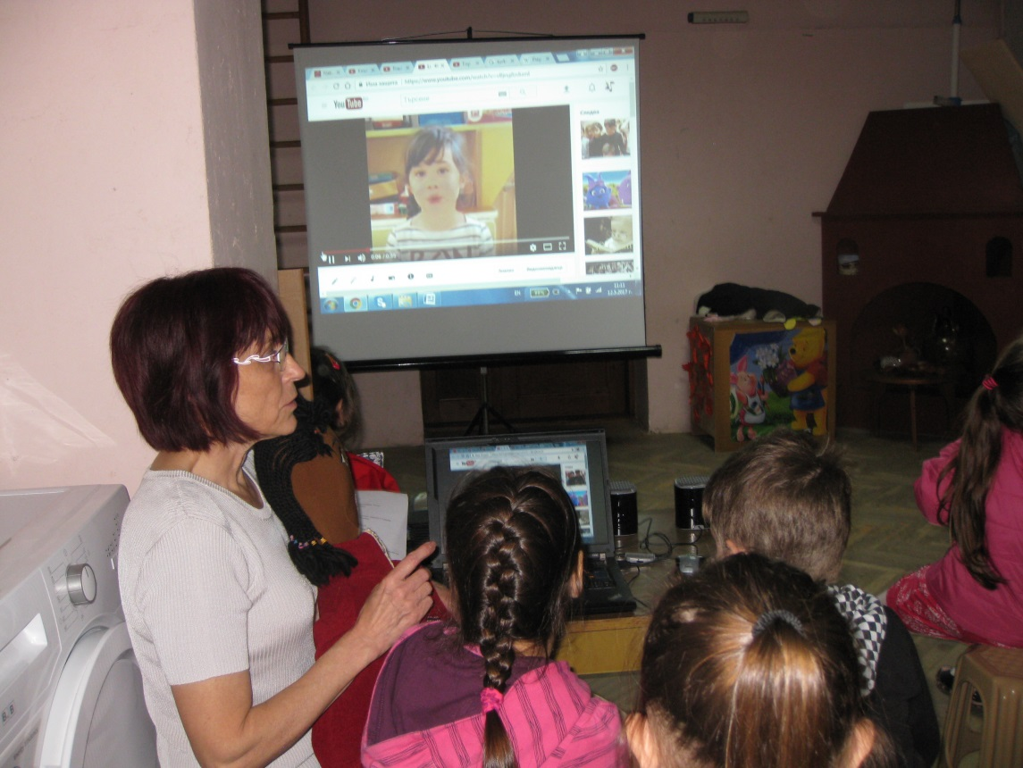
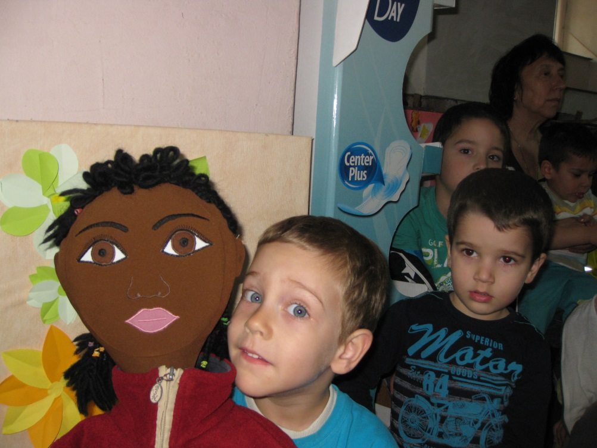
Turkish lullaby- https://youtu.be/vBjng8zdumI

Slide 8
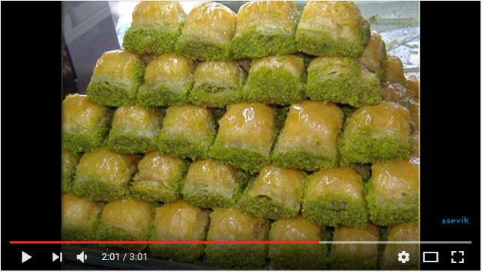
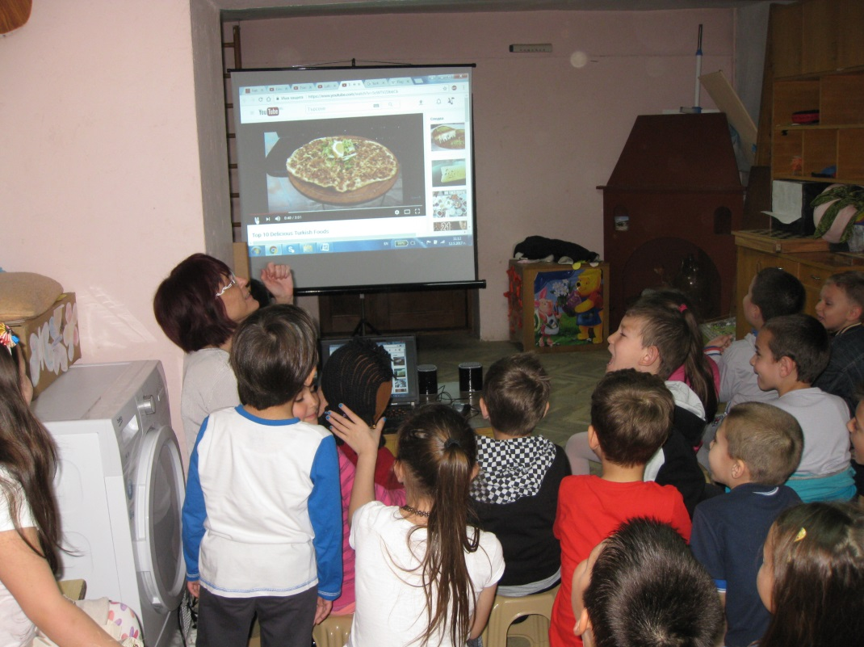
Top 10 Delicious Turkish Food - https://youtu.be/5cWTVZ0bkCk

Slide 9
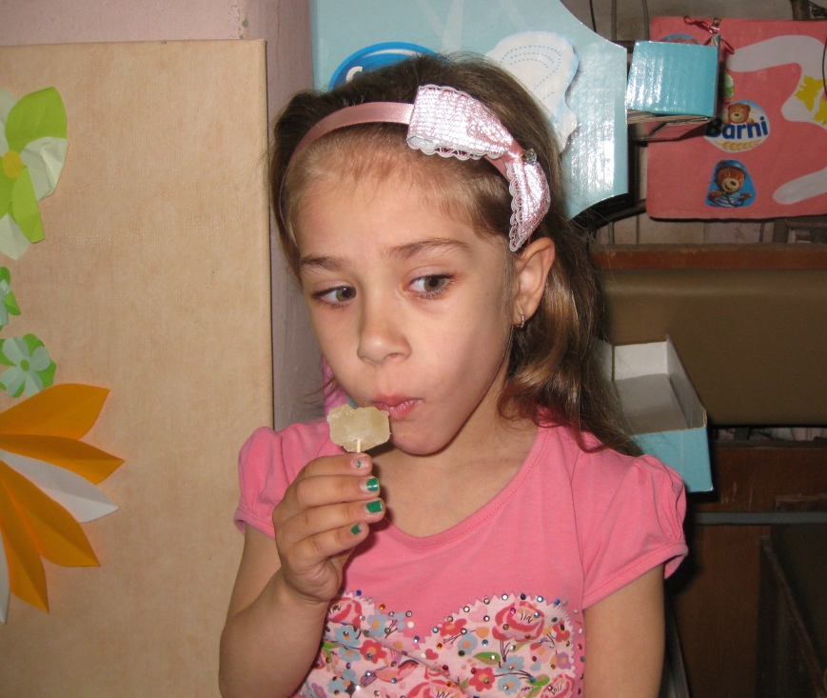
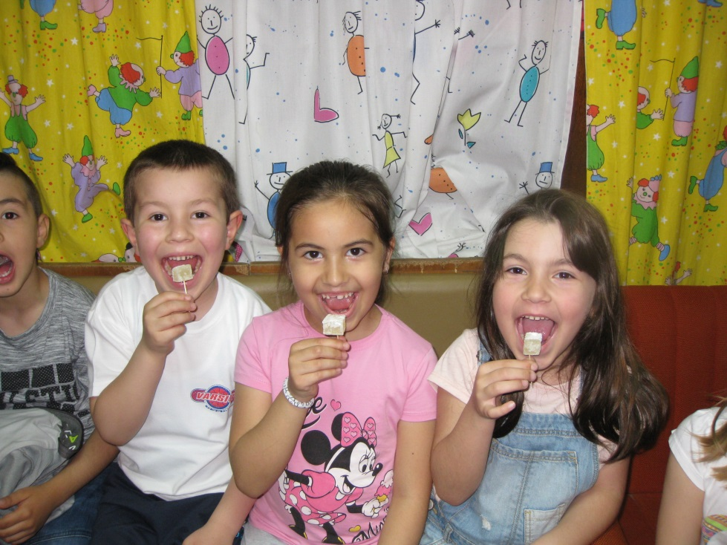
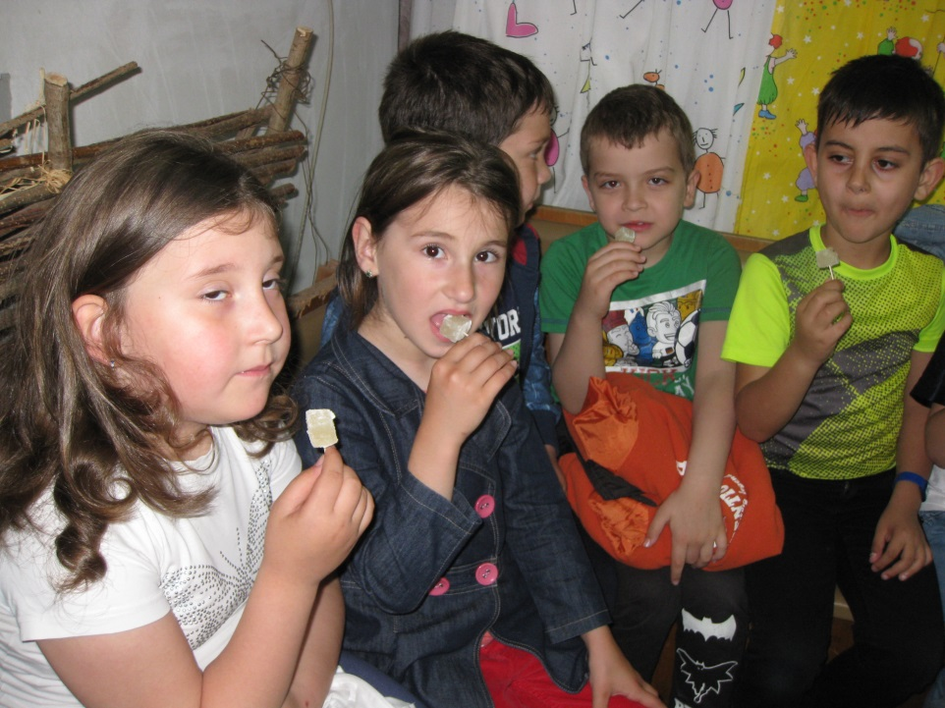
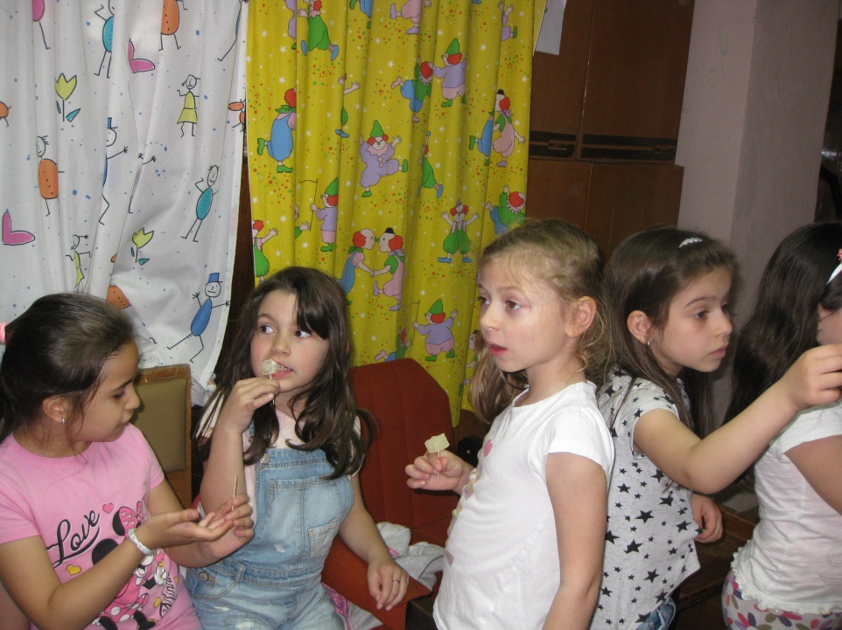
Kelvin give the children Turkish delight

Slide 10
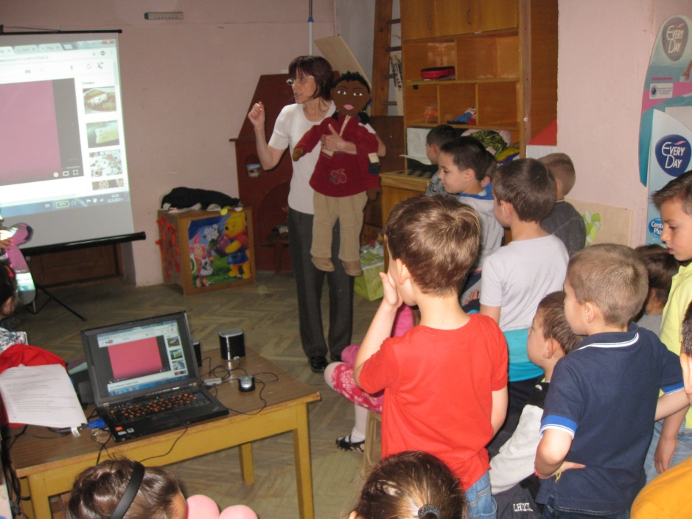
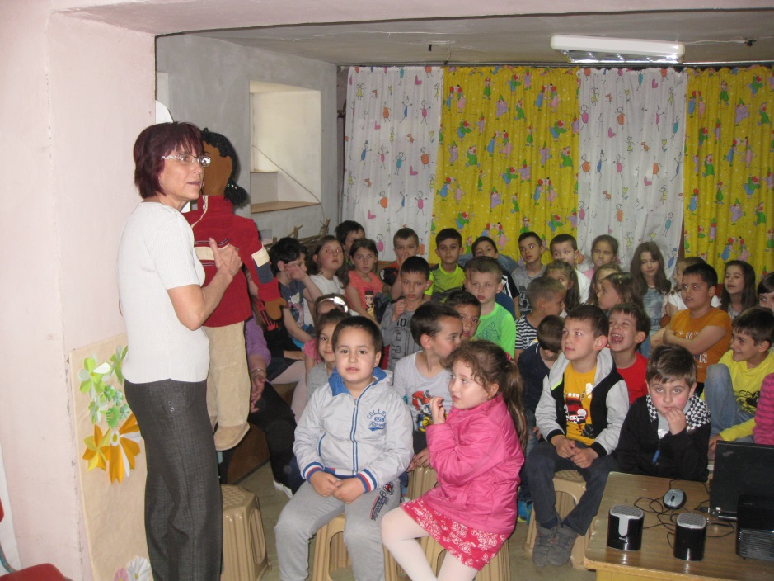
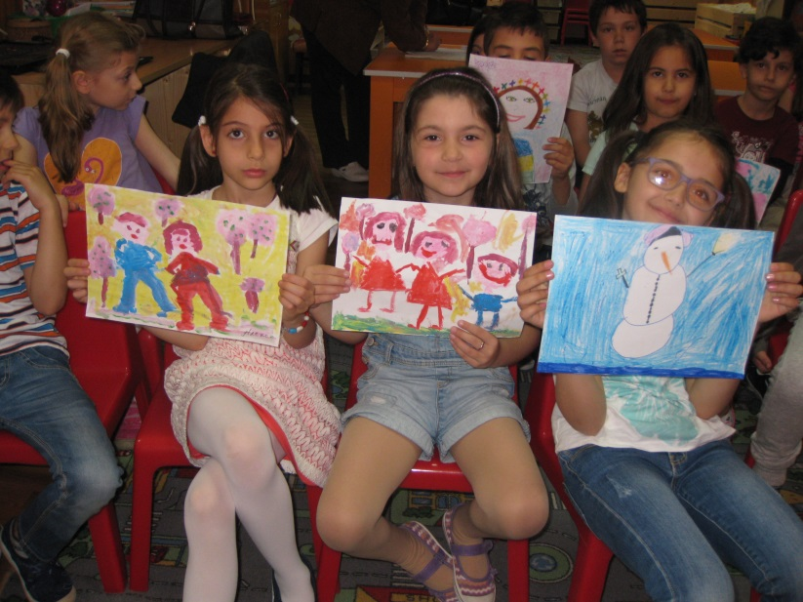
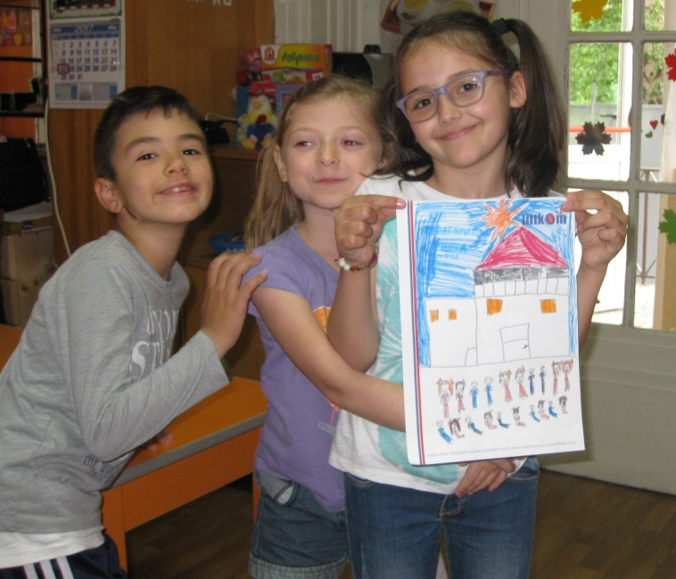
At the end of session, Kelvin asked the children how to please his friends from Izmir

Slide 11
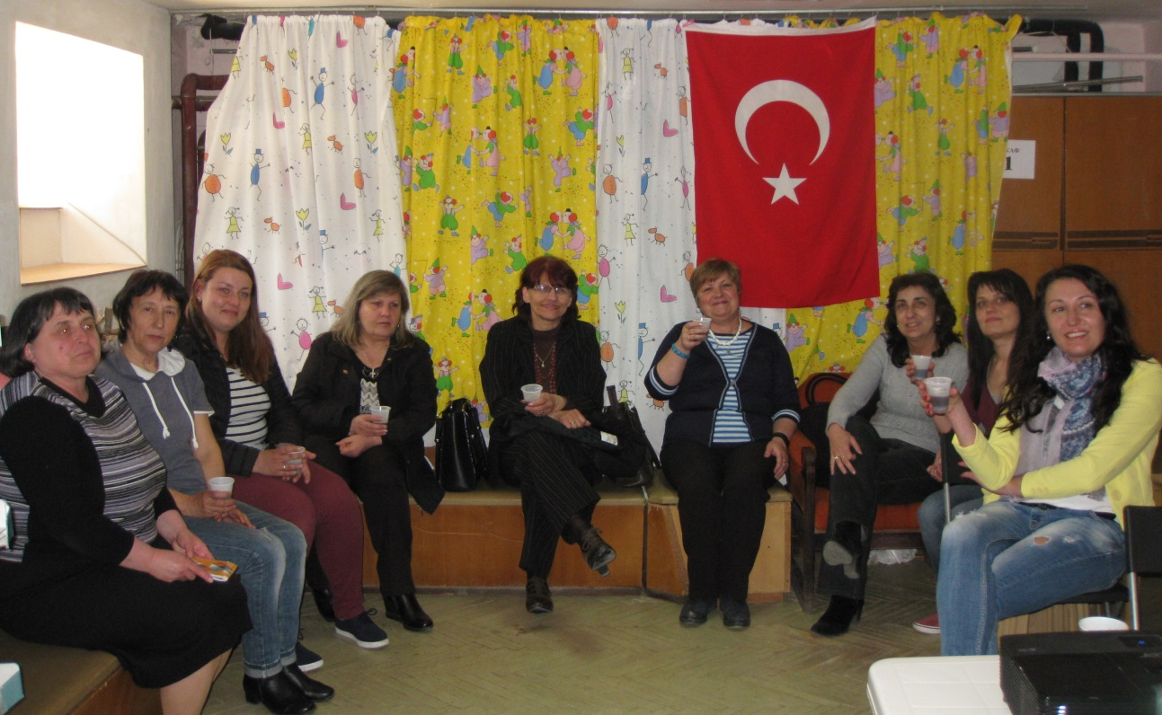
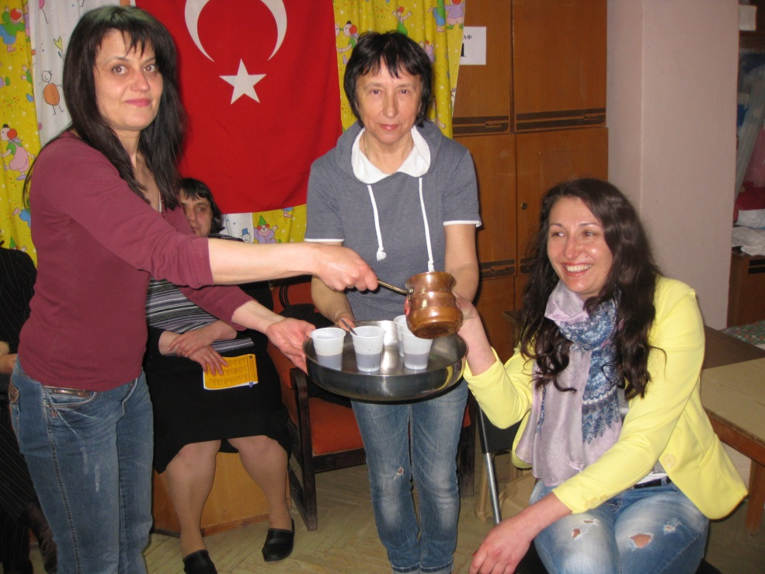
To colleagues …

Slide 12
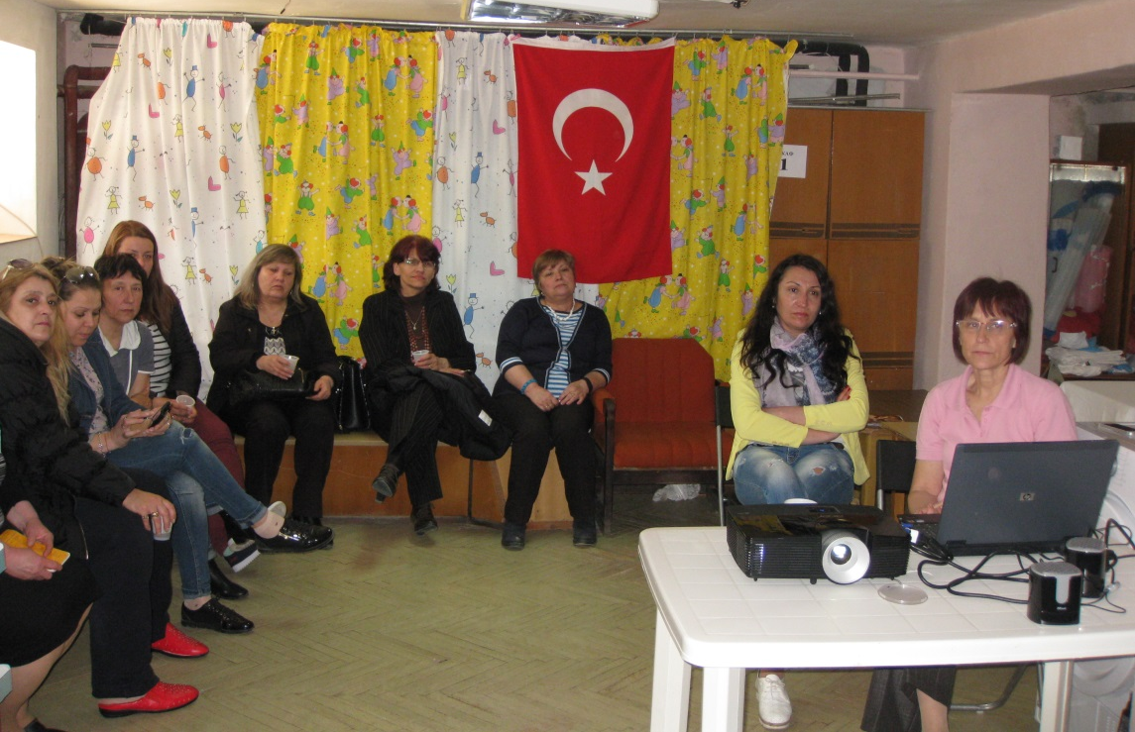
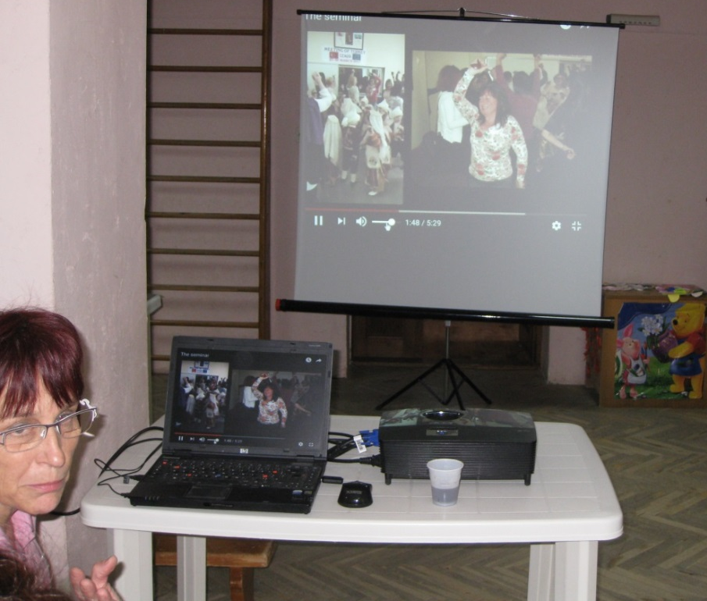
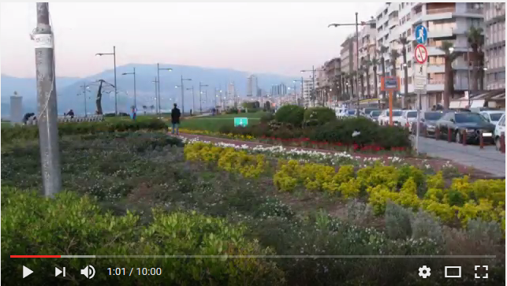
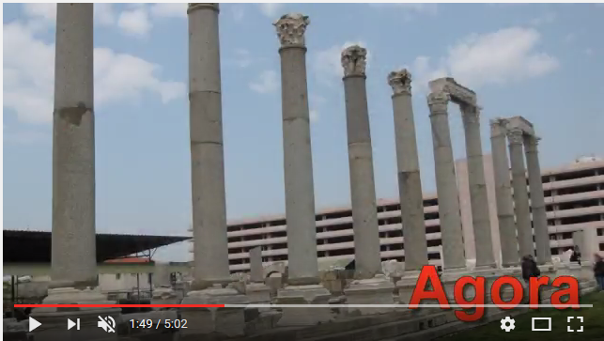
https://youtu.be/XulLsNKoLKc
https://youtu.be/CWxDuPSwcFg

Slide 13
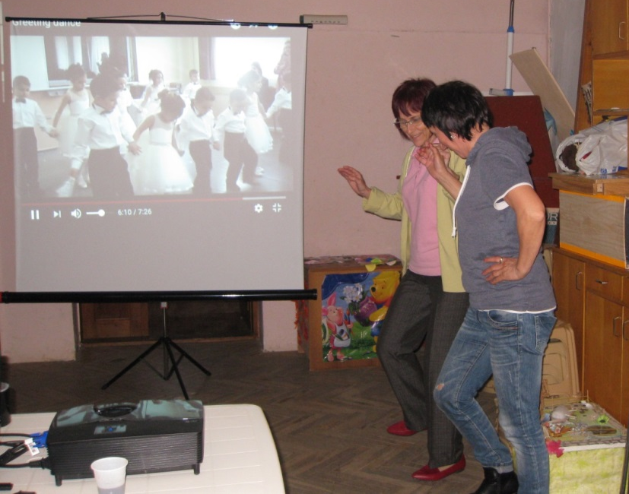
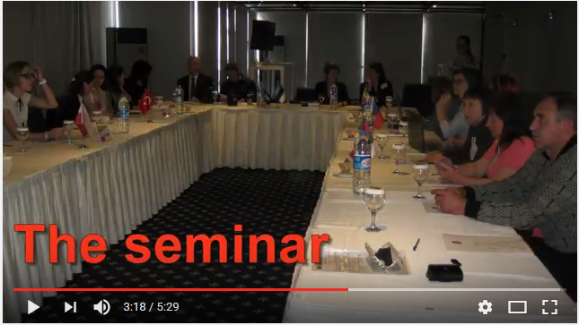
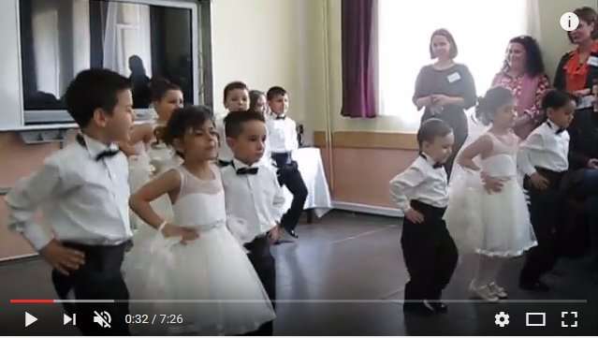
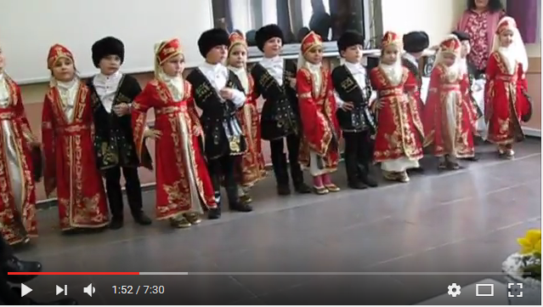
https://youtu.be/R_-lcDE8s5Q
https://youtu.be/GFB-85L3lEs
https://youtu.be/38VObWP6EhU

Slide 14
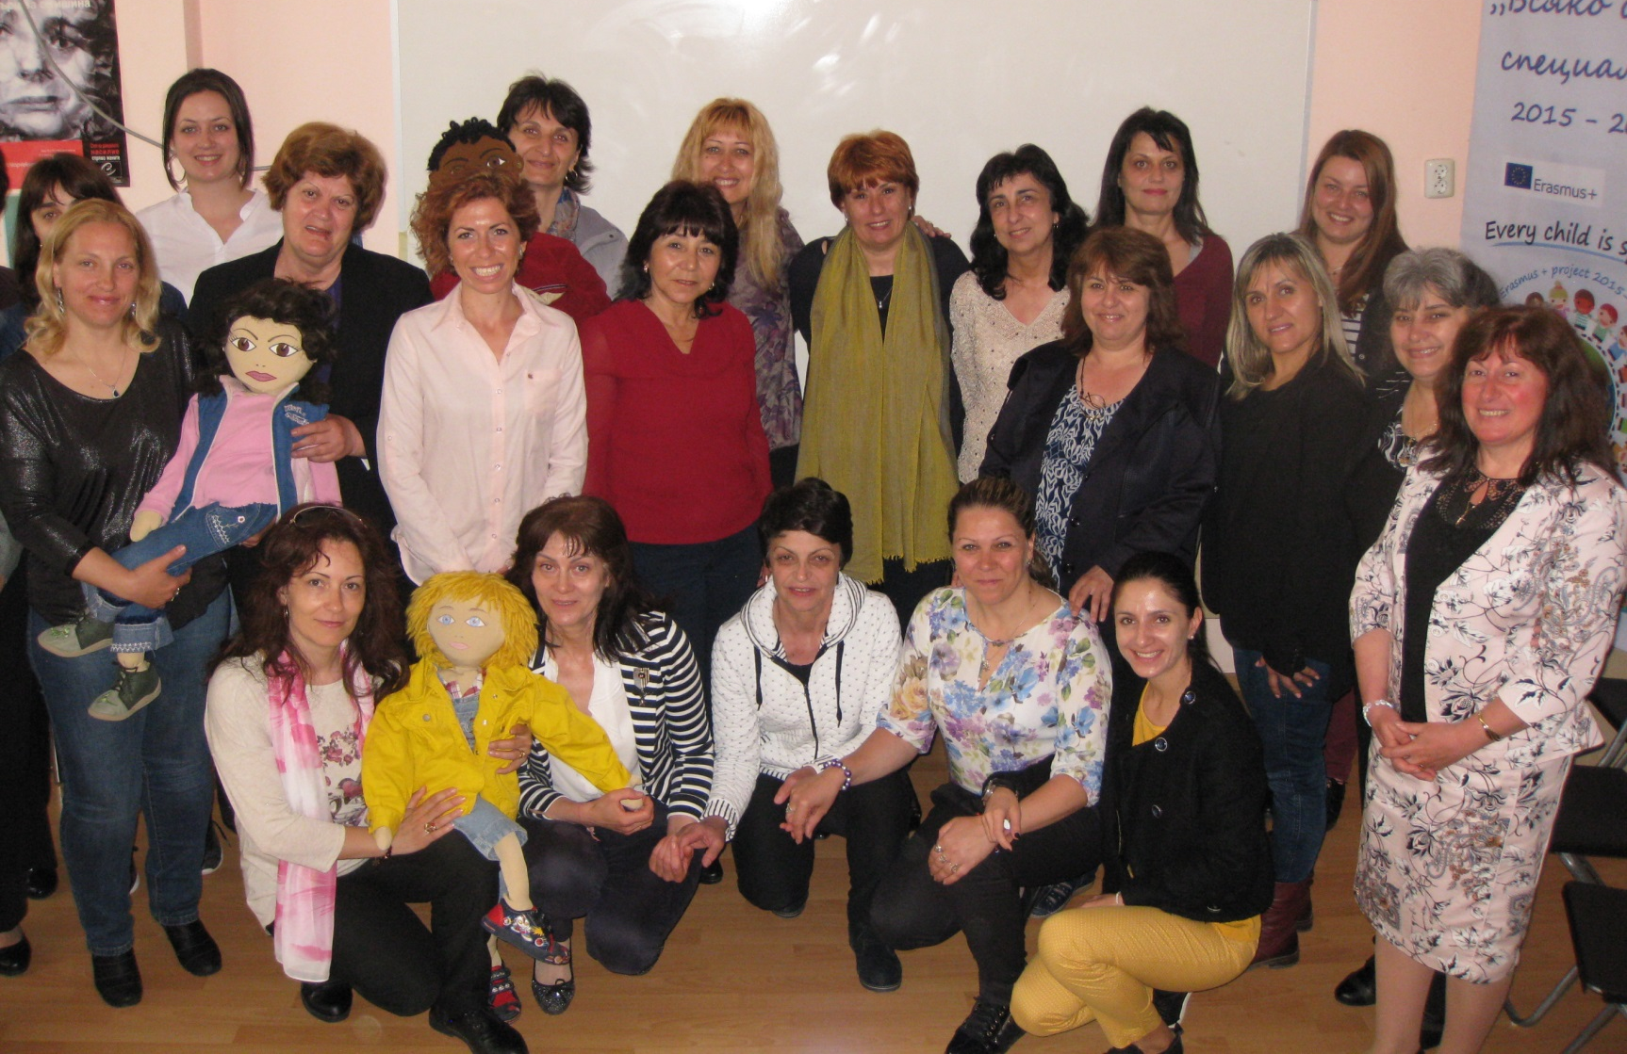
National seminar
organized by our kindergarten
for the training of teachers from Bulgaria

Slide 15
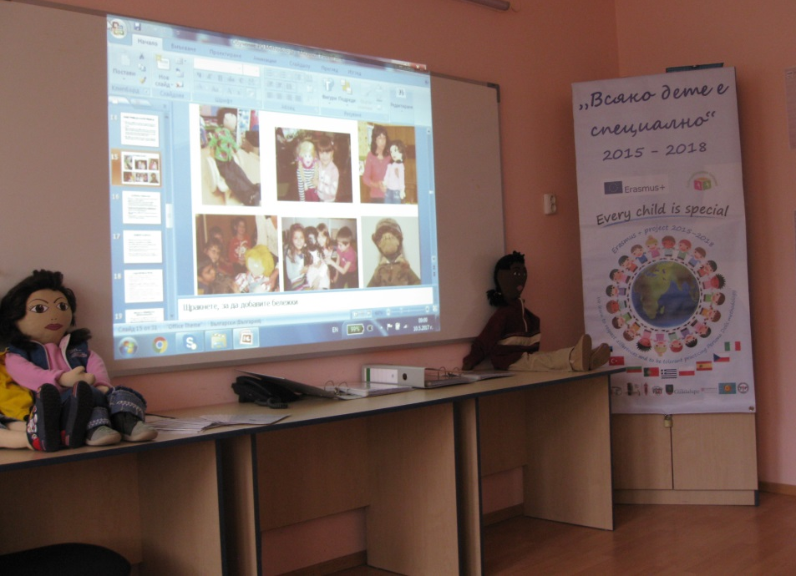
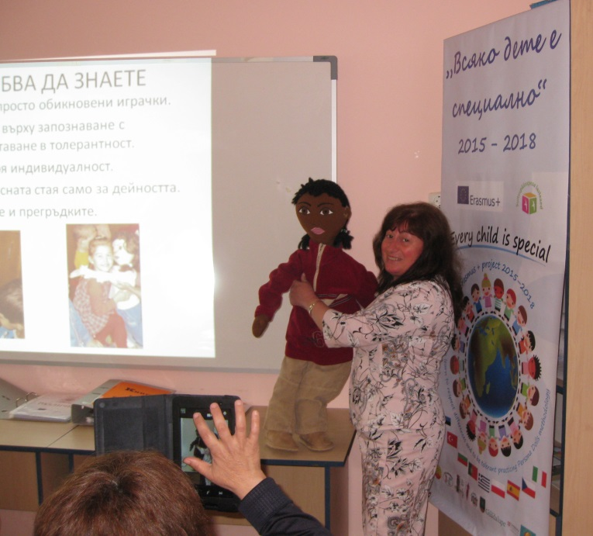
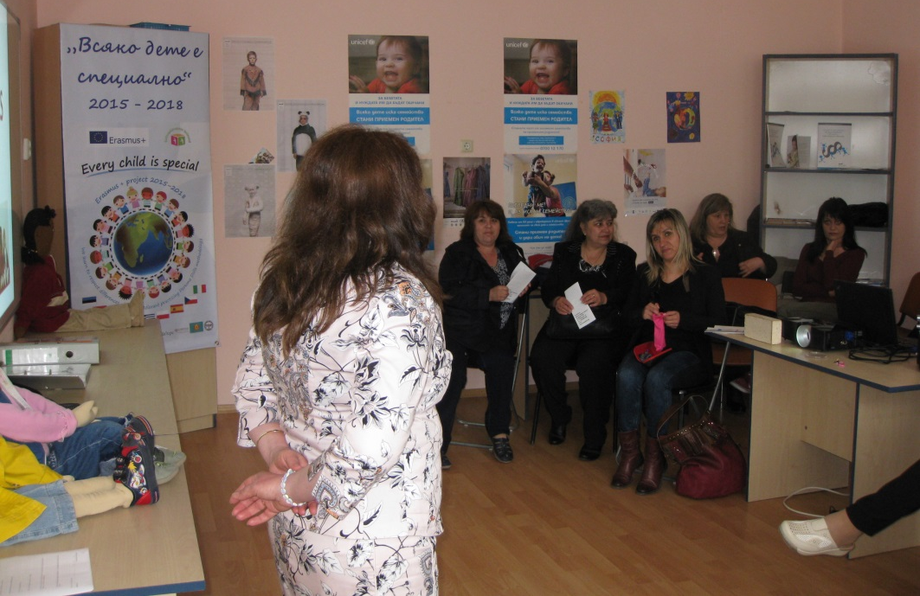
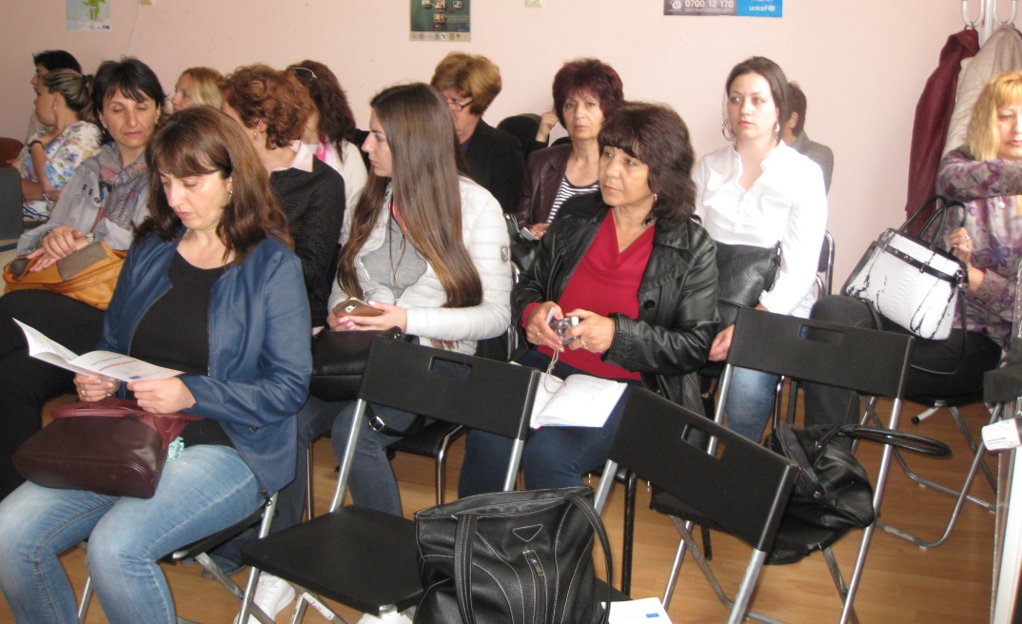
Persona Dolls methodology training

Slide 16
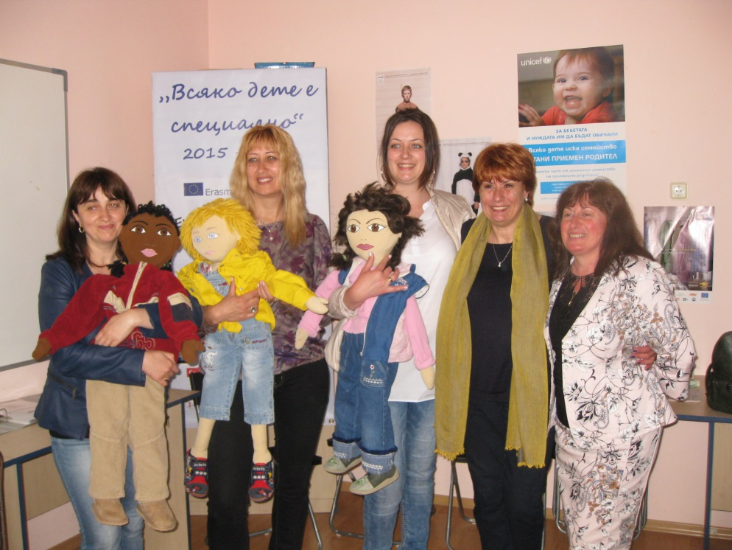
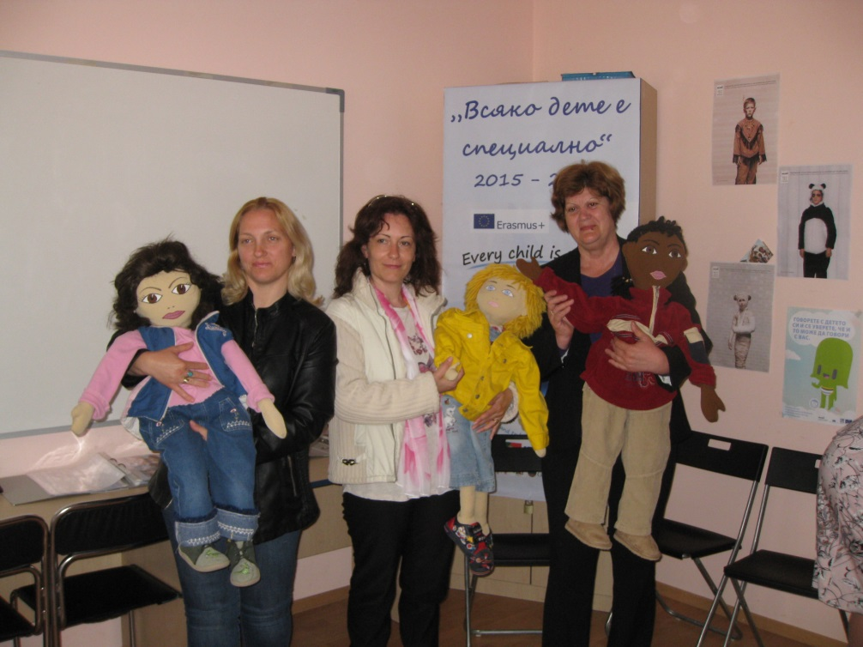
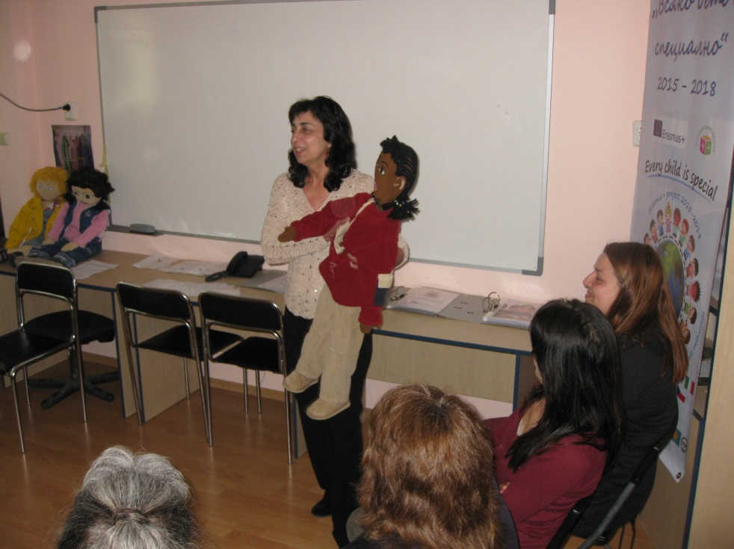
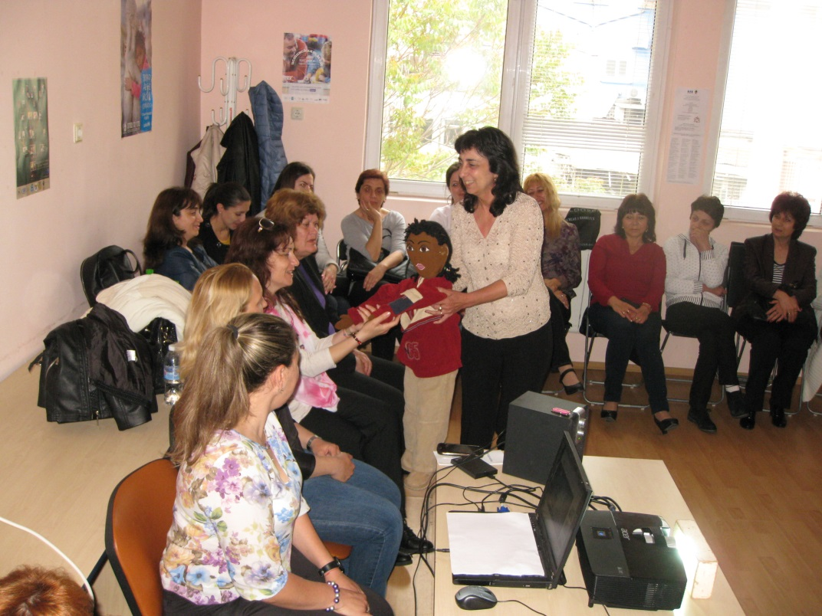
Session with Doll

Slide 17
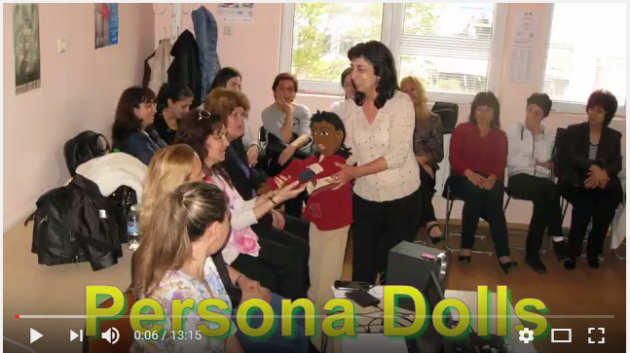
The whole training session
https://youtu.be/nCZJDfSmc6c

Slide 18
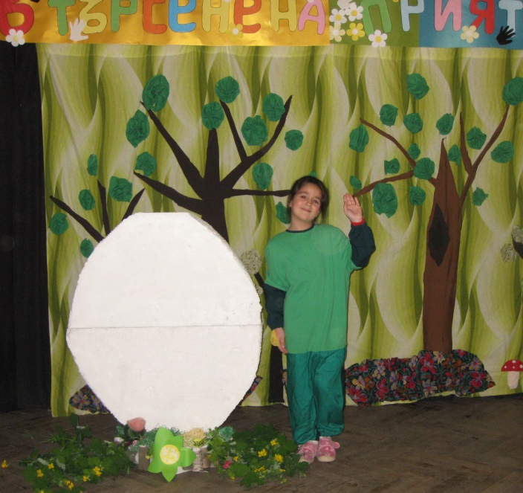
Continuation of Differences week II with the play "Looking for friends"

Slide 21
The children created a speaking book under the International project "You & I". It tells about the differences and similarities between peers from two continents. How can we make friendship between children with different cultures and nations. How to accept differences.
https://www.storyjumper.com/book/index/41121526
http://joom.ag/dDwW

Slide 22
Producing
fourth
Persona
Doll
ALISA

Slide 23
Session about children who have difficulties with speaking and communicate differently with other children - https://www.youtube.com/watch?v=tClvd_MyU6c

