Slide 1
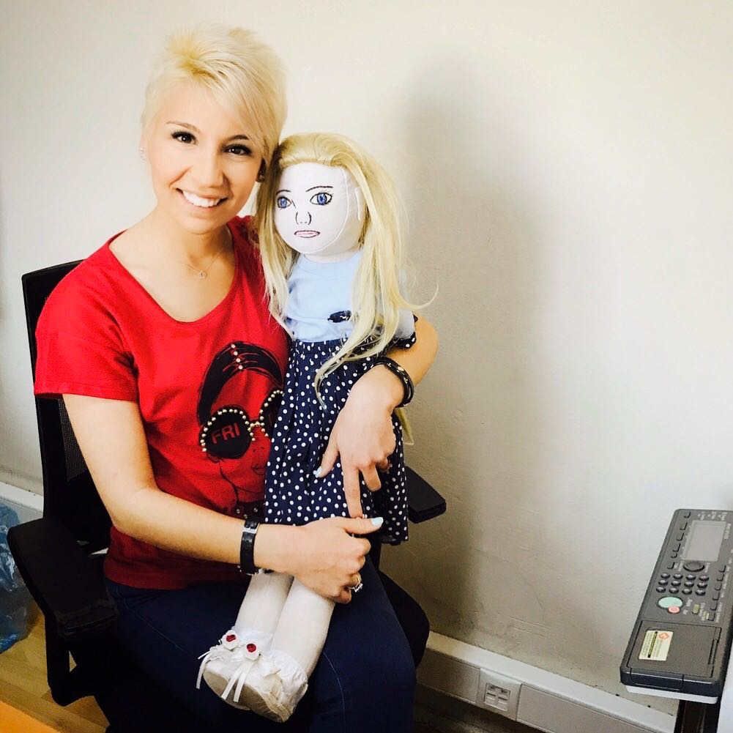
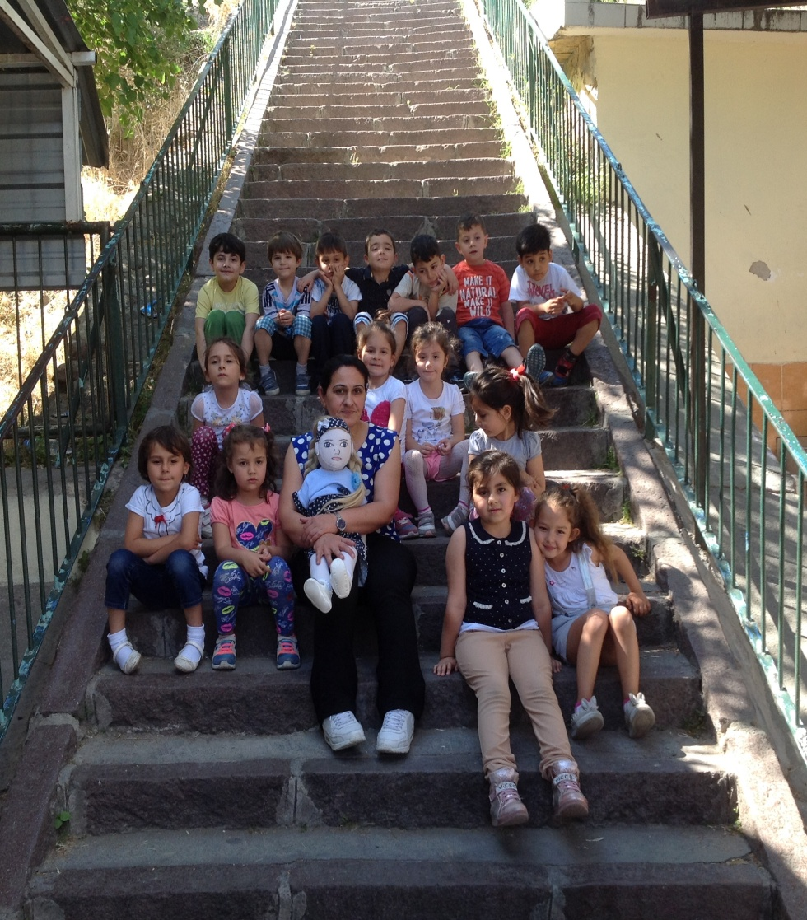
FOURTH DOLL’S NAME IS ESMA

Slide 2
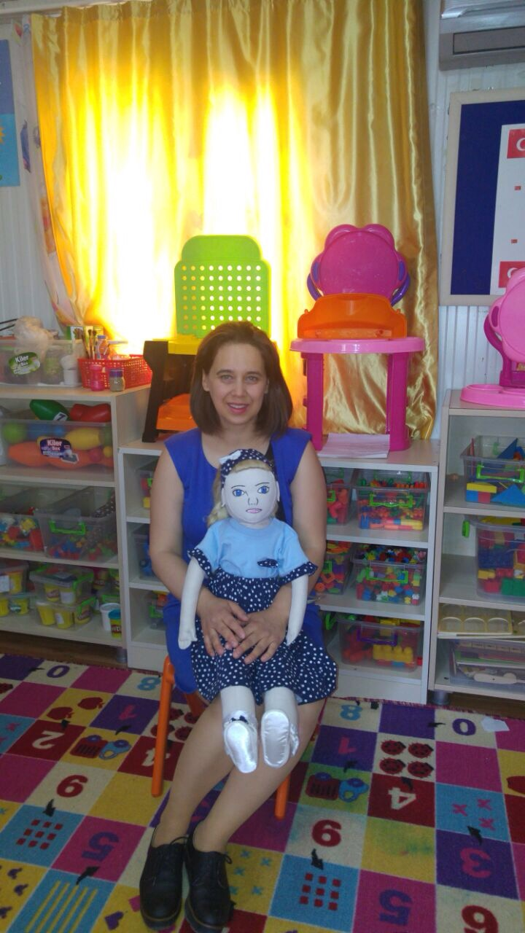
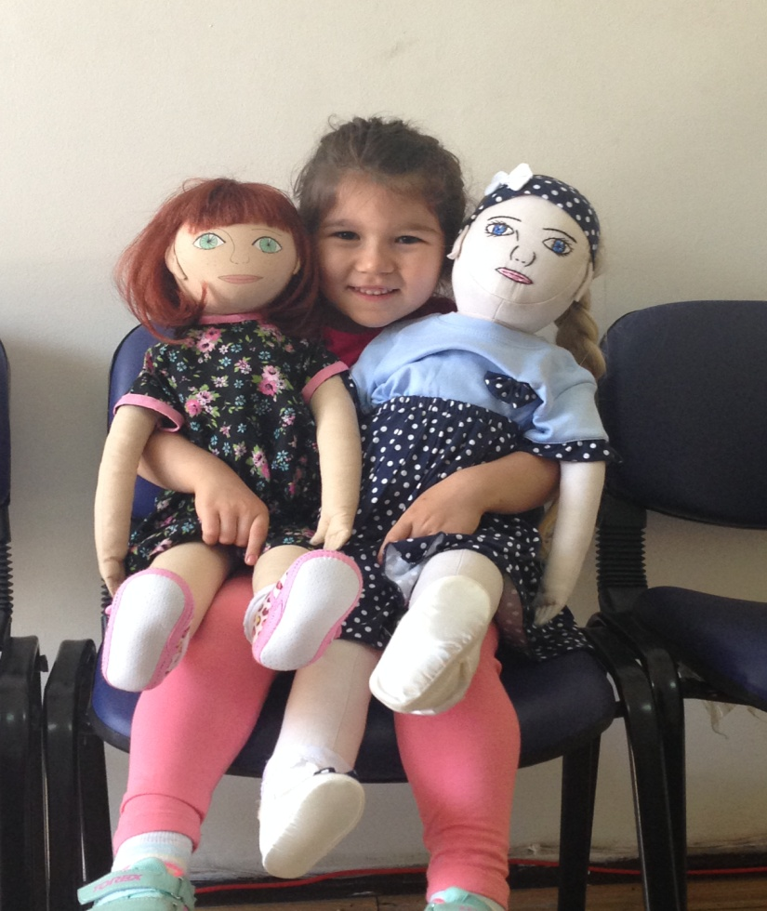
HER FATHER IS OFFICE WORKER
HER MOTHER IS HOUSEWIFE☺

Slide 3
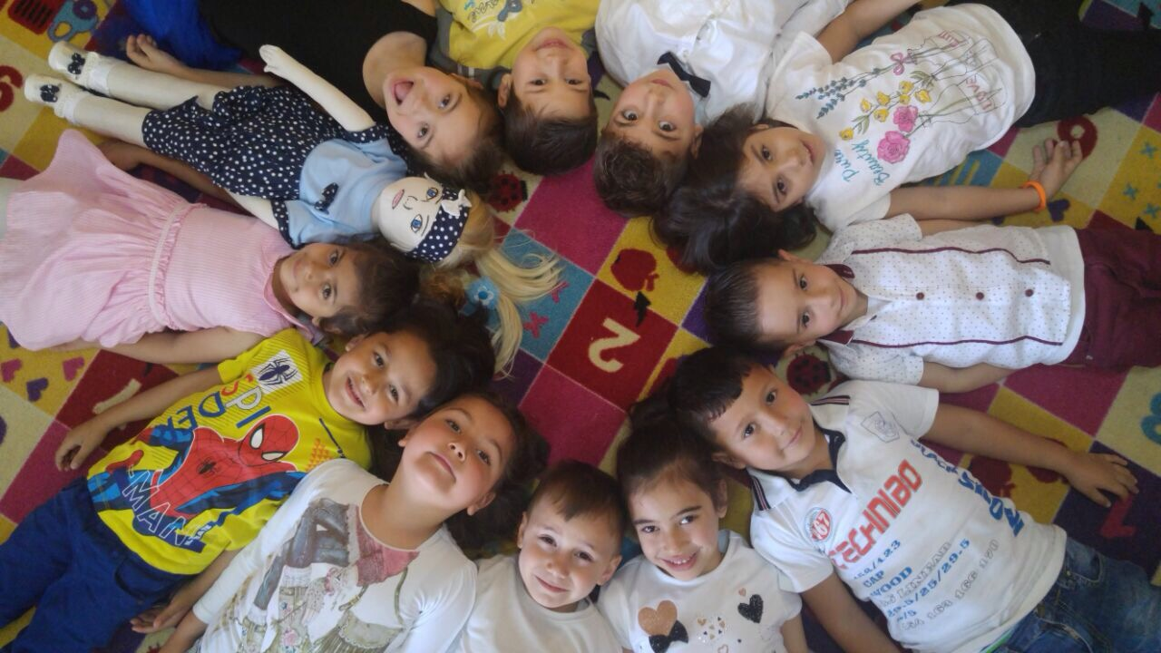
CULTURAL BACKGROUND
HER MOTHER AND HER FATHER ARE TURKISH.
SHE HAS GRANDFATHER AND GRANDMOTHER IN A VILLAGE.
SHE HAS OLDER SISTER.
SHE LIVES WITH HER FAMILY IN A FLAT.
SHE SPEAKS JUST TURKISH.

Slide 4
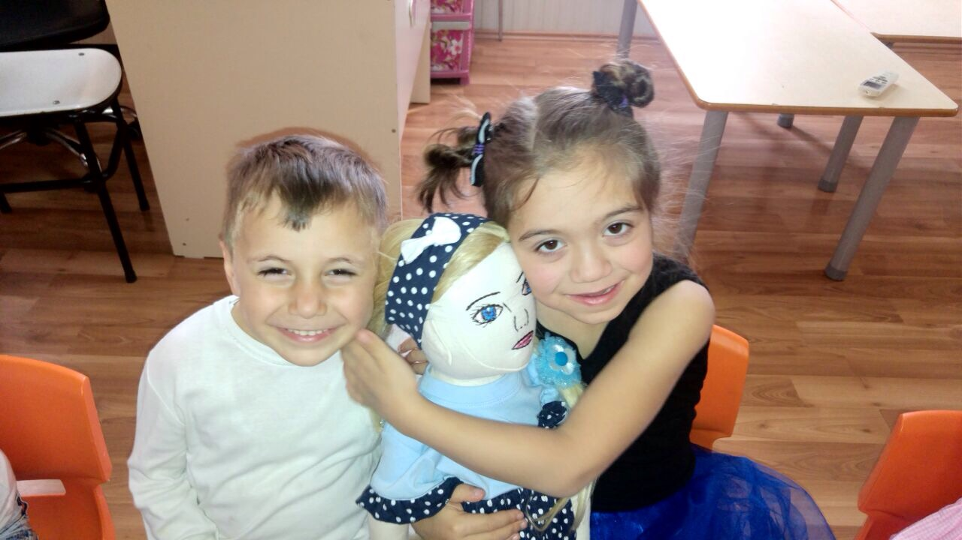
THINGS SHE LIKES
THINGS SHE DISLIKES
SHE LOVES NUMBERS
PLAYING PUZZLE
WATCHING WASH MACHINE WHEN IT WORKS
SHE LIKES REPETITIVE THINGS
SHE LOVES MUSIC
PLAYING GROUP GAMES.
CONTACT OTHER PEOPLE.
SHE IS NOT INTERESTED HER ENVIRONMENT
SHE LOVES HORSE ESPECIALLY PONIES
SHE IS OBSESSED WITH THE BLUE

Slide 5
DIFFICULT TO DO
SHE IS AUTISTIC.
SHE CAN’T JOIN HIS FRIENDS ON GAMES.
SHE HAS SOCIAL PROBLEMS.
SHE SCREAMS SOMETIMES.
SHE GETS AGRESSIVE WHEN SHE METS PEOPLE WHO SHE DOESN’T KNOW.
SHE HAS CONTACT JUST HER TEACHER IN CLASS.

Slide 6
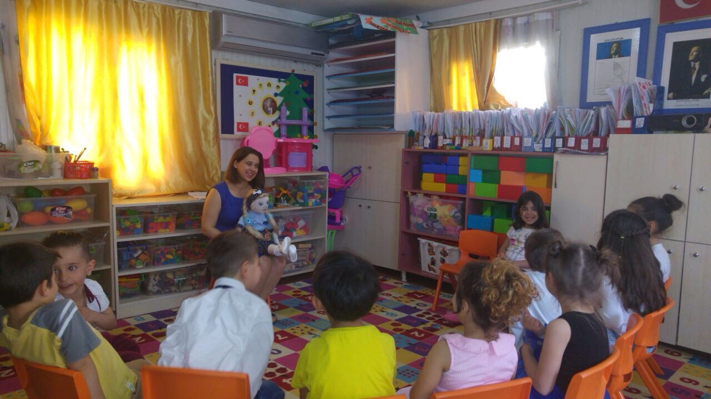
SHE PREFERS BEING ALONE.
SHE ONLY PLAYS ON HER OWN.
SHE ALWAYS ASK INTEREST ONE ON ONE.

Slide 7
HER RECENT STORY
HER FAMILY REALIZED HER DIFFERENCIES WHEN SHE WAS 2 YEARS OLD.
THEY WENT TO CHILDREN DOCTOR. THEY LEARNED THAT SHE IS AUTISTIC.
SHE BEGAN TO GO TO REHABILITATION.
SHE HAD MANY MANY PROBLEM WHEN SHE STARTED TO COME TO OUR KINDERGARTEN.
HER TEACHER AND HER FAMILY ALWAYS KEEP IN TOUCH FOR SOLVE HER PROBLEM.

Slide 8
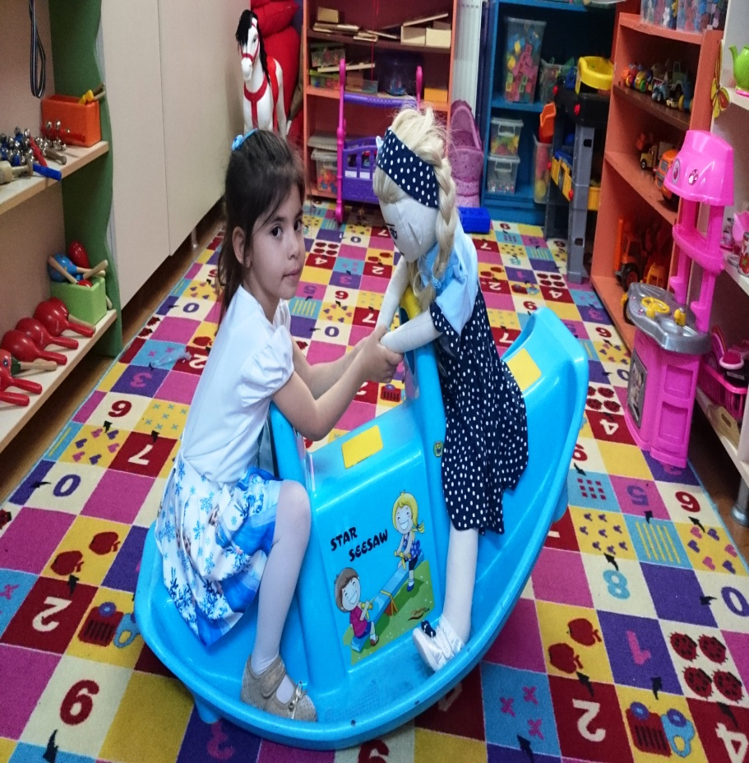
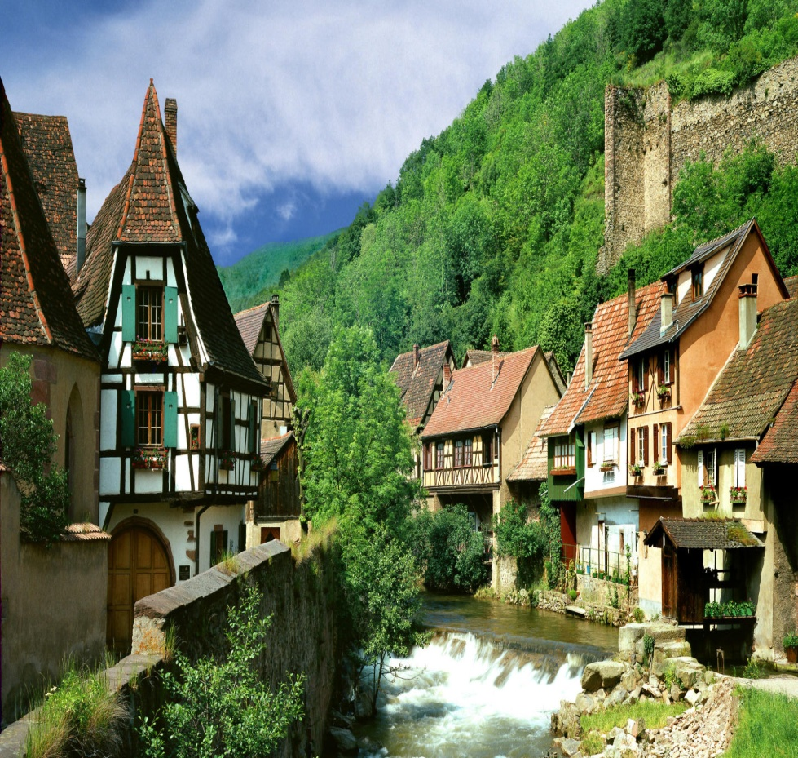
SHE LOVES BEING VILLAGE WHERE HER GRANDPARENTS LIVE.
BECAUSE SHE FEELS IN PEACE THERE.

