Slide 1
Teaching differences in Bulgaria
Project "Every child is special"

Slide 2
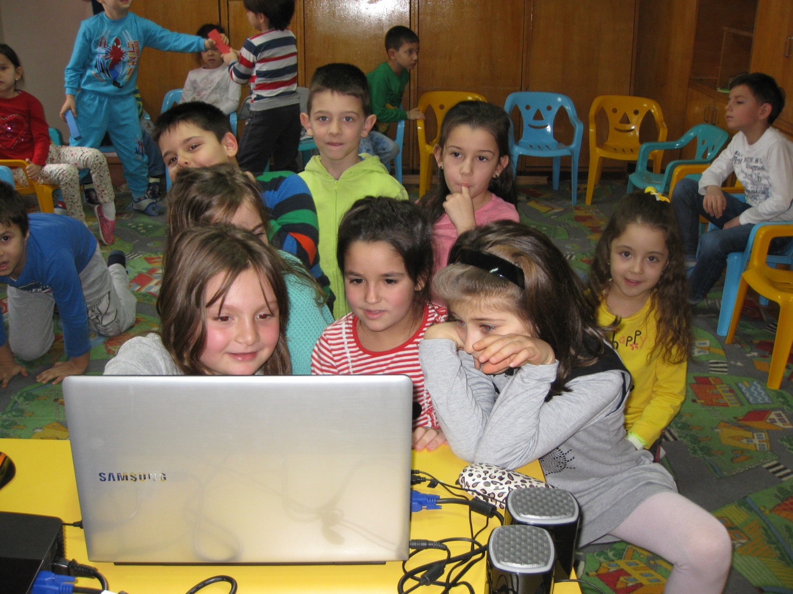
In Kindergarten "Zvanche" Shumen, pre-school education aimed at acquiring a set of competencies - knowledge, skills and relationships through the "I Change the World" program.

Slide 3
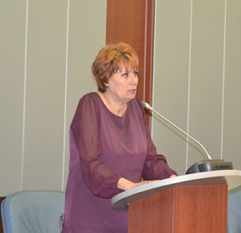
"I Change the World" is a program of Prof. Dr. Irina Koleva. The kindergarten has been working since 1990 on this program. Objective - Developing the quotient of intelligence of the 3-7 year old child in the context of the socialization process.

Slide 4
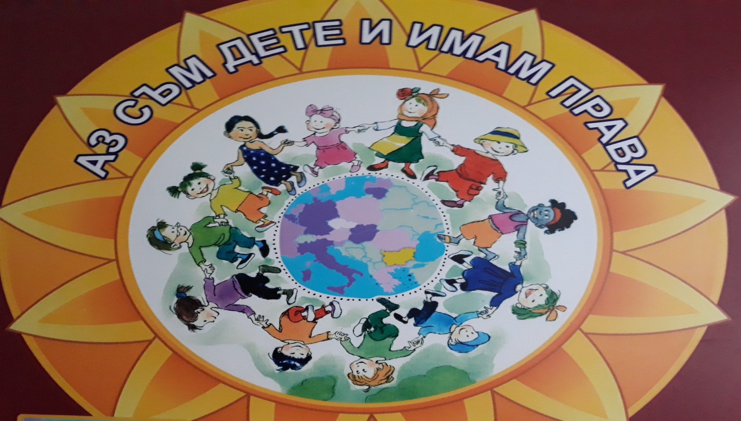
The program is subject to the Convention on the Rights of the Child, affirming the child as a person, stimulating motivation for achievement, creativity and emotional intelligence.

Slide 5
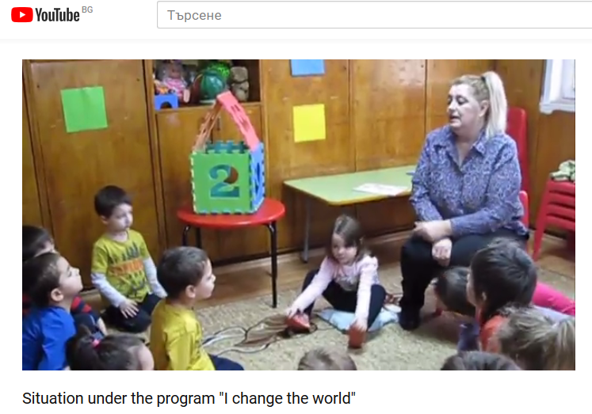
https://youtu.be/hNzDbL97N_o

Slide 6
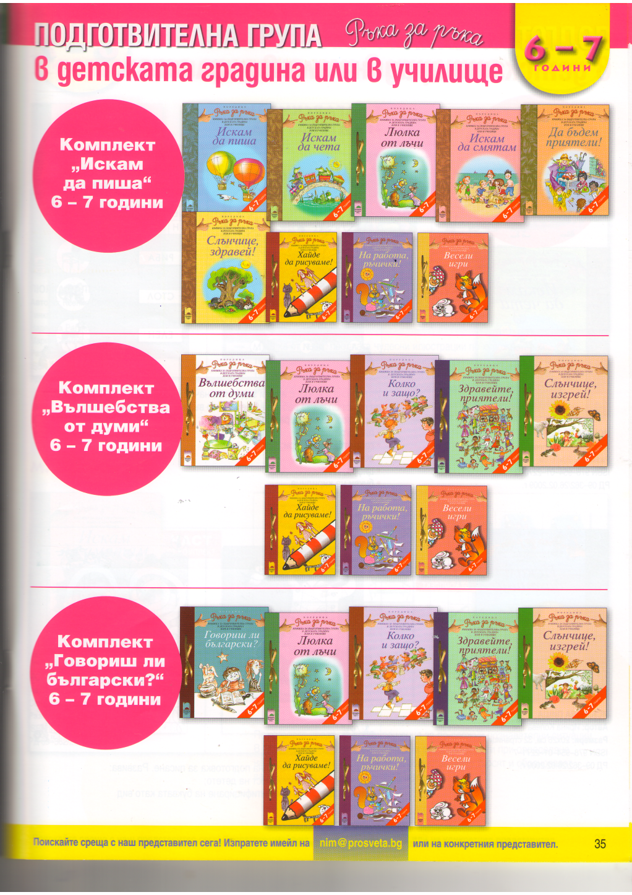
Gamebooks for children are means for realizing the pedagogical interaction.

Slide 7
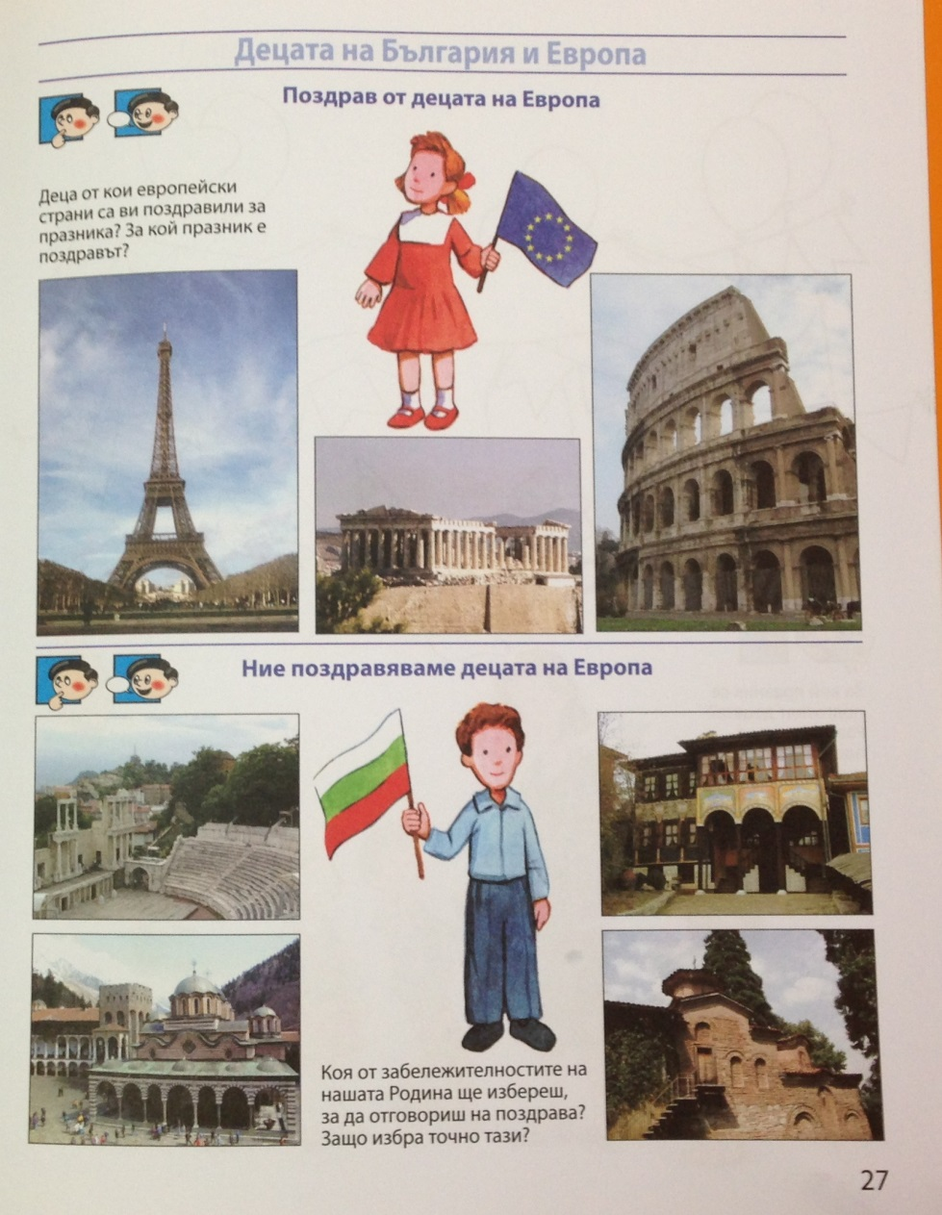
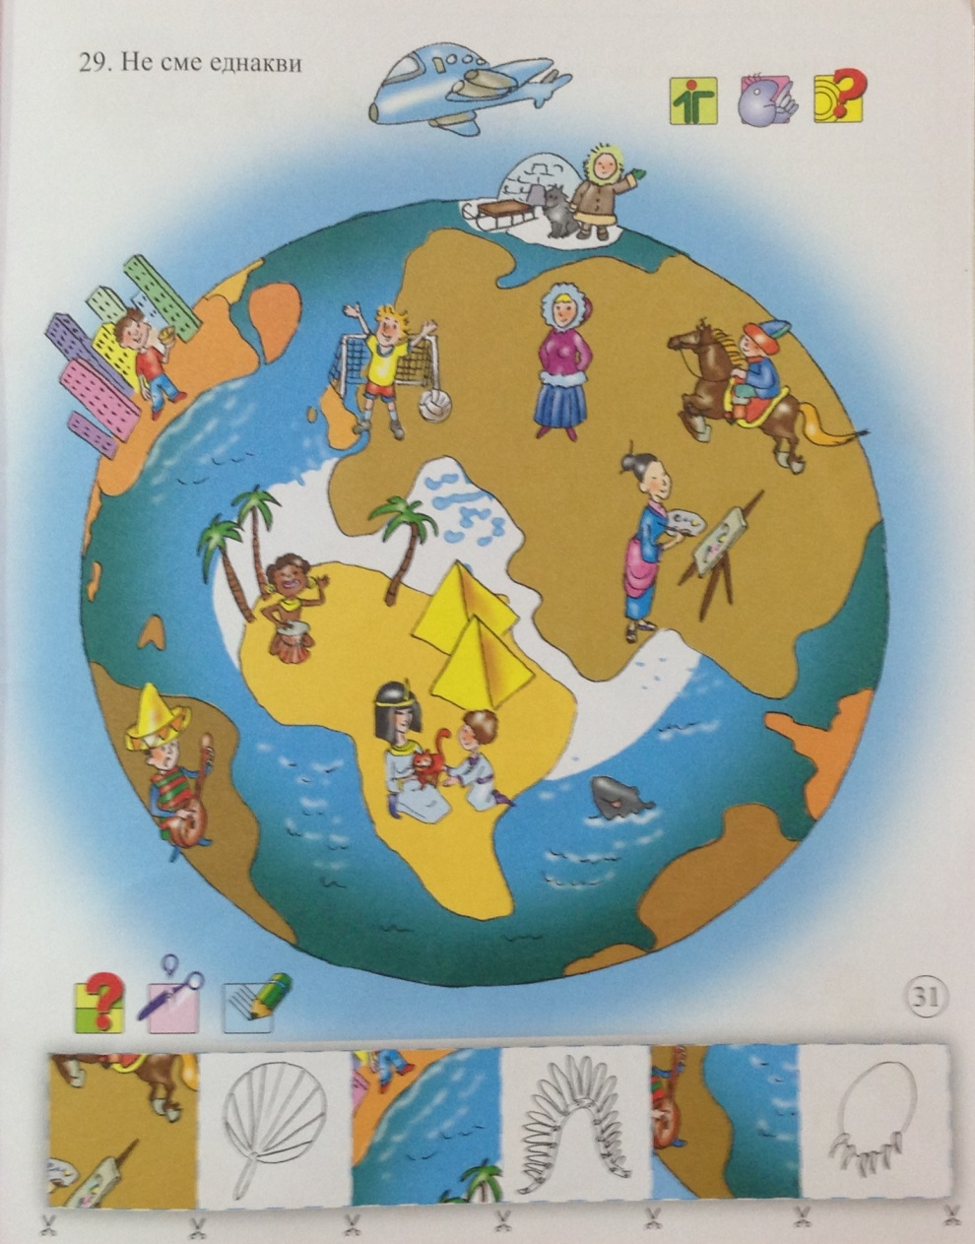

Slide 8
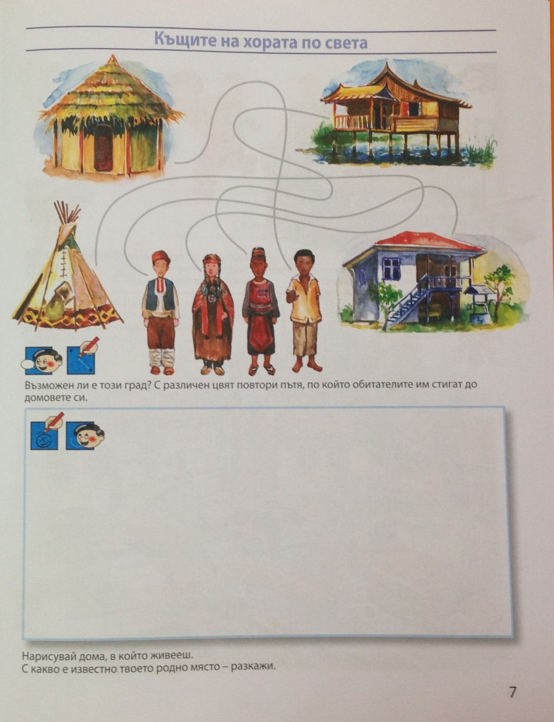
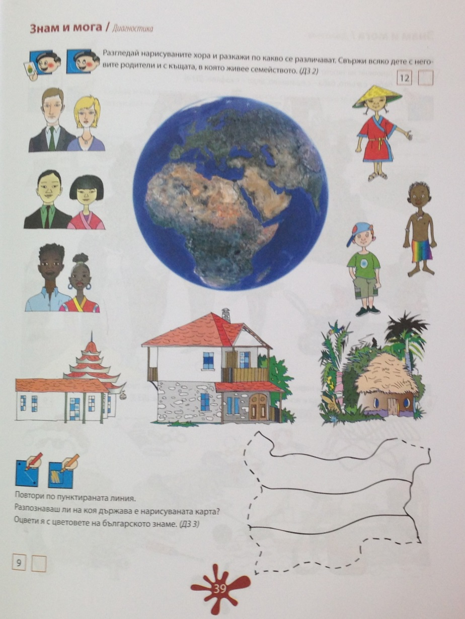

Slide 9
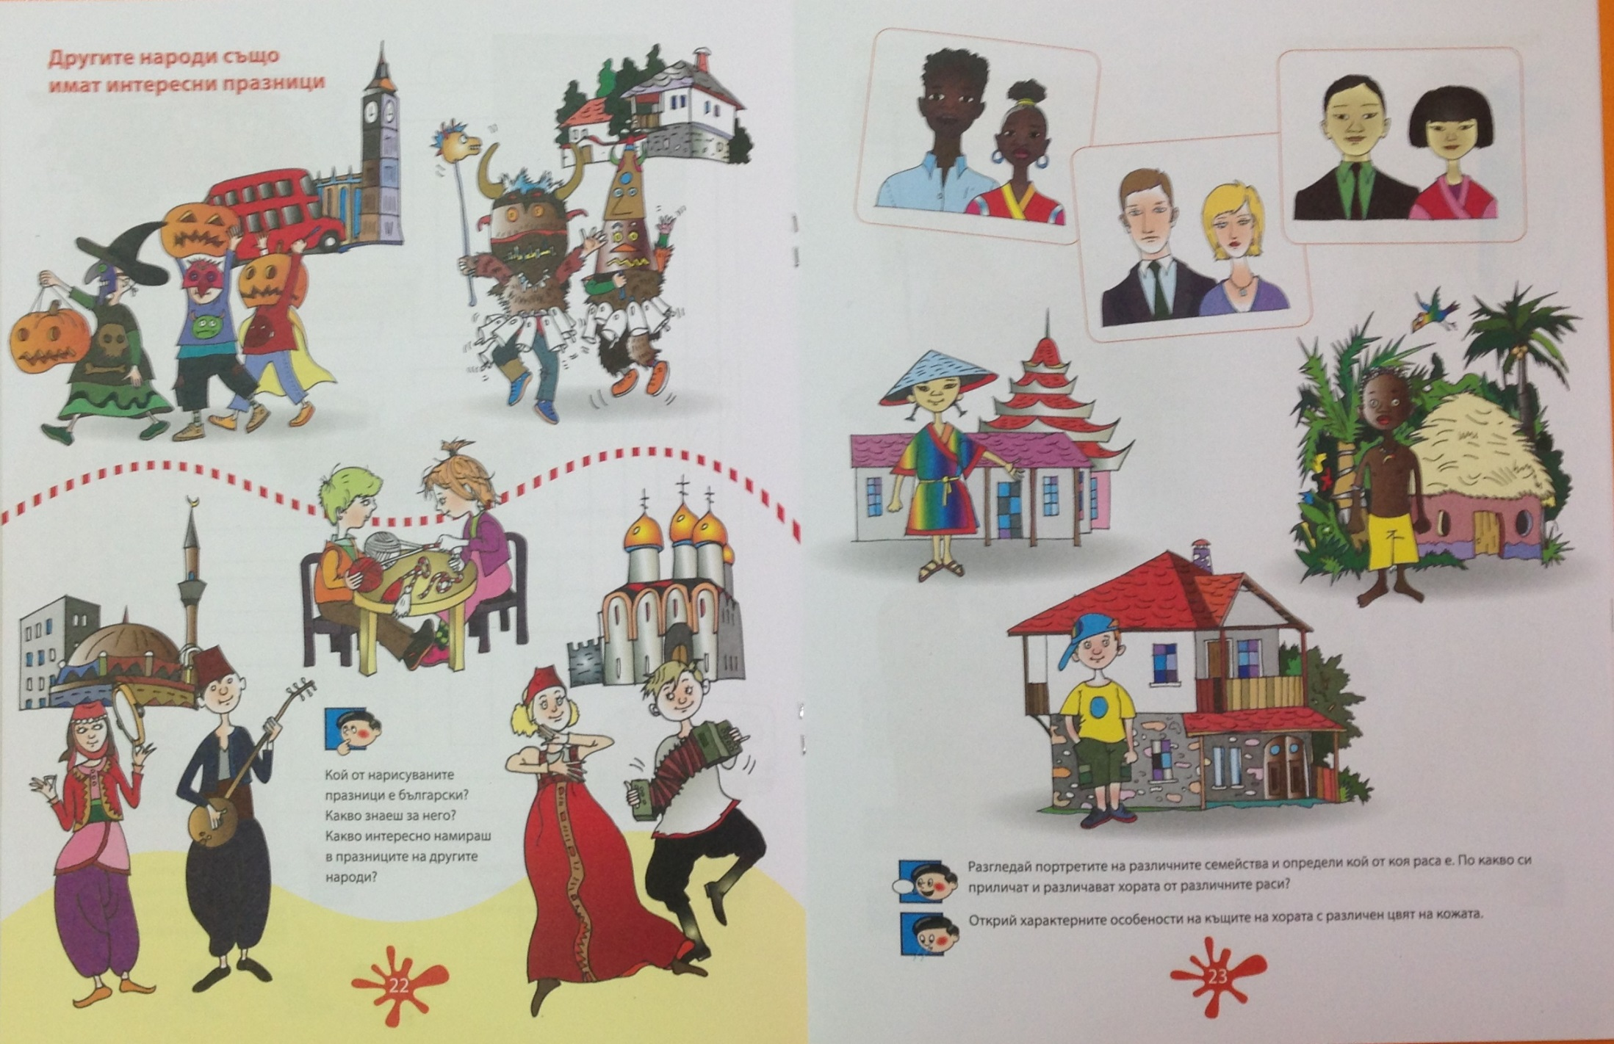

Slide 10
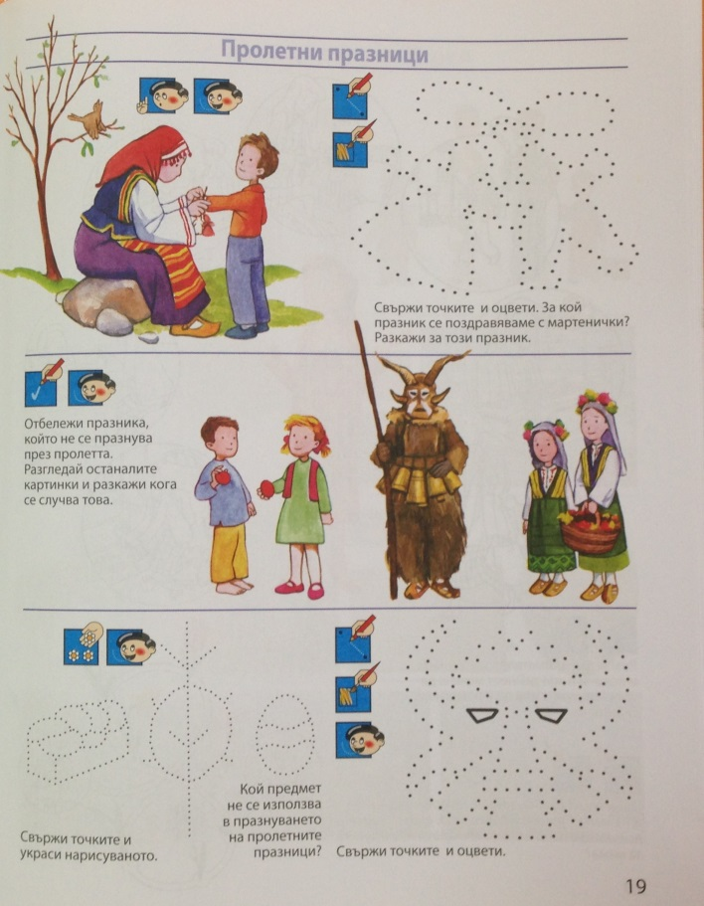
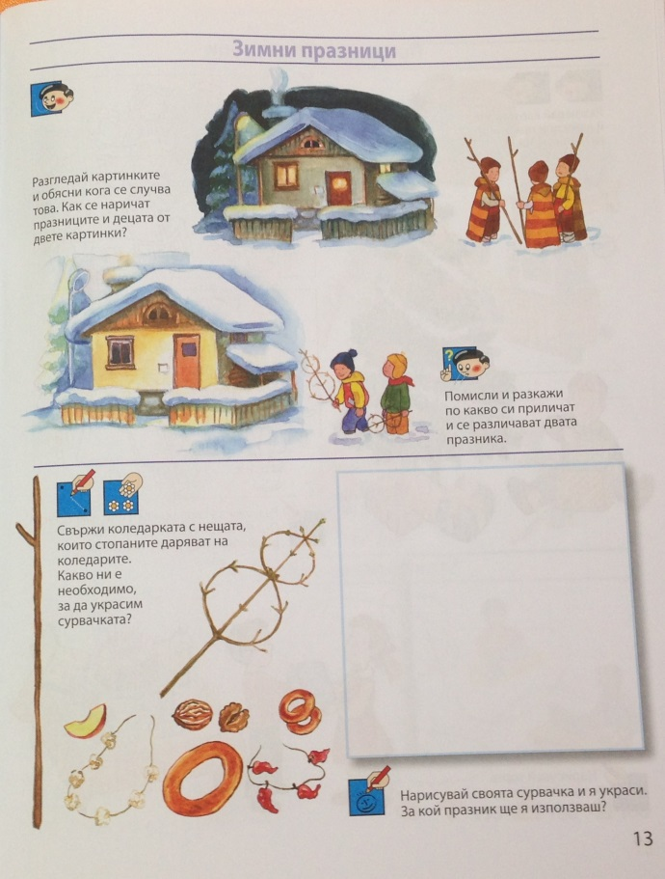

Slide 11
Children learn about the differences that exist between us through international Kindergarten is involved
Partners from 24 countries on 3 continents - Europe: Romania, France, Italy, Spain, Sweden, England, Greece, Poland, Lithuania, Turkey, Malta, Slovakia, Slovenia, Croatia, Estonia, Hungary, Czech Republic, Cyprus, Portugal, Netherlands, Germany, Finland Asia: Georgia Africa: Reunion

Slide 12
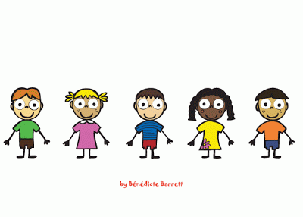
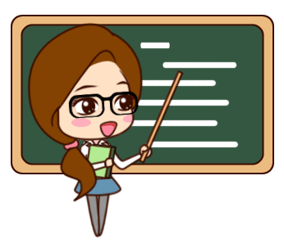
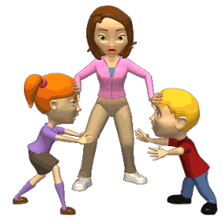
Benefits for students:
Young children who start speaking early with children from other countries will be able to live with them in a world of peace and tolerance.
Bruno Colavin - Africa
Practically realize the differences between people - skin colour, cultural differences, behavioral differences. They learn to talk about themselves
Benefits for teachers : share their own good pedagogical experience, apply new teaching techniques, add new curriculum content to the obligatory curriculum on subject teaching differences between people
Benefits for parents: learn with the children, they are partners in the common mission for the development of child socialization and emotional intelligence.
Benefits for the institution: European dimension of the educational process in the kindergarten.

Slide 13
3rd week of differences

Slide 14
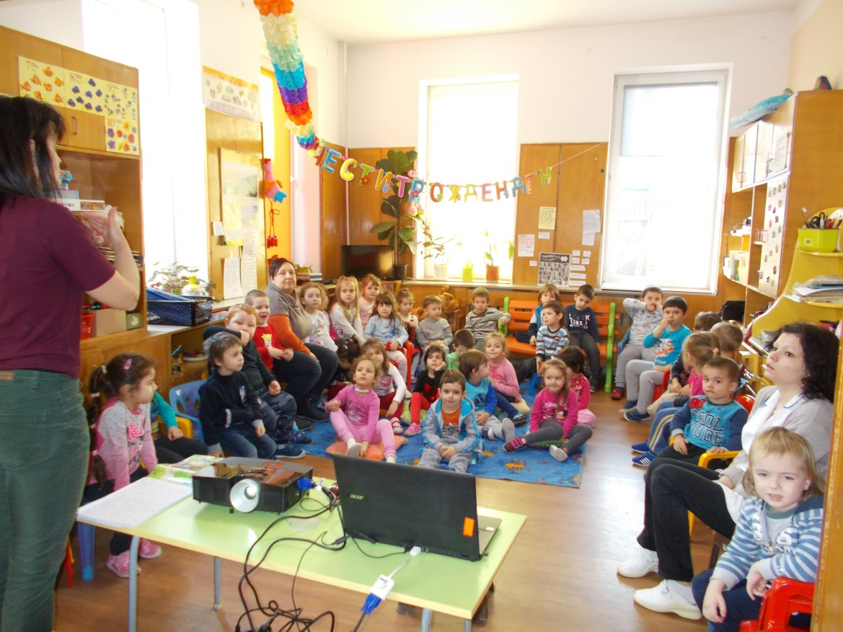
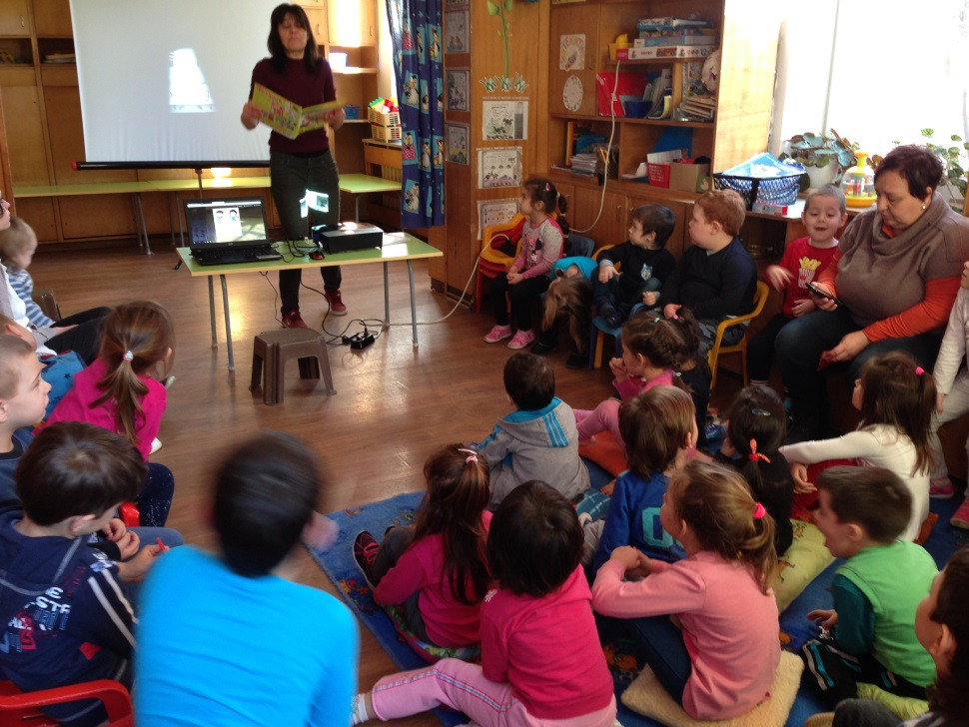
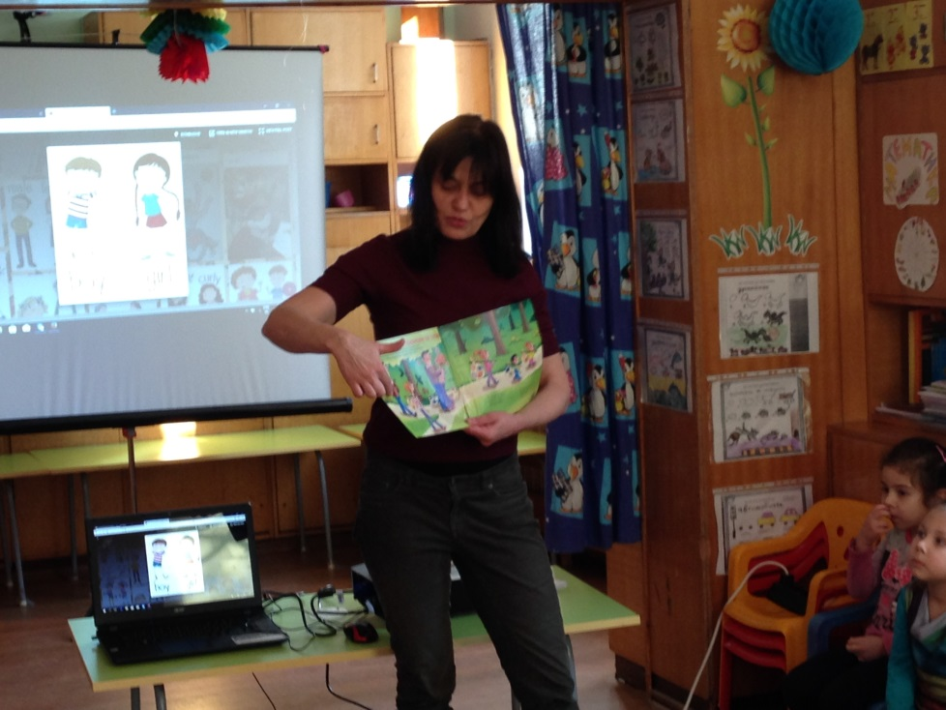

Slide 15
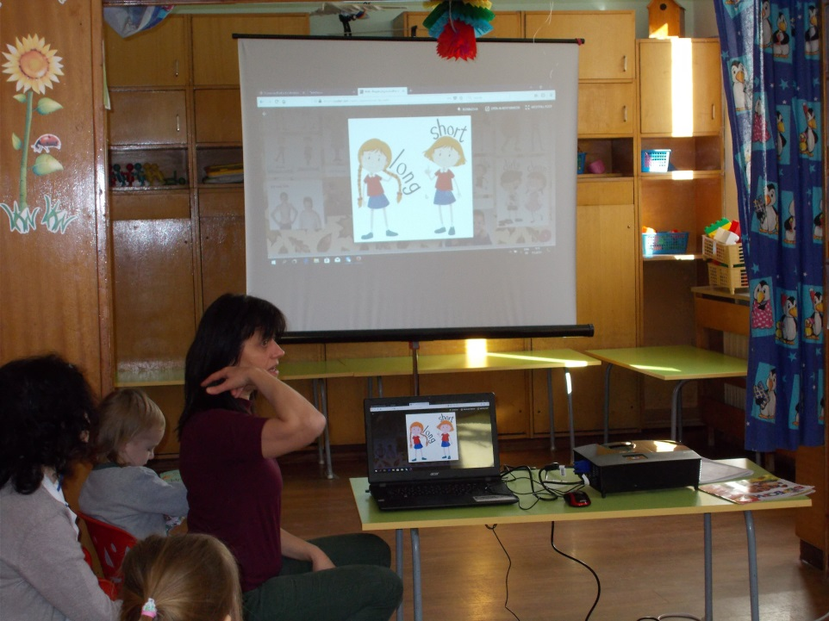
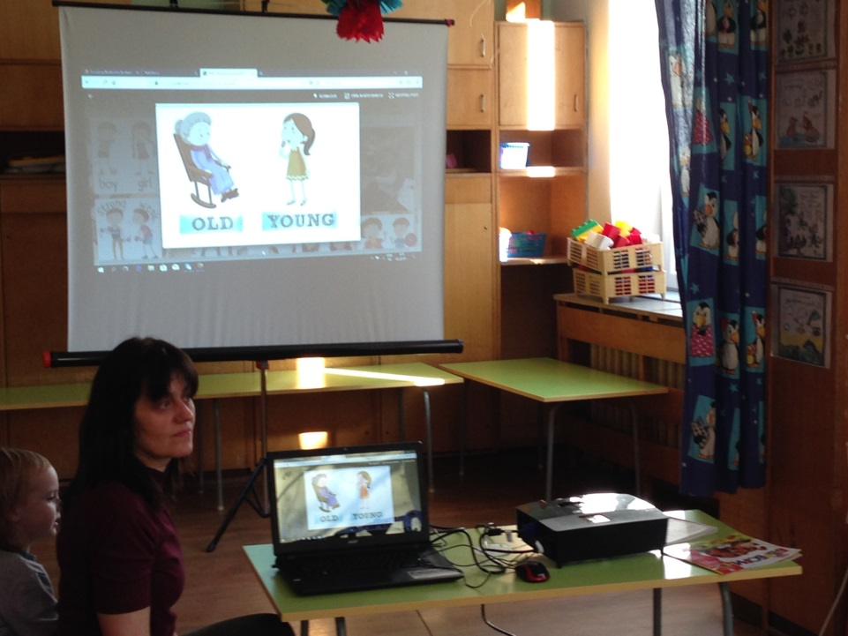
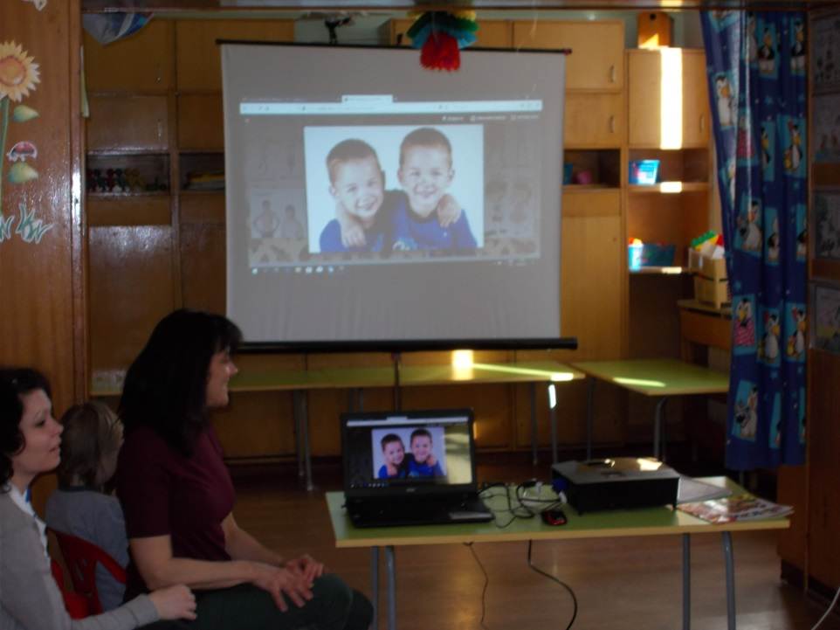
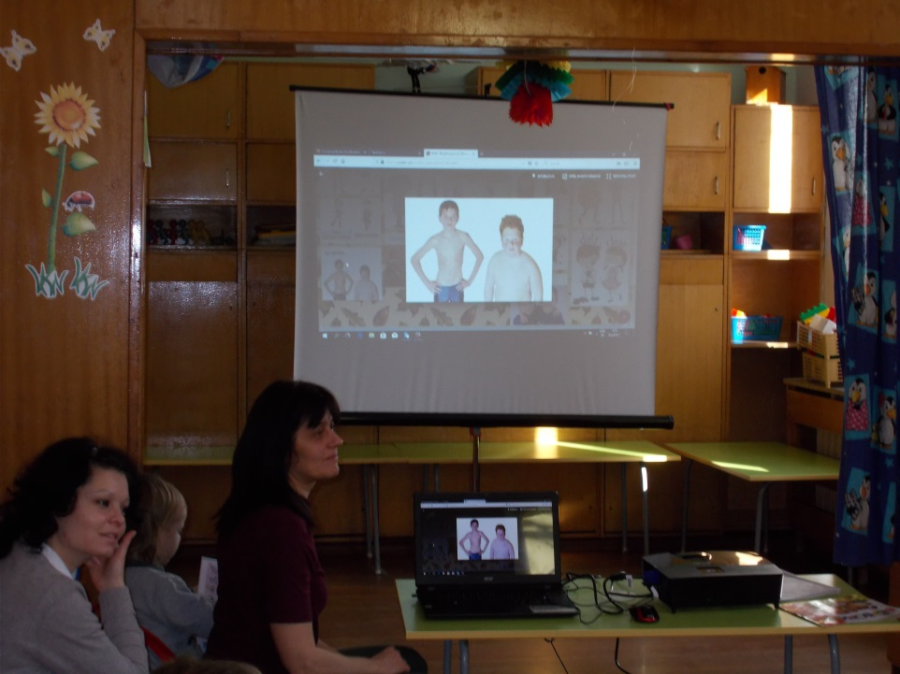
People with different appearance - height, overweight, age, sex, twins People with Special Needs

Slide 16
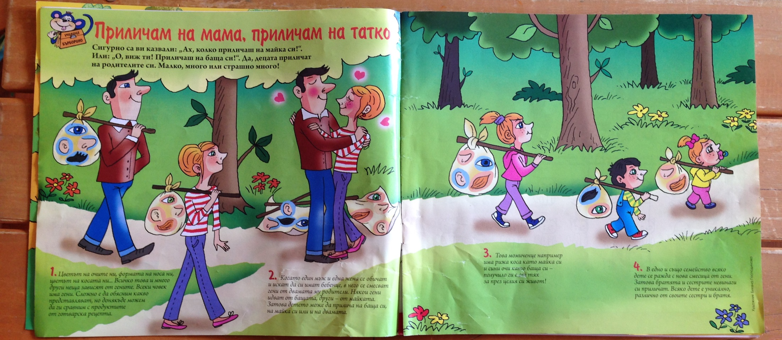
“I look like Mom, I look like Dad” = how does it make children look like their parents - a tale of genes.

Slide 17
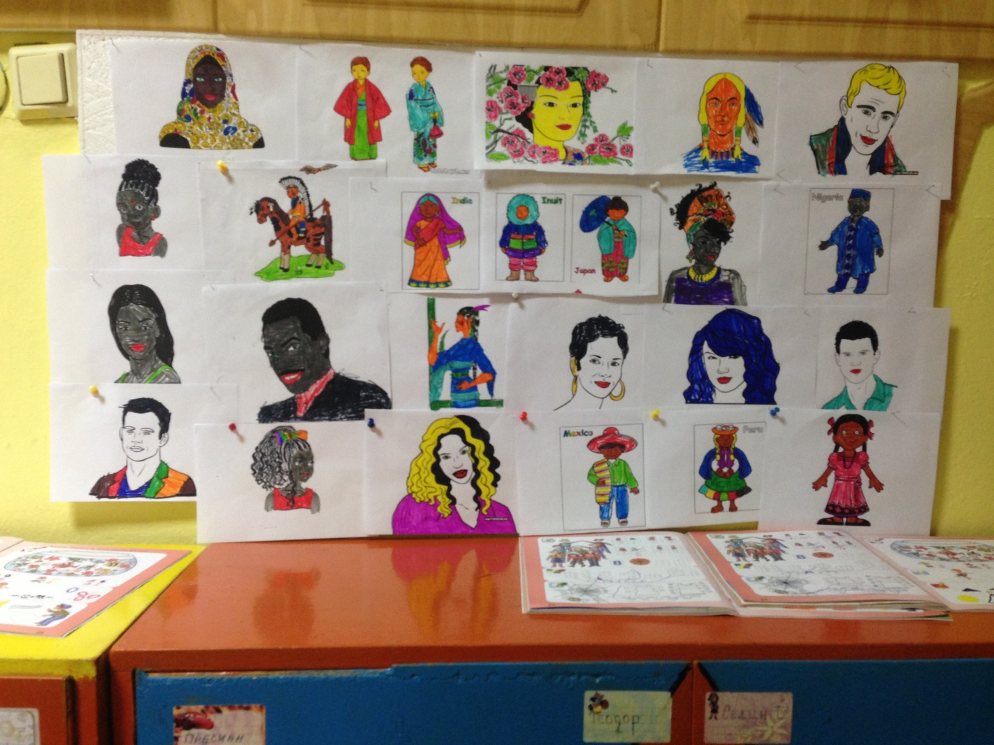
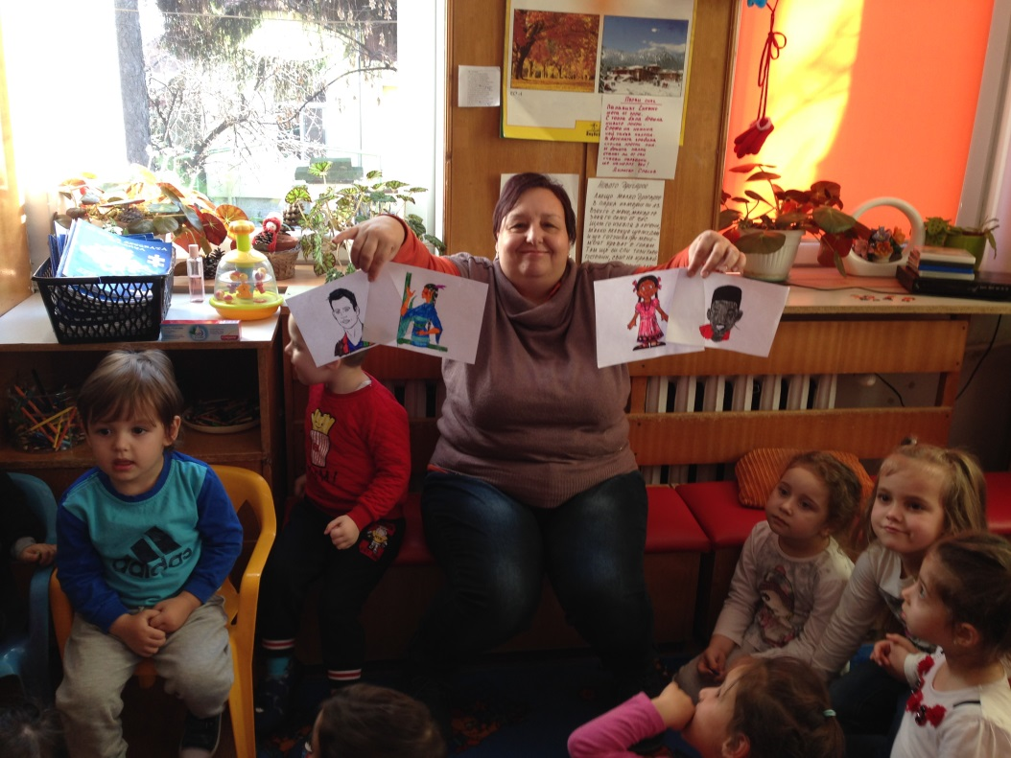
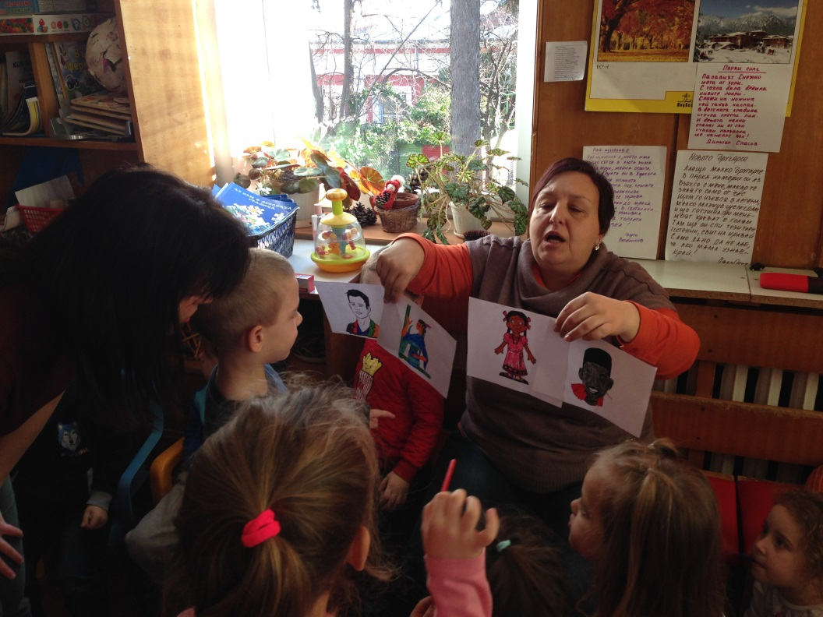

Slide 18
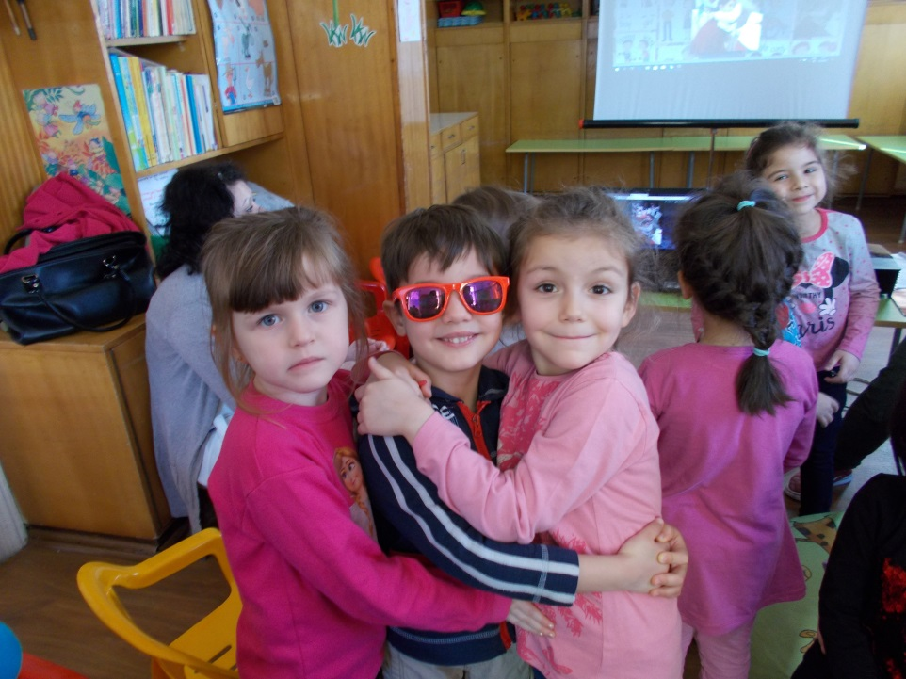
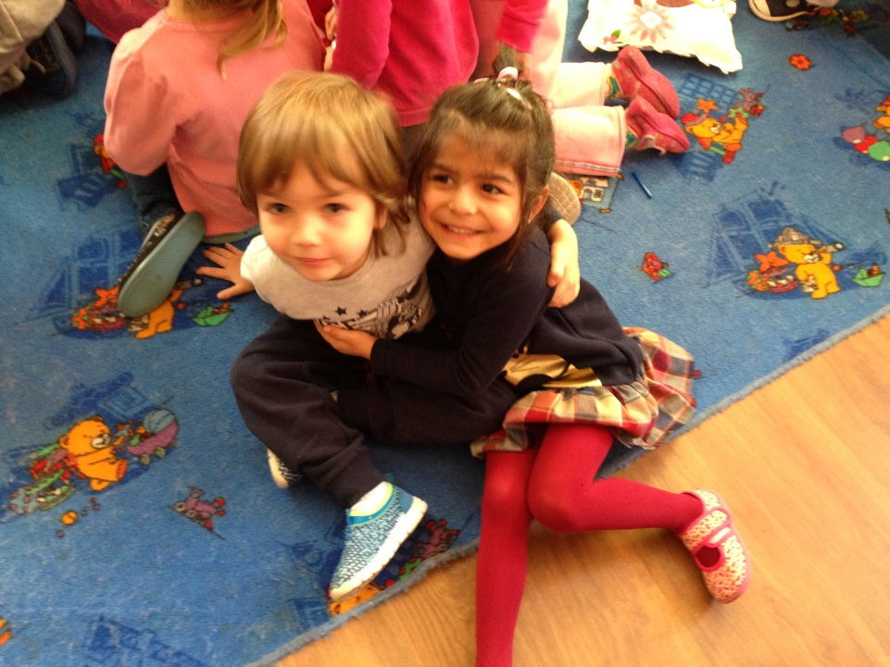
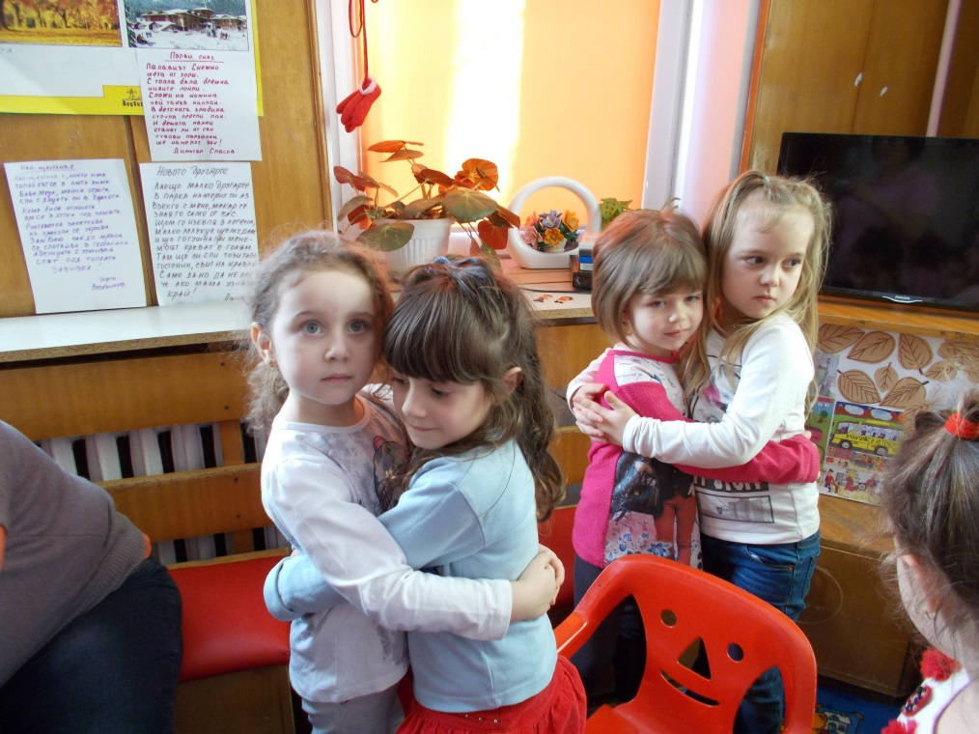
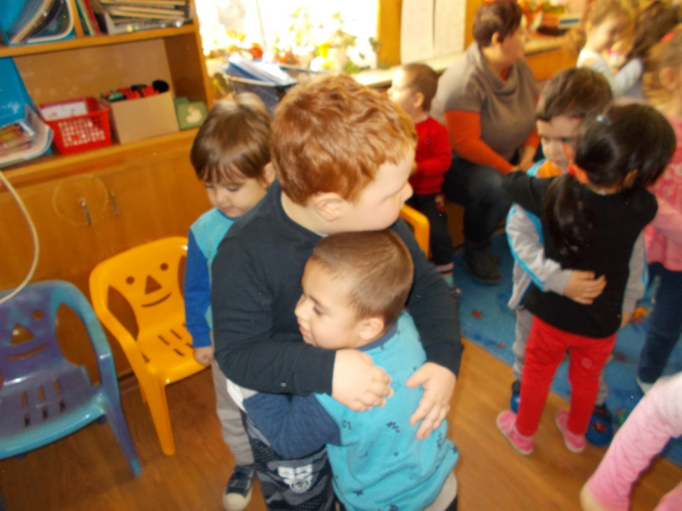

Slide 19
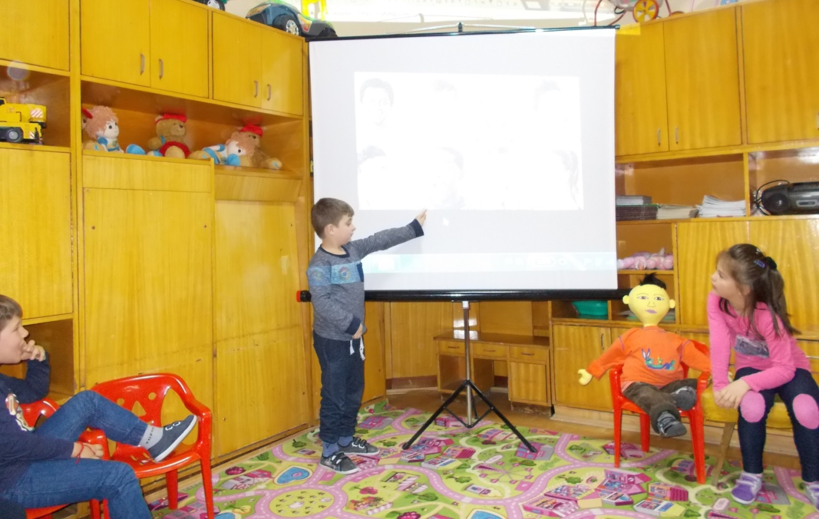
Session with Chan Li “They mock me because I'm different”
Chan Li is overweight. He is from China - he has different eyes, hair and hairstyle. He is well brought-up child, but no friends.

Slide 20
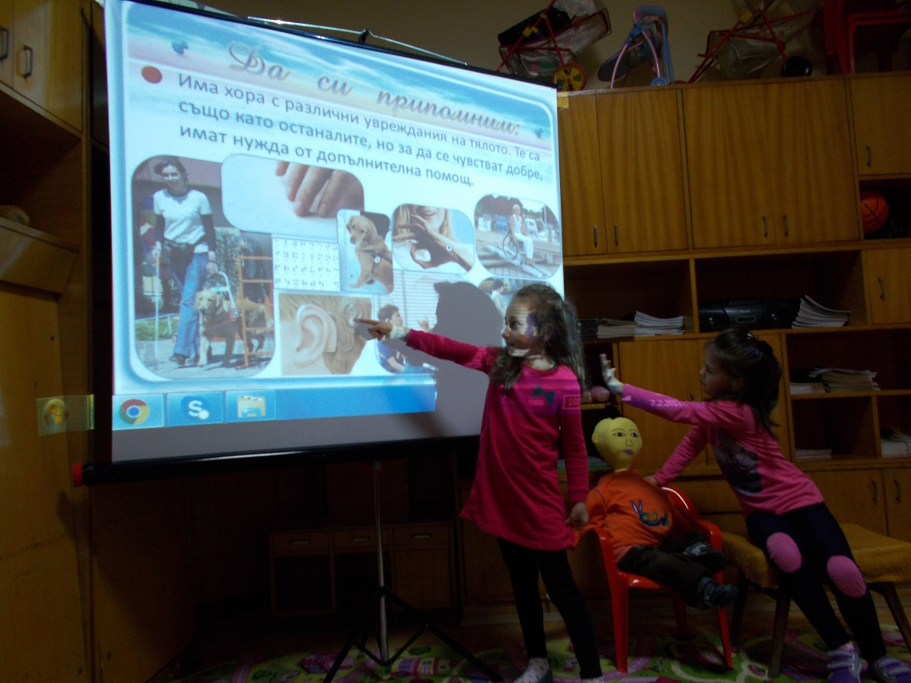
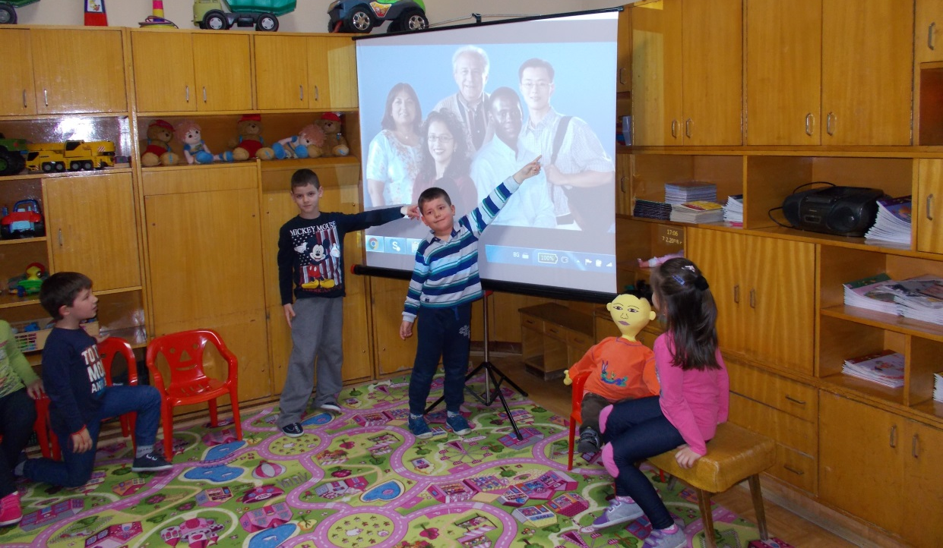
1st game "How do the people of the pictures differ?"
people with special needs
people with different skin color

Slide 21
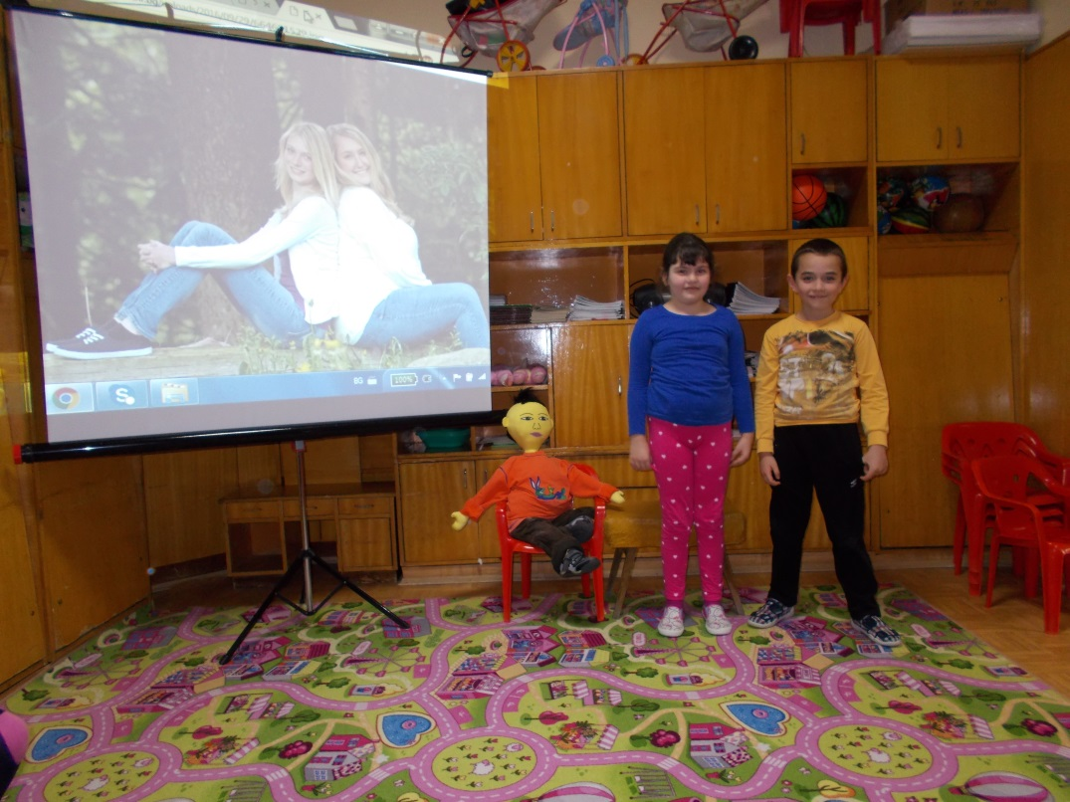
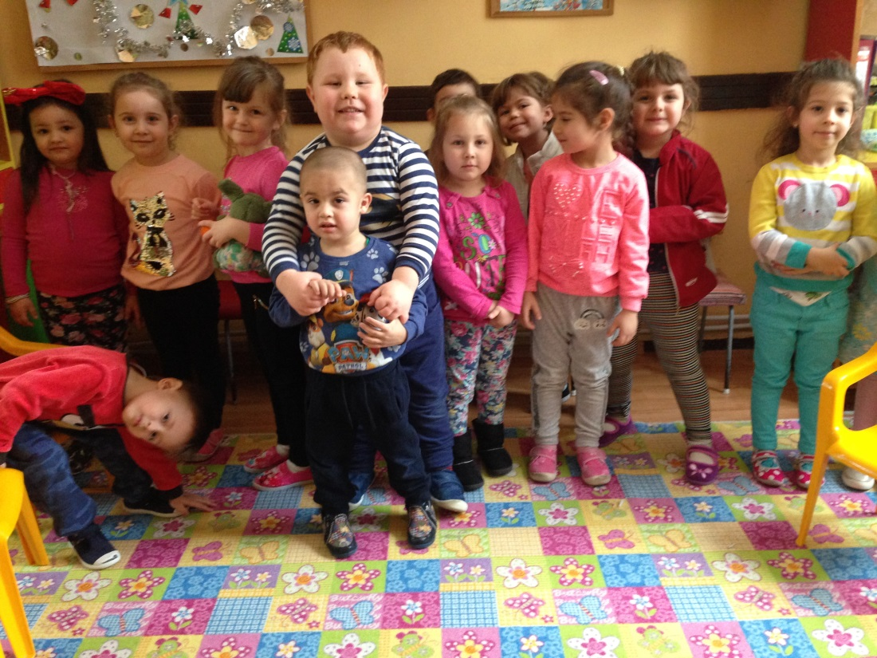
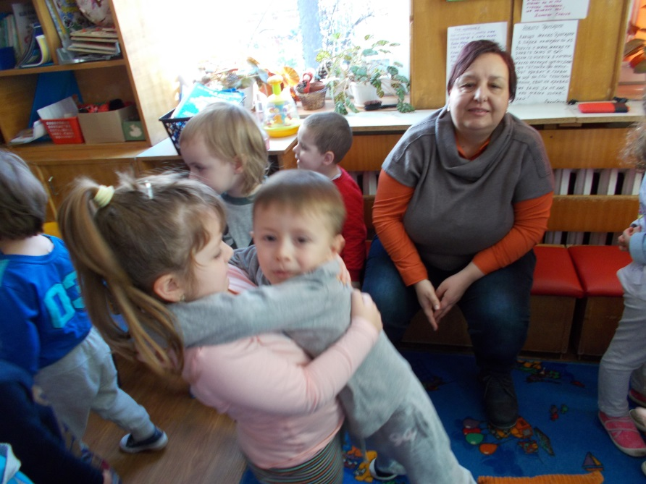
2nd game “Invite a friend who is different from you! Tell us how different you are. "

Slide 22
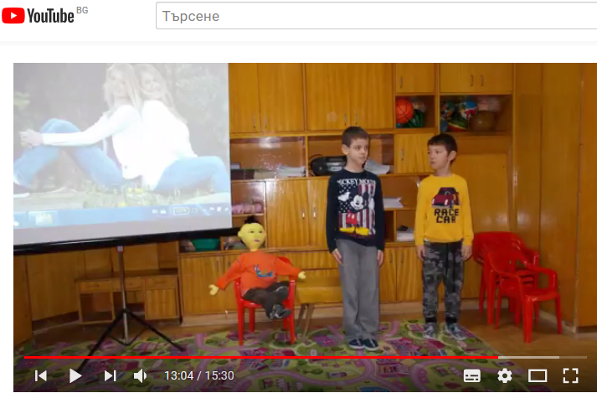
Session with Chan Li
https://youtu.be/jorBZjVOjGI

