Slide 1
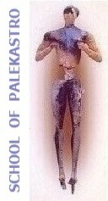
Presentations of 1st and 2nd Persona Doll
Erasmus+ project, 2015 – 2018
“Every child is special”

Slide 2
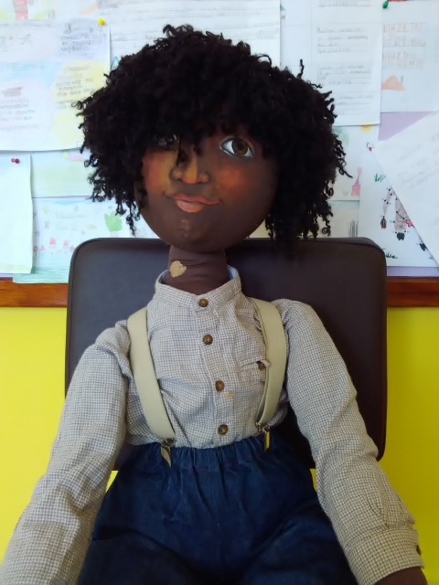
THIS IS ERIC

Slide 3
Eric’s Profile
He comes from Senegal and he is muslim.
He has one brother and one sister both older than him.
His parents work at a local company of olive oil .
His family came to Crete because they had some relatives living here but at the moment they are the only africaners in the village because their relatives have left some months ago.

Slide 4
Eric’s Profile
He likes to spend his time playing football around the village.
He does not studying enough or taking part in school activities.
He doesn’t speak greek and it is difficult for him to find friends and to communicate with others.
He doesn’t like to eat with the other kids .

Slide 5
School of Palekastro
What have we done?
We have talked with children about migration and problems migrants face in their new home.
We are trying him to learn better greek and being closer to him and his difficulties.

Slide 6
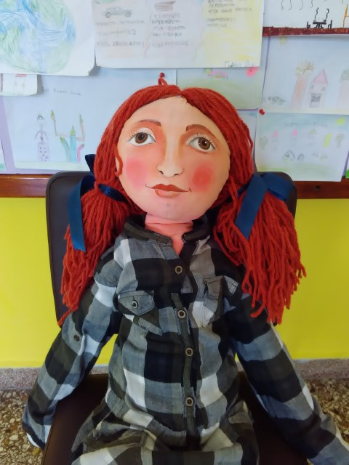
THIS IS ELLEN

Slide 7
Ellen’s Profile
Ellen was born in Denmark, her family came to Crete because of her father’s work(he works in an energy factory as enginner).
She speaks danish and little of English. It is difficult for her to speak and understand greek that’s why it’s difficult to communicate with other kids.
She does not like playing with other kids due to her difficulty in communication.
He likes to read books and to play with her little sister.

Slide 8
Ellen’s Profile
She likes greek food.
She likes local sweets and fruits.
She can dance very well.
She looks different comparing to greek girls because of her blonde hair.
They have lived in Germany for a year before coming to Greece.

Slide 9
School of Palekastro
What have we done?
Greek language lessons for better and faster communication.
Giving more opportunities her to take part in school activities and village’s life.

