Slide 1
ACTIVITIES OF INFANT AND PRIMARY SCHOOL
Comprehensive Education Institute “BATTIPAGLIA SALVEMINI”

Slide 2
INFANT SCHOOL This is the wall of differences

Slide 3
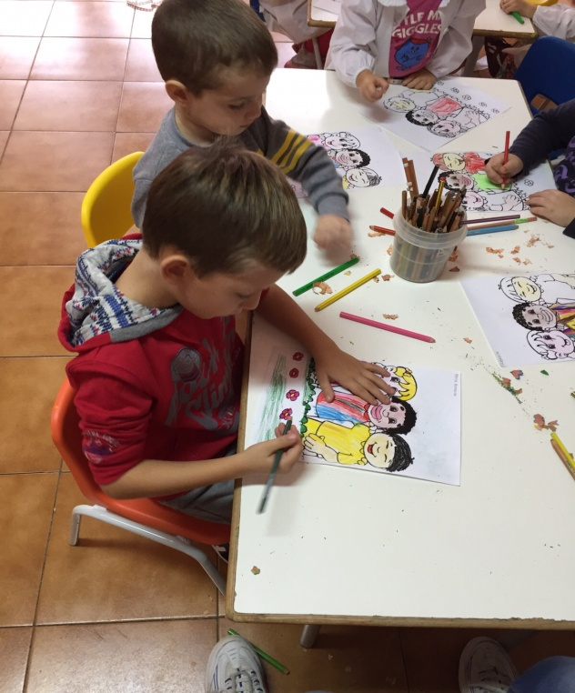
The children are drawing the different colour of the human skin.

Slide 4
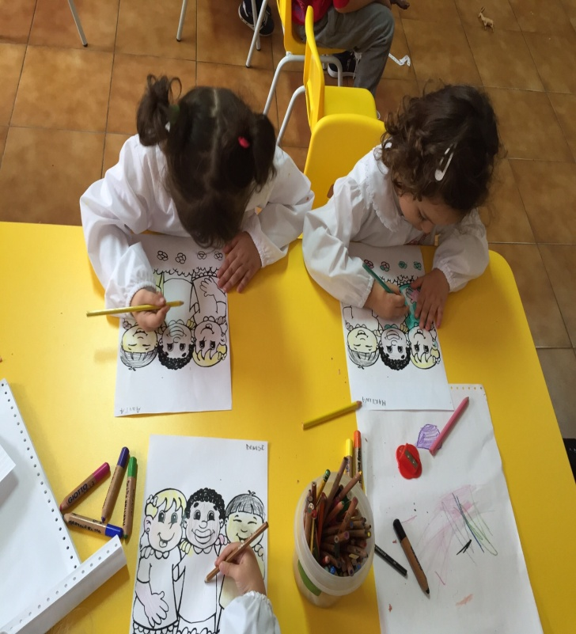
They are painting the world

Slide 5
PRIMARY SCHOOL This is the wall of diffences of my school, in the centre there is my student Jacopo with my class.

Slide 6
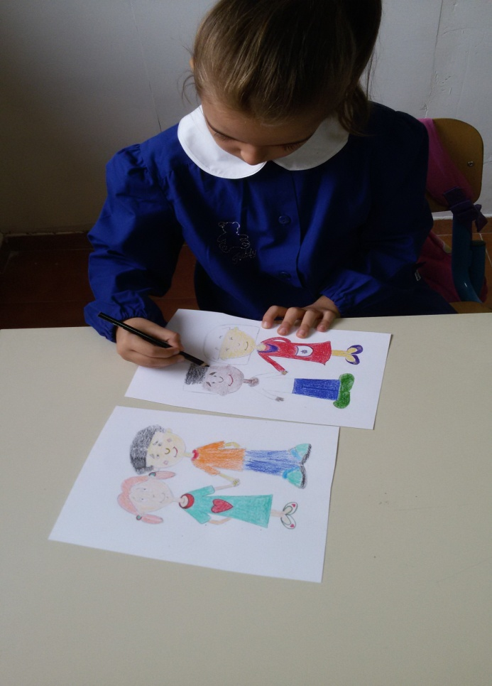
Here you can see a lesson in my classroom. It’s deals with different kind of people referring to the different colours of their skin.

Slide 7
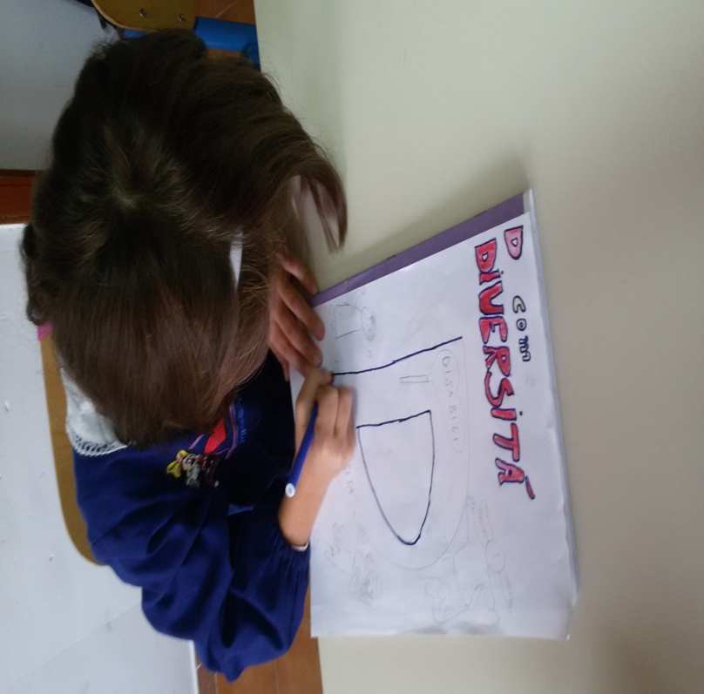
Our wall of differences is so organized: you can see the different colours of the human skin and the key letters of the alphabet. For exmple: D= DIVERSITY, T= TOLERANCE, J= JOY, B= BROTHERHOOD.

Slide 8
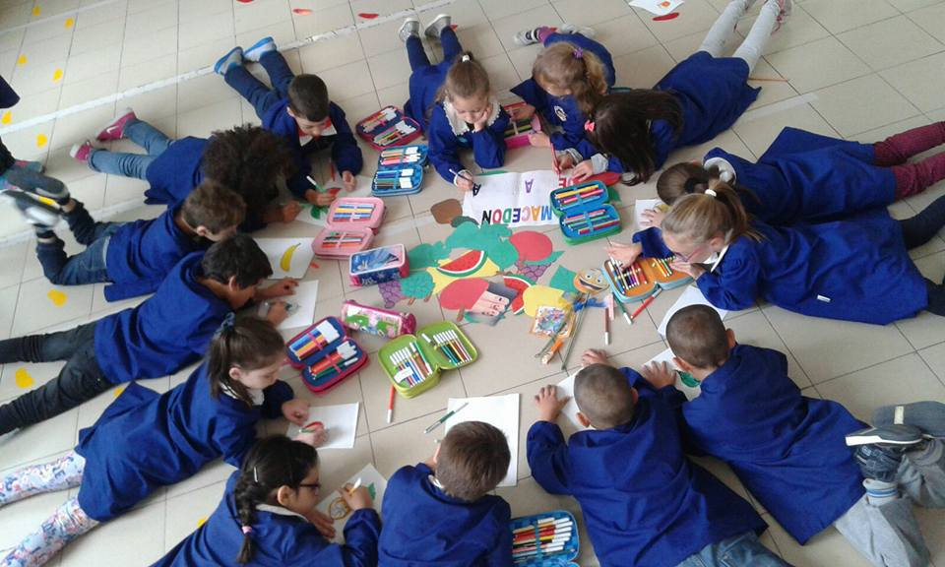
Different kind of fruit. In this lesson the students are analysing the different colours of fruit to find the rights colours of the human skin.

