Slide 1
Teaching differences
Almeria, Spain 19.03 – 23.03.2018
Mateřská škola Šardice,příspěvková organizace
Czech republic

Slide 2
1. Differences activities with children
Introducing differences
Differences walls
I am special
Differences books
Good mate rules
Persona dolls methodology and “Kindergarten free of bullying”

Slide 3
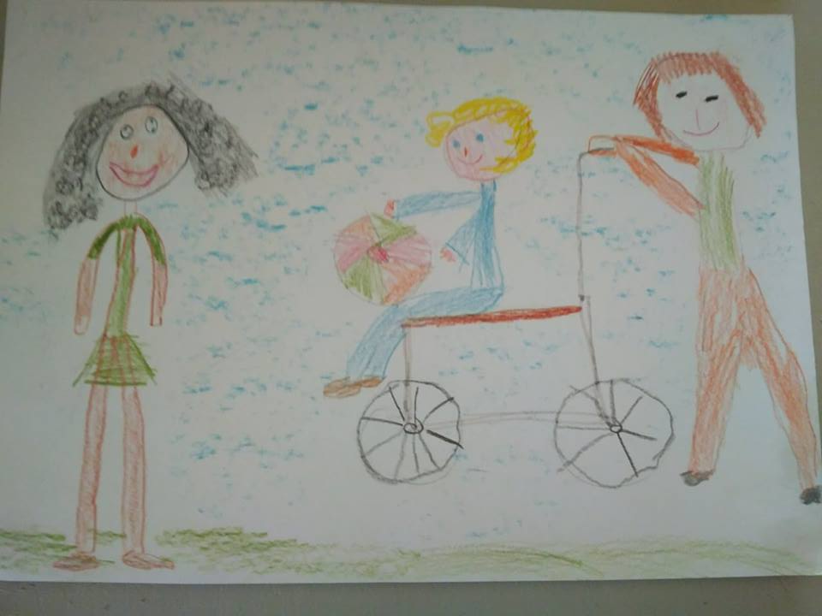

Slide 4
2. Differences weeks
Introducing countries
Intorducing people physical differences
Teaching differences through tales, stories

Slide 5
Difference week, January 2018

Slide 6
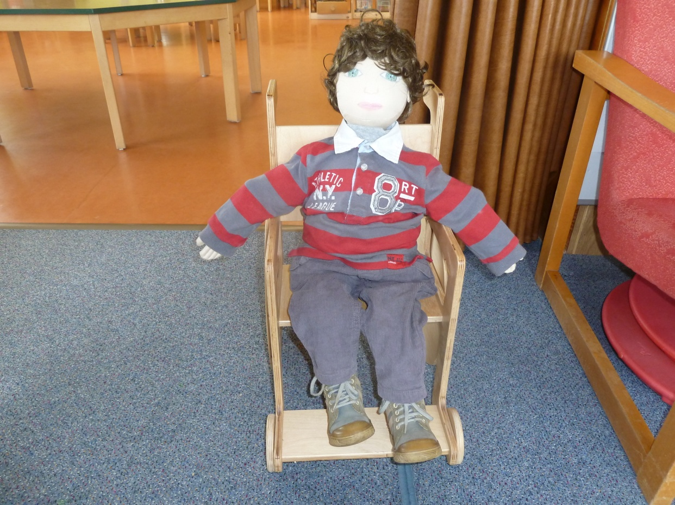
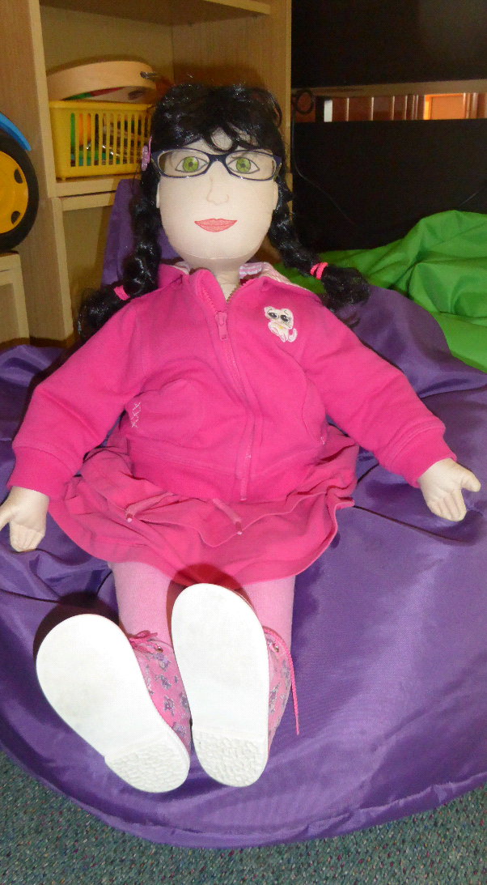
https://youtu.be/bdMjyy8_g_M In our kindergarten we have 2 dolls with physical disability. It´s Vojta and Anna. Vojta visited us with his story in January 2018

Slide 7
https://www.youtube.com/watch?v=UpmN10I_32A Children tried to use wheelchair

Slide 8
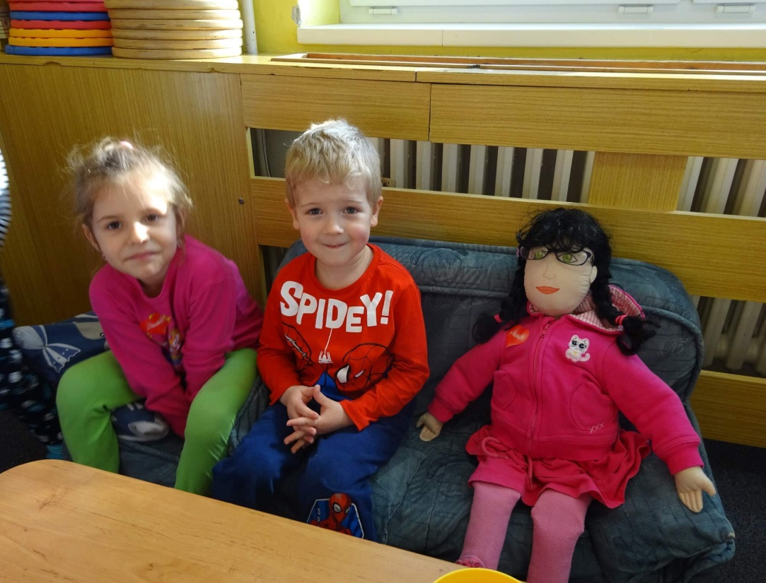
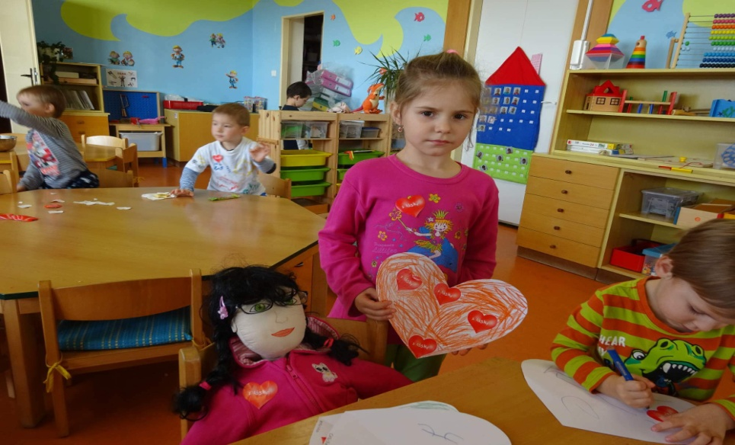
Activities with Anna.

Slide 9
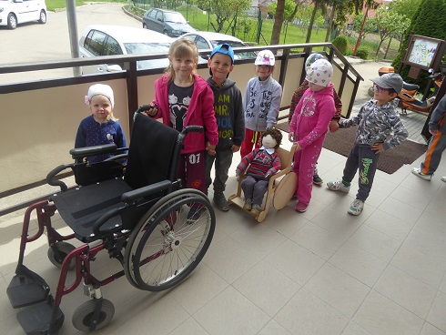
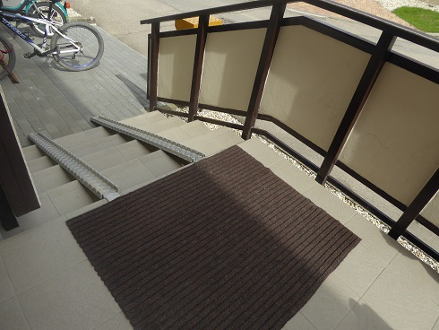
Day to introduce people with physical special need

Slide 10
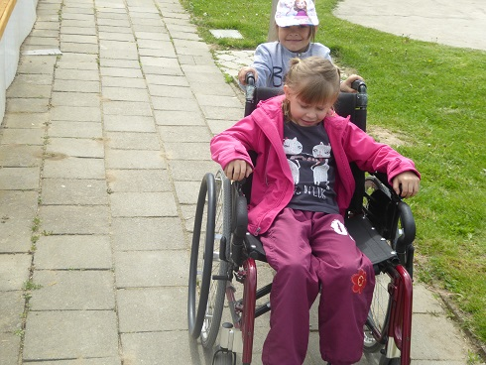
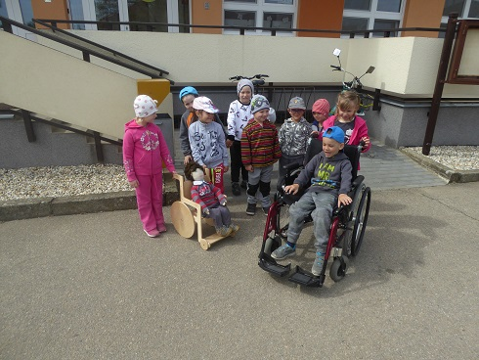

Slide 11
3. Introducing other countries
Introducing countries where our children are from
Introducing neighbor countries
Introducing European countries
Introducing different countries around world
Parents participation

Slide 12
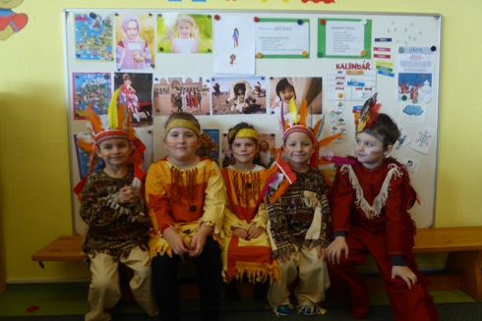
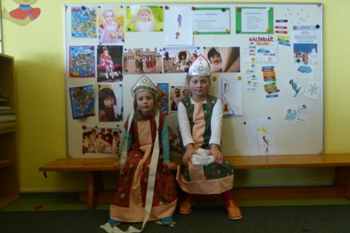

Slide 13
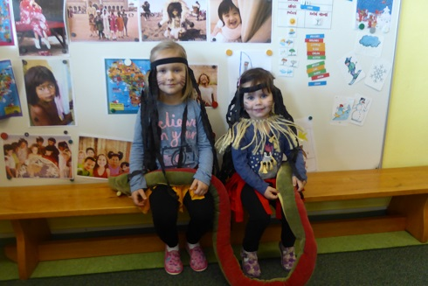
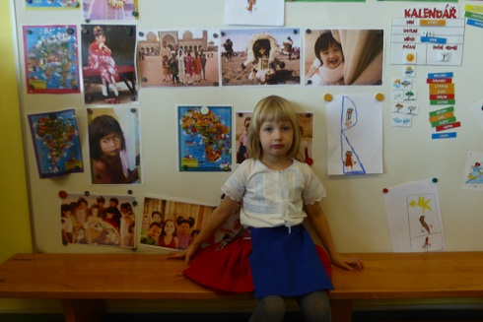

Slide 14
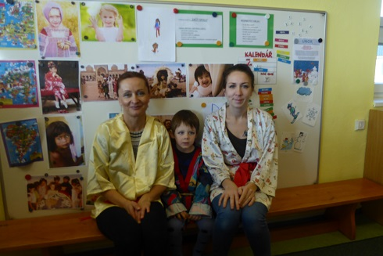

Slide 15
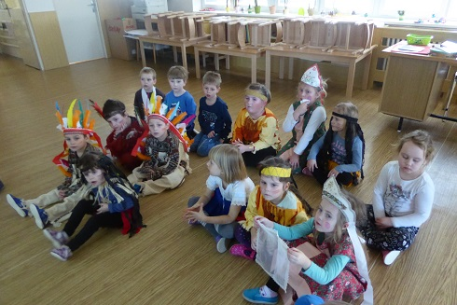
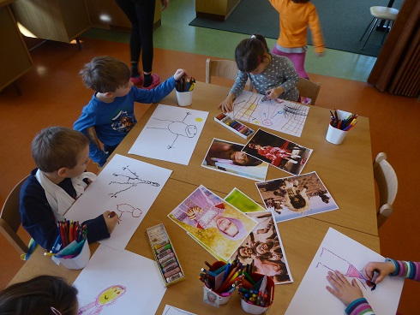

Slide 16
https://youtu.be/Jt9A1HdjxzA

