Slide 1
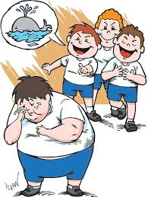
ERASMUS +
“EVERY CHILD IS SPECIAL” TRANSNATIONAL MEETING
Bulgaria “bullying”
From 16 th to 20 th of october

Slide 2
Bullying
WHAT IS BULLYING?
It is a dangerious behavior.
It makes it difficult for the victims, the defense.
There are three types of bullying
physical: beating, kicking
Verbal: insults
Indirect: excluded from group

Slide 3
This is bullying

Slide 4
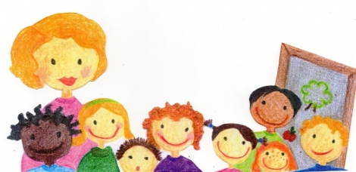

Slide 5
THE BULLY
The bully is aggressive, physically strong, insecure
He has a very tall level of anger
He needs to attract the attention of other people

Slide 6
The bully's profile
The bully may have some unidentified difficulties.
He might have difficulties such as dyslexia, autism, stuttering, deafness etc.
He feeling not accepted by the group develops aggressive behavior to get attention

Slide 8
The Victims
How can you become a victim
The victim is often a child
fat
color
wears glasses
He has large ears
He has red and curly hair
He has strange clothes
professing a different religion

Slide 10
IN KINDERGARTEN
In kindergarten we can not talk about bullying itself, but between three and six years are manifested more like episodes of bullying related particular to a stronger self-absorption and a constant demand for attention. The parents of a bully boy or those who suffer bullying is not easy, but you need to understand from where this deviant attitude.
In an age so small, between three and six years, it is easy to come to know of these episodes because children tend to tell all about it when they see the parent, at least as regards the victim. But the one who denies spite is just the little "bully" by refusing to make peace or to apologize.

Slide 11
The school is of great importance when it comes to helping and preventing bullying. Parents and other authorities should play a role in this process. This means that great efforts on the development of these students are necessary and that the school, along with parents, must support these efforts.

Slide 13
Schools must promote the development of a democratic competence in the environment of the class. Training team has the task of putting every child in a position of having a peaceful growth. A child peaceful and happy he'll be a good citizen in the future.

Slide 14
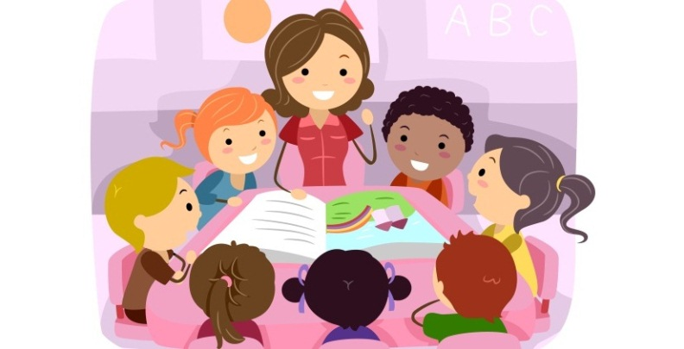

Slide 15
At school we have to observe and listen to children.
You have to call the parents and understand what's going on with them.
The parents of the bully and the parents of the victim
Important, finally, that parents will do a little soul-searching. Children are like sponges that absorb everything living and they see in adults, especially in attitudes. If in the house there is an air of submission or bullying it is normal for a child to become a "victim" or "bully" . Talking and watching are two tips that call you to put into practice. Intervene at an early manner is useful to avoid future unpleasant situation

Slide 16
What does a teacher when he wants to be of help for a child being bullied?
The teacher should encourage the children to get to grips with the problem of choice and help them discover other possibilities, to evaluate the alternatives and then think about the consequences. The adult can support this process.
Every child should grow according to the amendments of the International Convention on Children's Rights, adopted by the UN in 1989

Slide 17
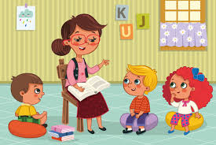

Slide 18
THANK YOU SO MUCH FOR YOUR ATTENTION!!!

