Slide 1
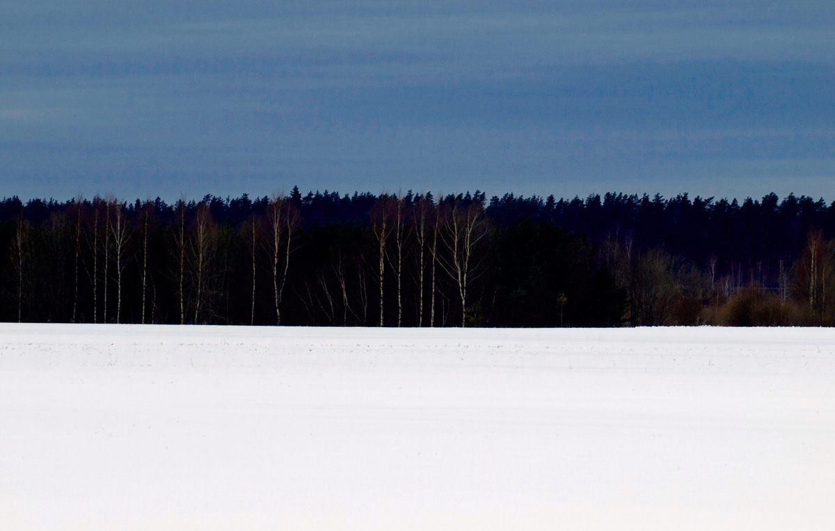
WELCOME TO ESTONIA

Slide 2
Estonia
Official name: Republic of Estonia
National Day: Independence Day, February 24.
Area: 45 227 square km
Islands: 1521
Forests: cover 55% of the country
Lakes: over thousand lakes
Highest point: Suur Munamägi 318 m

Slide 3
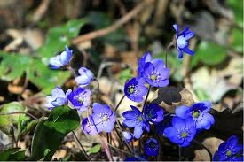
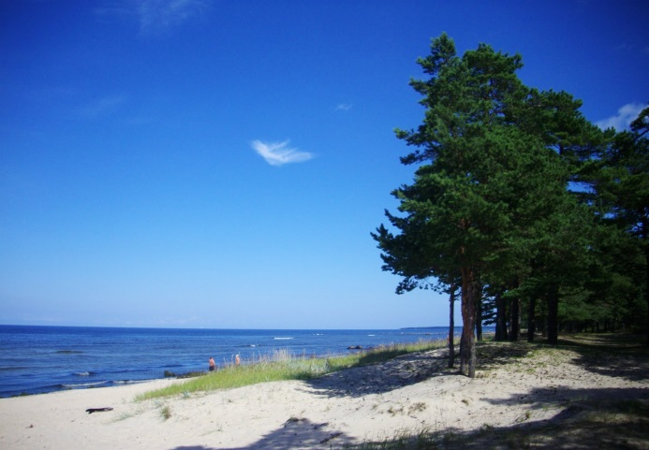
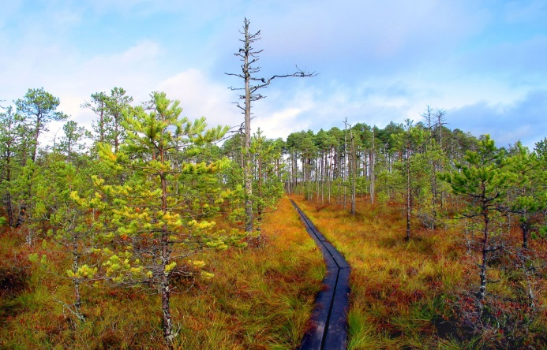
Seasons
Four seasons :
Winter, spring, summer and autumn.
Temperature averages : -3.9°C in winter (may sink to -25°C usually in February)
15.6°C in summer (may rise to 28°C usually in July)
5.6 °C average per year

Slide 4
Population: 1.340 million
Largest ethnic groups: Estonians (69%), Russians (26%), Ukrainians (2%), Belarussians (1%) and Finns (1%).
The capital of Estonia is Tallinn
The other large cities are: Tartu, Narva, Kohtla-Järve, Pärnu

Slide 5
State
Type: parliamentary democracy.
Head of the State: the President, who is elected by the parliament or an electoral body. Term: 5 years. Current President: Mr.Toomas Hendrik Ilves
National legislature: the Riigikogu. A unicameral parliament of 101 members. Term: 4 years. Next elections for the 13th Riigikogu: March 2015.
Administrative division: 15 counties, 33 towns and 194 rural municipalities.

Slide 6
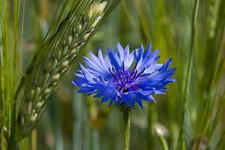
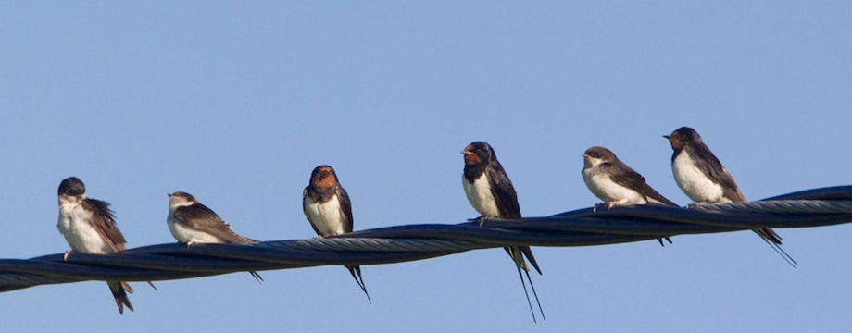
Symbols
Cornflower
Coat of arms
Swallows

Slide 8
Traditional folk clothes

Slide 9
Kadrioru castle

Slide 10
Long Hermann castle

Slide 11
Tallinn Old town

Slide 12
Statue of Liberty

Slide 13
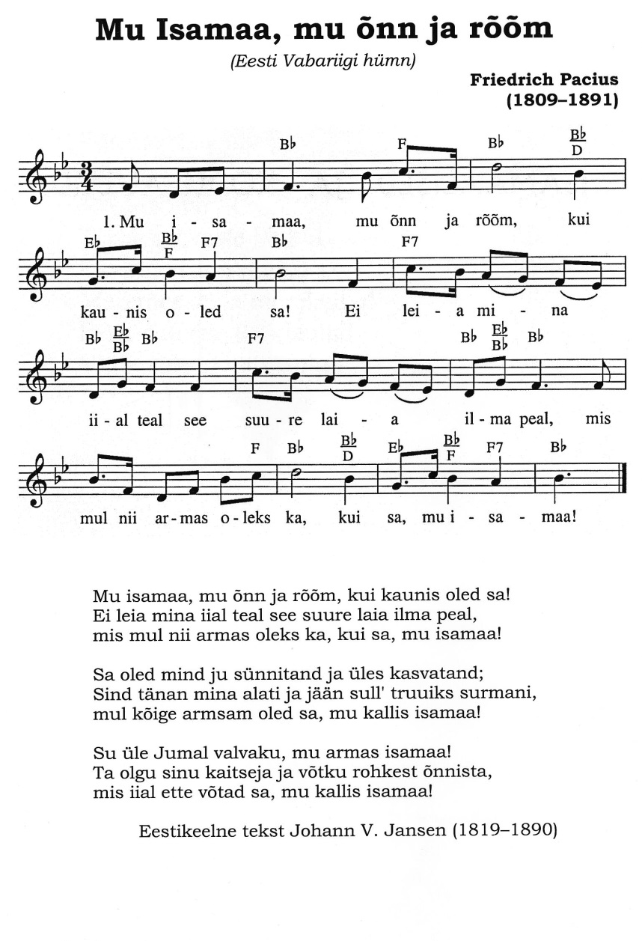
National Anthem of Estonia
Eesti hümn

Slide 14
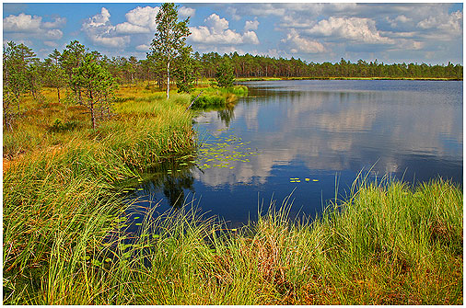
Estonian nature
https://www.youtube.com/watch?v=hVv4aRAnS5U
https://www.youtube.com/watch?v=fAC8F_2qTTY

Slide 15
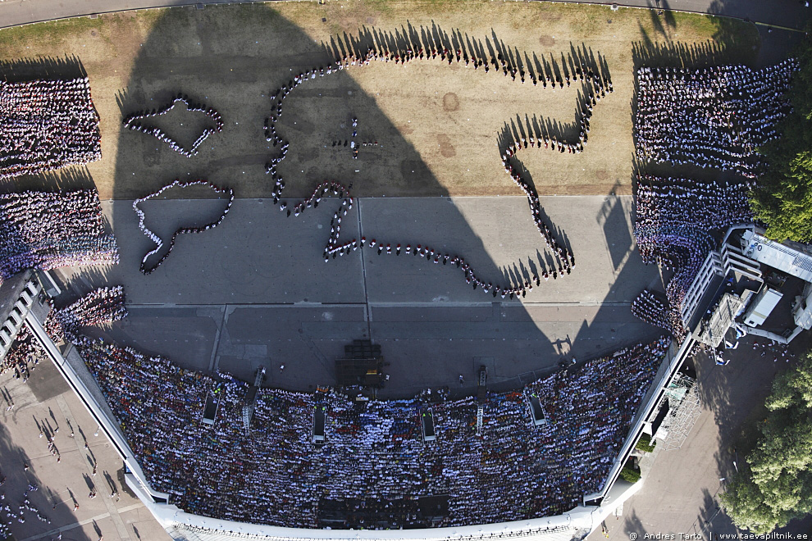
Estonian song and dance festival
https://www.youtube.com/watch?v=CKzSXhPvqtM
https://www.youtube.com/watch?v=DMMnaXUmbGc

Slide 16
Thank you for your attention !

