Slide 1
ACTIVITIES HAVE DONE FOR DEVELOP CHILDREN SOCIAL SKILLS

Slide 2
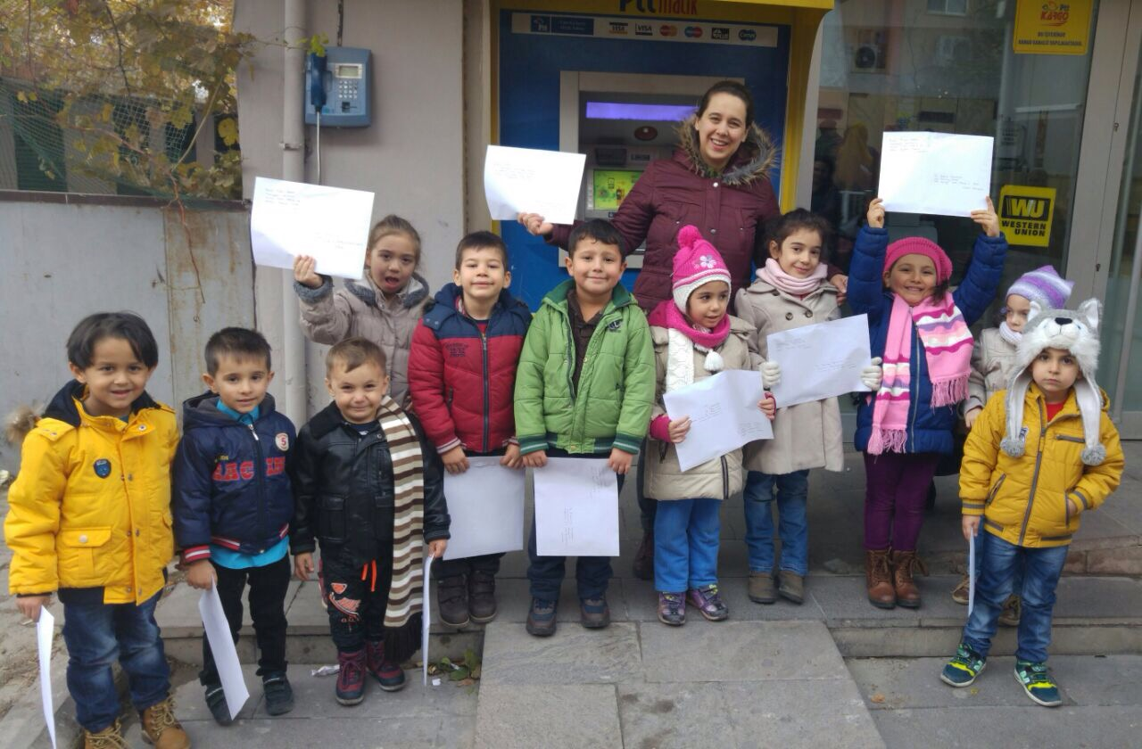
WE HAVE ORGANIZED TO SEND CRISTMAS CARD DIFFERENT COUNTRIES DUE TO DEVELOP OUR CHILDREN’S SOCIAL SKILLS

Slide 3
HERE IS PROCESS OF SENDING CARD…

Slide 4
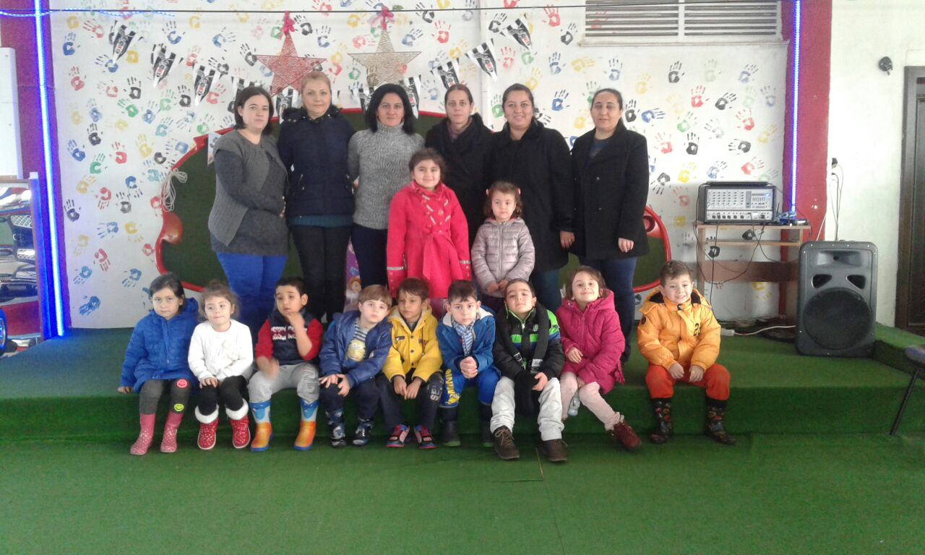
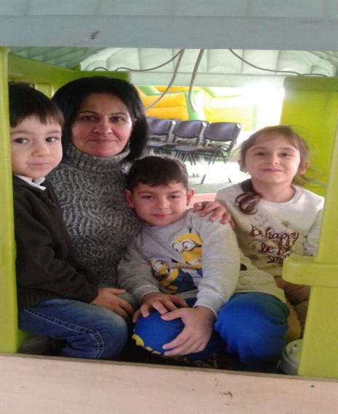
OUR CHILDREN AND PARENTS TOGETHER VISITED “CRAZY INVENTORS’ HOUSE”

Slide 5
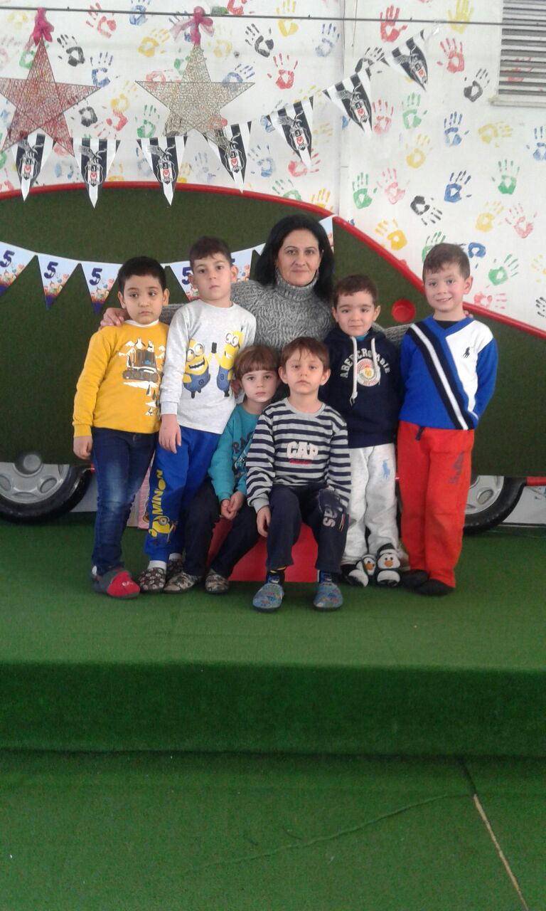
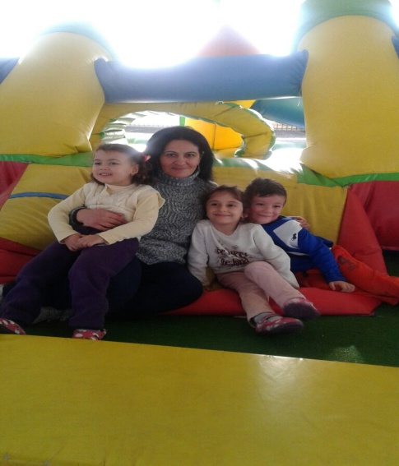
An area of 300 square meters has been set up for our children's science learning and planned science and entertainment centers.

Slide 6
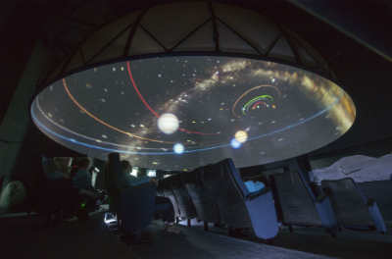
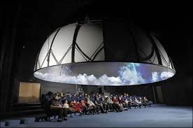
IZMIR HAS PLANET’S HOUSE. MANY KIND OF SCHOOL VISIT EVERY TIME HERE. İTK Planet house is the first public fixed digital planetarium in our country. it is an educational environment established to better understand nature, universe and celestial bodies.

Slide 7
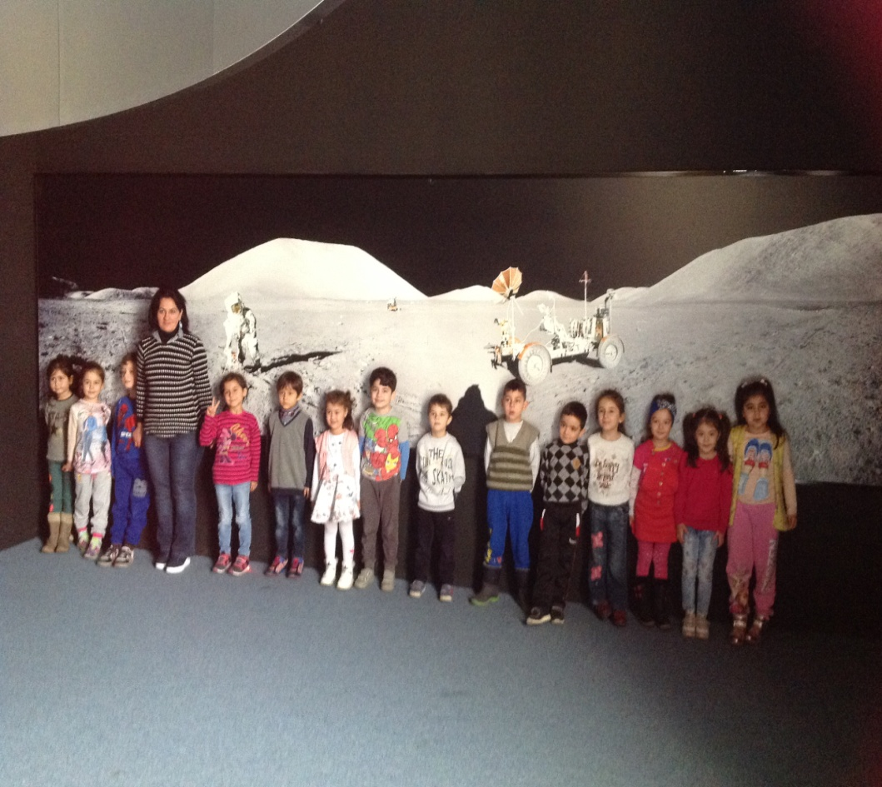
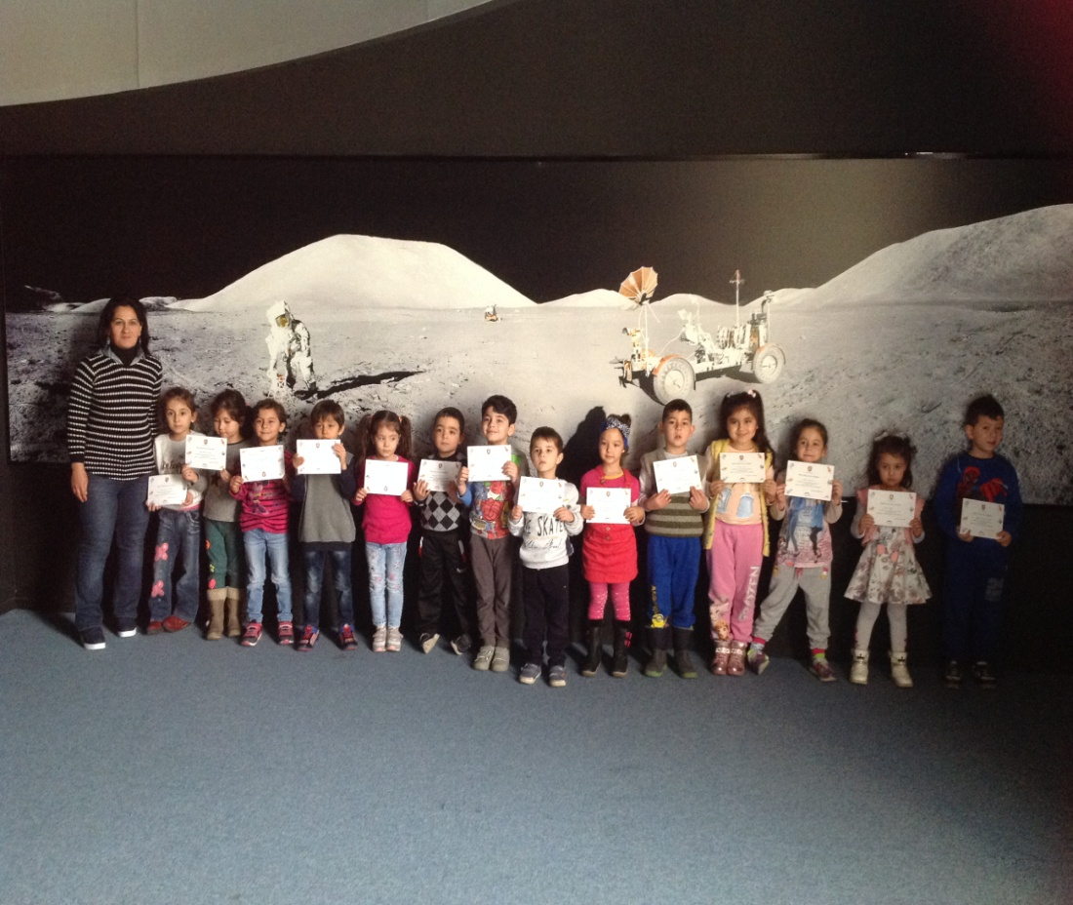
OUR CHILDREN VISITED ALSO… AND THEY GOT CERTIFICATE OF LITTLE ASTRONOUT.

Slide 8
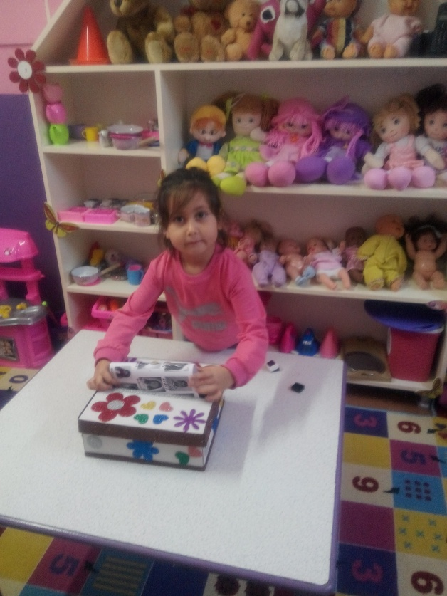
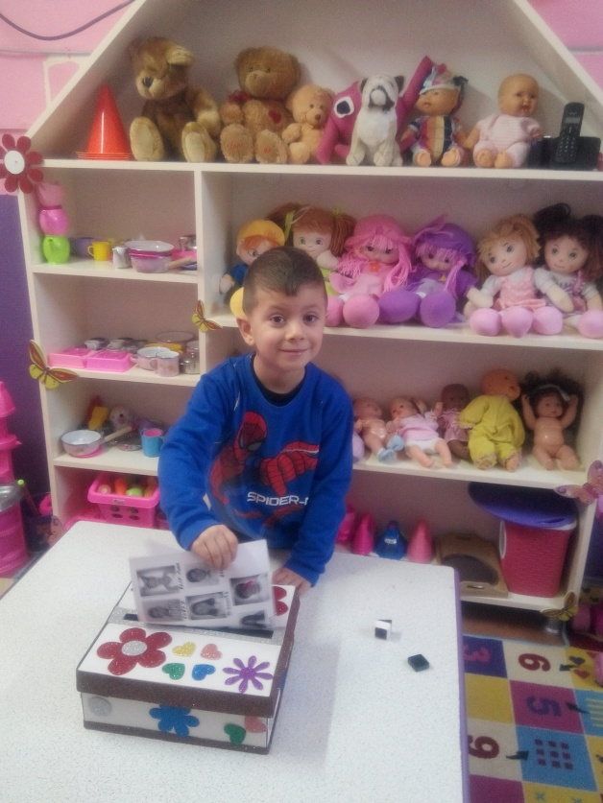
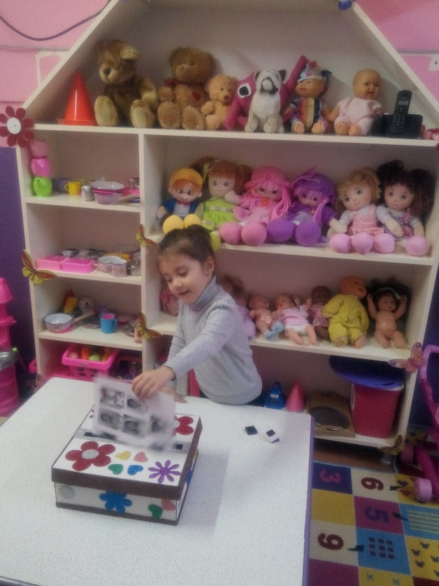
ONE OF ACTIVITIES THAT ELECTION WORKSHOP. THIS ACTIVITY HAVE DONE FOR AWARENESS OF DEMOCRACY.

Slide 9
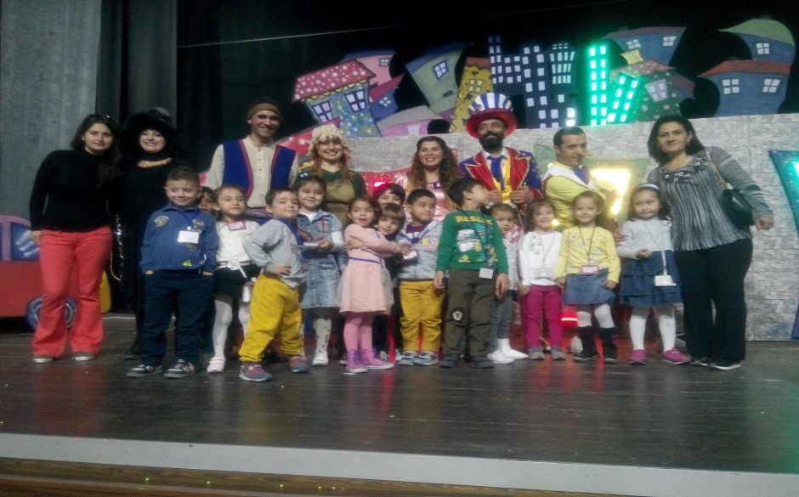
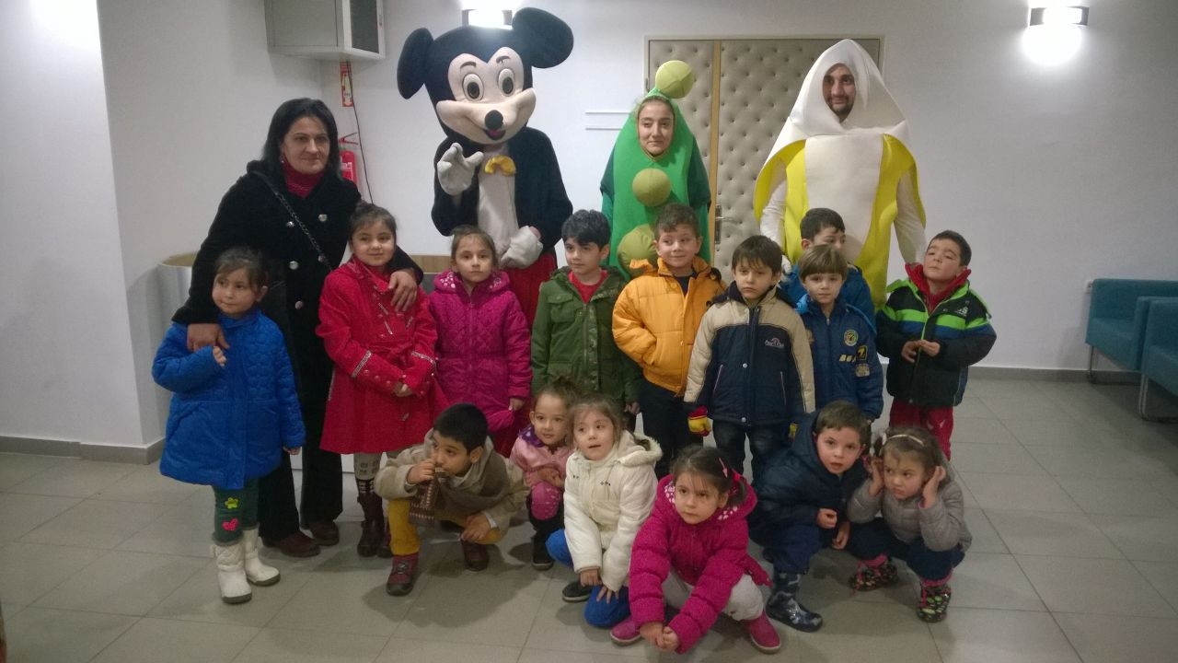
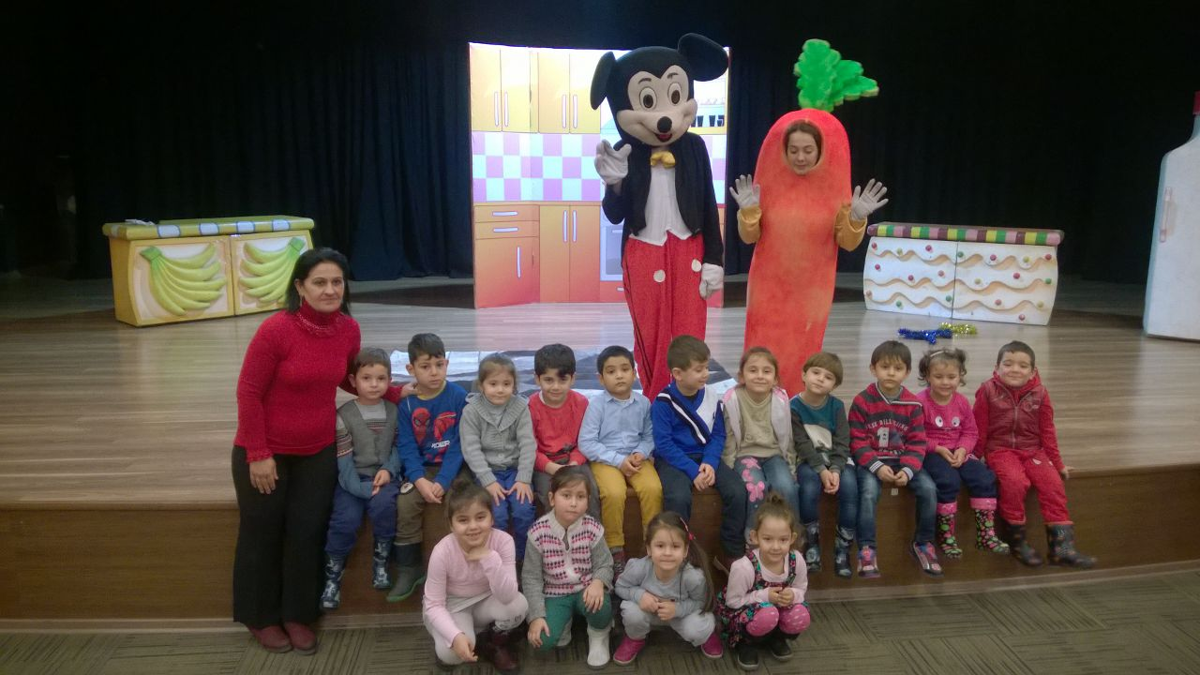
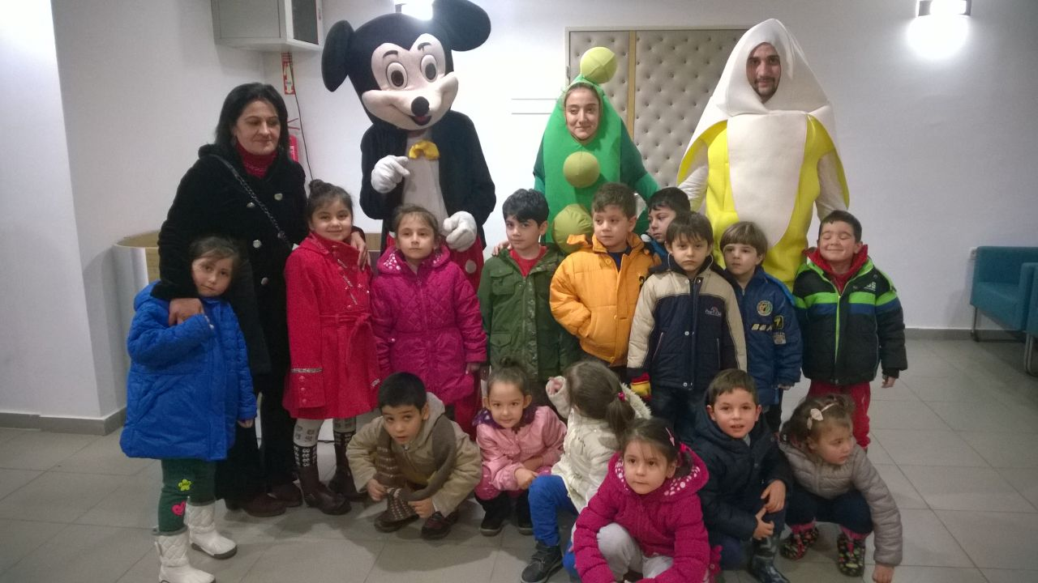
THEATRE ACTIVITIES IS VERY IMPORTANT FOR US AND OUR CHILDREN. THAT’S WHY OUR CHILDREN ALWAYS GO TO THEATRE.

Slide 10
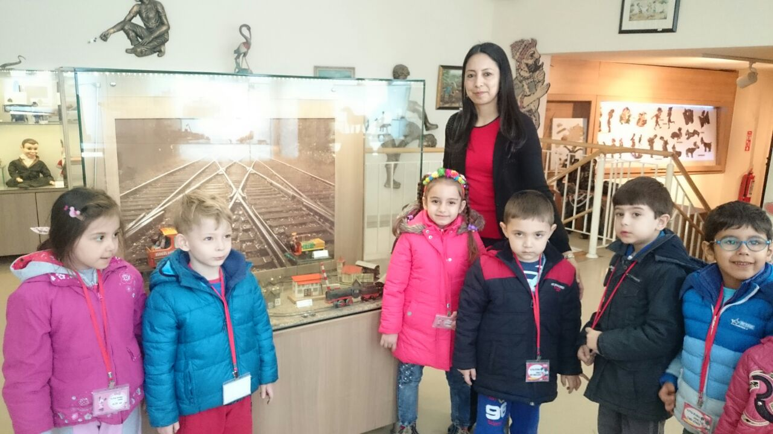
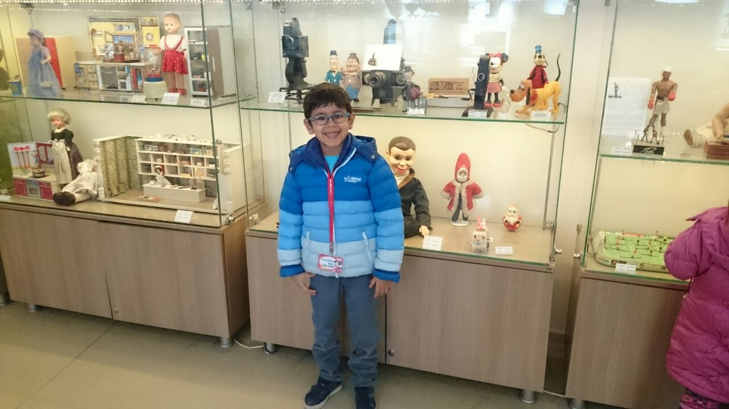
OUR CHILDREN GO TO MUSEUMS. ONE OF THESE IS MUSEUM OF TOYS.

Slide 11
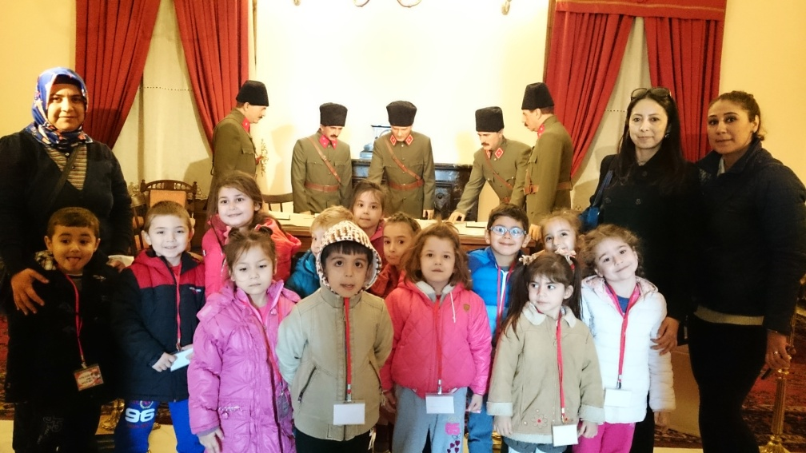
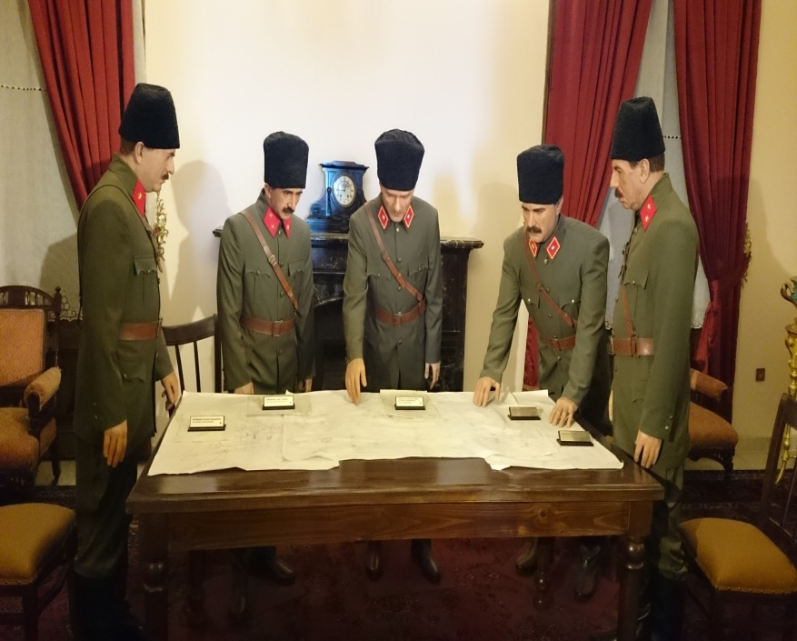
ANOTHER IS ATATURK’S MUSEUM.

